Slide 2
Concept of Cascading Style Sheets.
Syntax of Cascading Style Sheets

Slide 3
Cascading Style Sheet
CSS is used to control the style of a web document in a simple and easy way.
CSS is the acronym for "Cascading Style Sheet".

Slide 4
Cascading Style Sheet
CSS is used to control the style of a web document in a simple and easy way.
CSS is the acronym for "Cascading Style Sheet".

Slide 5
Cascading Style Sheet
Cascading Style Sheets, fondly referred to as CSS, is a simple design language intended to simplify the process of making web pages presentable.
CSS is a MUST for students and working professionals to become a great Software Engineer specially when they are working in Web Development Domain

Slide 6
Cascading Style Sheet
Cascading Style Sheets, fondly referred to as CSS, is a simple design language intended to simplify the process of making web pages presentable.
CSS is a MUST for students and working professionals to become a great Software Engineer specially when they are working in Web Development Domain

Slide 7
Why to Learn CSS?
Create Stunning Web site - CSS handles the look and feel part of a web page. Using CSS, you can control the color of the text, the style of fonts, the spacing between paragraphs, how columns are sized and laid out, what background images or colors are used, layout designs,variations in display for different devices and screen sizes as well as a variety of other effects.
Become a web designer - If you want to start a carrer as a professional web designer, HTML and CSS designing is a must skill.

Slide 8
Why to Learn CSS?
Create Stunning Web site - CSS handles the look and feel part of a web page. Using CSS, you can control the color of the text, the style of fonts, the spacing between paragraphs, how columns are sized and laid out, what background images or colors are used, layout designs,variations in display for different devices and screen sizes as well as a variety of other effects.
Become a web designer - If you want to start a carrer as a professional web designer, HTML and CSS designing is a must skill.

Slide 9
Why to Learn CSS?
Control web - CSS is easy to learn and understand but it provides powerful control over the presentation of an HTML document. Most commonly, CSS is combined with the markup languages HTML or XHTML.
Learn other languages - Once you understands the basic of HTML and CSS then other related technologies like javascript, php, or angular are become easier to understand.

Slide 10
Why to Learn CSS?
Control web - CSS is easy to learn and understand but it provides powerful control over the presentation of an HTML document. Most commonly, CSS is combined with the markup languages HTML or XHTML.
Learn other languages - Once you understands the basic of HTML and CSS then other related technologies like javascript, php, or angular are become easier to understand.

Slide 11
Applications of CSS
CSS saves time - You can write CSS once and then reuse same sheet in multiple HTML pages. You can define a style for each HTML element and apply it to as many Web pages as you want.
Pages load faster - If you are using CSS, you do not need to write HTML tag attributes every time. Just write one CSS rule of a tag and apply it to all the occurrences of that tag. So less code means faster download times.

Slide 12
Applications of CSS
CSS saves time - You can write CSS once and then reuse same sheet in multiple HTML pages. You can define a style for each HTML element and apply it to as many Web pages as you want.
Pages load faster - If you are using CSS, you do not need to write HTML tag attributes every time. Just write one CSS rule of a tag and apply it to all the occurrences of that tag. So less code means faster download times.

Slide 13
Applications of CSS
Easy maintenance - To make a global change, simply change the style, and all elements in all the web pages will be updated automatically.
Superior styles to HTML - CSS has a much wider array of attributes than HTML, so you can give a far better look to your HTML page in comparison to HTML attributes.

Slide 14
Applications of CSS
Easy maintenance - To make a global change, simply change the style, and all elements in all the web pages will be updated automatically.
Superior styles to HTML - CSS has a much wider array of attributes than HTML, so you can give a far better look to your HTML page in comparison to HTML attributes.

Slide 15
Applications of CSS
Multiple Device Compatibility - Style sheets allow content to be optimized for more than one type of device. By using the same HTML document, different versions of a website can be presented for handheld devices such as PDAs and cell phones or for printing.

Slide 16
Applications of CSS
Global web standards - Now HTML attributes are being deprecated and it is being recommended to use CSS. So its a good idea to start using CSS in all the HTML pages to make them compatible to future browsers.

Slide 17
CSS - Syntax
A CSS comprises of style rules that are interpreted by the browser and then applied to the corresponding elements in your document. A style rule is made of three parts

Slide 18
CSS - Syntax
Selector − A selector is an HTML tag at which a style will be applied. This could be any tag like <h1> or <table> etc.
Property − A property is a type of attribute of HTML tag. Put simply, all the HTML attributes are converted into CSS properties. They could be color, border etc.
Value − Values are assigned to properties. For example, color property can have value either red or #F1F1F1 etc.

Slide 19
CSS - Syntax
Selector − A selector is an HTML tag at which a style will be applied. This could be any tag like <h1> or <table> etc.
Property − A property is a type of attribute of HTML tag. Put simply, all the HTML attributes are converted into CSS properties. They could be color, border etc.
Value − Values are assigned to properties. For example, color property can have value either red or #F1F1F1 etc.

Slide 20
CSS - Syntax
Selector − A selector is an HTML tag at which a style will be applied. This could be any tag like <h1> or <table> etc.
Property − A property is a type of attribute of HTML tag. Put simply, all the HTML attributes are converted into CSS properties. They could be color, border etc.
Value − Values are assigned to properties. For example, color property can have value either red or #F1F1F1 etc.

Slide 21
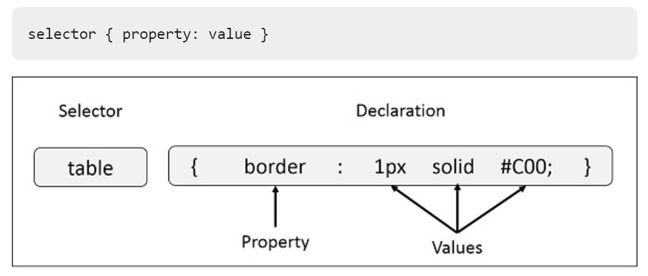
CSS Style Rule Syntax

Slide 22
Example
− You can define a table border as follows −
table{ border :1px solid #C00; }
Here table is a selector and border is a property and given value 1px solid #C00 is the value of that property.

Slide 23
Define selectors in various simple ways
The Type Selectors
h1 {
color: #36CFFF;
}
The Universal Selectors
Rather than selecting elements of a specific type, the universal selector quite simply matches the name of any element type −
* {
color: #000000;
}
This rule renders the content of every element in our document in black.

Slide 24
Define selectors in various simple ways
The Descendant Selectors
Suppose you want to apply a style rule to a particular element only when it lies inside a particular element. As given in the following example, style rule will apply to <em> element only when it lies inside <ul> tag.
ul em {
color: #000000;
}

Slide 25
The Class Selectors
You can define style rules based on the class attribute of the elements. All the elements having that class will be formatted according to the defined rule.
.black {
color: #000000;
}
This rule renders the content in black for every element with class attribute set to black in our document.

Slide 26
Example
You can make it a bit more particular. For example −
h1.black {
color: #000000;
}

Slide 27
Example
This rule renders the content in black for only <h1> elements with class attribute set to black.
You an apply more than one class selectors to given element. Consider the following example −
<p class = "center bold">
This para will be styled by the classes center and bold.
</p>

Slide 28
CSS - Inclusion
There are four ways to associate styles with your HTML document.
Most commonly used methods are
Inline CSS and
External CSS.

Slide 29
CSS - Inclusion
There are four ways to associate styles with your HTML document.
Most commonly used methods are
Inline CSS and
External CSS.

Slide 30
Embedded CSS - The <style> Element
You can put your CSS rules into an HTML document using the <style> element. This tag is placed inside the <head>...</head> tags. Rules defined using this syntax will be applied to all the elements available in the document.

Slide 31
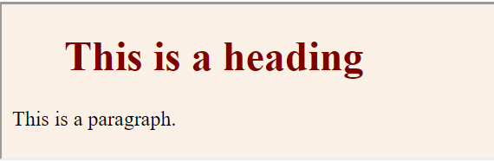
Embedded CSS - The <style> Element
<!DOCTYPE html>
<html> <head>
<style type = "text/css" media = "all">
body {
background-color: linen;
}
h1 { color: maroon;
margin-left: 40px; }
</style>
</head>
<body>
<h1>This is a heading</h1>
<p>This is a paragraph.</p>
</body>
</html>

Slide 32
Attributes
Attributes associated with <style> elements are −
Attribute | Value | Description
type | text/css | Specifies the style sheet language as a content-type (MIME type). This is required attribute.
media | screen tty tv projection handheld print braille aural all | Specifies the device the document will be displayed on. Default value is all. This is

Slide 33
Inline CSS - The style Attribute
You can use style attribute of any HTML element to define style rules. These rules will be applied to that element only. Here is the generic syntax −
<element style = "...style rules....">
Attribute | Value | Description
style | style rules | The value of style attribute is a combination of style declarations separated by semicolon (;).

Slide 34
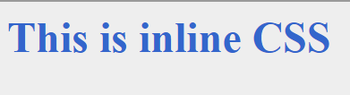
Example
<html>
<head>
</head>
<body>
<h1 style = "color:#36C;">
This is inline CSS
</h1>
</body>
</html>

Slide 35
External CSS - The <link> Element
The <link> element can be used to include an external stylesheet file in your HTML document.
An external style sheet is a separate text file with .css extension. You define all the Style rules within this text file and then you can include this file in any HTML document using <link> element.

Slide 36
External CSS - The <link> Element
The <link> element can be used to include an external stylesheet file in your HTML document.
An external style sheet is a separate text file with .css extension. You define all the Style rules within this text file and then you can include this file in any HTML document using <link> element.

Slide 37
External CSS - The <link> Element
Here is the generic syntax of including external CSS file −
<head>
<link type = "text/css" href = "..." media = "..." />
</head>

Slide 38
Attributes
Attribute | Value | Description
type | text css | Specifies the style sheet language as a content-type (MIME type). This attribute is required.
href | URL | Specifies the style sheet file having Style rules. This attribute is a required.
media | screen tty tv projection handheld print braille aural all | Specifies the device the document will be displayed on. Default value is all. This is optional attribute

Slide 39
Example
Consider a simple style sheet file with a name mystyle.css having the following rules −
h1, h2, h3 {
color: #36C;
font-weight: normal;
letter-spacing: .4em;
margin-bottom: 1em;
text-transform: lowercase;
}
Now you can include this file mystyle.css in any HTML document as follows −
<head>
<link type = "text/css" href = "mystyle.css" media = " all" />
</head>

Slide 40
Imported CSS - @import Rule
@import is used to import an external stylesheet in a manner similar to the <link> element. Here is the generic syntax of @import rule.
<head>
@import "URL";
</head>
Here URL is the URL of the style sheet file having style rules. You can use another syntax as well −
<head>
@import url("URL");
</head>

Slide 41

Practical

