Slide 2
Work with Colors in CSS.
Understand font styling using CSS.

Slide 3
Cascading Style Sheet
CSS is used to control the style of a web document in a simple and easy way.
CSS is the acronym for "Cascading Style Sheet".
Cascading Style Sheets, fondly referred to as CSS, is a simple design language intended to simplify the process of making web pages presentable.
CSS is a MUST for students and working professionals to become a great Software Engineer specially when they are working in Web Development Domain

Slide 4
Why to Learn CSS?
Create Stunning Web site - CSS handles the look and feel part of a web page. Using CSS, you can control the color of the text, the style of fonts, the spacing between paragraphs, how columns are sized and laid out, what background images or colors are used, layout designs,variations in display for different devices and screen sizes as well as a variety of other effects.
Become a web designer - If you want to start a carrer as a professional web designer, HTML and CSS designing is a must skill.
Control web - CSS is easy to learn and understand but it provides powerful control over the presentation of an HTML document. Most commonly, CSS is combined with the markup languages HTML or XHTML.
Learn other languages - Once you understands the basic of HTML and CSS then other related technologies like javascript, php, or angular are become easier to understand.

Slide 5
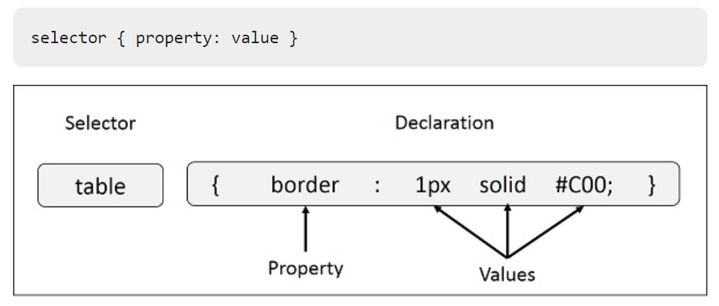
CSS Style Rule Syntax

Slide 6

Example
<html>
<head>
</head>
<body>
<h1 style = "color:#36C;">
This is inline CSS
</h1>
</body>
</html>

Slide 7
CSS Colors
Colors in CSS can be specified by the following methods:
Hexadecimal colors
Hexadecimal colors with transparency
RGB colors
RGBA colors
HSL colors
HSLA colors
Predefined/Cross-browser color names
With the currentcolor keyword

Slide 8
Hexadecimal Colors
A hexadecimal color is specified with: #RRGGBB, where the RR (red), GG (green) and BB (blue) hexadecimal integers specify the components of the color. All values must be between 00 and FF.
For example, the #0000ff value is rendered as blue, because the blue component is set to its highest value (ff) and the others are set to 00.

Slide 9
Hexadecimal Colors
A hexadecimal color is specified with: #RRGGBB, where the RR (red), GG (green) and BB (blue) hexadecimal integers specify the components of the color. All values must be between 00 and FF.
For example, the #0000ff value is rendered as blue, because the blue component is set to its highest value (ff) and the others are set to 00.

Slide 10
Example
different HEX colors:
#p1 {background-color: #ff0000;} /* red */
#p2 {background-color: #00ff00;} /* green */
#p3 {background-color: #0000ff;} /* blue */

Slide 11
Hexadecimal Colors With Transparency
A hexadecimal color is specified with: #RRGGBB. To add transparency, add two additional digits between 00 and FF.
Example
Define different HEX colors with transparency:
#p1a {background-color: #ff000080;} /* red transparency */
#p2a {background-color: #00ff0080;} /* green transparency */
#p3a {background-color: #0000ff80;} /* blue transparency */

Slide 12
RGB Colors
An RGB color value is specified with the rgb() function, which has the following syntax:
rgb(red, green, blue)
Each parameter (red, green, and blue) defines the intensity of the color and can be an integer between 0 and 255 or a percentage value (from 0% to 100%).

Slide 13
RGB Colors
An RGB color value is specified with the rgb() function, which has the following syntax:
rgb(red, green, blue)
Each parameter (red, green, and blue) defines the intensity of the color and can be an integer between 0 and 255 or a percentage value (from 0% to 100%).

Slide 14
RGB Colors
An RGB color value is specified with the rgb() function, which has the following syntax:
rgb(red, green, blue)
Each parameter (red, green, and blue) defines the intensity of the color and can be an integer between 0 and 255 or a percentage value (from 0% to 100%).

Slide 15
RGB Colors
For example, the rgb(0,0,255) value is rendered as blue, because the blue parameter is set to its highest value (255) and the others are set to 0.
Also, the following values define equal color: rgb(0,0,255) and rgb(0%,0%,100%)

Slide 16
RGB Colors
For example, the rgb(0,0,255) value is rendered as blue, because the blue parameter is set to its highest value (255) and the others are set to 0.
Also, the following values define equal color: rgb(0,0,255) and rgb(0%,0%,100%)

Slide 17
RGBA Colors
RGBA color values are an extension of RGB color values with an alpha channel - which specifies the opacity of the object.
An RGBA color is specified with the rgba() function, which has the following syntax:
rgba(red, green, blue, alpha)

Slide 18
RGBA Colors
RGBA color values are an extension of RGB color values with an alpha channel - which specifies the opacity of the object.
An RGBA color is specified with the rgba() function, which has the following syntax:
rgba(red, green, blue, alpha)

Slide 19
RGBA Colors
RGBA color values are an extension of RGB color values with an alpha channel - which specifies the opacity of the object.
An RGBA color is specified with the rgba() function, which has the following syntax:
rgba(red, green, blue, alpha)

Slide 20
HSL Colors
HSL stands for hue, saturation, and lightness - and represents a cylindrical-coordinate representation of colors.
An HSL color value is specified with the hsl() function, which has the following syntax:
hsl(hue, saturation, lightness)

Slide 21
HSL Colors
HSL stands for hue, saturation, and lightness - and represents a cylindrical-coordinate representation of colors.
An HSL color value is specified with the hsl() function, which has the following syntax:
hsl(hue, saturation, lightness)

Slide 22
HSL Colors
HSL stands for hue, saturation, and lightness - and represents a cylindrical-coordinate representation of colors.
An HSL color value is specified with the hsl() function, which has the following syntax:
hsl(hue, saturation, lightness)

Slide 23
Predefined/Cross-browser Color Names
140 color names are predefined in the HTML and CSS color specification.
For example: blue, red, coral, brown, etc:

Slide 24
Predefined/Cross-browser Color Names
140 color names are predefined in the HTML and CSS color specification.
For example: blue, red, coral, brown, etc:

Slide 25
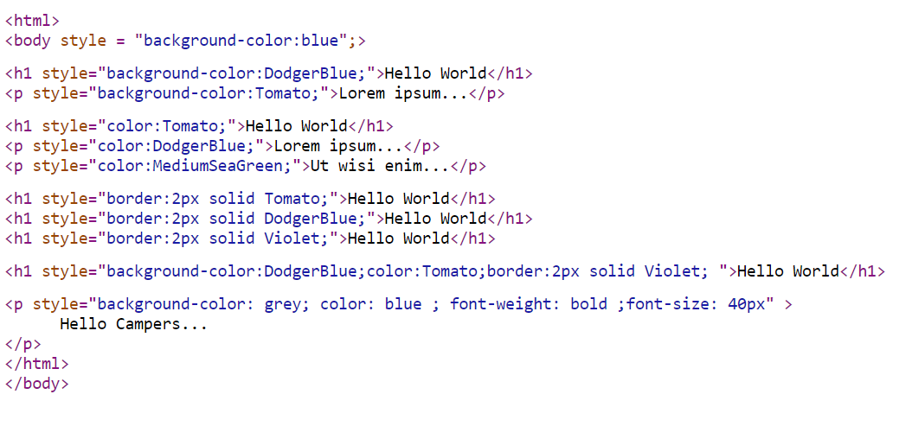
Example

Slide 26
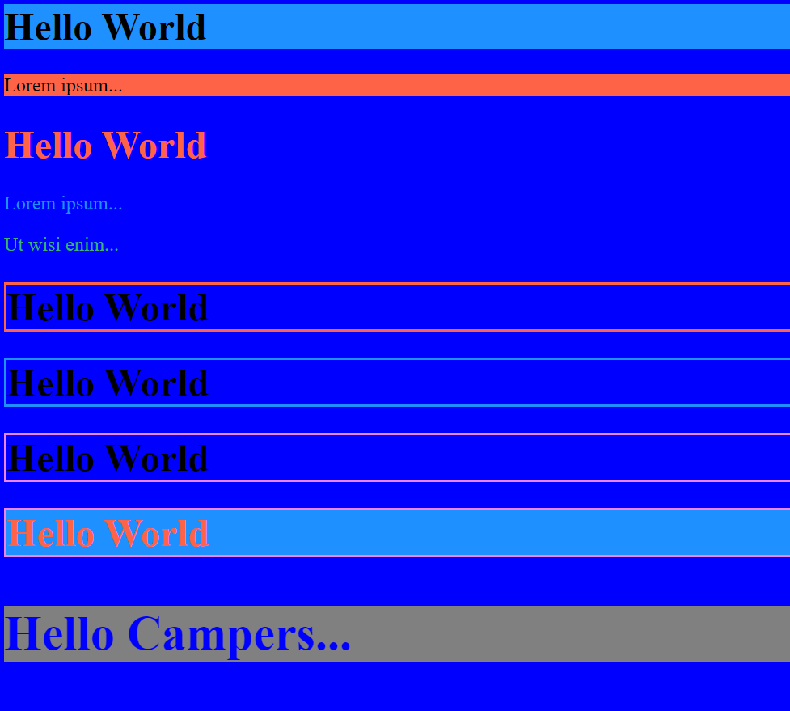
Output

Slide 27
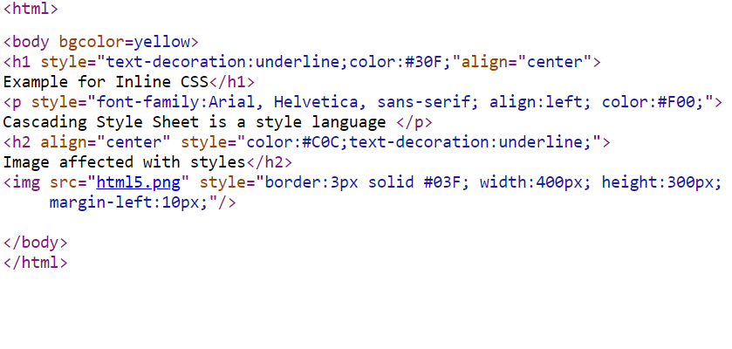
Image in css

Slide 28
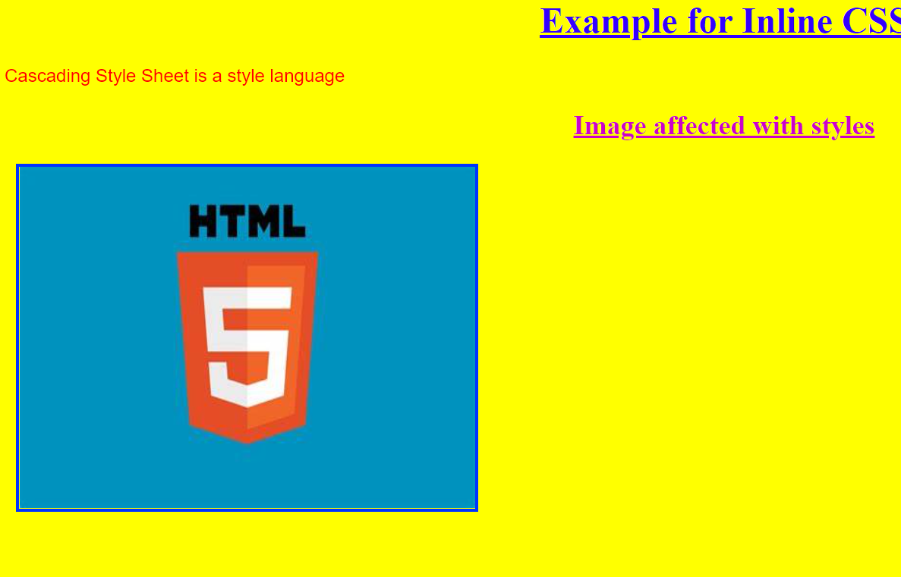
Output

