Slide 2
understand the anatomy of css rule
create HTML table using CSS

Slide 3
CSS - Syntax
A CSS comprises of style rules that are interpreted by the browser and then applied to the corresponding elements in your document. A style rule is made of three parts

Slide 4
CSS - Syntax
Selector − A selector is an HTML tag at which a style will be applied. This could be any tag like <h1> or <table> etc.
Property − A property is a type of attribute of HTML tag. Put simply, all the HTML attributes are converted into CSS properties. They could be color, border etc.
Value − Values are assigned to properties. For example, color property can have value either red or #F1F1F1 etc.

Slide 5
CSS - Syntax
Selector − A selector is an HTML tag at which a style will be applied. This could be any tag like <h1> or <table> etc.
Property − A property is a type of attribute of HTML tag. Put simply, all the HTML attributes are converted into CSS properties. They could be color, border etc.
Value − Values are assigned to properties. For example, color property can have value either red or #F1F1F1 etc.

Slide 6
CSS - Syntax
Selector − A selector is an HTML tag at which a style will be applied. This could be any tag like <h1> or <table> etc.
Property − A property is a type of attribute of HTML tag. Put simply, all the HTML attributes are converted into CSS properties. They could be color, border etc.
Value − Values are assigned to properties. For example, color property can have value either red or #F1F1F1 etc.

Slide 7
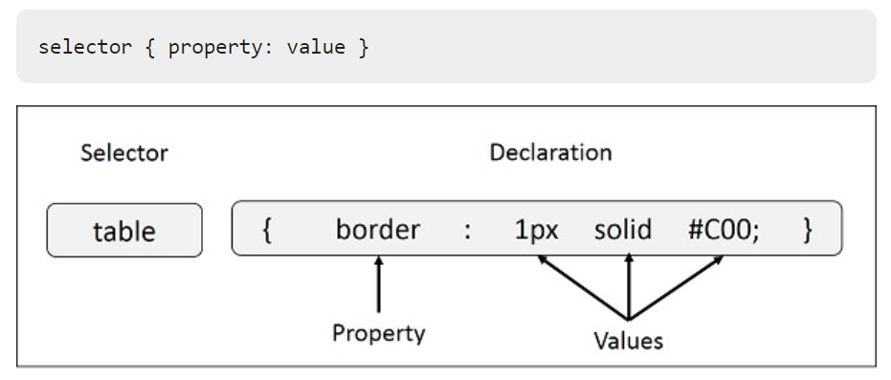
CSS Style Rule Syntax

Slide 8
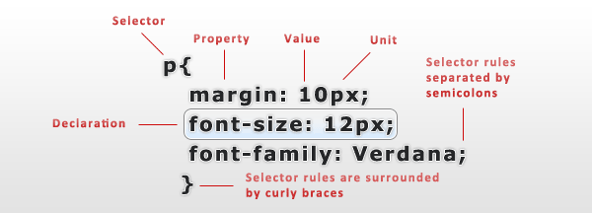
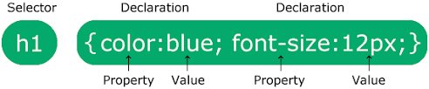
Anatomy of css Rule

Slide 9
How CSS works
CSS is interpreted by the browser (the application used to view the webpage, e.g. Internet Explorer or Google Chrome) and then used to decide how the webpage should look.

Slide 10

How CSS works
There is a very thorough specification of the CSS language, the many browsers across all of the possible devices interprets your CSS code in its own way.
This means that even though most of your work will likely look and act the way you expect it to, there might be subtle differences if you view your work in some of the many browsers on the market..

Slide 11
How CSS works
There is a very thorough specification of the CSS language, the many browsers across all of the possible devices interprets your CSS code in its own way.
This means that even though most of your work will likely look and act the way you expect it to, there might be subtle differences if you view your work in some of the many browsers on the market..

Slide 12
How CSS works
CSS is interpreted by the client (usually a web browser) on each request, and since different browsers uses different parsing engines, things might not look entirely the same across different devices, platforms and browser versions.

Slide 13
Caution
Make sure that you test all of your pages in as many browsers as possible and to help reduce the number of problems you should make sure that your CSS code can pass the checks of the W3 validator

Slide 14
HTML table using CSS
The border-collapse specifies whether the browser should control the appearance of the adjacent borders that touch each other or whether each cell should maintain its style.
The border-spacing specifies the width that should appear between table cells.

Slide 15
HTML table using CSS
The border-collapse specifies whether the browser should control the appearance of the adjacent borders that touch each other or whether each cell should maintain its style.
The border-spacing specifies the width that should appear between table cells.

Slide 16
HTML table using CSS
The caption-side captions are presented in the <caption> element. By default, these are rendered above the table in the document. You use the caption-side property to control the placement of the table caption.

Slide 17
HTML table using CSS
The empty-cells specifies whether the border should be shown if a cell is empty.
The table-layout allows browsers to speed up layout of a table by using the first width properties it comes across for the rest of a column rather than having to load the whole table before rendering it.

Slide 18
HTML table using CSS
The empty-cells specifies whether the border should be shown if a cell is empty.
The table-layout allows browsers to speed up layout of a table by using the first width properties it comes across for the rest of a column rather than having to load the whole table before rendering it.

Slide 19
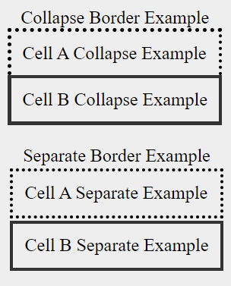
The border-collapse Property
This property can have two values collapse and separate. The following example uses both the values −

Slide 20
The border-spacing Property
The border-spacing property specifies the distance that separates adjacent cells. borders. It can take either one or two values; these should be units of length.
If you provide one value, it will apply to both vertical and horizontal borders. Or you can specify two values, in which case, the first refers to the horizontal spacing and the second to the vertical spacing

Slide 21
The border-spacing Property
The border-spacing property specifies the distance that separates adjacent cells. borders. It can take either one or two values; these should be units of length.
If you provide one value, it will apply to both vertical and horizontal borders. Or you can specify two values, in which case, the first refers to the horizontal spacing and the second to the vertical spacing

Slide 22
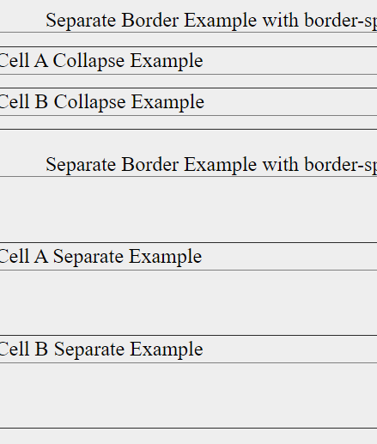

Example

Slide 23
The caption-side Property
The caption-side property allows you to specify where the content of a <caption> element should be placed in relationship to the table. The table that follows lists the possible values.
This property can have one of the four values top, bottom, left or right. The following example uses each value.

Slide 24
The caption-side Property
The caption-side property allows you to specify where the content of a <caption> element should be placed in relationship to the table. The table that follows lists the possible values.
This property can have one of the four values top, bottom, left or right. The following example uses each value.

Slide 25
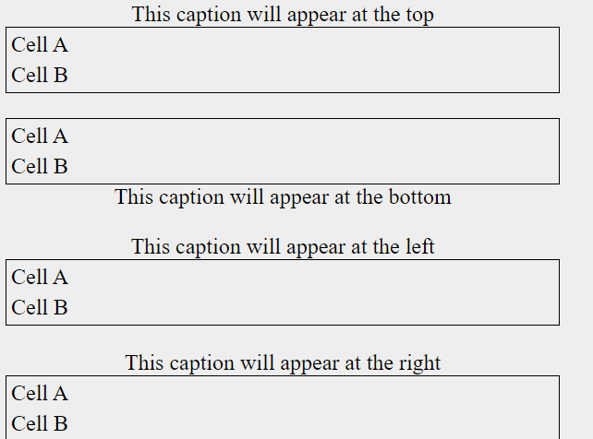
Example

