Slide 2
understand CSS position Property.
go over CSS fonts styles.

Slide 3
CSS position Property
The position property specifies the type of positioning method used for an element (static, relative, absolute, fixed, or sticky).

Slide 4
CSS position-Syntax
Static
Absolute
Fixed
Relative
Sticky
Initial

Slide 5
CSS position-Syntax
Value | Description
static | Default value. Elements render in order, as they appear in the document flow.
absolute | The element is positioned relative to its first positioned (not static) ancestor element
fixed | The element is positioned relative to the browser window
relative | The element is positioned relative to its normal position, so "left:20px" adds 20 pixels to the element's LEFT position
sticky | The element is positioned based on the user's scroll position

Slide 6
Example
h2.pos_left
{
position: relative;
left: -20px;
}
h2.pos_right
{
position: relative;
left: 20px;
}

Slide 7
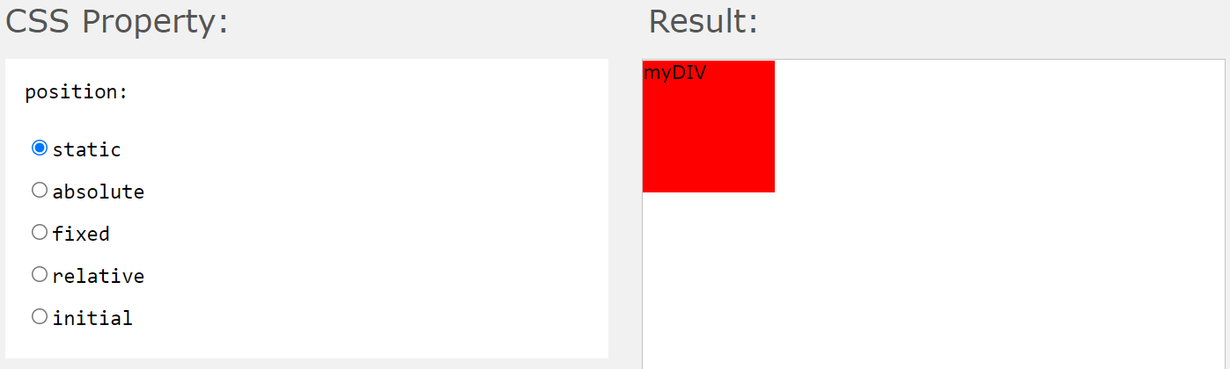
Static
A static positioned element is always positioned according to the normal flow of the page. HTML elements are positioned static by default. Static positioned elements are not affected by the top, bottom, left, right, and z-index properties.

Slide 8
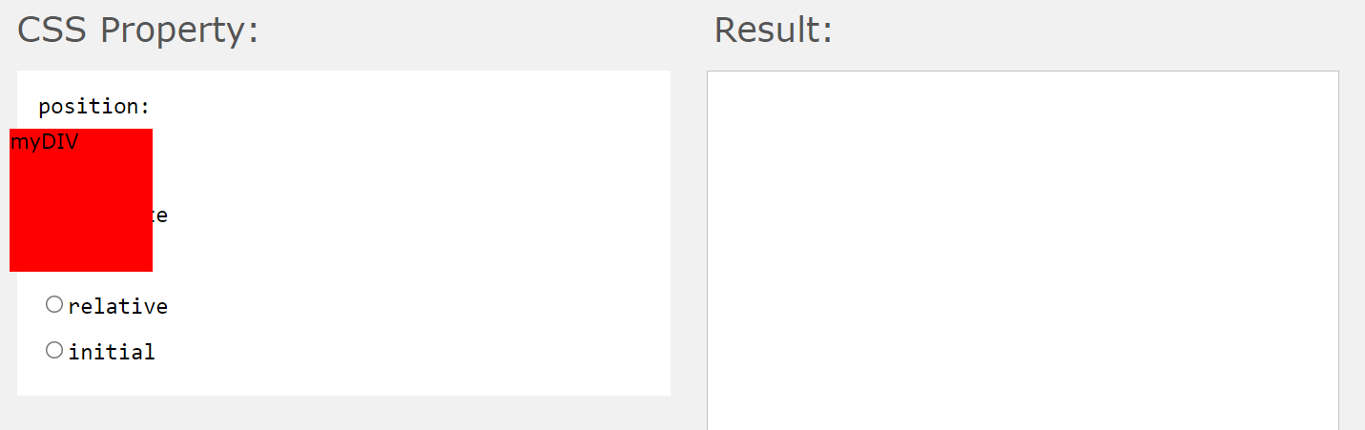
Absolute
An absolutely positioned element is positioned relative to the first parent element that has a position other than static. If no such element is found, it will be positioned on a page relative to the 'top-left' corner of the browser window. The box's offsets further can be specified using one or more of the properties top, right, bottom, and left.

Slide 9
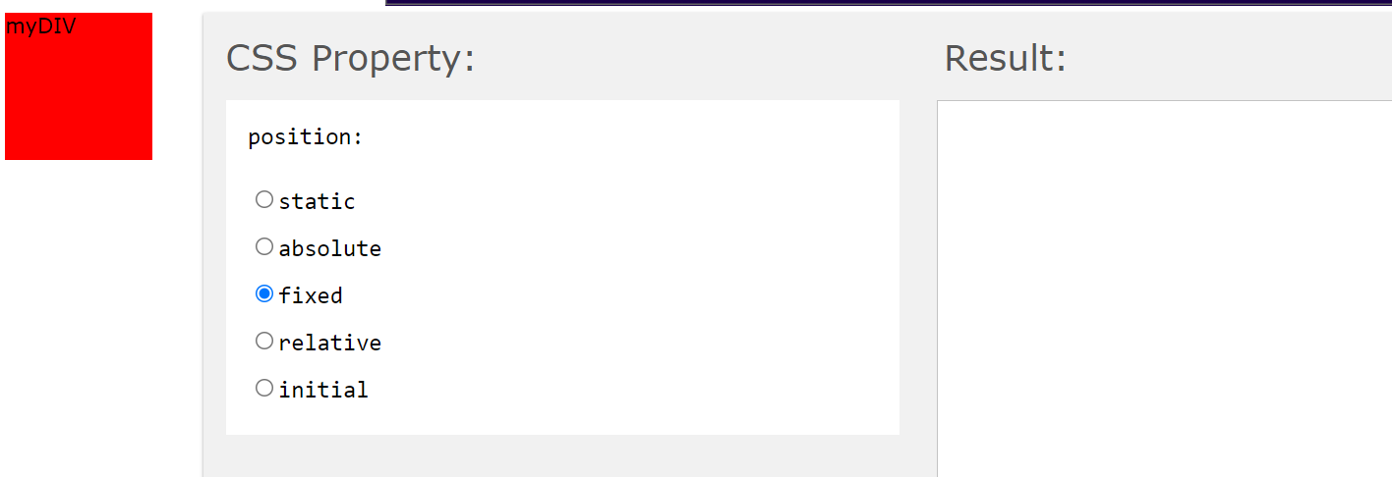
Fixed
Fixed positioning is a subcategory of absolute positioning.
The only difference is, a fixed positioned element is fixed with respect to the browser's viewport and does not move when scrolled.

Slide 10
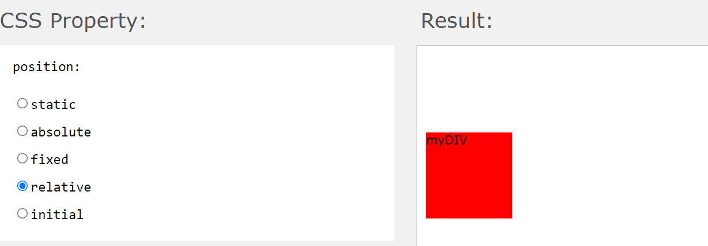
Relative
A relative positioned element is positioned relative to its normal position.
In the relative positioning scheme the element's box position is calculated according to the normal flow. Then the box is shifted from this normal position according to the properties — top or bottom and/or left or right.

Slide 11
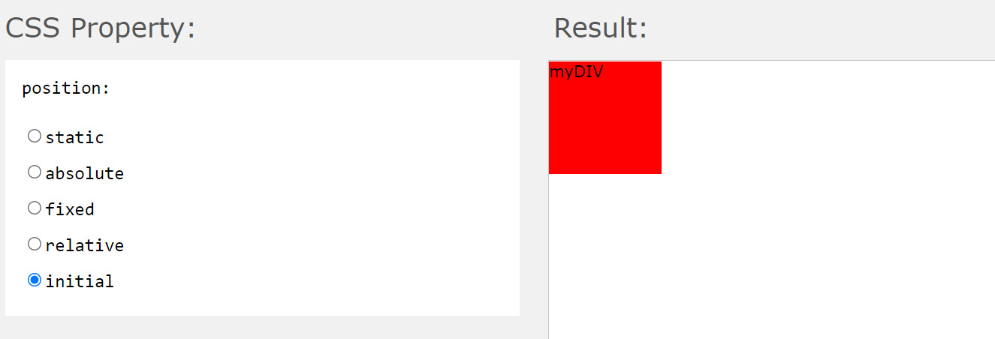
Initial

Slide 12
CSS Fonts
Font Selection is Important
Choosing the right font has a huge impact on how the readers experience a website.
The right font can create a strong identity for your brand.
Using a font that is easy to read is important. The font adds value to your text. It is also important to choose the correct color and text size for the font.

Slide 13
Generic Font Families
In CSS there are five generic font families:
Serif fonts have a small stroke at the edges of each letter. They create a sense of formality and elegance.
Sans-serif fonts have clean lines (no small strokes attached). They create a modern and minimalistic look.

Slide 14
Generic Font Families
Monospace fonts - here all the letters have the same fixed width. They create a mechanical look.
Cursive fonts imitate human handwriting.
Fantasy fonts are decorative/playful fonts.

Slide 15
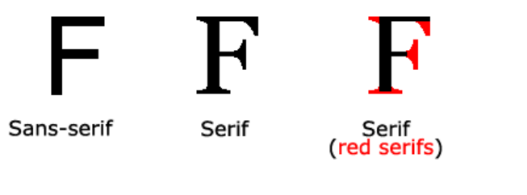
Difference Between Serif and Sans-serif Fonts

Slide 16
The CSS font-family Property
In CSS, we use the font-family property to specify the font of a text.
Font-family Property

Slide 17
Example
.p1 {
font-family: "Times New Roman", Times, serif;
}
.p2 {
font-family: Arial, Helvetica, sans-serif;
}
.p3 {
font-family: "Lucida Console", "Courier New", monospace;
}

Slide 18
CSS Google Fonts
Google Fonts
If you do not want to use any of the standard fonts in HTML, you can use Google Fonts.
Google Fonts are free to use and have more than 1000 fonts to choose from.

Slide 19
How To Use Google Fonts
<head>
<link rel="stylesheet" href="https://fonts.googleapis.com/css?family=Sofia">
<style>
body {
font-family: "Sofia", sans-serif;
}
</style>
</head>

Slide 20
Practical

