Slide 2
understand Bootstrap Grid.
go over Bootstrap Navigation Bar

Slide 3

What is Bootstrap?
Bootstrap is a free front-end framework for faster and easier web development
Also gives you the ability to easily create responsive designs

Slide 4
What is Bootstrap?
Bootstrap is a free front-end framework for faster and easier web development
Also gives you the ability to easily create responsive designs

Slide 5

What is Bootstrap?
Bootstrap includes HTML and CSS based design templates for typography, forms, buttons, tables, navigation, modals, image carousels and many other, as well as optional JavaScript plugins.

Slide 6
Advantages of Bootstrap
Anybody with just basic knowledge of HTML and CSS can start using Bootstrap
1
Easy to use
Responsive features
Bootstrap's responsive CSS adjusts to phones, tablets, and desktops.
2

Slide 7
Advantages of Bootstrap
Mobile-first approach
In Bootstrap 3, mobile-first styles are part of the core framework
3
Responsive features
Bootstrap is compatible with all modern browsers (Chrome, Firefox, Internet Explorer, Safari, and Opera)
4

Slide 8
Where to Get Bootstrap?
EITHER
Download Bootstrap from getbootstrap.com
If you want to download and host Bootstrap yourself, go to getbootstrap.com, and follow the instructions there.

Slide 9
Where to Get Bootstrap?
OR
Include Bootstrap from a CDN
If you don't want to download and host Bootstrap yourself, you can include it from a CDN (Content Delivery Network).
MaxCDN provides CDN support for Bootstrap's CSS and JavaScript. You must also include jQuery.

Slide 10
Bootstrap Grid
In graphic design, a grid is a structure (usually two-dimensional) made up of a series of intersecting straight (vertical, horizontal) lines used to structure the content. It is widely used to design layout and content structure in print design. In web design, it is a very effective method to create a consistent layout rapidly and effectively using HTML and CSS.

Slide 11
Bootstrap Grid System
The Bootstrap Grid System allows up to 12 columns across the page. You can use all 12 columns individually or you can group the columns together to create wider columns.

Slide 12
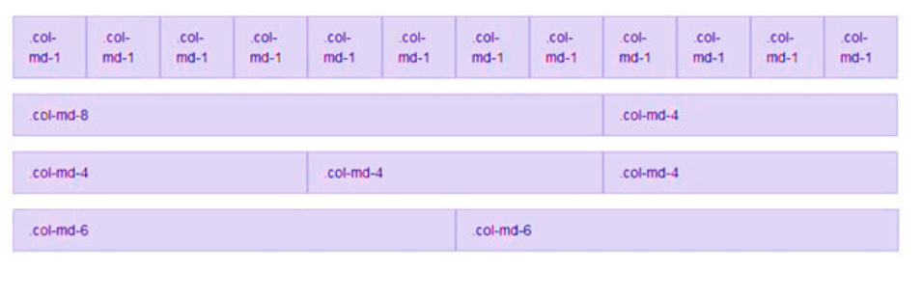
Example

Slide 13
Bootstrap Grid System
Bootstrap Grid System is responsive, and the columns are re-arranged automatically according to the screen size

Slide 14
Grid Classes
There are four classes in Bootstrap Grid System:
xs (for phones)
sm (for tablets)
md (for desktops)
lg (for larger desktops)
You can combine the above classes to create more dynamic and flexible layouts.

Slide 15
Basic Structure of a Bootstrap Grid
<div class="row">
<div class="col-*-*"></div>
</div>
<div class="row">
<div class="col-*-*"></div>
<div class="col-*-*"></div>
<div class="col-*-*"></div>
</div>
<div class="row">
...
</div>

Slide 16
Instructions while creating a Bootstrap Grid
Create a row (<div class="row">).
Add the number of columns, you want in the grid (tags with appropriate .col-*-* classes).
Note that numbers in .col-*-* should always add up to 12 for each row.

Slide 17
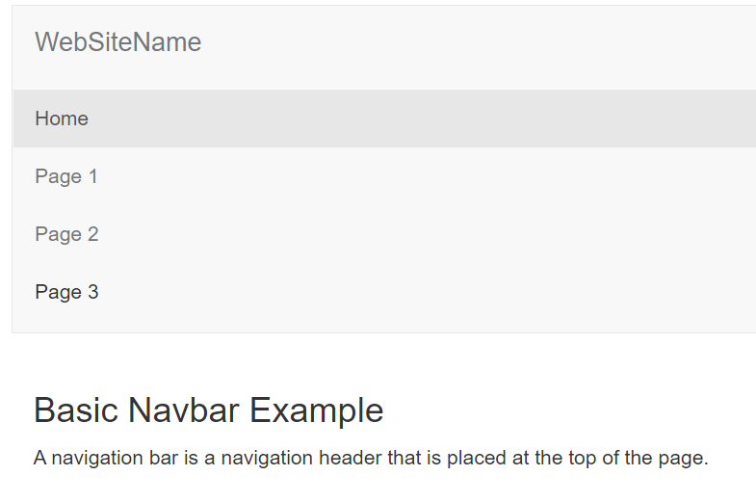
Bootstrap Navigation Bar
A navigation bar is like a navigation header that is placed at the top of the page. You can collapse or extend it according to the screen size.

Slide 18
Bootstrap Navigation Bar
You can create a standard navigation bar at the top of the page with with :
<NAV CLASS="NAVBAR NAVBAR-DEFAULT">.

Slide 19
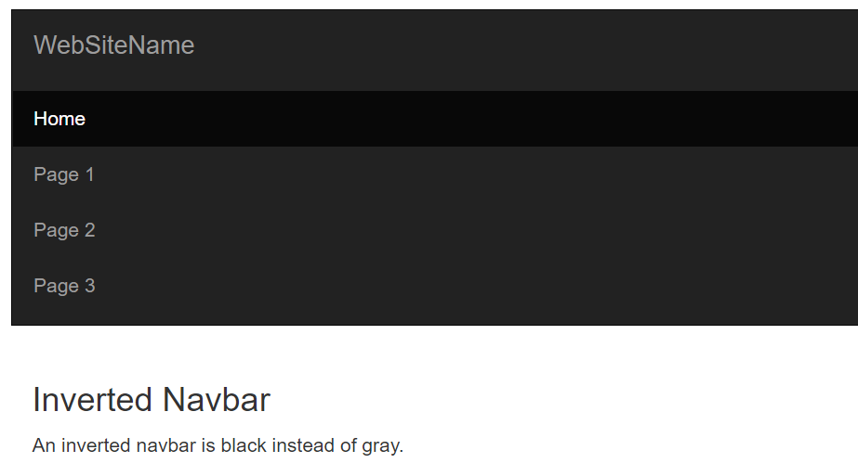
Bootstrap Inverted Navigation Bar
Inverted navigation bar provides an alternative black navbar. It can be used to style the default navigation bar by changing .navbar-default class into .navbar-inverse class.

