Slide 2
Understand concept of React JavaScript library.
Understand Installation of React JavaScript library.

Slide 3
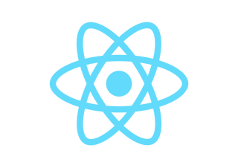
React
React (also known as React.js or ReactJS) is a free and open-source front-end JavaScript library for building user interfaces based on UI components. It is maintained by Meta (formerly Facebook) and a community of individual developers and companies.

Slide 4
React (JavaScript library)
React can be used as a base in the development of single-page or mobile applications. However, React is only concerned with state management and rendering that state to the DOM, so creating React applications usually requires the use of additional libraries for routing, as well as certain client-side functionality.

Slide 5
Notable features
Declarative-React adheres to the declarative programming paradigm. Developers design views for each state of an application, and React updates and renders components when data changes. This is in contrast with imperative programming

Slide 6
Components
React code is made of entities called components. These components are reusable and must be formed in the SRC folder following the Pascal Case as its naming conversion.
Components can be rendered to a particular element in the DOM using the React DOM library

Slide 7
Virtual DOM
Another notable feature is the use of a virtual Document Object Model, or virtual DOM. React creates an in-memory data-structure cache, computes the resulting differences, and then updates the browser's displayed DOM efficiently. This process is called reconciliation. This allows the programmer to write code as if the entire page is rendered on each change, while the React libraries only render subcomponents that actually change.

Slide 8
React installation
Install NodeJS and NPM.
Install Visual Studio Code.
Install React from terminal .
npm install -g create-react-app

Slide 9
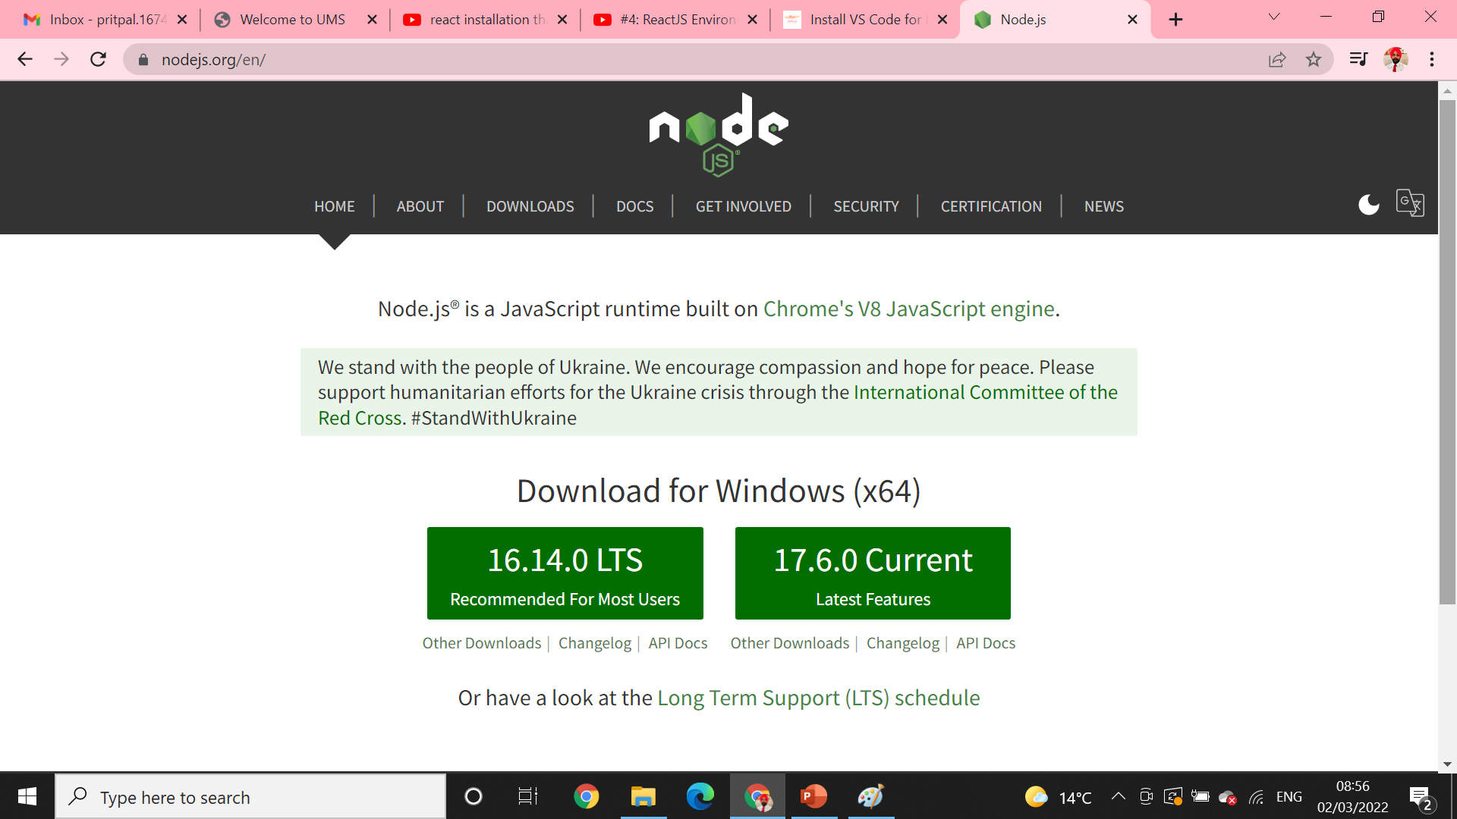
Install NodeJS and NPM.
Go to https://nodejs.org/en/
Download the latest version of NodeJS LTS with Administrator privileges.

Slide 10
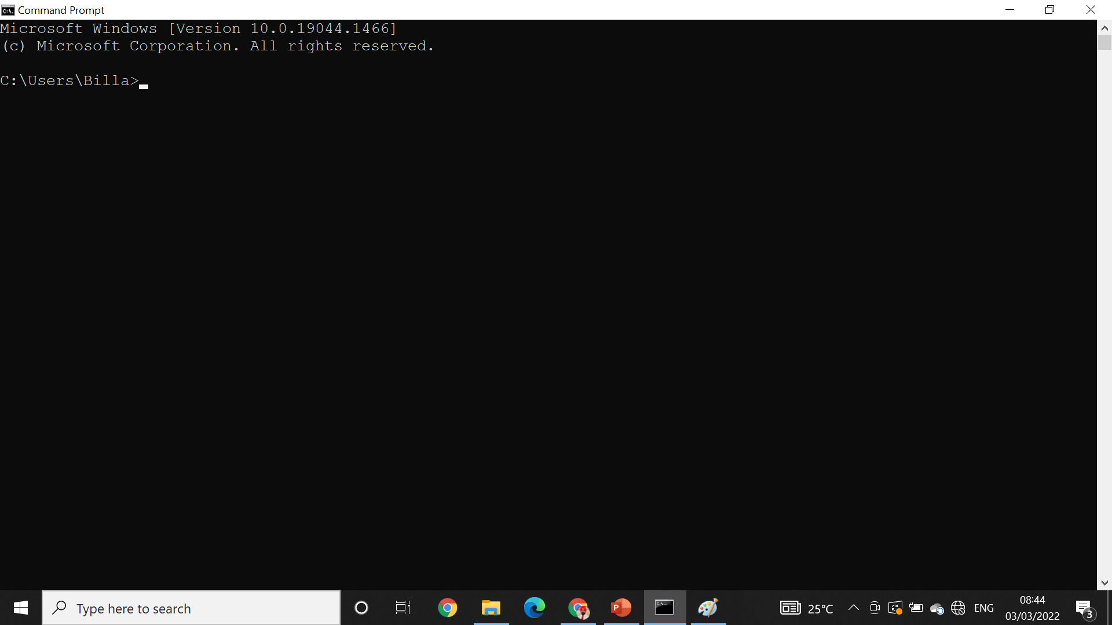
Open cmd *cmd

Slide 11

To check version* node -v

Slide 12
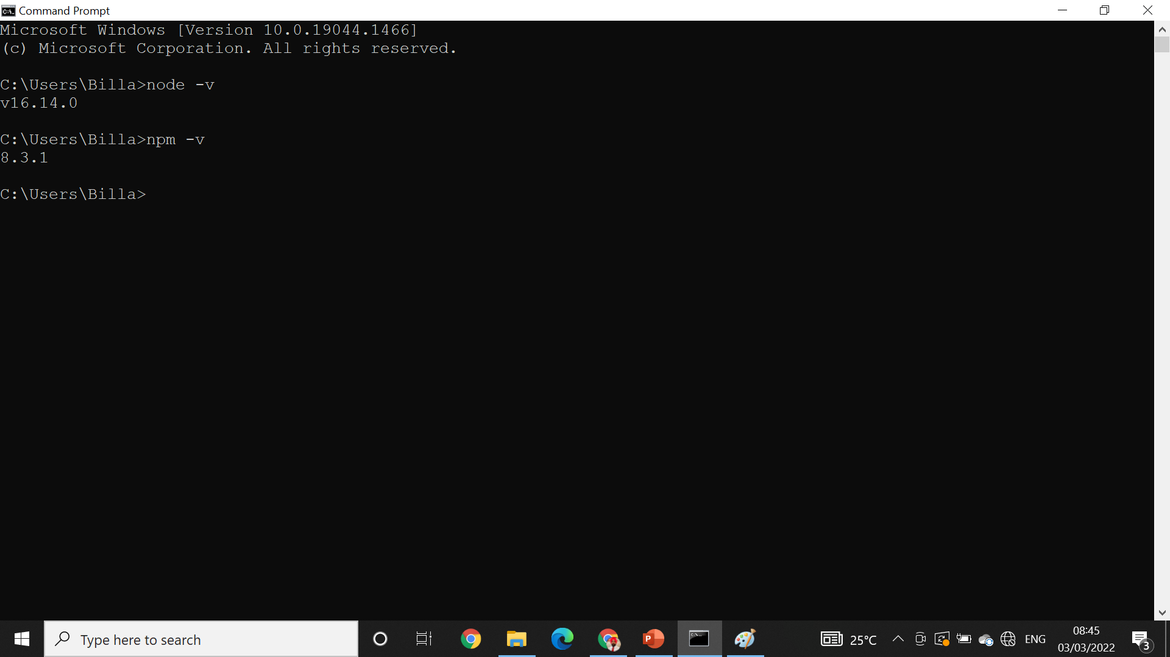
Npm installation* npm -v

Slide 13
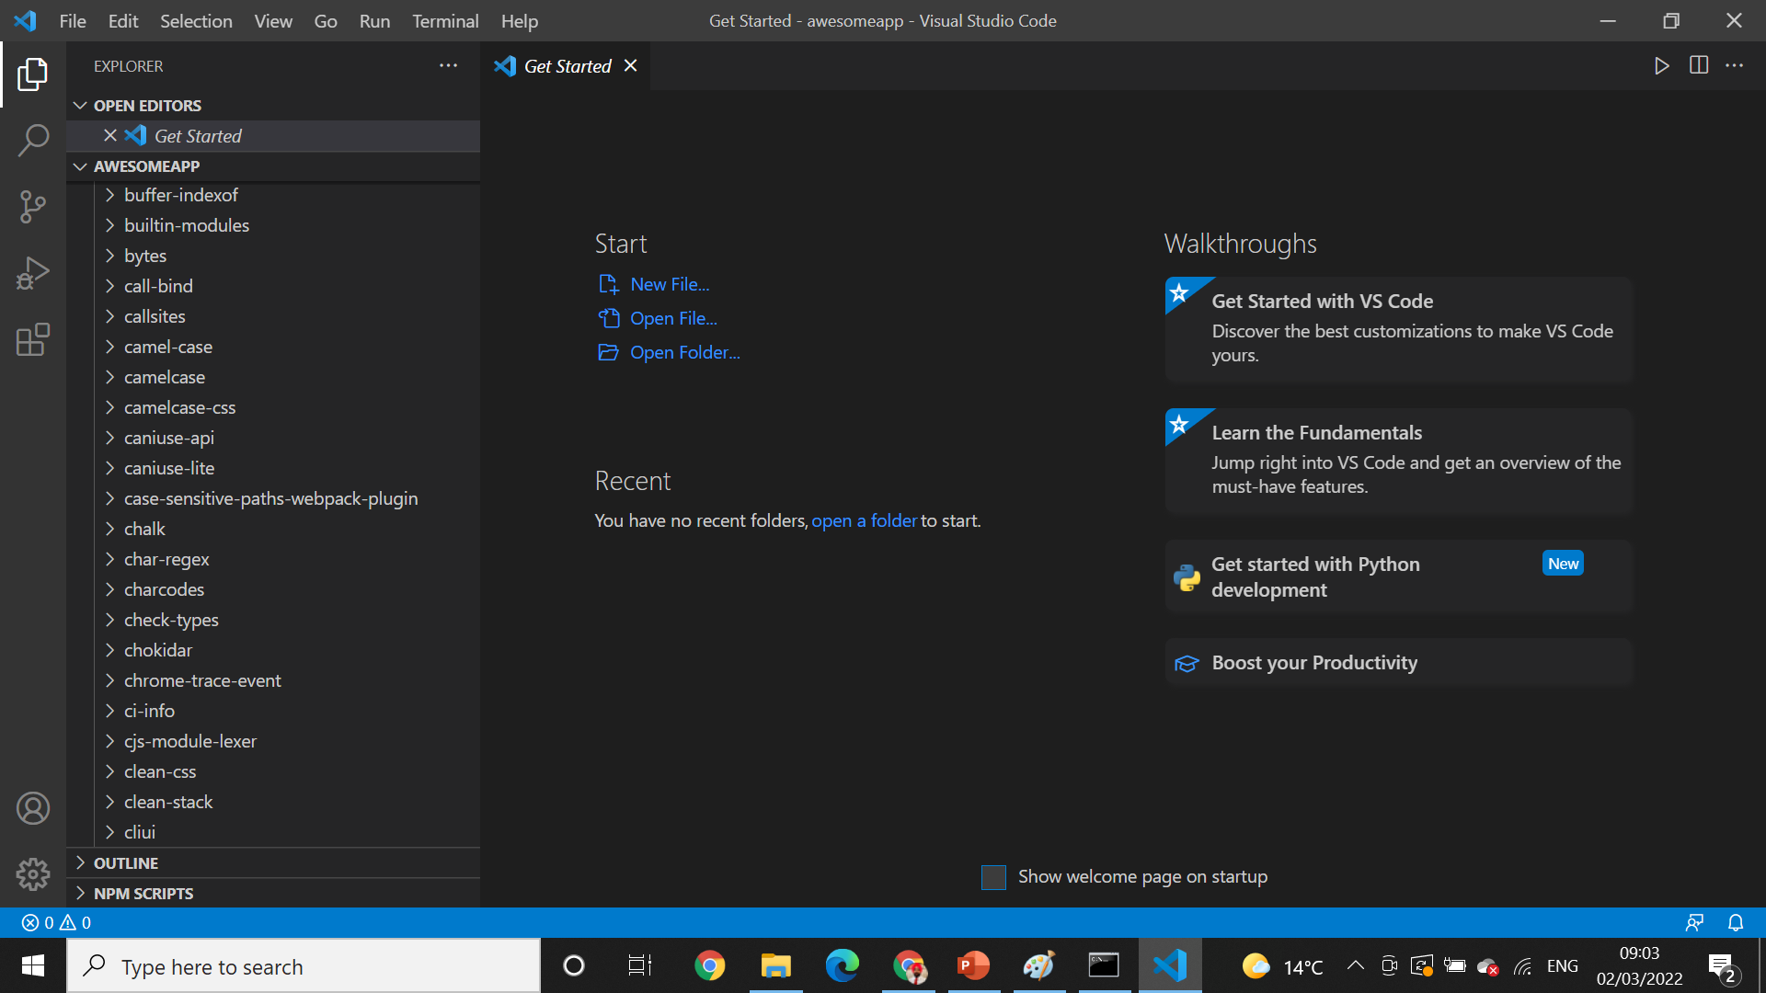
Install visual studio code

Slide 14
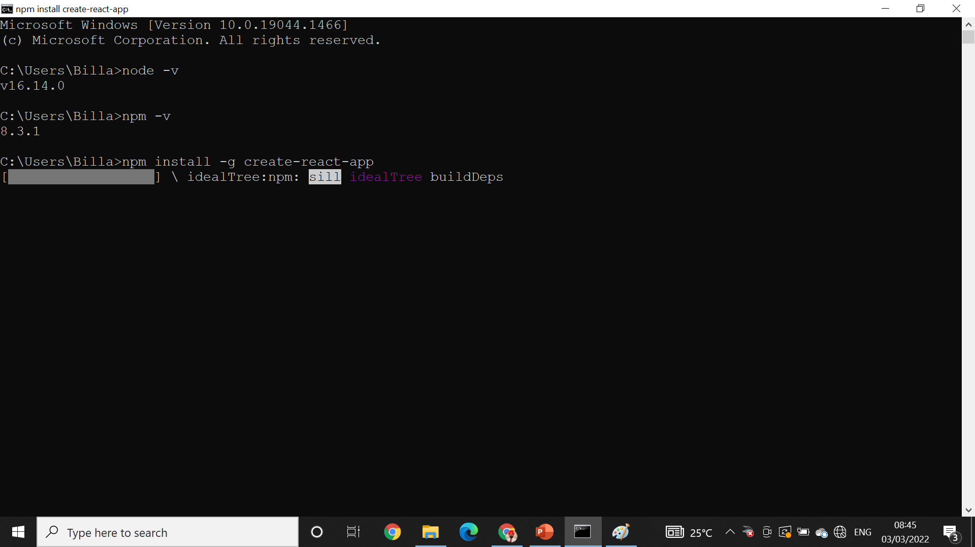
Install react from terminal
npm install -g create-react-app

Slide 15
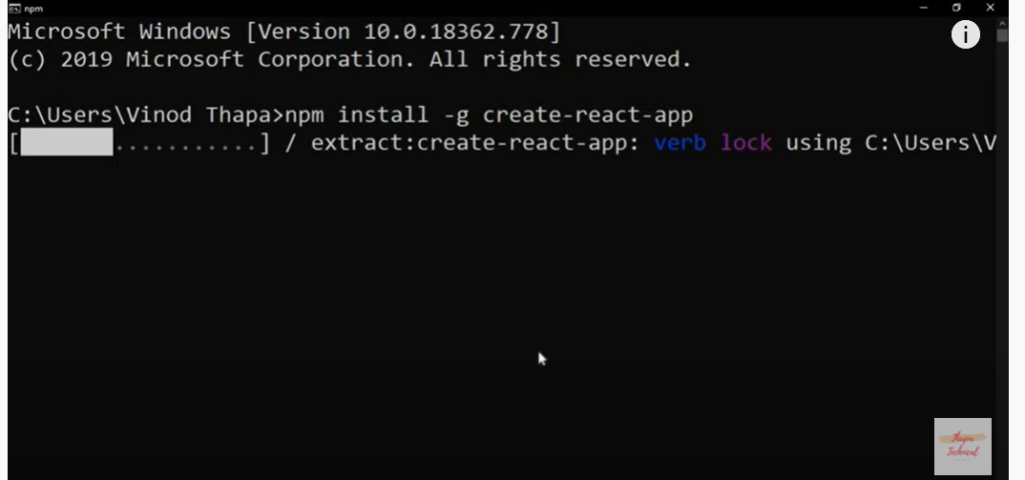
Installation

Slide 16
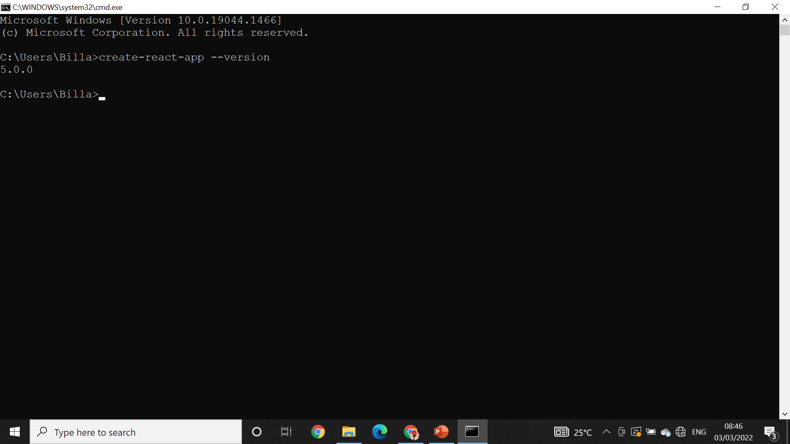
React version* create-react-app –-version

Slide 17
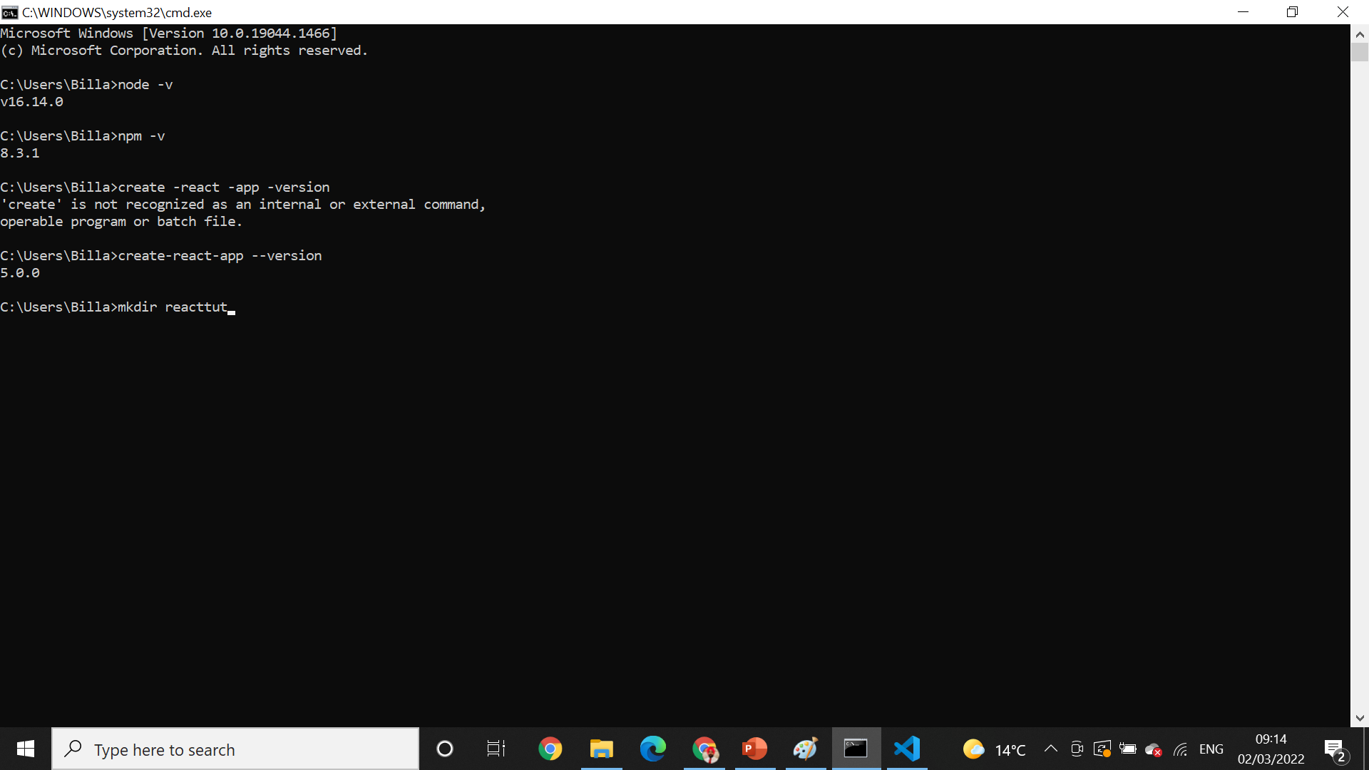
Creating directory* mkdir

Slide 18
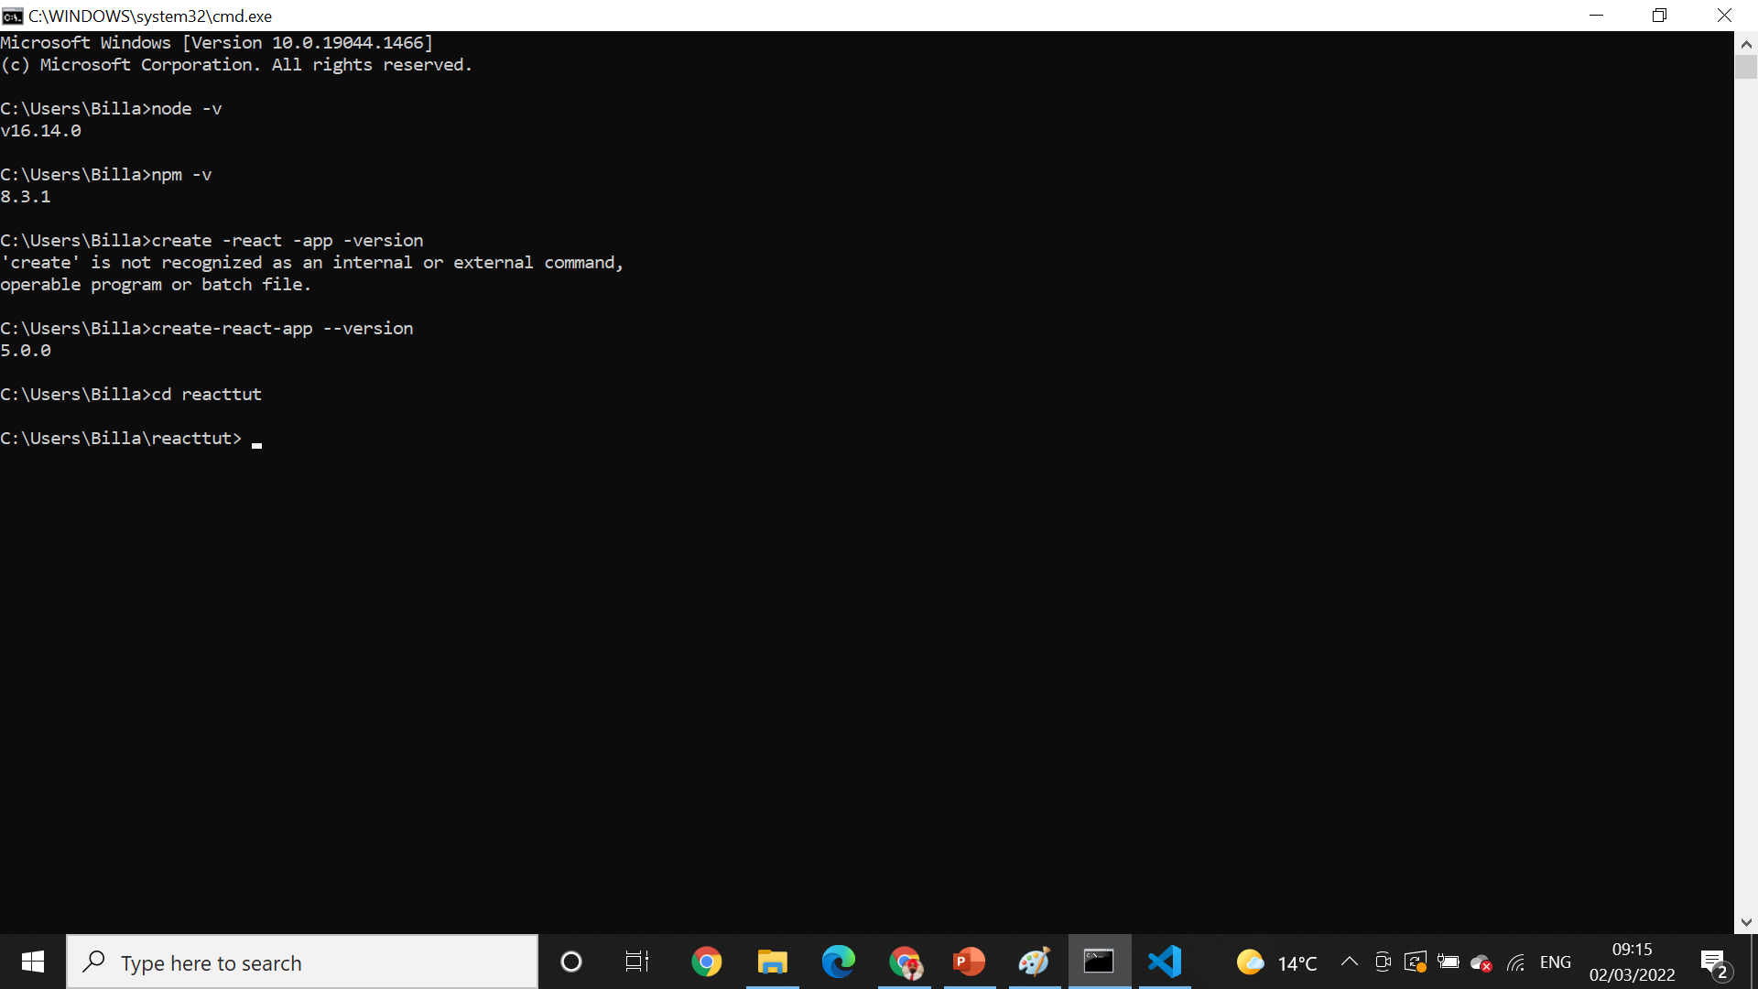
Change working directory* CD

Slide 19

Create app inside directory * create-react-app-awesomeapp

Slide 20
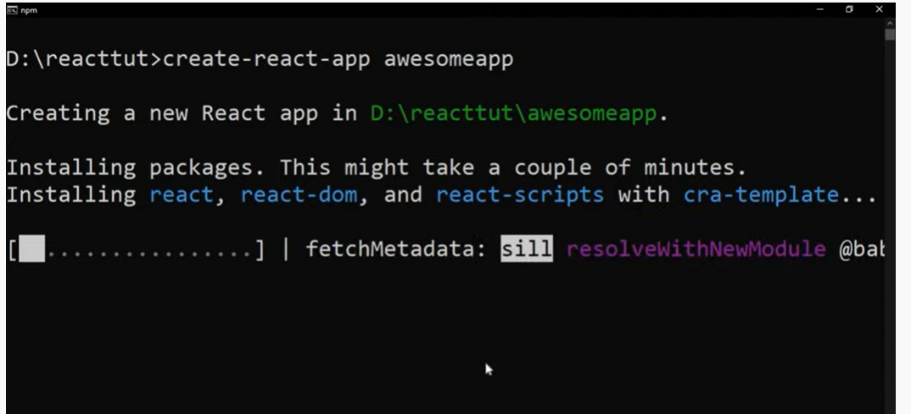
Installation going on

Slide 21
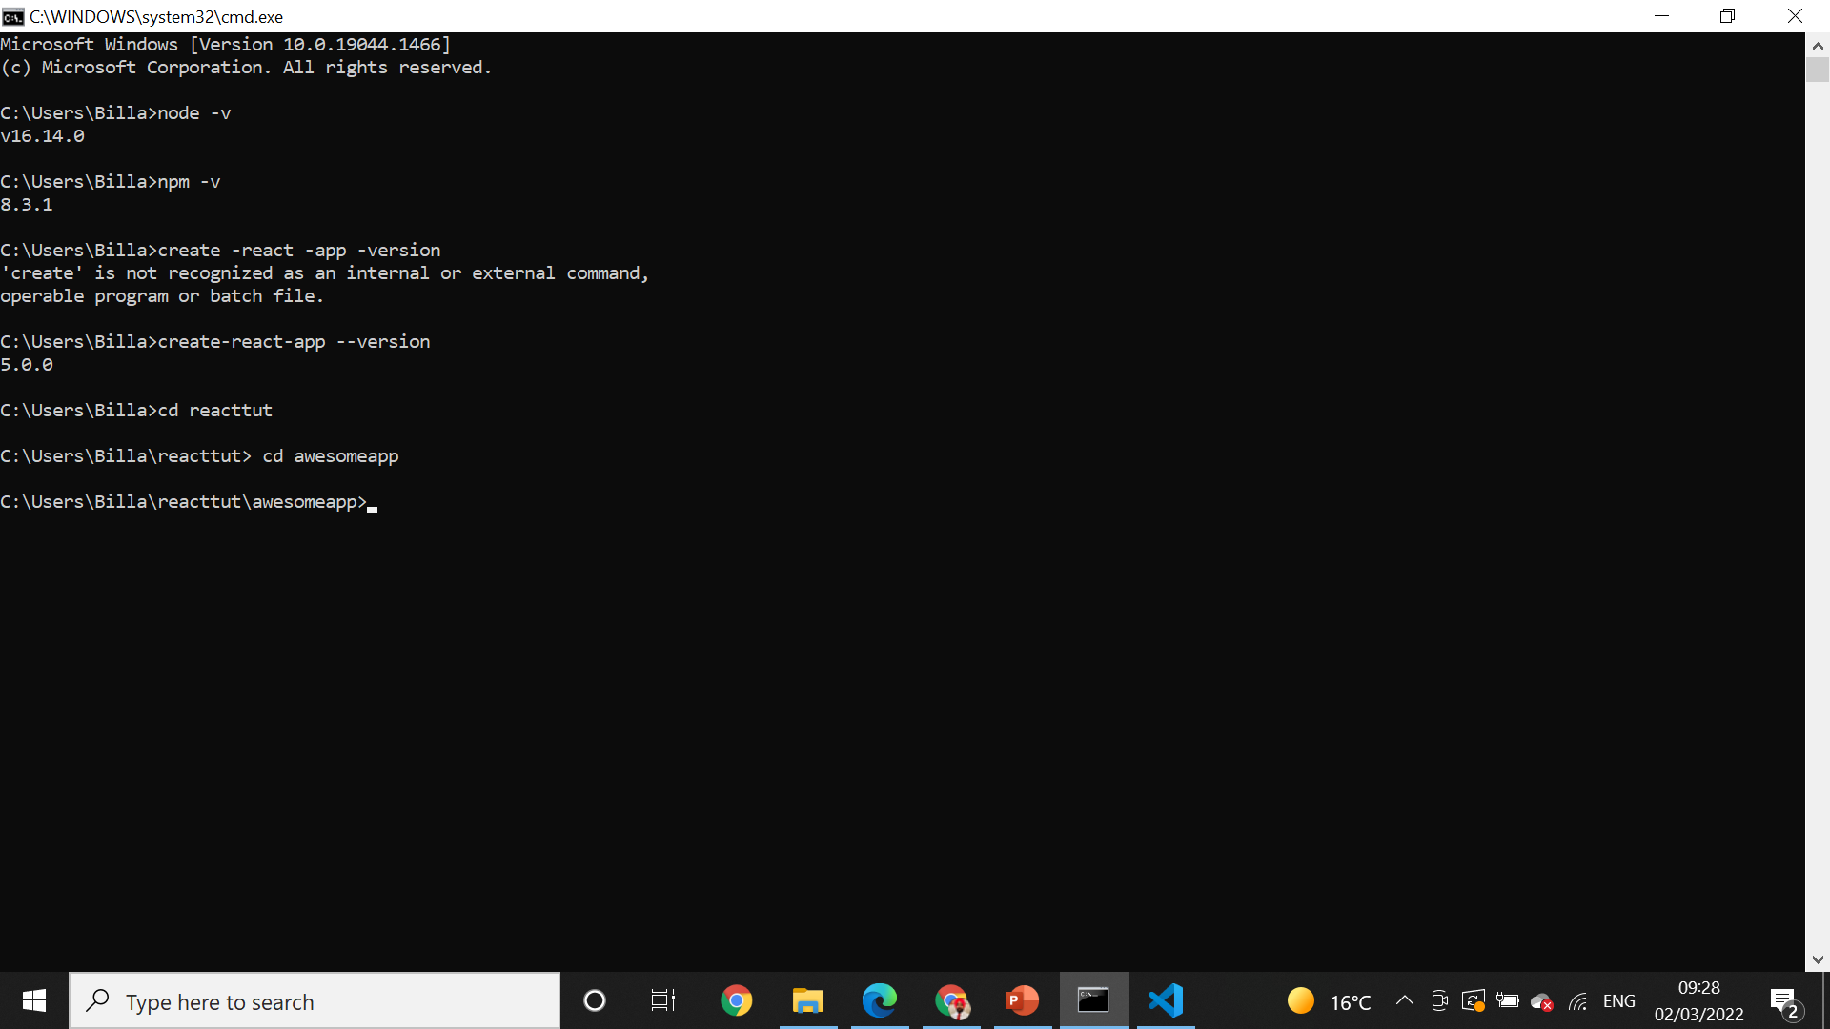
Change directory * CD

Slide 22
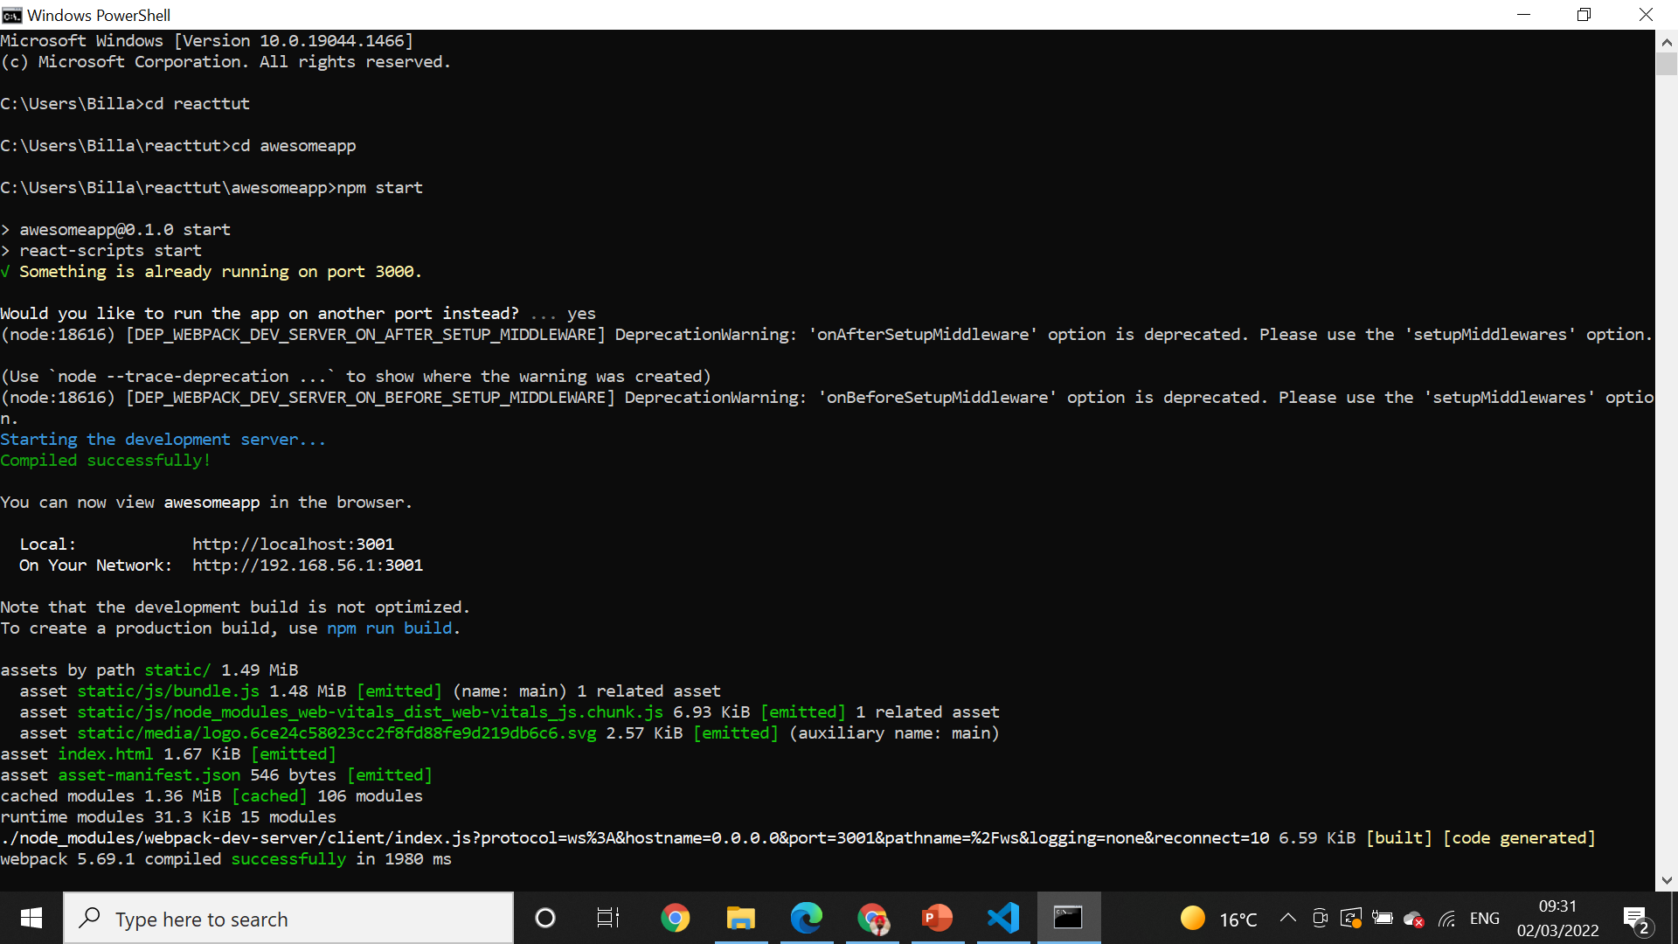
Npm start* npm start

Slide 23
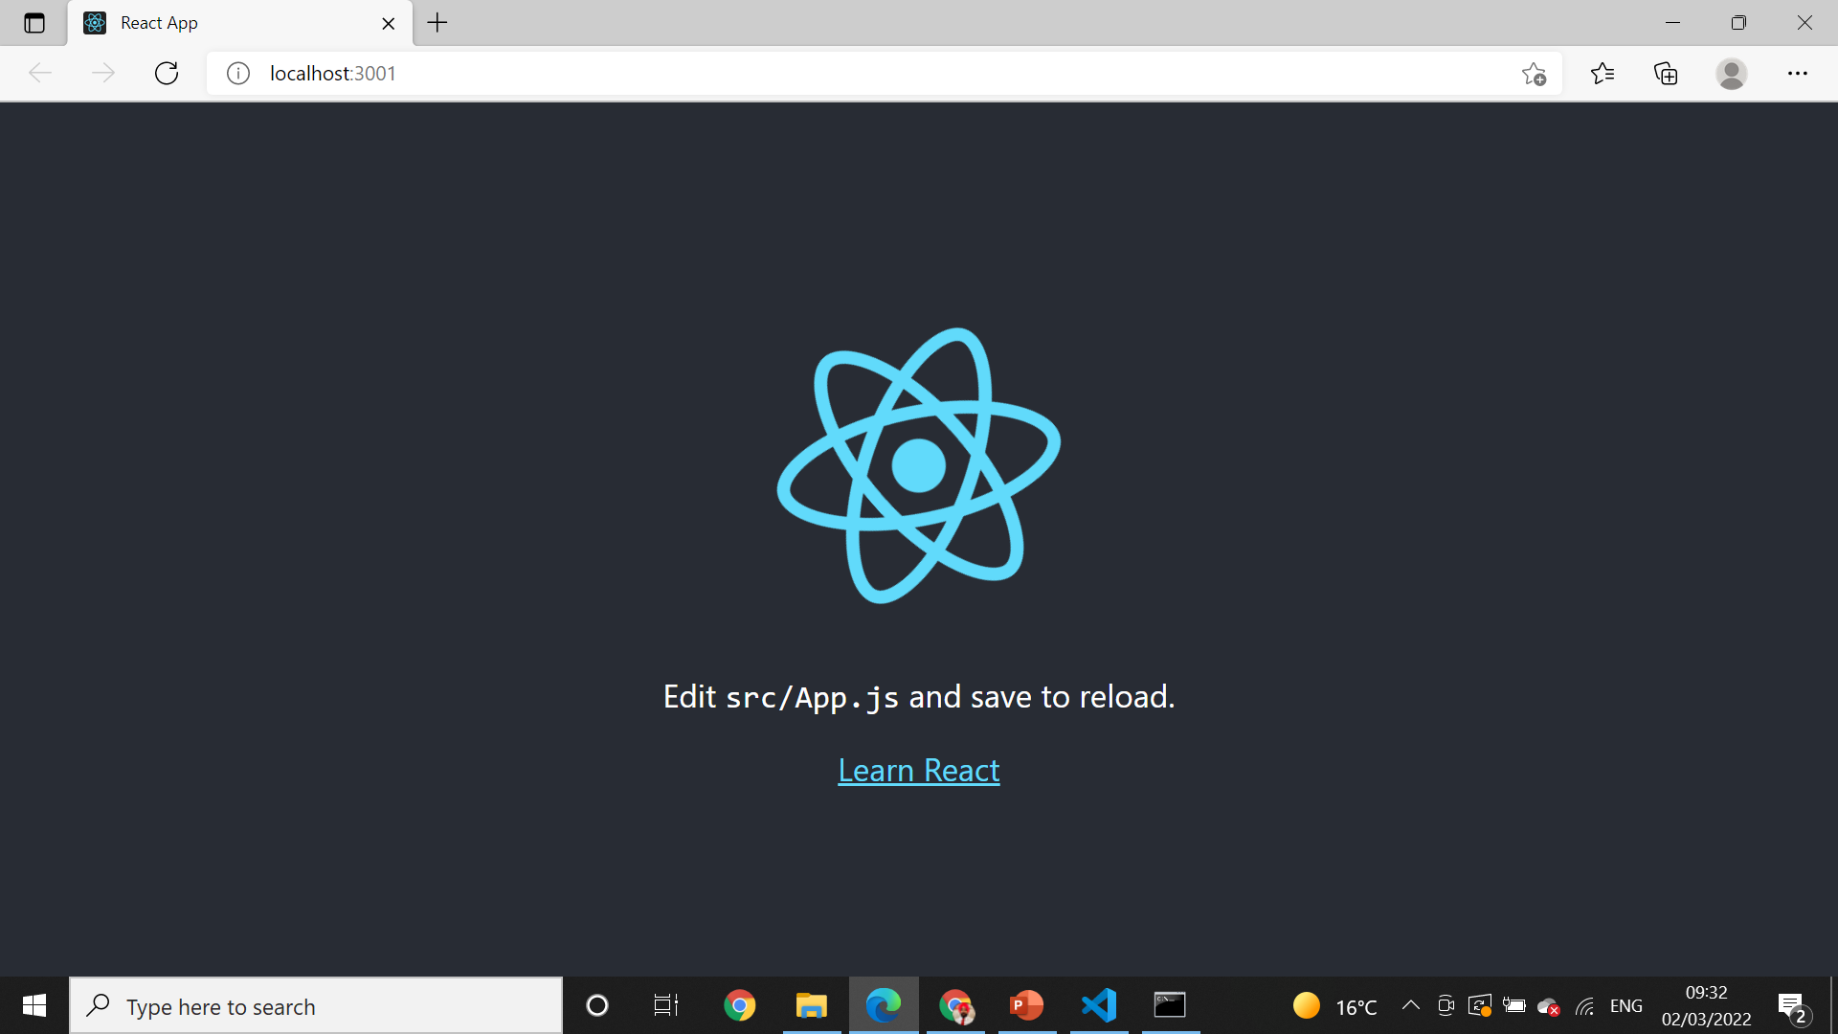
Local host

Slide 24
What is npm for?
npm is the package manager for the Node JavaScript platform. It puts modules in place so that node can find them, and manages dependency conflicts intelligently. It is extremely configurable to support a wide variety of use cases. Most commonly, it is used to publish, discover, install, and develop node programs.

Slide 25
MVC (Model-View-Controller)
MVC (Model-View-Controller) is a pattern in software design commonly used to implement user interfaces, data, and controlling logic. It emphasizes a separation between the software's business logic and display. This "separation of concerns" provides for a better division of labor and improved maintenance.

Slide 26
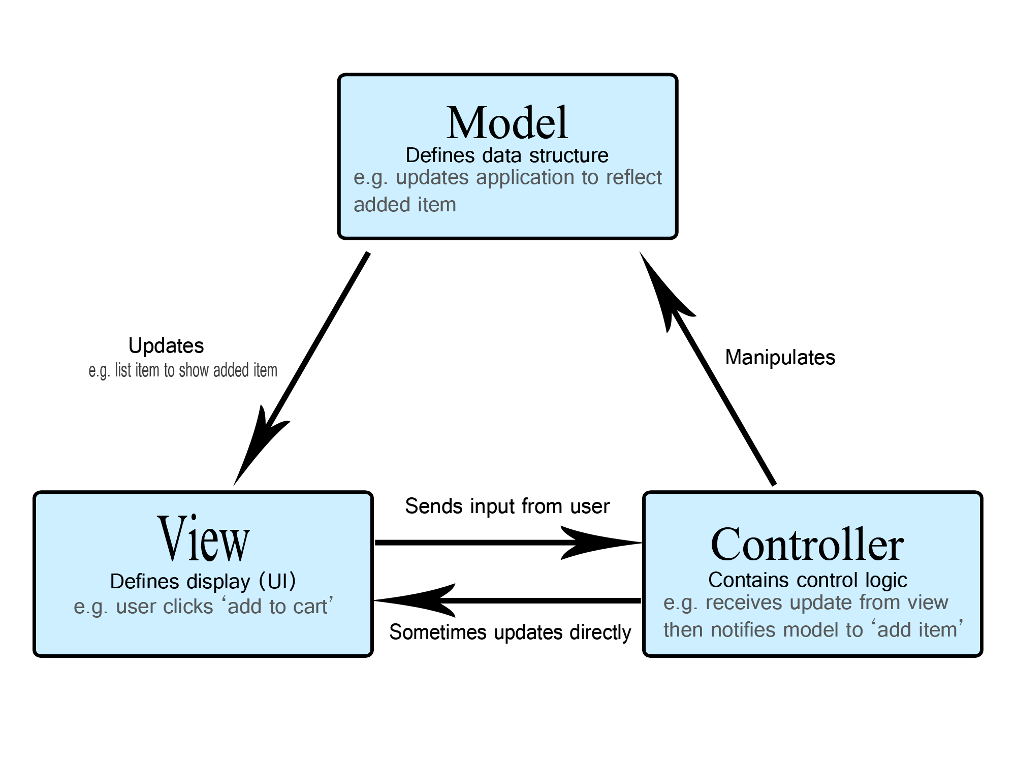
MVC (Model-View-Controller)

Slide 27
What is Gitignore?
The . gitignore file tells Git which files to ignore when committing your project to the GitHub repository. gitignore is located in the root directory of your repo. / will ignore directories with the name.
Ignored files are usually build artifacts and machine generated files that can be derived from your repository source or should otherwise not be committed

Slide 28
package. json file
The package. json file is the heart of any Node project. It records important metadata about a project which is required before publishing to NPM, and also defines functional attributes of a project that npm uses to install dependencies, run scripts, and identify the entry point to our package.

Slide 29
What is a package lock json file?
In version 5, npm introduced the package-lock. ... json file is to keep track of the exact version of every package that is installed so that a product is 100% reproducible in the same way even if packages are updated by their maintainers. This solves a very specific problem that package.

