Slide 2
Understand basics of React folder structure.
Create first react application.

Slide 3

React
React (also known as React.js or ReactJS) is a free and open-source front-end JavaScript library for building user interfaces based on UI components. It is maintained by Meta (formerly Facebook) and a community of individual developers and companies.

Slide 4

React (JavaScript library)
React can be used as a base in the development of single-page or mobile applications. However, React is only concerned with state management and rendering that state to the DOM, so creating React applications usually requires the use of additional libraries for routing, as well as certain client-side functionality.

Slide 5
React installation
Install NodeJS and NPM.
Install Visual Studio Code.
Install React from terminal .
npm install -g create-react-app

Slide 6
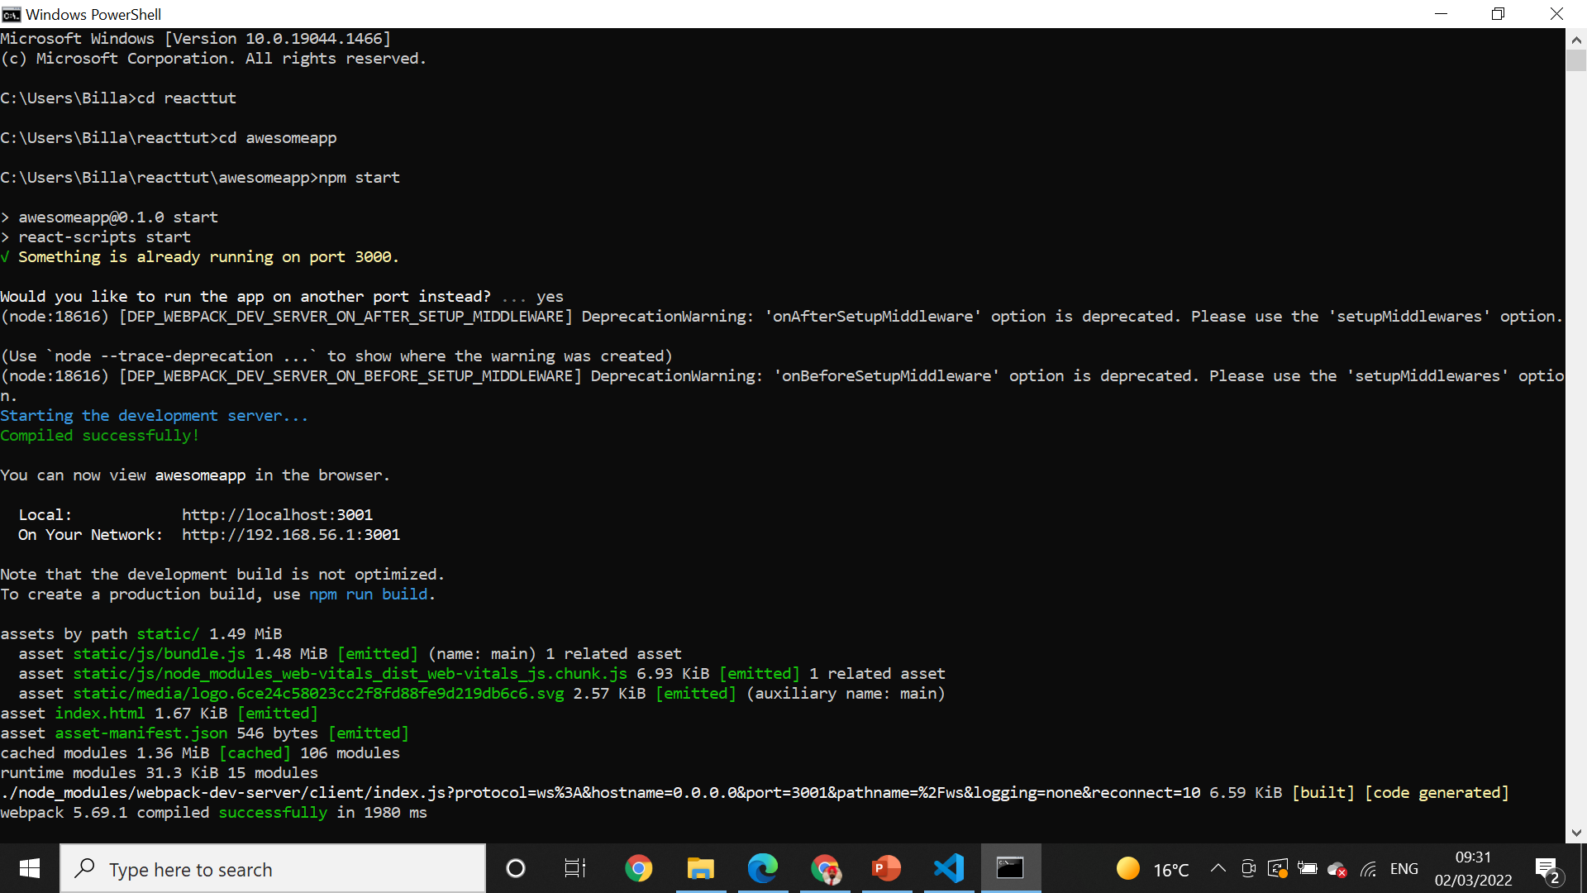
Npm start* npm start

Slide 7
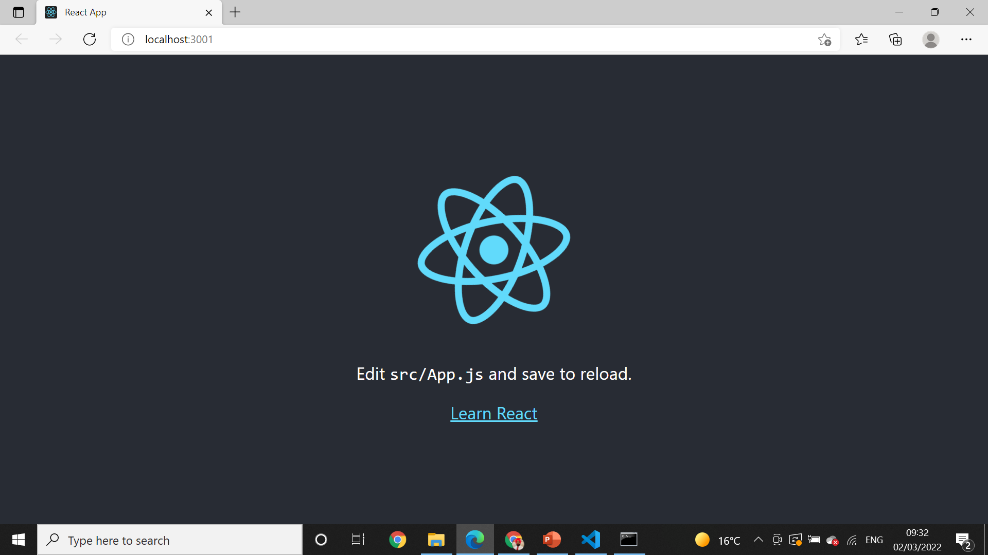
Local host .

Slide 8
How does React Work?
React creates a VIRTUAL DOM in memory.
Instead of manipulating the browser's DOM directly, React creates a virtual DOM in memory, where it does all the necessary manipulating, before making the changes in the browser DOM.
React only changes what needs to be changed!
React finds out what changes have been made, and changes only what needs to be changed.

Slide 9
React.JS History
Current version of React.JS is V17.0.2 (August 2021).
Initial Release to the Public (V0.3.0) was in July 2013.
React.JS was first used in 2011 for Facebook's Newsfeed feature.
Facebook Software Engineer, Jordan Walke, created it.
Current version of create-react-app is v4.0.3 (August 2021).
create-react-app includes built tools such as webpack, Babel, and ESLint.

Slide 10
How to use files in public folder in ReactJS ?
The public folder contains static files such as index.html, JavaScript library files, images, and other assets, etc. which you don’t want to be processed by webpack. Files in this folder are copied and pasted as they are directly into the build folder. Only files inside the `public` folder can be referenced from the HTML.

Slide 11
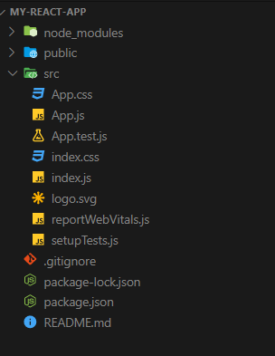
React folder structure

Slide 12
After creating a React application
After creating a React application, we will notice that in Terminal, it provides quick tips or commands that will help in executing the React application. For example :-
npm start - This command will start the development server.
npm run build - Bundles the app into static files for production.
npm test - starts the test runner.
npm run object - Removes this tool and copies build dependencies, configuration files, and scripts into the app directory. If you do this, you can’t go back!

Slide 13
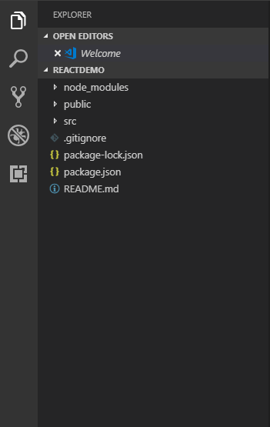
Folder Structure
The React application automatically creates required folders, as shown below.

Slide 14
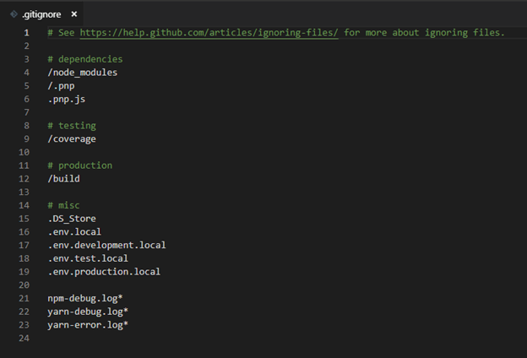
.gitignore
.gitignore - This file is the standard file which is used by source control tool git to identify which files and folders are need to be ignored while committing the code. Until and unless this file exists, the create-react-app command will not create a git repo in this folder.

Slide 15
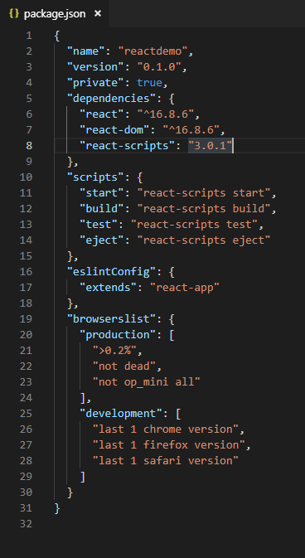
package.json
package.json – This file contains dependencies and scripts required for the project.

Slide 16
Package.json : contains all settings for React applications
name - points to name of your app.
version - refers to the current version that the application is using.
“private”: true - is a foolproof setting which avoids accidentally publishing of your react app as a public package in npm ecosystem.
Dependencies will contain all required node modules and versions required for the application.

Slide 17
package-lock.json
package-lock.json contain exact dependency tree to be installed in /node_modules. It helps while a team is working on private apps to ensure that they are working on the same version of dependencies and sub-dependencies. It also maintains a history of changes done in package.json so, that at any point of time, when required previous changes can be looked back in the package-lock.json file.

Slide 18
node_modules
This folder contains all dependencies and sub-dependencies specified in package.json used by React app. It contains more than 800 subfolders, this folder is automatically added in the .gitignore file

Slide 19
public -
This folder contains files which don’t require additional processing by webpack. The index.html file is considered as an entry point for the web application. Here, the favicon is a header icon and manifest.xml file contains configuration when your application is used for Android app

Slide 20
src -
This folder is the heart of React application as it contains JavaScript which needs to be processed by webpack. In this folder, there is a main component App.js, its related styles (App.css), test suite (App.test.js). index.js, and its style (index.css); which provide an entry point into the App. Lastly, it contains registerServiceWorker.js which takes care of caching and updating files for the end user. It helps in offline capability and faster page loading after the first visit.

Slide 21
Components
After all this, we add /Component folder in src to add our custom component and its related files and /Views folder for adding React views and its related files.

Slide 22
Practical

