Slide 2
Understand concept of React Dom, The Virtual Dom and React Elements.

Slide 3
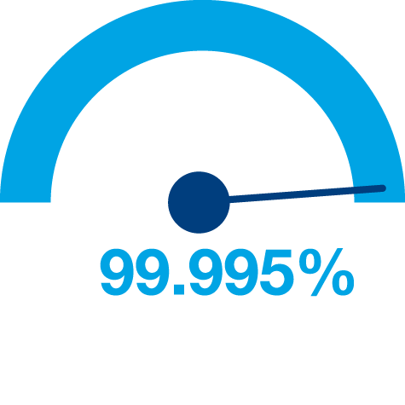



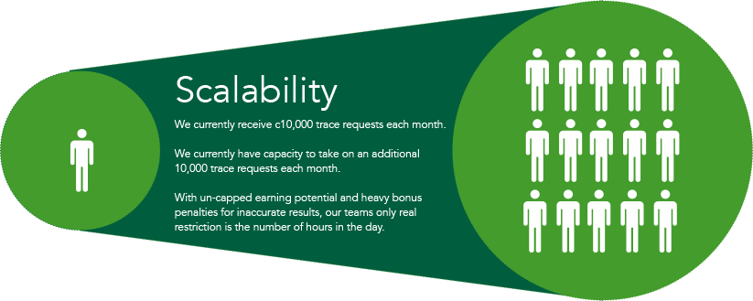
Principles of Web Design
Availability
Performance
Reliability
Scalability
Manageability
Cost
Notes:
Availability: The uptime of a website is absolutely critical to the reputation and functionality of many companies. For some of the larger online retail sites, being unavailable for even minutes can result in thousands or millions of dollars in lost revenue, so designing their systems to be constantly available and resilient to failure is both a fundamental business and a technology requirement. High availability in distributed systems requires the careful consideration of redundancy for key components, rapid recovery in the event of partial system failures, and graceful degradation when problems occur.
Performance: Website performance has become an important consideration for most sites. The speed of a website affects usage and user satisfaction, as well as search engine rankings, a factor that directly correlates to revenue and retention. As a result, creating a system that is optimized for fast responses and low latency is key.
Reliability: A system needs to be reliable, such that a request for data will consistently return the same data. In the event the data changes or is updated, then that same request should return the new data. Users need to know that if something is written to the system, or stored, it will persist and can be relied on to be in place for future retrieval.
Scalability: When it comes to any large distributed system, size is just one aspect of scale that needs to be considered. Just as important is the effort required to increase capacity to handle greater amounts of load, commonly referred to as the scalability of the system. Scalability can refer to many different parameters of the system: how much additional traffic can it handle, how easy is it to add more storage capacity, or even how many more transactions can be processed.
Manageability: Designing a system that is easy to operate is another important consideration. The manageability of the system equates to the scalability of operations: maintenance and updates. Things to consider for manageability are the ease of diagnosing and understanding problems when they occur, ease of making updates or modifications, and how simple the system is to operate. (I.e., does it routinely operate without failure or exceptions?)
Cost: Cost is an important factor. This obviously can include hardware and software costs, but it is also important to consider other facets needed to deploy and maintain the system. The amount of developer time the system takes to build, the amount of operational effort required to run the system, and even the amount of training required should all be considered. Cost is the total cost of ownership.

Slide 4
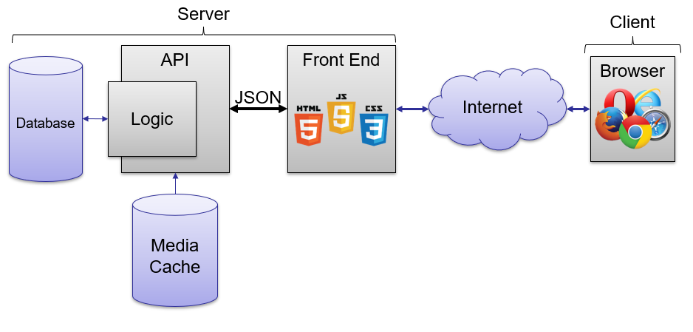
Core Components of Web Applications
UI (Front End (DOM, Framework))
Request Layer (Web API)
Back End (Database, Logic)

Slide 5
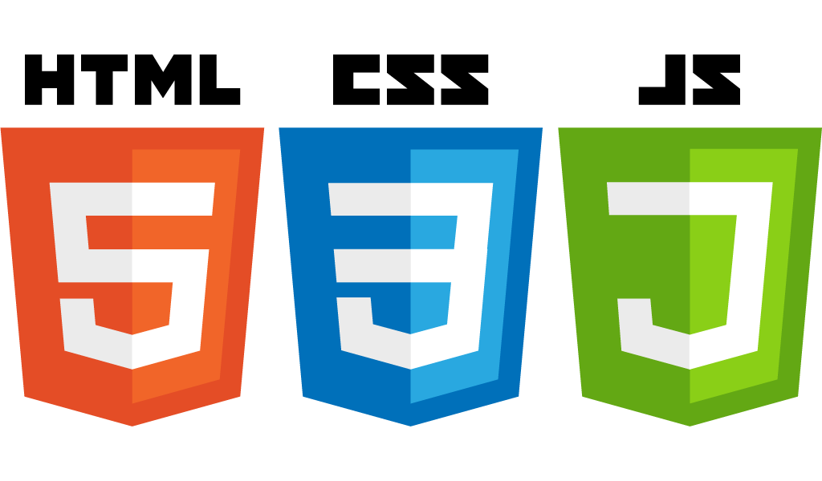
Front End Languages
HTML/CSS
JavaScript
Java (applets)
What is the most popular?
Answer: JavaScript/HTML/CSS is the only real option for front-end native languages and is basically the standard. But there are many variations on JavaScript that are used.

Slide 6

DOM (Document Object Model)
Document Object Model makes every addressable item in a web application an Object that can be manipulated for color, transparency, position, sound and behaviors.
Every HTML Tag is a DOM object

Slide 7
DOM (Document Object Model)
JavaScript
HTML
CSS
DOM

Slide 8
Document Object Model
According to W3C - "The W3C Document Object Model (DOM) is a platform and language-neutral interface that allows programs and scripts to dynamically access and update the content, structure, and style of a document."

Slide 9
Document Object Model
The document object represents the whole html document.
When html document is loaded in the browser, it becomes a document object. It is the root element that represents the html document. It has properties and methods. By the help of document object, we can add dynamic content to our web page.

Slide 10
Why DOM is required?
HTML is used to structure the web pages and Javascript is used to add behavior to our web pages. When an HTML file is loaded into the browser, the javascript can not understand the HTML document directly. So, a corresponding document is created(DOM). DOM is basically the representation of the same HTML document but in a different format with the use of objects.

Slide 11
Why DOM is required?
Javascript interprets DOM easily i.e javascript can not understand the tags(<h1>H</h1>) in HTML document but can understand object h1 in DOM. Now, Javascript can access each of the objects (h1, p, etc) by using different functions.

Slide 12
Why called an Object Model?
Documents are modeled using objects, and the model includes not only the structure of a document but also the behavior of a document and the objects of which it is composed of like tag elements with attributes in HTML.

Slide 13
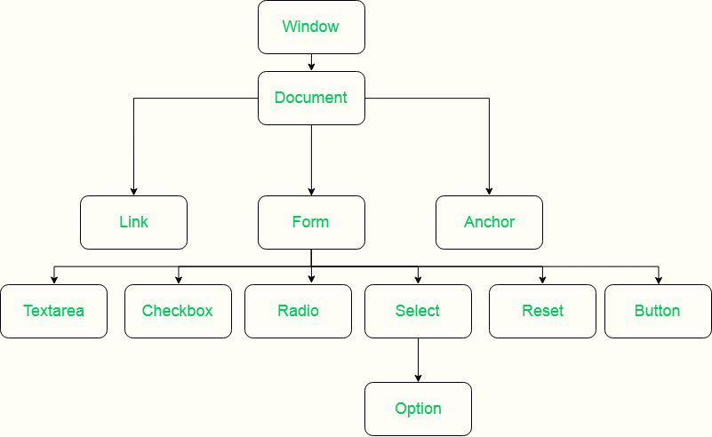
Properties of DOM:
Let’s see the properties of the document object that can be accessed and modified by the document object.

Slide 14
Properties of DOM:
Window Object: Window Object is always at top of the hierarchy.
Document object: When an HTML document is loaded into a window, it becomes a document object.
Form Object: It is represented by form tags.
Link Object: It is represented by link tags.
Anchor Object: It is represented by a href tags.
Form Control Elements:: Form can have many control elements such as text fields, buttons, radio buttons, and checkboxes, etc.

Slide 15
What is a Framework?
Software Framework designed to reduce overhead in web development
Types of Framework Architectures
Model-View-Controller (MVC)
Push vs Pull Based

Slide 16
What is a Framework?
Most MVC Frameworks user push-based architecture “action based” (Django, Ruby on Rails, Symfony, Stripes)
Pull-based or “component based” (Lift, Angular2, React)
Three Tier Organization
Client (Usually the browser running HTML/Javascipt/CSS)
Application (Running the Business Logic)
Database (Data Storage)

Slide 17
What is a Framework?
Types of Frameworks
Server Side: Django, Ruby on Rails
Client Side: Angular, React, Vue

Slide 18
Framework
Framework
JavaScript
HTML
CSS
DOM
Notes:
HTML: Creates the DOM
CSS: Decorates the DOM
JavaScript: Modifies the DOM Dynamically
Back End Language: (PHP, Python, Ruby, F#): Generates the DOM on the fly

Slide 19




Javascript Frameworks
AngularJS/Angular 2
ASP.net
React
Polymer 1.0
Ember.js
Vue.js

Slide 20
MVC (Model View Controller)
A Web Application Development Framework
Model (M):
Where the data for the DOM is stored and handled)
This is where the backend connects

Slide 21
MVC (Model View Controller)
View (V):
Think of this like a Page which is a single DOM
Where changes to the page are rendered and displayed
Control (C):
This handles user input and interactions
Buttons
Forms
General Interface

Slide 22
MVC Model
Controller
Update
Notify
Update
User Action
Model
View

Slide 23
What is a Backend?
All of the awesome that runs your application.
Web API
Connection layer between the frontend and backend
Connected through API calls (POST, GET, PUT, etc. )
Transmit Content from the Backend to the Frontend commonly in JSON Blobs
Service Architecture that drives everything (Where all the logic is)

Slide 24
What is a WebAPI?
The intermediate layer between front end and back-end systems
A “must have” if your APIs will be consumed by third-party services
Attention to details:
How consumable is the API (signature, content negotiation)?

Slide 25
What is a WebAPI?
Does it comply with standards (response codes, etc.)?
Is it secure?
How do you handle multiple versions?
Is it truly RESTful?

Slide 26
Virtual dom
The virtual DOM (VDOM) is a programming concept where an ideal, or “virtual”, representation of a UI is kept in memory and synced with the “real” DOM by a library such as ReactDOM. This process is called reconciliation

Slide 27
Virtual DOM
React uses Virtual DOM exists which is like a lightweight copy of the actual DOM(a virtual representation of the DOM). So for every object that exists in the original DOM, there is an object for that in React Virtual DOM.
It is exactly the same, but it does not have the power to directly change the layout of the document. Manipulating DOM is slow, but manipulating Virtual DOM is fast as nothing gets drawn on the screen.

Slide 28
Virtual DOM
So each time there is a change in the state of our application, virtual DOM gets updated first instead of the real DOM. You may still wonder, “Aren’t we doing the same thing again and doubling our work? How can this be faster?” Read below to understand how things will be faster using virtual DOM.

Slide 29
How Virtual DOM actually make the things faster:
When anything new is added to the application, a virtual DOM is created and it is represented as a tree. Each element in the application is a node in this tree. So, whenever there is a change in state of any element, a new Virtual DOM tree is created.
This new Virtual DOM tree is then compared with the previous Virtual DOM tree and make a note of the changes. After this, it finds the best possible ways to make these changes to the real DOM. Now only the updated elements will get rendered on the page again.

Slide 30
How Virtual DOM helps React
In react, everything is treated as a component be it a functional component or class component. A component can contain a state. Each time we change something in our JSX file or let’s put it in simple terms, whenever the state of any component is changed react updates it’s Virtual DOM tree.

Slide 31
How Virtual DOM helps React
Though it may sound that it is ineffective but the cost is not much significant as updating the virtual DOM doesn’t take much time. React maintains two Virtual DOM at each time, one contains the updated Virtual DOM and one which is just the pre-update version of this updated Virtual DOM.

Slide 32
How Virtual DOM helps React
It just mean that the changes to the real DOM are sent in batches instead of sending any update for a single change in the state of a component.
We have seen that the re-rendering of the UI is the most expensive part and React manages to do this most efficiently by ensuring that the Real DOM receives batch updates to re-render the UI. This entire proces of transforming changes to the real DOM is called Reconciliation

Slide 33
React Element
Elements are the smallest building blocks of React apps. An element specifies what should be there in our UI. An Element is a plain object describing what we want to appear in terms of the DOM nodes.

Slide 34
React Element
Creating a React Element is Cheap compared to DOM elements. An Element can be Created by using JSX or React without JSX
const element = <h1>Hello, world</h1>;
Object of type h1 and assigned it to a variable called as element. This element should be rendered into the Browser DOM, and for that we need a container

Slide 35
React Element
React Element - It is a simple object that describes a DOM node and its attributes or properties you can say. It is an immutable description object and you can not apply any methods on it.
React Component - It is a function or class that accepts an input and returns a React element.

