Slide 2
Understand concept of React Props and React Components.

Slide 3
React Components
Components are like functions that return HTML elements.

Slide 4
React Components
Components are independent and reusable bits of code. They serve the same purpose as JavaScript functions, but work in isolation and return HTML.

Slide 5
React Components
Components come in two types, Class components and Function components, in this tutorial we will concentrate on Function components.

Slide 6
Create Your First Component
When creating a React component, the component's name MUST start with an upper-case letter.
01
A class component must include the extends React. Component statement. This statement creates an inheritance to React.Component and gives your component access to React.Component's functions.
02
03
The component also requires a render() method, this method returns HTML.

Slide 7
Create Your First Component
When creating a React component, the component's name MUST start with an upper-case letter.
01
A class component must include the extends React. Component statement. This statement creates an inheritance to React.Component and gives your component access to React.Component's functions.
02
03
The component also requires a render() method, this method returns HTML.

Slide 8
Create Your First Component
When creating a React component, the component's name MUST start with an upper-case letter.
01
A class component must include the extends React. Component statement. This statement creates an inheritance to React.Component and gives your component access to React.Component's functions.
02
03
The component also requires a render() method, this method returns HTML.

Slide 9
Example
Create a Class component called Car
class Car extends React. Component
{
render() {
return <h2>Hi, I am a Car!</h2>;
}
}

Slide 10
Function Component
A Function component also returns HTML, and behaves much the same way as a Class component, but Function components can be written using much less code, are easier to understand.

Slide 11
Example
Create a Function component called Car
function Car()
{
return <h2>Hi, I am a Car!</h2>;
}

Slide 12
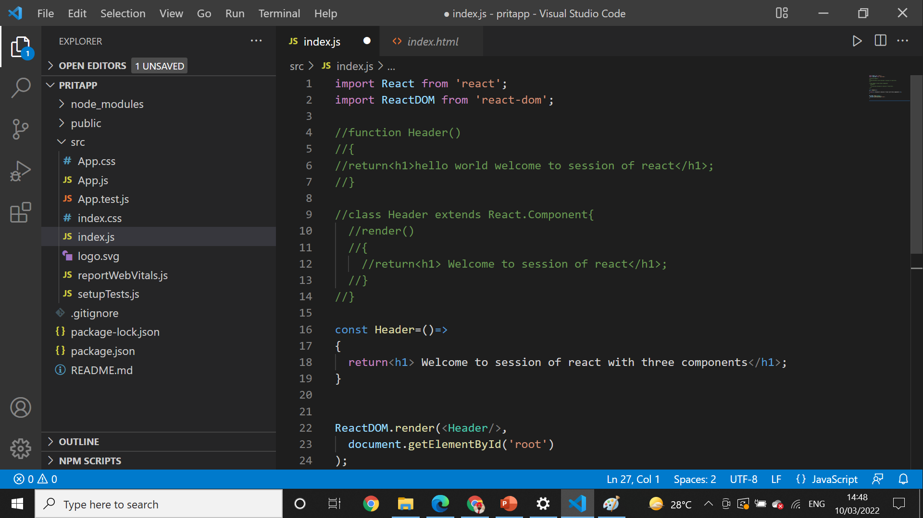
Example

Slide 13
Why Should You Use React?
React is remarkably flexible. Once you have learned it, you can use it on a vast variety of platforms to build quality user interfaces. React is a library, NOT a framework. Its library approach has allowed React to evolve into such a remarkable tool.
React was created with a single focus: to create components for web applications. A React component can be anything in your web application like a Button, Text, Label, or Grid.
React is Flexible

Slide 14
Why Should You Use React?
React is remarkably flexible. Once you have learned it, you can use it on a vast variety of platforms to build quality user interfaces. React is a library, NOT a framework. Its library approach has allowed React to evolve into such a remarkable tool.
React was created with a single focus: to create components for web applications. A React component can be anything in your web application like a Button, Text, Label, or Grid.
React is Flexible

Slide 15
Why Should You Use React?
React is remarkably flexible. Once you have learned it, you can use it on a vast variety of platforms to build quality user interfaces. React is a library, NOT a framework. Its library approach has allowed React to evolve into such a remarkable tool.
React was created with a single focus: to create components for web applications. A React component can be anything in your web application like a Button, Text, Label, or Grid.
React is Flexible

Slide 16
React Props
Props are arguments passed into React components.
Props are passed to components via HTML attributes.
Props stands for properties.

Slide 17
React Props
Props stand for "Properties."
They are read-only components. It is an object which stores the value of attributes of a tag and work similar to the HTML attributes.
It gives a way to pass data from one component to other components.
It is similar to function arguments. Props are passed to the component in the same way as arguments passed in a function.

Slide 18
React Props
Props are immutable so we cannot modify the props from inside the component. Inside the components, we can add attributes called props. These attributes are available in the component as this.props and can be used to render dynamic data in our render method.
When you need immutable data in the component, you have to add props to reactDom.render() method in the main.js file of your ReactJS project and used it inside the component in which you need

Slide 19
React Props
Props can be used to pass any kind of data such as:
String
Array
Integer
Boolean
Objects or,
Functions

Slide 20
React Props
To send props into a component, use the same syntax as HTML attributes:
Example
Add a "brand" attribute to the Car element:
const myelement = <Car brand="Ford" />;

Slide 21
React Props
The component receives the argument as a props object:
Example
Use the brand attribute in the component:
function Car(props) {
return <h2>I am a { props.brand }!</h2>;
}

Slide 22
Pass Data
Props are also how you pass data from one component to another, as parameters.

Slide 23
Example-Send the "brand" property from the Garage component to the Car component:
function Car(props) {
return <h2>I am a { props.brand }!</h2>;
}
function Garage() {
return (
<>
<h1>Who lives in my garage?</h1>
<Car brand="Ford" />
</>
);
}
ReactDOM.render(<Garage />, document.getElementById('root'));

Slide 24
React Props
Props stand for "Properties."
They are read-only components. It is an object which stores the value of attributes of a tag and work similar to the HTML attributes.
It gives a way to pass data from one component to other components.
It is similar to function arguments. Props are passed to the component in the same way as arguments passed in a function.

Slide 25
Properties validation
Properties validation is a useful way to force the correct usage of the components. This will help during development to avoid future bugs and problems, once the app becomes larger. It also makes the code more readable, since we can see how each component should be used.

Slide 26
Need of Validating Props in React JS
Props are used to passing the read-only attributes to React components. For the proper functioning of components and to avoid future bugs and glitches it is necessary that props are passed correctly. Hence, it is required to use props validation for improving react component’s performance.

Slide 27
Need of Validating
React JS has an inbuilt feature for validating props data type to make sure that values passed through props are valid. React components have a property called propTypes which is used to setup data type validation.

Slide 28
Syntax
The syntax to use propTypes is shown below.
class Component extends React.Component {
render() {}
}
Component.propTypes = {/* definition goes here*/};

Slide 29
Validators
Prop Types object contains a list of validators for basic data types, some of them are:
This means the prop can be of any data type.
PropTypes.any
This means the prop should be a boolean.
PropTypes.bool
This means the prop should be a number.
PropTypes.number

Slide 30
Validators
This means the prop should be a string.
PropTypes.string
This means the prop should be a function.
PropTypes.func
This means the prop should be an array.
PropTypes.array
This means the prop should be an object.
PropTypes.object

Slide 31
Validators
This means the prop should be a symbol.
PropTypes.symbol
This means the prop should be an instance of a particular JavaScript class.
PropTypes.instanceOf
This means the prop should be provided.
PropTypes.isRequired
This means the props should be one of several types of specified values.
PropTypes.oneOf()
This means the props must be an element.
PropTypes.element

Slide 32
Why PropTypes is used in React?
PropTypes are a mechanism to ensure that components use the correct data type and pass the right data, and that components use the right type of props, and that receiving components receive the right type of props.

Slide 33
What Do You Need to Know About React Web Development
Netflix is a very good React website example; as well as Salesforce, Yahoo Mail, Flipboard, and many React examples. Some of these were early adopters while others joined in late. What’s common to all of them is that, at some point, they took a decision to switch from a previous tech stack. Then, we need to ask, what makes this JS library stand out?

Slide 34
What Do You Need to Know About React Web Development
It is one of the most popular open-source JavaScript libraries today that prides itself upon enabling developers to build interactive user interfaces. Thus, there are popular websites built with React in abundance. It was originally developed as an internal technology for use within Facebook but became open-source in 2013

Slide 35
Popular React JS Websites List
Facebook
React was created by a software engineer at Facebook. Since then, Facebook has maintained the framework even though it remains open-source. As such, it would be unusual if Facebook does not use it while others do. There is a lot of interactivity on the Facebook website.

Slide 36
British Broadcasting Corporation
This is another one of the top websites built with React. The BBC has migrated its website since 2015 and it still uses it till now, although it moved to a new React-based application.Single Page Application built by the BBC World Service as a rendering platform.

Slide 37
Salesforce
Salesforce is another one of the React site examples that were an early adopter. According to Salesforce’ blog, the experience as more of a library than a framework. Particularly, because it is presentational and declarative, it could be built into existing projects, conveniently.

Slide 38
Asana
Yet another firmly established among top react websites is Asana. One of Asana’s primary motivations for migrating was to build a system that would be optimized for developers to be the most productive. They had a First Experience (FX) team whose goal was to deliver the maximum experience for first time users in the first few seconds. This FX team had to facilitate cohesion between Asana’s Luna framework and React.

Slide 39
Instacart
Instarcart joined the list of best React sites in 2016, when the grocery delivery and pick-up service moved the technology stack for its website, which had been built as a single-page application (SPA) using jQuery, Haml, Underscore, and Backbone. However, this app started having issues with performance and debugging as it grew in size.

Slide 40
Dropbox (HelloSign)
One of the best websites built with React is Dropbox. Last year, the Dropbox tech team documented how it migrated the HelloSign Editor from jQuery to React. Before then, it already used the library for the Signer. HelloSign is a company owned by Dropbox and it offers a way to electronically sign documents.

Slide 41
Scribd
Another one of the top websites built with React is the book subscription service, Scribd, which uses it for the frontend of its website. Initially, implementing it was challenging, due issues with updates. Particularly, the use of JSX for code in React made it ‘joyfully easy to read and write.’ The Scribd team was also motivated by the fact that it enjoyed good support from the developer community. Thus, coding in JSX was less challenging than the alternatives.

Slide 42
Practical

