Slide 2
understand the importance of Java programing
learn the comparative analysis between java and C++
identify the various features of Java
know the different operators and data types of java

Slide 3
What is JAVA?
Java is a programming language and a platform.

Slide 4
What is JAVA?
Java is a programming language and a platform.
Java is a high level, robust, object-oriented and secure programming language.

Slide 5
What is JAVA?
Java is a programming language and a platform.
Java is a high level, robust, object-oriented and secure programming language.
Java was developed by Sun Microsystems in the year 1995.

Slide 6
What is JAVA?
James Gosling is known as the father of Java.

Slide 7
What is JAVA?
James Gosling is known as the father of Java.
Before Java, its name was Oak.

Slide 8
Java Platforms / Editions
There are 4 platforms or editions of Java:
Java SE (Java Standard Edition)
Java EE (Java Enterprise Edition)
Java ME (Java Micro Edition)
JavaFX

Slide 9
Features of Java
Features of Java
Simple
Object Oriented
Platform Independent
Secure
Robust
Interpreted
Architectural Neutral
Multi threaded
Distributed
High Performance
Dynamic

Slide 10
Features of Java
Features of Java
Simple
Object Oriented
Platform Independent
Secure
Robust
Interpreted
Architectural Neutral
Multi threaded
Distributed
High Performance
Dynamic

Slide 11
Features of Java
Features of Java
Simple
Object Oriented
Platform Independent
Secure
Robust
Interpreted
Architectural Neutral
Multi threaded
Distributed
High Performance
Dynamic

Slide 12
Features of Java
Features of Java
Simple
Object Oriented
Platform Independent
Secure
Robust
Interpreted
Architectural Neutral
Multi threaded
Distributed
High Performance
Dynamic

Slide 13
Features of Java
Features of Java
Simple
Object Oriented
Platform Independent
Secure
Robust
Interpreted
Architectural Neutral
Multi threaded
Distributed
High Performance
Dynamic

Slide 14
Features of Java
Features of Java
Simple
Object Oriented
Platform Independent
Secure
Robust
Interpreted
Architectural Neutral
Multi threaded
Distributed
High Performance
Dynamic

Slide 15
Features of Java
Features of Java
Simple
Object Oriented
Platform Independent
Secure
Robust
Interpreted
Architectural Neutral
Multi threaded
Distributed
High Performance
Dynamic

Slide 16
Features of Java
Features of Java
Simple
Object Oriented
Platform Independent
Secure
Robust
Interpreted
Architectural Neutral
Multi threaded
Distributed
High Performance
Dynamic

Slide 17
Features of Java
Features of Java
Simple
Object Oriented
Platform Independent
Secure
Robust
Interpreted
Architectural Neutral
Multi threaded
Distributed
High Performance
Dynamic

Slide 18
Features of Java
Features of Java
Simple
Object Oriented
Platform Independent
Secure
Robust
Interpreted
Architectural Neutral
Multi threaded
Distributed
High Performance
Dynamic

Slide 19
Features of Java
Features of Java
Simple
Object Oriented
Platform Independent
Secure
Robust
Interpreted
Architectural Neutral
Multi threaded
Distributed
High Performance
Dynamic

Slide 20
Comparison between C++ and Java
Features | C++ | Java
Platform-independent | C++ is platform-dependent. | Java is platform-independent.
Mainly used for | C++ is mainly used for system programming. | Java is mainly used for application programming.
Goto | C++ supports the go to statement. | Java doesn't support the goto statement.
Multiple inheritance | C++ supports multiple inheritance. | Java doesn't support multiple inheritance. It can be achieved by interfaces in java.
Operator Overloading | C++ supports operator overloading. | Java doesn't support operator overloading.
Pointers | C++ supports pointers. You can write pointer program in C++. | You can't write the pointer program in java.

Slide 21
Comparison between C++ and Java
Features | C++ | Java
Compiler and Interpreter | C++ uses compiler only. | Java uses compiler and interpreter both.
Call by Value and Call by reference | C++ supports both call by value and call by reference. | Java supports call by value only. There is no call by reference in java.
Structure and Union | C++ supports structures and unions. | Java doesn't support structures and unions.
Thread Support | C++ doesn't have built-in support for threads. It relies on third-party libraries for thread support. | Java has built-in thread support.
Hardware | C++ is nearer to hardware. | Java is not so interactive with hardware.

Slide 22
Comparison between C++ and Java
Features | C++ | Java
Documentation comment | C++ doesn't support documentation comment. | Java supports documentation comment (/** ... */) to create documentation for java source code.
Virtual Keyword | C++ supports virtual keyword so that we can decide whether or not override a function. | Java has no virtual keyword.Non-static methods are virtual by default.
Inheritance Tree | C++ creates a new inheritance tree always. | Java uses a single inheritance tree always because all classes are the child of Object class in java. The object class is the root of the inheritance tree in java.

Slide 23
Structure of Java Program
Documentation Section | Suggested
Package Statement | Optional
Import Statement | Optional
Interface Statement | Optional
Class Definitions | Optional
Main Method Class { Main method Definition } | Essential

Slide 24
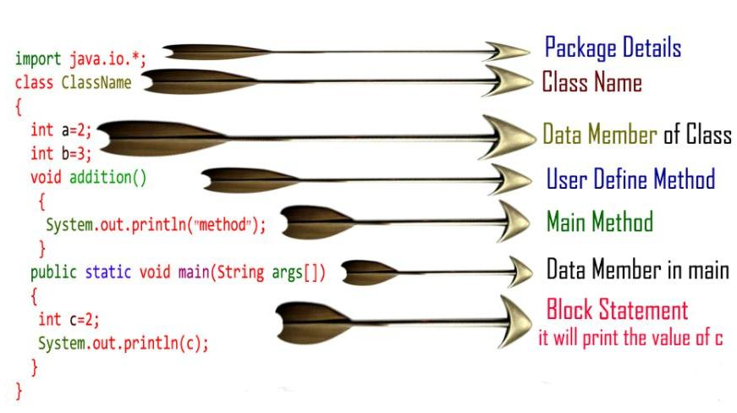
Sample Program

Slide 25
Operators in Java
Operator in Java is a symbol which is used to perform operations. For example: +, -, *, / etc. There are many types of operators in Java which are given below:
Unary Operator
Arithmetic Operator
Shift Operator
Relational Operator
Bitwise Operator
Logical Operator
Ternary Operator
Assignment Operator

Slide 26
Operators & their Precedence
Operator Type | Category | Precedence
Unary | postfix | expr++ expr--
 | prefix | ++expr --expr
Arithmetic | multiplicative | * / %
 | additive | + -
Shift | shift | << >> >>>
Relational | comparison | < > <= >= instanceof
 | equality | == !=
Bitwise | bitwise AND | &
 | bitwise exclusive OR | ^
 | bitwise inclusive OR | |

Slide 27
Operators & their Precedence
Operator Type | Category | Precedence
Logical | logical AND | &&
 | logical OR | ||
Ternary | ternary | ? :
Assignment | assignment | = += -= *= /= %= &= ^= |= <<= >>= >>>=

Slide 28
Data Types
Data types specify the different sizes and values that can be stored in the variable. There are two types of data types in Java:
Primitive data types: The primitive data types include boolean, char, byte, short, int, long, float and double.
Non-primitive data types: The non-primitive data types include Classes, Interfaces, and Arrays.

Slide 29
Data Types
Data types specify the different sizes and values that can be stored in the variable. There are two types of data types in Java:
Primitive data types: The primitive data types include boolean, char, byte, short, int, long, float and double.
Non-primitive data types: The non-primitive data types include Classes, Interfaces, and Arrays.

Slide 30
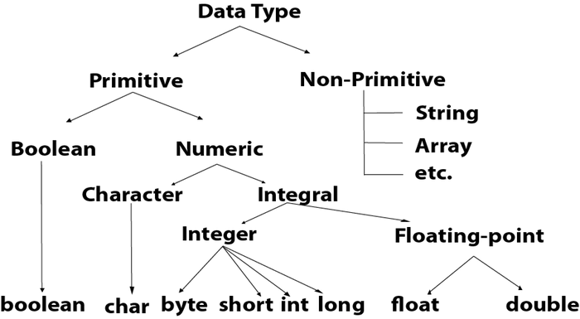
Data Types

Slide 31
Data Type with default values
Data Type | Default Value | Default size
boolean | false | 1 bit
char | '\u0000' | 2 byte
byte | 0 | 1 byte
short | 0 | 2 byte
int | 0 | 4 byte
long | 0L | 8 byte
float | 0.0f | 4 byte
double | 0.0d | 8 byte

Slide 32
Boolean Data Type
The Boolean data type is used to store only two possible values:
true
false.
Example: Boolean one = false

Slide 33
Byte Data Type
It is an 8-bit signed two's complement integer.
Its value-range lies between -128 to 127 (inclusive).
Its minimum value is -128 and maximum value is 127. Its default value is 0.
It saves space because a byte is 4 times smaller than an integer.
Example: byte a = 10, byte b = -20

Slide 34
Byte Data Type
It is an 8-bit signed two's complement integer.
Its value-range lies between -128 to 127 (inclusive).
Its minimum value is -128 and maximum value is 127. Its default value is 0.
It saves space because a byte is 4 times smaller than an integer.
Example: byte a = 10, byte b = -20

Slide 35
Byte Data Type
It is an 8-bit signed two's complement integer.
Its value-range lies between -128 to 127 (inclusive).
Its minimum value is -128 and maximum value is 127. Its default value is 0.
It saves space because a byte is 4 times smaller than an integer.
Example: byte a = 10, byte b = -20

Slide 36
Byte Data Type
It is an 8-bit signed two's complement integer.
Its value-range lies between -128 to 127 (inclusive).
Its minimum value is -128 and maximum value is 127. Its default value is 0.
It saves space because a byte is 4 times smaller than an integer.
Example: byte a = 10, byte b = -20

Slide 37
Short Data Type
The short data type is a 16-bit signed two's complement integer.
Its value-range lies between -32,768 to 32,767 (inclusive).
A short data type is 2 times smaller than an integer.
Example: short s = 10000, short r = -5000

Slide 38
Short Data Type
The short data type is a 16-bit signed two's complement integer.
Its value-range lies between -32,768 to 32,767 (inclusive).
A short data type is 2 times smaller than an integer.
Example: short s = 10000, short r = -5000

Slide 39
Short Data Type
The short data type is a 16-bit signed two's complement integer.
Its value-range lies between -32,768 to 32,767 (inclusive).
A short data type is 2 times smaller than an integer.
Example: short s = 10000, short r = -5000

Slide 40
int data type
The int data type is a 32-bit signed two's complement integer.
Its value-range lies between - 2,147,483,648 (-2^31) to 2,147,483,647 (2^31 -1) (inclusive).
Example: int a = 100000, int b = -200000

Slide 41
int data type
The int data type is a 32-bit signed two's complement integer.
Its value-range lies between - 2,147,483,648 (-2^31) to 2,147,483,647 (2^31 -1) (inclusive).
Example: int a = 100000, int b = -200000

Slide 42
Float Data Type
The float data type is a single-precision 32-bit IEEE 754 floating point.
Its value range is unlimited.
The float data type should never be used for precise values, such as currency.
Its default value is 0.0F.
Example: float f1 = 234.5f

Slide 43
Float Data Type
The float data type is a single-precision 32-bit IEEE 754 floating point.
Its value range is unlimited.
The float data type should never be used for precise values, such as currency.
Its default value is 0.0F.
Example: float f1 = 234.5f

Slide 44
Float Data Type
The float data type is a single-precision 32-bit IEEE 754 floating point.
Its value range is unlimited.
The float data type should never be used for precise values, such as currency.
Its default value is 0.0F.
Example: float f1 = 234.5f

Slide 45
Float Data Type
The float data type is a single-precision 32-bit IEEE 754 floating point.
Its value range is unlimited.
The float data type should never be used for precise values, such as currency.
Its default value is 0.0F.
Example: float f1 = 234.5f

Slide 46
Double Data Type
The double data type is a double-precision 64-bit IEEE 754 floating point.
Its value range is unlimited.
The double data type is generally used for decimal values just like float.
Example: double d1 = 12.3

Slide 47
Double Data Type
The double data type is a double-precision 64-bit IEEE 754 floating point.
Its value range is unlimited.
The double data type is generally used for decimal values just like float.
Example: double d1 = 12.3

Slide 48
Double Data Type
The double data type is a double-precision 64-bit IEEE 754 floating point.
Its value range is unlimited.
The double data type is generally used for decimal values just like float.
Example: double d1 = 12.3

Slide 49
Char Data Type
The char data type is a single 16-bit Unicode character.
Its value-range lies between '\u0000' (or 0) to '\uffff' (or 65,535 inclusive).
The char data type is used to store characters.
Example: char letterA = 'A'

Slide 50
Char Data Type
The char data type is a single 16-bit Unicode character.
Its value-range lies between '\u0000' (or 0) to '\uffff' (or 65,535 inclusive).
The char data type is used to store characters.
Example: char letterA = 'A'

Slide 51
Char Data Type
The char data type is a single 16-bit Unicode character.
Its value-range lies between '\u0000' (or 0) to '\uffff' (or 65,535 inclusive).
The char data type is used to store characters.
Example: char letterA = 'A'

