Slide 2
Learn the basics of JDK,JRE and JVM
Understand the working of JDK,JRE and JVM

Slide 3
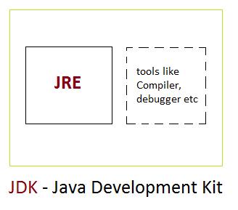
What is JDK
JDK stand for java development kit .
It is used to build and develop the java program.
It internally contains JRE.
It contains the compiler and debugger.

Slide 4
What is JDK?
It contains all the related set of libraries and files to build and compile the java program.
Without JDK we cant build any java program

Slide 5
Basic JDK Tools
The following are the basic tools that becomes the foundation of Java Development Kit.
Javac
Java
Javadoc
Appletviewer
Jar

Slide 6
Javac
Javac is the compiler for the Java programming language.
It is used to compile .java file.
It creates a class file which can be run by using java command.
Example: c:javac TestFile.java

Slide 7
Java & Javadoc
When a class file has been created, the java command can be used to run the Java program.
Example: c:java TestFile.class
JavaDoc is an API documentation generator for the Java language, which generates documentation in HTML format from Java source code.

Slide 8
Appletviewer & jar
Appletviewer run and debug applets without a web browser, its standalone command-line program to run Java applets.
The jar is (manage Java archive) a package file format that contains class, text, images and sound files for a Java application or applet gathered into a single compressed file.

Slide 9
What is JVM
It is:
A specification where working of Java Virtual Machine is specified. But implementation provider is independent to choose the algorithm. Its implementation has been provided by Oracle and other companies.

Slide 10
What is JVM
An implementation Its implementation is known as JRE (Java Runtime Environment).
Runtime Instance Whenever you write java command on the command prompt to run the java class, an instance of JVM is created.

Slide 11
What is JVM
Mostly in other Programming Languages, compiler produce code for a particular system but Java compiler produce Bytecode for a Java Virtual Machine.
When we compile a Java program, then bytecode is generated that can be used to run on any platform.
It is the medium which compiles Java code to bytecode which gets interpreted on a different machine and hence it makes it Platform/Operating system independent.

Slide 12
Platform Independent
Java is called platform independent because of Java Virtual Machine.
JVM is the main component of Java architecture.
As different computers with the different operating system have their JVM, when we submit a .class file to any operating system, JVM interprets the bytecode into machine level language.

Slide 13
Platform Independent
A program of JVM is written in C Programming Language, and JVM is Operating System dependent.
JVM is responsible for allocating the necessary memory needed and also responsible for deallocating the memory space not required by the Java program.

Slide 14
Working of JVM
The JVM performs following operation:
Loads code
Verifies code
Executes code
Provides runtime environment
Class Loader
Byte code Verifier
Execution Engine

Slide 15
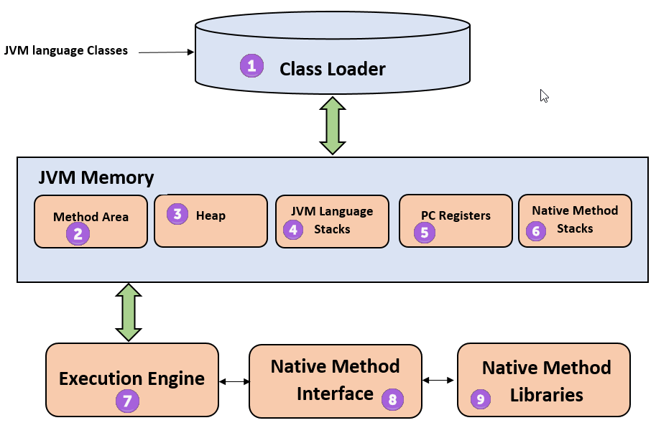
JVM Architecture

Slide 16
JVM Architecture
Class loader
The class loader is a subsystem used for loading class files. It performs three major functions viz. Loading, Linking, and Initialization.
2) Method Area
JVM Method Area stores class structures like metadata, the constant runtime pool, and the code for methods.

Slide 17
JVM Architecture
3) Heap
All the Objects, their related instance variables, and arrays are stored in the heap.
This memory is common and shared across multiple threads.

Slide 18
JVM Architecture
4) JVM language Stacks
Java language Stacks store local variables, and it’s partial results.
Each thread has its own JVM stack, created simultaneously as the thread is created.
A new frame is created whenever a method is invoked, and it is deleted when method invocation process is complete.

Slide 19
JVM Architecture
5) PC Registers
PC register store the address of the Java virtual machine instruction which is currently executing.
In Java, each thread has its separate PC register.
6) Native Method Stacks
Native method stacks hold the instruction of native code depends on the native library.
It is written in another language instead of Java.

Slide 20
JVM Architecture
7) Execution Engine
It is a type of software used to test hardware, software, or complete systems.
The test execution engine never carries any information about the tested product.

Slide 21
JVM Architecture
8) Native Method interface
The Native Method Interface is a programming framework that Java code which is running in a JVM to call by libraries and native applications.
9) Native Method Libraries
Native Libraries is a collection of the Native Libraries(C, C++) which are needed by the Execution Engine.

Slide 22
What is JRE?
A Java runtime environment (JRE) is a set of components to create and run a Java application.
A JRE is part of a Java development kit (JDK).
A JRE is made up of :
Java virtual machine (JVM)
Java class libraries
Java class loader.

Slide 23
Working of JRE
Once we write any source code, we have to save it with the .java extension.
Next, we compile our program using the “javac” command in command prompt.
It translates the code to the bytecode which is platform-independent.
When we compile our program, it will generate a .class which has the bytecode for the equivalent java file. And that bytecode is executed on any platform having the JRE.

Slide 24
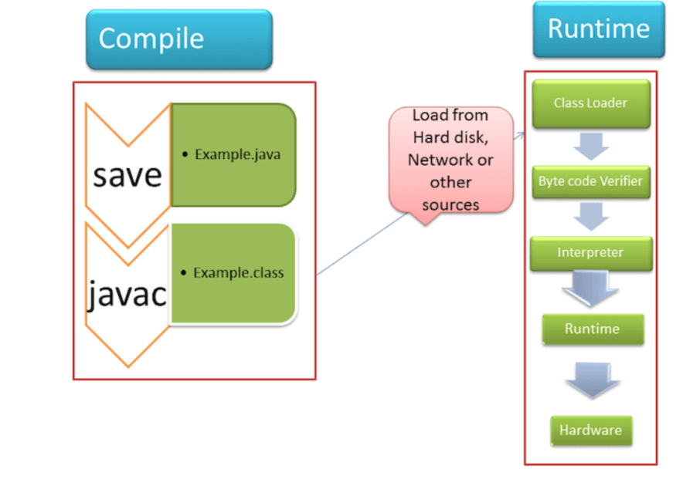
Working of JRE

Slide 25
Working of JRE
The workflow is explained below.
ClassLoader
It loads the various classes dynamically in the JVM (Java Virtual Machine), which are essential for executing the program. After JVM started following three class loader are used:
Bootstrap class loader
Extension class loader
System class loader

Slide 26
Working of JRE
Byte code verifier
It verifies the byte code during the run time so that the code doesn’t make any disturbance for the interpreter.
The codes are interpreted, only if it passes the tests of the bytecode verifier that check the formatting and for illegal code.

Slide 27
Working of JRE
Interpreter
When class loaded and code gets verified, then it reads the assembly code line by line and process the following two functions:
It executes the Byte Code.
Make appropriate calls to the integrated hardware.

Slide 28
Difference Between JDK,JRE and JVM
JDK | JRE | JVM
The full form of JDK is Java Development Kit. | The full form of JRE is Java Runtime Environment. | The full form of JVM is Java Virtual Machine.
JDK is platform dependent. | JRE is also platform dependent. | JVM is platform-independent.
JDK is a software development kit to develop applications in Java. | It is a software bundle which provides Java class libraries with necessary components to run Java code. | JVM executes Java byte code and provides an environment for executing it.
It is the superset of JRE | It is the subset of JDK. | JVM is a subset of JRE.
JDK comes with the installer. | JRE only contain environment to execute source code. | JVM bundled in both software JDK and JRE.

Slide 29
Difference Between JDK,JRE and JVM
JDK | JRE | JVM
The JDK enables developers to create Java programs that can be executed and run by the JRE and JVM. | The JRE is the part of Java that creates the JVM. | It is the Java platform component that executes source code.
It contains tools for developing, debugging, and monitoring java code. | It contains class libraries and other supporting files that JVM requires to execute the program. | Software development tools are not included in JVM.

