Slide 2
learn the basic concept of Arrays
understand the different types of Arrays
implementation difference in one dimensional and multi-dimensional Array

Slide 3
Arrays
Arrays are used to store multiple values in a single variable, instead of declaring separate variables for each value.
It is an object which contains elements of a similar data type.
The elements of an array are stored in a contiguous memory location.

Slide 4
Arrays
We can store only a fixed set of elements in a Java array.
Array in Java is index-based, the first element of the array is stored at the 0th index, 2nd element is stored on 1st index and so on.

Slide 5
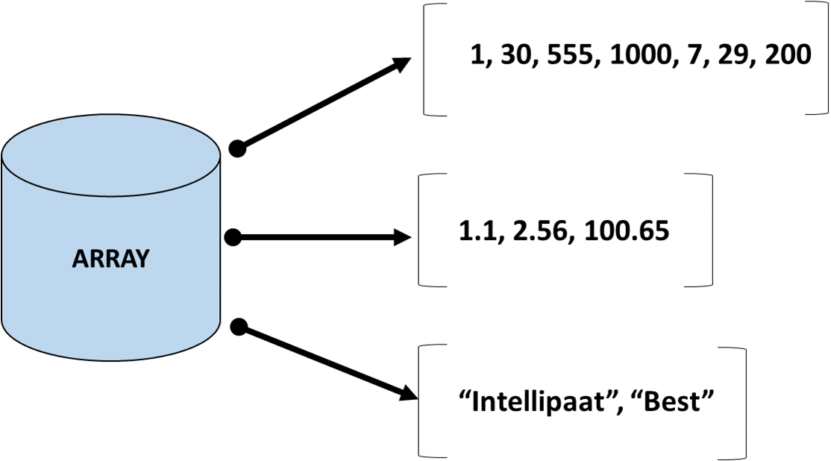
Arrays

Slide 6
Arrays
In Java all arrays are dynamically allocated.

Slide 7
Arrays
In Java all arrays are dynamically allocated.
Since arrays are objects in Java, we can find their length using the object property length.

Slide 8
Arrays
To declare an array, define the variable type with square brackets:
type var-name[];
OR
type[] var-name;

Slide 9
Arrays
The size of an array must be specified by an int or short value and not long.
The direct superclass of an array type is Object.
Every array type implements the interfaces Cloneable and java.io.Serializable.
Java array can be also be used as a static field, a local variable or a method parameter.

Slide 10
Representation of Array Elements
Element (at index 8)
First Index
0 | 1 | 2 | 3 | 4 | 5 | 6 | 7 | 8 | 9
Indices
Array length is 10

Slide 11
Types of Array
Types of Arrays
Single Dimensional Array
Multi Dimensional Array

Slide 12
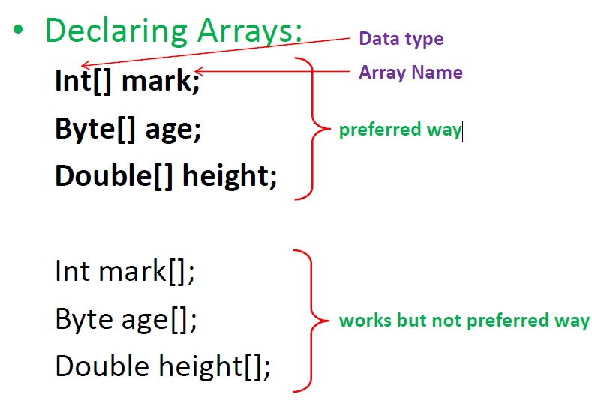
Declaration

Slide 13
Single Dimensional Array Declaration
Syntax:
type var-name[];
OR
type[] var-name;
Example:
int intArray[];
or int[] intArray;

Slide 14
Instantiating an Array
When an array is declared, only a reference of array is created.
To actually create or give memory to array, you create an array like this:
The general form of new as it applies to one-dimensional arrays appears as follows:
var-name = new type [size];

Slide 15
Example
int intArray[]; //declaring array
intArray = new int[20]; // allocating memory to array
OR
int[] intArray = new int[20]; // combining both statements in one

Slide 16
Array Literal
In a situation, where the size of the array and variables of array are already known, array literals can be used.
Example:
int[] intArray = new int[]{ 1,2,3,4,5,6,7,8,9,10 }; // Declaring array literal

Slide 17
Accessing Array Elements using for Loop
Each element in the array is accessed via its index.
The index begins with 0 and ends at (total array size)-1.
All the elements of array can be accessed using Java for Loop.

Slide 18
Accessing Array Elements using for Loop
Example: // accessing the elements of the specified array
for (int i = 0; i < arr.length; i++)
System.out.println("Element at index " + i + " : "+ arr[i]);

Slide 19
Example
class Testarray{
public static void main(String args[])
{
int a[]=new int[5];//declaration and instantiation
a[0]=10;//initialization
a[1]=20;
a[2]=70;
a[3]=40;
a[4]=50;
//traversing array
for(int i=0;i<a.length;i++)//length is the property of array
System.out.println(a[i]);
}}

Slide 20
For-each Loop for Array
We can also print the Java array using for-each loop.
The Java for-each loop prints the array elements one by one.
It holds an array element in a variable, then executes the body of the loop.

Slide 21
For-each Loop for Array
Syntax:
for(data_type variable:array)
{
//body of the loop
}

Slide 22
Example
class Testarray1{
public static void main(String args[]){
int arr[]={33,3,4,5};
//printing array using for-each loop
for(int i:arr)
System.out.println(i);
}}

Slide 23
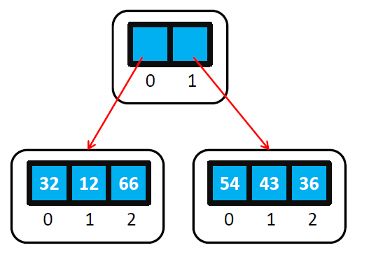
Two Dimensional Array
Int[ ][ ] har=new int[2][3];
har[0][0]=32;
har[0][1]=12;
har[0][2]=66;
har[1][0]=54;
har[1][1]=43;
har[1][2]=36;

Slide 24
Multidimensional Array
Multidimensional Arrays can be defined in simple words as array of arrays. Data in multidimensional arrays are stored in tabular form (in row major order).
Syntax:
data_type[1st dimension][2nd dimension][]..[Nth dimension] array_name = new data_type[size1][size2]….[sizeN];

Slide 25
Example
class MultidimensionalArray {
public static void main(String[] args) {
int[ ][ ] a = {
{1, -2, 3},
{-4, -5, 6, 9},
{7},
};
for (int i = 0; i < a.length; ++i) {
for(int j = 0; j < a[i].length; ++j) {
System.out.println(a[i][j]); // Printing of array elements.
}
} } }

Slide 26
Size of multidimensional arrays
The total number of elements that can be stored in a multidimensional array can be calculated by multiplying the size of all the dimensions.
Example:
The array int[ ][ ] x = new int[10][20] can store a total of (10*20) = 200 elements.

Slide 27
String Array
A String Array is an Array of a fixed number of String values.
A string is an immutable object, which means the value of the string can not be changed.
The String Array works similarly to other data types of Array.

Slide 28
Features of String Array
It is an object of the Array.
It can be declared by the two methods:
by specifying the size
without specifying the size.
It can be initialized either at the time of declaration or by populating the values after the declaration.

Slide 29
Features of String Array
The elements can be added to a String Array after declaring it.
The String Array can be iterated using the for loop.
The searching and sorting operation can be performed on the String Array.

Slide 30
Declaration of String Array
String[ ] stringArray1.
Declaration of the String Array without specifyingthe size
String[ ] stringArray2=new String[2]
Declaration by specifying the size

Slide 31
Initialization of String Array
1. String[] strAr1=new String[] {"Ani", "Sam", "Joe"}; //inline initialization

Slide 32
Initialization of String Array
1. String[] strAr1=new String[] {"Ani", "Sam", "Joe"}; //inline initialization
2. String[] strAr2 = {"Ani", "Sam", " Joe"};

Slide 33
Initialization of String Array
3. String[] strAr3= new String[3];
strAr3[0]= "Ani"; //Initialization after declaration with specific size
strAr3[1]= "Sam";
strAr3[2]= "Joe";

Slide 34
Example
String[] strAr = {"Ani", "Sam", "Joe"};
for (int i=0; i<StrAr.length; i++)
{
System.out.println(strAr[i]);
}

