Slide 2
learn the basic concept of Strings,
understand the ways of creating Strings,
use of different String functions.

Slide 3
Strings
Basically, string is a sequence of characters but it’s not a primitive type.
When we create a string in java, it actually creates an object of type String
String is immutable object which means that it cannot be changed once it is created.

Slide 4
Strings
String is the only class where operator overloading is supported in java.
We can concat two strings using + operator. For example "a"+"b"="ab".
Java provides two useful classes for String manipulation – StringBuffer and StringBuilder.

Slide 5
Strings
Strings in Java are Objects that are backed internally by a char array.
Since arrays are immutable(cannot grow), Strings are immutable as well.
Whenever a change to a String is made, an entirely new String is created.
A String variable contains a collection of characters surrounded by double quotes.

Slide 6
Strings
Syntax:
<String_Type> <string_variable> = "<sequence_of_string>";
Example:
String str = "Geeks";

Slide 7
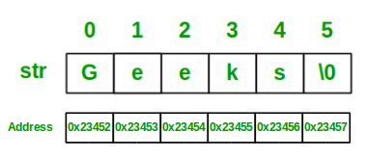
Memory Representation of String

Slide 8
Memory Allocation to Strings
JVM divides the allocated memory to a Java program into two parts.
Stack
heap.
Stack is used for execution purpose and heap is used for storage purpose.
In that heap memory, JVM allocates some memory specially meant for string literals.
This part of the heap memory is called String Constant Pool.

Slide 9
Memory Allocation to Strings
Whenever you create a string object using string literal, that object is stored in the string constant pool .
Whenever you create a string object using new keyword, such object is stored in the heap memory.

Slide 10
Memory Allocation to Strings
Example
String s1 = "abc";
String s2 = "xyz";
String s3 = "123";
String s4 = "A";
will be stored in the String Constant Pool.

Slide 11
Memory Allocation to Strings
When you create string objects using new keyword like below, they will be stored in the heap memory.
String s5 = new String("abc");
char[] c = {'J', 'A', 'V', 'A'};
String s6 = new String(c);
String s7 = new String(new StringBuffer());

Slide 12
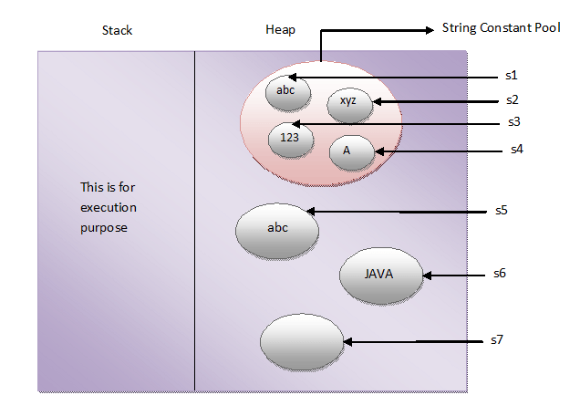
String data in String Constant Pool

Slide 13
Different Ways of Creating Strings
The following are the ways to create a string object:
Using string literal.
Using new keyword.

Slide 14
Using string literal
This is the most common way of creating string.
In this case a string literal is enclosed with double quotes.
Syntax:
String var_name=“value”
Example:
String str = "abc";

Slide 15
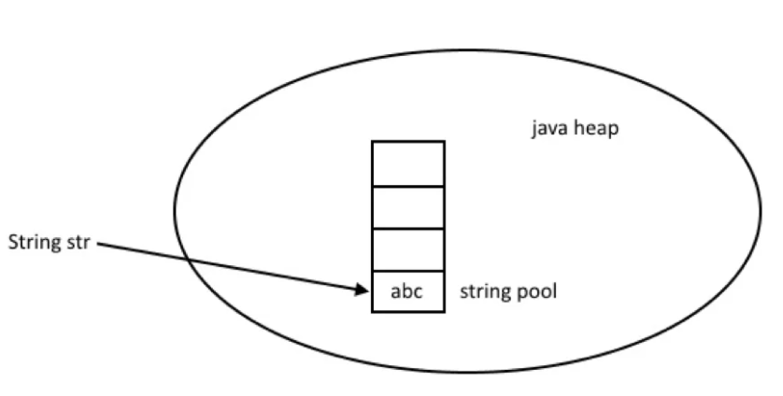
Internal Working

Slide 16
Using new keyword
We can create String object using new operator, just like any normal java class.
There are several constructors available in String class to get String from char array, byte array, StringBuffer and StringBuilder.

Slide 17
Using new keyword
Example:
String str = new String("abc");
char[ ] a = {'a', 'b', 'c'};
String str2 = new String(a);

Slide 18
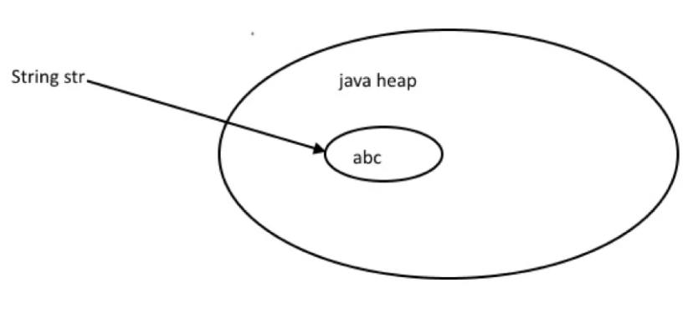
Internal Working Using new

Slide 19
Example
public class StringDemo {
public static void main(String args[ ]) {
char[ ] helloArray = { 'h', 'e', 'l', 'l', 'o', '.' };
String helloString = new String(helloArray);
System.out.println( helloString );
}
}

Slide 20
String Methods
A String in Java is actually an object, which contain methods that can perform certain operations on strings which are as follows:
String Length.
String Concatenation.
Finding a Character in a String.
To convert the case of a String.
Comparison of Strings.
contains

Slide 21
String Length
The accessor method that you can use with strings is the length() method, which returns the number of characters contained in the string object.

Slide 22
String Length
Example:
public class Main {
public static void main(String[] args) {
String txt = "ABCDEFGHIJKLMNOPQRSTUVWXYZ";
System.out.println("The length of the txt string is: " + txt.length());
}
}
Output: 26

Slide 23
String Concatenation
Strings are more commonly concatenated with the + operator
The + operator can be used between strings to combine them.
Example:
"Hello," + " world" + "!“
results in −
"Hello, world!"

Slide 24
Example
public class StringDemo {
public static void main(String args[]) {
String string1 = "saw I was ";
System.out.println("Dot " + string1 + "Tod");
}
}
Output:
Dot saw I was Tod

Slide 25
String Concatenation
You can also use the concat() method with string literals for concatenation.
Syntax:
string1.concat(string2);
This returns a new string that is string1 with string2 added to it at the end.
Example:
"My name is ".concat("Zara");

Slide 26
Finding a Character in a String
The indexOf() method returns the index of the first occurrence of a specified text in a string
Example:
public class Main {
public static void main(String[] args) {
String txt = "Please locate where 'locate' occurs!";
System.out.println(txt.indexOf("locate"));
}
}
Output: 7

Slide 27
To convert the case of a String
toUpperCase() and toLowerCase() are used to convert the case of a string.
Example:
String txt = "Hello World";
System.out.println(txt.toUpperCase()); // Outputs "HELLO WORLD"
System.out.println(txt.toLowerCase()); // Outputs "hello world"

Slide 28
Comparison of Strings
String class provides equals() and equalsIgnoreCase() methods to compare two strings.
These methods compare the value of string to check if two strings are equal or not.
It returns true if two strings are equal and false if not.

Slide 29
Example
public class StringEqualExample
{
public static void main(String[] args)
{ //creating two string object
String s1 = "abc";
String s2 = "abc";
String s3 = "def";
String s4 = "ABC";

Slide 30
Example
System.out.println(s1.equals(s2));//true
System.out.println(s2.equals(s3));//false
System.out.println(s1.equals(s4));//false;
System.out.println(s1.equalsIgnoreCase(s4));//true } }

Slide 31
Comparison of Strings
String class implements Comparable interface, which provides compareTo() and compareToIgnoreCase() methods and it compares two strings lexicographically.
Both strings are converted into Unicode value for comparison and return an integer value which can be greater than, less than or equal to zero.
If strings are equal then it returns zero or else it returns either greater or less than zero.

Slide 32
Example
public class StringCompareToExample {
public static void main(String[] args)
{
String a1 = "abc";
String a2 = "abc";
String a3 = "def";
String a4 = "ABC";

Slide 33
Example
System.out.println(a1.compareTo(a2));//0
System.out.println(a2.compareTo(a3));//less than 0 System.out.println(a1.compareTo(a4));//greater than 0 System.out.println(a1.compareToIgnoreCase(a4));//0
} }

Slide 34
Contains
Java String contains() methods checks if string contains specified sequence of character or not.
This method returns true if string contains specified sequence of character, else returns false.

Slide 35
Example
public class StringContainsExample
{
public static void main(String[] args)
{
String s = "Hello World"; System.out.println(s.contains("W"));//true System.out.println(s.contains("X"));//false
} }

