Slide 2
learn the basic concept Inheritance,
understand the different types of access specifiers,
implementation of different types of inheritance.

Slide 3
Access Specifiers
There are two types of modifiers in Java:
access specifiers.
non-access specifiers.
The access modifiers in Java specify the accessibility or scope of a field, method, constructor, or class.
We can change the access level of fields, constructors, methods, and classes by applying the access modifier on them.

Slide 4
Access Specifiers
For classes, you can use either public or default.
For attributes, methods and constructors, you can use the one of the following:
public
Private
Default
protected

Slide 5
Access Specifiers
Access Modifier | Within class | Within package | Outside package by subclass only | Outside package
Private | Y | N | N | N
Default | Y | Y | N | N
Protected | Y | Y | Y | N
Public | Y | Y | Y | Y

Slide 6
Private Access Specifier
class A{
private int data=40;
private void msg(){System.out.println("Hello java");}
}
public class Simple{
public static void main(String args[]){
A obj=new A();
System.out.println(obj.data);//Compile Time Error
obj.msg();//Compile Time Error
}
}

Slide 7
Default Access Specifier
package pack;
class A{
void msg(){System.out.println("Hello");}
}
package mypack;
import pack.*;
class B{
public static void main(String args[]){
A obj = new A();
//Compile Time Error
obj.msg();
//Compile Time Error
}
}

Slide 8
Protected Access Specifier
package mypack;
import pack.*;
class B extends A{
public static void main(String args[]){
B obj = new B();
obj.msg();
}
}
package pack;
public class A{
protected void msg()
{
System.out.println("Hello");} }

Slide 9
Public Access Specifier
package pack;
public class A{
public void msg()
{
System.out.println("Hello");}
}
package mypack;
import pack.*;
class B{
public static void main(String args[])
{
A obj = new A();
obj.msg();
}
}

Slide 10
Inheritance
It is the mechanism in java by which one class is allowed to inherit the features of another class.
The idea behind inheritance in Java is that you can create new classes that are built upon existing classes.
When you inherit from an existing class, you can reuse methods and fields of the parent class.

Slide 11
Inheritance
Inheritance represents the IS-A relationship which is also known as a parent-child relationship.
Syntax:
class Subclass-name extends Superclass-name
{
//methods and fields
}

Slide 12
Important Terms
Class
Sub Class/Child Class
Super Class/Parent Class
Reusability

Slide 13
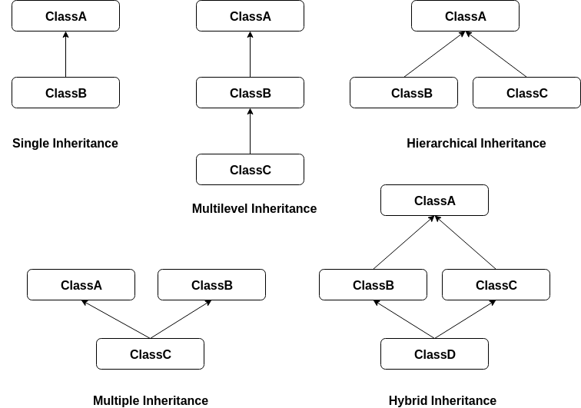
Types of inheritance

Slide 14
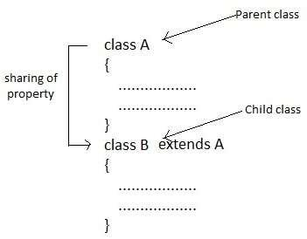
Single Inheritance

Slide 15
Single Inheritance Example
class Animal{
void eat(){System.out.println("eating...");
}
}
class Dog extends Animal{
void bark()
{
System.out.println("barking...");
}
}
class TestInheritance
{
public static void main(String args[])
{
Dog d=new Dog();
d.bark();
d.eat();
}
}

Slide 16
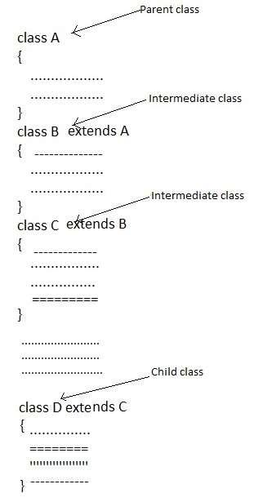
Multilevel Inheritance

Slide 17
Multilevel Inheritance Example
class Animal{
void eat(){System.out.println("eating...");}
}
class Dog extends Animal{
void bark()
{System.out.println("barking...");}
}
class BabyDog extends Dog{
void weep()
{System.out.println("weeping...");}
}
class TestInheritance2{
public static void main(String args[])
{
BabyDog d=new BabyDog();
d.weep();
d.bark();
d.eat();
}}

Slide 18
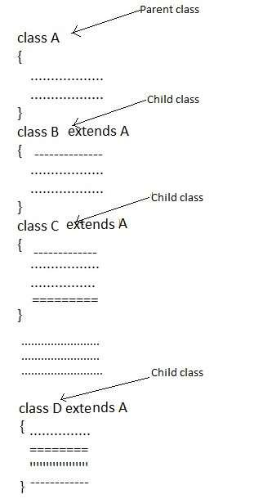
Multilevel Inheritance

Slide 19
Hierarchical Inheritance Example
class Animal{
void eat()
{System.out.println("eating...");}
}
class Dog extends Animal{
void bark()
{System.out.println("barking...");}
}
class Cat extends Animal{
void meow()
{System.out.println("meowing...");}
}
class TestInheritance3{
public static void main(String args[])
{
Cat c=new Cat();
c.meow();
c.eat();
}}

Slide 20
Multiple Inheritance
When the child class extends from more than one superclass, it is known as multiple inheritance.
However, Java does not support multiple inheritance.
To achieve multiple inheritance in Java, we must use the interface.
A
B
C
Multiple Inheritance

Slide 21
Multiple Inheritance using Interface
interface AnimalEat {
void eat();
}
interface AnimalTravel {
void travel();
}
class Animal implements AnimalEat, AnimalTravel
{
public void eat() {
System.out.println("Animal is eating");
}
public void travel() {
System.out.println("Animal is travelling");
}
}
public class Demo {
public static void main(String args[])
{
Animal a = new Animal();
a.eat();
a.travel();
}
}

Slide 22
Hybrid Inheritance
Hybrid Inheritance is a combination of both Single Inheritance and Multiple Inheritance.
Since java doesn’t support multiple inheritances with classes, hybrid inheritance is also not possible with classes.
In java, we can achieve hybrid inheritance only through Interfaces.

Slide 23
Important facts about inheritance
Default superclass.
Superclass can only be one.
Inheriting Constructors.
Private member inheritance.

