Slide 2
learn the basic concept of listiterator,
understand the different methods of listiterator.

Slide 3
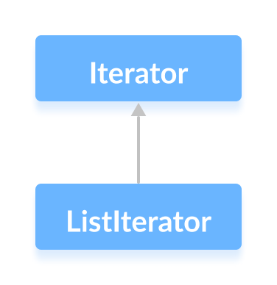
Listlterator
The ListIterator interface of the Java collections framework provides the functionality to access elements of a list.

Slide 4
Listlterator
It is bidirectional. This means it allows us to iterate elements of a list in both the direction.

Slide 5
Listlterator
It extends the Iterator interface.

Slide 6
Features of ListIterator
It is useful for list implemented classes.
Available since java 1.2.
It supports bi-directional traversal. i.e both forward and backward direction.
It supports all the four CRUD operations

Slide 7
Features of ListIterator
It is useful for list implemented classes.
Available since java 1.2.
It supports bi-directional traversal. i.e both forward and backward direction.
It supports all the four CRUD operations

Slide 8
Features of ListIterator
It is useful for list implemented classes.
Available since java 1.2.
It supports bi-directional traversal. i.e both forward and backward direction.
It supports all the four CRUD operations

Slide 9
Features of ListIterator
It is useful for list implemented classes.
Available since java 1.2.
It supports bi-directional traversal. i.e both forward and backward direction.
It supports all the four CRUD operations

Slide 10
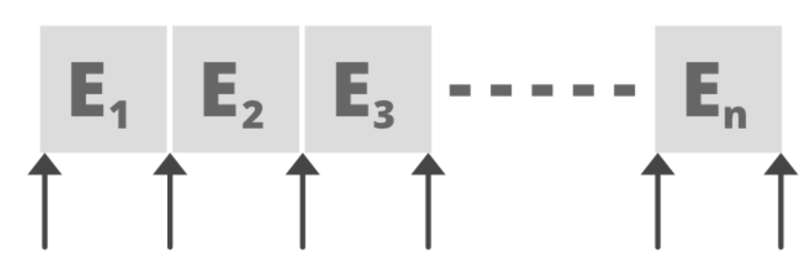
Position of Cursor

Slide 11
Declaration of ListIterator
public interface ListIterator<E> extends Iterator<E>
Syntax to get a list Iterator on a list:
ListIterator<E> listIterator()

Slide 12
Methods of ListIterator
ListIterator is a bi-directional iterator. For this functionality, it has two kinds of methods:

Slide 13
Methods of ListIterator
1. Forward direction iteration
hasNext()
next()
nextIndex()

Slide 14
Methods of ListIterator
1. Forward direction iteration
hasNext()
next()
nextIndex()

Slide 15
Methods of ListIterator
1. Forward direction iteration
hasNext()
next()
nextIndex()

Slide 16
Methods of ListIterator
2. Backward direction iteration
hasPrevious()
previous()
previousIndex()

Slide 17
Methods of ListIterator
2. Backward direction iteration
hasPrevious()
previous()
previousIndex()

Slide 18
Methods of ListIterator
2. Backward direction iteration
hasPrevious()
previous()
previousIndex()

Slide 19
Array List Iterator methods
A. listIterator()
B. listIterator(int index)

Slide 20
Array List Iterator methods
A. listIterator()
B. listIterator(int index)

