Slide 2
learn the basic concept of treeset Class
understand the syntax of creating treeset class
analyze the various methods available in treeset Class and their implementation

Slide 3
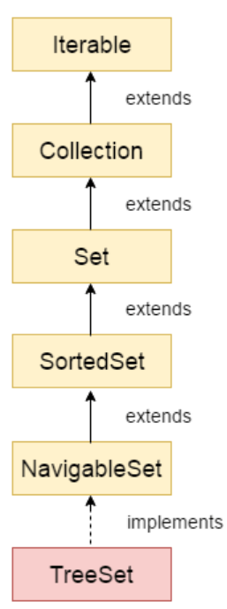
TreeSet class
The TreeSet class of the Java collections framework provides the functionality of a tree data structure.
Java TreeSet class implements the Set interface that uses a tree for storage.
It inherits AbstractSet class and implements the NavigableSet interface.
The objects of the TreeSet class are stored in ascending order.

Slide 4
TreeSet class
The TreeSet class of the Java collections framework provides the functionality of a tree data structure.
Java TreeSet class implements the Set interface that uses a tree for storage.
It inherits AbstractSet class and implements the NavigableSet interface.
The objects of the TreeSet class are stored in ascending order.

Slide 5
TreeSet class
The TreeSet class of the Java collections framework provides the functionality of a tree data structure.
Java TreeSet class implements the Set interface that uses a tree for storage.
It inherits AbstractSet class and implements the NavigableSet interface.
The objects of the TreeSet class are stored in ascending order.

Slide 6
TreeSet class
The TreeSet class of the Java collections framework provides the functionality of a tree data structure.
Java TreeSet class implements the Set interface that uses a tree for storage.
It inherits AbstractSet class and implements the NavigableSet interface.
The objects of the TreeSet class are stored in ascending order.

Slide 7
Points to remember
Java TreeSet class contains unique elements only like HashSet.
Java TreeSet class access and retrieval times are quite fast.
Java TreeSet class doesn't allow null element.
Java TreeSet class is non synchronized.
Java TreeSet class maintains ascending order.

Slide 8
Points to remember
Java TreeSet class contains unique elements only like HashSet.
Java TreeSet class access and retrieval times are quite fast.
Java TreeSet class doesn't allow null element.
Java TreeSet class is non synchronized.
Java TreeSet class maintains ascending order.

Slide 9
Points to remember
Java TreeSet class contains unique elements only like HashSet.
Java TreeSet class access and retrieval times are quite fast.
Java TreeSet class doesn't allow null element.
Java TreeSet class is non synchronized.
Java TreeSet class maintains ascending order.

Slide 10
Points to remember
Java TreeSet class contains unique elements only like HashSet.
Java TreeSet class access and retrieval times are quite fast.
Java TreeSet class doesn't allow null element.
Java TreeSet class is non synchronized.
Java TreeSet class maintains ascending order.

Slide 11
Points to remember
Java TreeSet class contains unique elements only like HashSet.
Java TreeSet class access and retrieval times are quite fast.
Java TreeSet class doesn't allow null element.
Java TreeSet class is non synchronized.
Java TreeSet class maintains ascending order.

Slide 12
Creating a TreeSet
In order to create a tree, set, we must import the java.util.TreeSet package first.
Once we import the package, here is how we can create a TreeSet in Java.

Slide 13
Creating a TreeSet
In order to create a tree, set, we must import the java.util.TreeSet package first.
Once we import the package, here is how we can create a TreeSet in Java.
Syntax:
TreeSet<Integer> numbers = new TreeSet<>();
Here, we have created a TreeSet without any arguments.

Slide 14
Methods of TreeSet
Insert Elements to TreeSet
add() - inserts the specified element to the set
addAll() - inserts all the elements of the specified collection to the set

Slide 15
Methods of TreeSet
Access TreeSet Elements
To access the elements of a tree set, we can use the iterator() method.
In order to use this method, we must import java.util.Iterator package.

Slide 16
Methods of TreeSet
Remove Elements
remove() - removes the specified element from the set
removeAll() - removes all the elements from the set

Slide 17
Methods for Navigation
1. first() and last() Methods
first() - returns the first element of the set
last() - returns the last element of the set

Slide 18
Methods for Navigation
2. pollfirst() and pollLast() Methods
pollFirst() - returns and removes the first element from the set
pollLast() - returns and removes the last element from the set

Slide 19
Methods for Navigation
3. ceiling(), floor(), higher() and lower() Methods
higher(element) - Returns the lowest element among those elements that are greater than the specified element.

Slide 20
Methods for Navigation
3. ceiling(), floor(), higher() and lower() Methods
lower(element) - Returns the greatest element among those elements that are less than the specified element.

Slide 21
Methods for Navigation
3. ceiling(), floor(), higher() and lower() Methods
ceiling(element) - Returns the lowest element among those elements that are greater than the specified element. If the element passed exists in a tree set, it returns the element passed as an argument.

Slide 22
Methods for Navigation
3. ceiling(), floor(), higher() and lower() Methods
floor(element) - Returns the greatest element among those elements that are less than the specified element. If the element passed exists in a tree set, it returns the element passed as an argument.

Slide 23
Methods for Navigation
4. headSet(), tailSet() and subSet() Methods
The headSet() method returns all the elements of a tree set before the specified element.
The tailSet() method returns all the elements of a tree set after the specified element (which is passed as a parameter) including the specified element.

Slide 24
Methods for Navigation
4. headSet(), tailSet() and subSet() Methods
subSet(e1, bv1, e2, bv2)
The subSet() method returns all the elements between e1 and e2 including e1.
The bv1 and bv2 are optional parameters. The default value of bv1 is true, and the default value of bv2 is false.

