Slide 2
learn the basic concept of pooling.
understand the concept of thread communication and the process of thread communication
know the difference between wait and sleep

Slide 3
What is Pooling?
The process of testing a condition repeatedly till it becomes true is known as pooling.
Java provide benefits of avoiding thread pooling using inter-thread communication.
Pooling is usually implemented with the help of loops to check whether a particular condition is true or not.
If it is true, certain action is taken.

Slide 4
How to avoid Pooling
To avoid pooling, Java uses three methods, namely, wait(), notify() and notifyAll().
wait()
notify()
notifyAll()

Slide 5
Thread Communication
Inter-thread communication or Co-operation is all about allowing synchronized threads to communicate with each other.
It is the process in which two threads communicate with each other by using wait(), notify(), and notifyAll() methods.

Slide 6
Important Points to Remember
wait(), notify() and notifyAll() methods are available in Object class but not in Thread class because Thread can call these methods on any common object.
To call wait(), notify() and notify All() methods compulsory the current thread should be the owner of that object .
Once a thread calls the wait() method on the given object 1st it releases the lock of that object immediately and entered into the waiting state.

Slide 7
Important Points to Remember
Except for these methods, there is no other place or method where the lock releases will happen.
One important thing to note that when a thread calls wait(), notify(), notifyAll() methods on any object then it releases the lock of that particular object but not all the lock it has.
Also note that on which object we are calling wait(), notify() and notifyAll() methods that corresponding object lock we have to get but not other object locks.

Slide 8
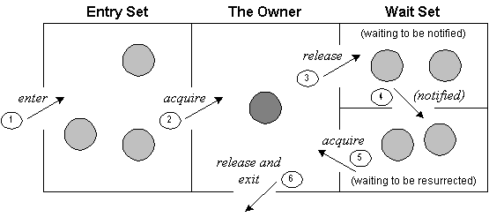
Inter-thread communication Process

Slide 9
Difference between wait() and sleep()
wait() | sleep()
wait() method releases the lock | sleep() method doesn't release the lock.
is the method of Object class | is the method of Thread class
is the non-static method | is the static method
should be notified by notify() or notifyAll() methods | after the specified amount of time, sleep is completed.

