Slide 2
learn the basic concept suspending and resuming a thread.
implement suspend() and resume().

Slide 3
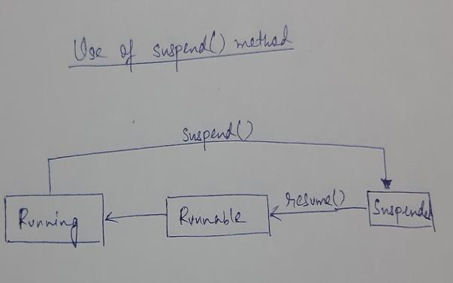
Suspending a Thread
Due to the multi-threading concept, we may need to block one particular thread while some other thread is executing.

Slide 4
Suspending a Thread
As we have seen in the life cycle diagram, there are several inbuilt methods provided to us by the thread class to change the state of a thread.

Slide 5
Suspending a Thread
One of them is the suspend() method.
It is used to change the thread from a Running state to Suspended/Blocked state.

Slide 6
Example
public class Testing extends Thread
{
public void run()
{
try
{
for(int i=0;i<7;i++)
{
Thread.sleep(500);
System.out.println(this.getName() + ": " + i);
} } catch(InterruptedException e)
{
e.printStackTrace();
} }

Slide 7
Example
public static void main(String args[])
{
Testing srd1=new Testing();
Testing srd2=new Testing();
srd1.setName("First");
srd2.setName("Second");
srd1.start();
srd2.start();
try
{
Thread.sleep(1000);
Thread.sleep(1000);
srd1.resume();
System.out.println("Resuming thread First");
Thread.sleep(1000);
srd2.suspend();
System.out.println("Suspending thread Second");
Thread.sleep(1000);
srd2.resume();
System.out.println("Resuming thread Second"); }
catch(InterruptedException e)
{
e.printStackTrace();
} } }

Slide 8
Resuming a Thread
Suspend() method puts thread from running to waiting state.
And thread can go from waiting to runnable state only when resume() method is called on thread.
Suspend method is deprecated method.

Slide 9
Resuming a Thread
Resume() method is only used with suspend() method that’s why it’s also deprecated method.
Suspend() and remove() are deprecated methods because if not used properly they might lead to deadlock.

Slide 10
Resuming a Thread
public class Resume implements Runnable {
public void run() {
for (int i = 0; i <=3; i++) {
System.out.println(Thread.currentThread().getName() + " " + i);
}
}
public static void main(String args[]) throws Exception
{
Thread th = new Thread(new Resume());
Thread th1 = new Thread(new Resume());
Continue….

Slide 11
Resuming a Thread
Continue….
System.out.println("Starting " + th.getName() + "...");
th.start();
System.out.println("Suspending " + th.getName() + "...");
//Suspend the thread.
th.suspend();
System.out.println("Starting " + th.getName() + "...");
th1.start();
th1.join();
// Resume the thread.
th.resume();
System.out.println("Starting " + th.getName() + "...");
}
}

