Slide 2
learn the basic concept of GridLayout
understand the various constructors and methods of GridLayout
implementation of GridLayout

Slide 3
GridLayout
GridLayout class represents a layout manager with a specified number of rows and columns in a rectangular grid.
The GridLayout container is divided into an equal-sized of rectangles

Slide 4
GridLayout
Every rectangle cell has the same size therefore, they contain a component, which fills the entire cell.
When the user changes or adjusts the size of the container, the size of each rectangles changes accordingly.

Slide 5
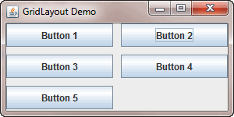
GridLayout

Slide 6
Constructors of GridLayout
GridLayout()
GridLayout(int rw, int cl)
GridLayout(int rw, int cl, int hgap, int vgap)

Slide 7
Methods used with GridLayout
addLayoutComponent(String str, Component cmp)
setColumns(int cl)
setHgap(int hgap)
setRows(int rw)
setVgap(int vgap) layoutContainer(Container pr)
toString()

