Slide 2
learn the basic concept of FlowLayout
understand the various constructors and methods of FlowLayout
implementation of FlowLayout

Slide 3
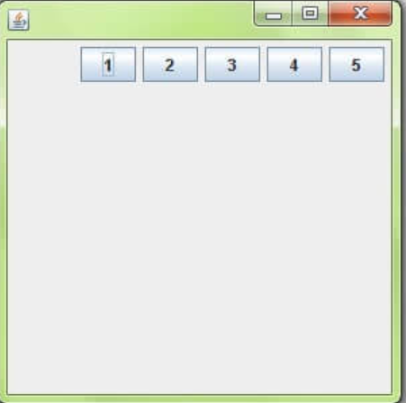
FlowLayout
The FlowLayout is used to arrange the components in a line, one after another .
It is the default layout of applet or panel.

Slide 4
Variables
LEFT
CENTER
RIGHT

Slide 5
Constructors of FlowLayout
FlowLayout()
FlowLayout(int align)
FlowLayout(int align, int HorizontalGap, int VerticalGap )
JLabel(String text)

Slide 6
Methods used in FlowLayout
setTitle(String Text)
getAlignment()
setAlignment(int align)
removeLayoutComponent(Component comp) :

