Slide 2
learn the basic concepts of BoxLayout and CardLayout
understand the various constructors and methods of BoxLayout and CardLayout
implementation of BoxLayout and CardLayout

Slide 3
BoxLayout
The BoxLayout is used to arrange the components either vertically or horizontally.

Slide 4
BoxLayout
For this purpose, BoxLayout provides four constants. They are as follows:
public static final int X_AXIS
public static final int Y_AXIS
public static final int LINE_AXIS
public static final int PAGE_AXIS

Slide 5
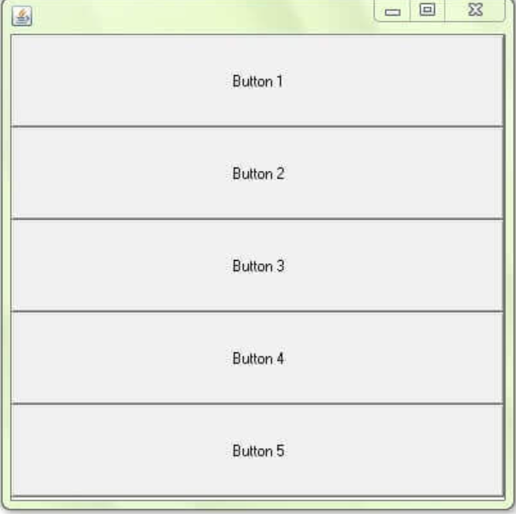
BoxLayout Constructor
BoxLayout(Container c, int axis): creates a box layout that arranges the components with the given axis.

Slide 6
Methods of BoxLayout
addLayoutComponent(Component cmp, Object obj)
getLayoutAlignmentX(Container con)
getLayoutAlignmentY(Container con)
maximumLayoutSize(Container con)

Slide 7
Methods of BoxLayout
minimumLayoutSize(Container con)
removeLayoutComponent(Component cmp)
layoutContainer(Container tar)

Slide 8
CardLayout
The CardLayout class manages the components in such a way that only one component is visible at a time.
It treats each component as a card in the container.
Only one card is visible at a time, and the container acts as a stack of cards.

Slide 9
Constructors of CardLayout
CardLayout()
CardLayout(int horizontalgap, int verticalgap)

Slide 10
Methods of CardLayout
public void next(Container parent)
public void previous(Container parent)
public void first(Container parent)
public void last(Container parent)
public void show(Container parent, String name )

Slide 11
Methods of CardLayout
getLayoutAlignmentX(Container parent)
getLayoutAlignmentY(Container parent)
getVgap()
addLayoutComponent(Component cm, Object cn)

Slide 12
Methods of CardLayout
getHgap()
toString()
removeLayoutComponent(Component cm)

