Slide 2
learn the basic concept of JDBC and its use
understand the different types of JDBC drivers
know the working of various components of JDBC
analyze the different architectural components and their use

Slide 3
JDBC
Java Database Connectivity(JDBC) is an Application Programming Interface(API) used to connect Java application with Database.
It is used to interact with various type of Database.
It can also be defined as the platform-independent interface between a relational database and Java programming.

Slide 4
JDBC
It allows java program to execute SQL statement and retrieve result from database.
The JDBC API consists of classes and methods that are used to perform various operations in the database.

Slide 5
Use of JDBC
Enterprise applications that are created using the JAVA EE technology need to interact with databases to store application-specific information.
Before JDBC, the ODBC API was the database API to connect and execute queries with the database.
But, the ODBC API uses the ODBC driver, which is written in the C language.

Slide 6
Use of JDBC
That is why Java has defined its own API (JDBC API) that uses JDBC drivers (written in the Java language).
This driver is used with JDBC to interact or communicate with various kinds of databases.

Slide 7
Use of JDBC
We can use JDBC API to handle database using Java program and can perform the following activities:
Connect to the database.
Execute queries and update statements to the database.
Retrieve the result received from the database.

Slide 8
JDBC Driver
JDBC Driver is a software component that enables java application to interact with the database.
Java API
JDBC Driver
Database

Slide 9
Types of JDBC Drivers
There are 4 types of JDBC drivers
JDBC-ODBC bridge driver
Native-API driver (partially java driver)
Network Protocol driver (fully java driver)
Thin driver (fully java driver)

Slide 10
Types of JDBC Drivers
There are 4 types of JDBC drivers:
JDBC-ODBC bridge driver
Native-API driver (partially java driver)
Network Protocol driver (fully java driver)
Thin driver (fully java driver)

Slide 11
Types of JDBC Drivers
There are 4 types of JDBC drivers:
JDBC-ODBC bridge driver
Native-API driver
Network Protocol driver (fully java driver)
Thin driver (fully java driver)

Slide 12
Types of JDBC Drivers
There are 4 types of JDBC drivers:
JDBC-ODBC bridge driver
Native-API driver (partially java driver)
Network Protocol driver
Thin driver (fully java driver)

Slide 13
Types of JDBC Drivers
There are 4 types of JDBC drivers:
JDBC-ODBC bridge driver
Native-API driver (partially java driver)
Network Protocol driver (fully java driver)
Thin driver

Slide 14
Which Driver should be Used?
If you are accessing one type of database, the preferred driver type is 4.
If your Java application is accessing multiple types of databases at the same time, type 3 is the preferred driver.
Type 2 drivers are useful in situations, where a type 3 or type 4 driver is not available yet for your database.

Slide 15
Which Driver should be Used?
The type 1 driver is not considered a deployment-level driver, and is typically used for development and testing purposes only.

Slide 16
Components of JDBC
DriverManager
Driver
Connection
Statement
ResultSet
SQLException

Slide 17
Components of JDBC
Driver Manager
Driver
Connection
Statement
Result Set
SQLException

Slide 18
Components of JDBC
DriverManager
Driver
Connection
Statement
ResultSet
SQLException

Slide 19
Components of JDBC
DriverManager
Driver
Connection
Statement
ResultSet
SQLException

Slide 20
Components of JDBC
DriverManager
Driver
Connection
Statement
ResultSet
SQLException

Slide 21
Components of JDBC
DriverManager
Driver
Connection
Statement
ResultSet
SQLException

Slide 22
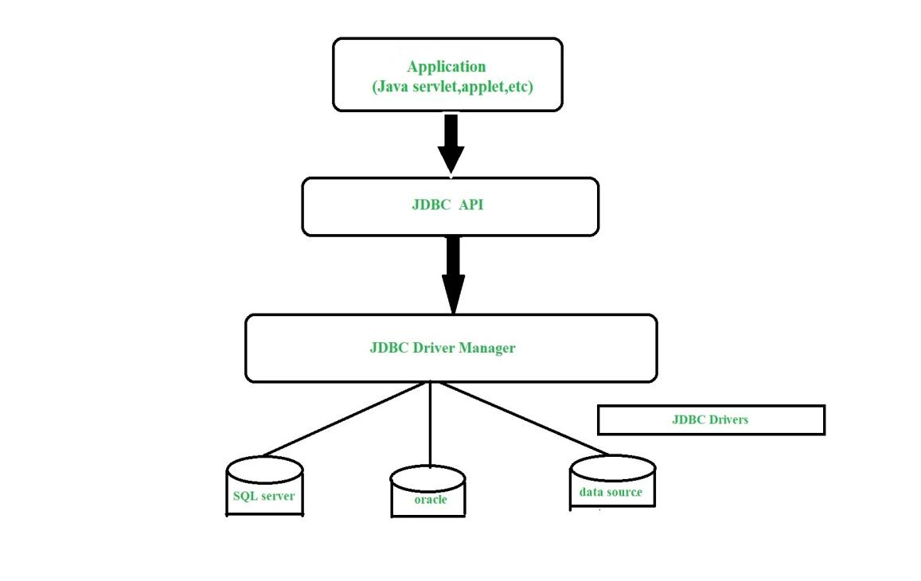
Architecture of JDBC

Slide 23
Architecture of JDBC
Application
The JDBC API
DriverManager
JDBC drivers

Slide 24
Types of JDBC Architecture
The JDBC architecture consists of two-tier and three-tier processing models to access a database.
Two-tier model
Three-tier model

