Slide 2
Learning Outcomes
Operations on arrays

Slide 3
Operations on arrays
Following operations can be performed on arrays:
Traversing
Searching
Insertion
Deletion
Sorting
Merging

Slide 4
Array traversing
Traversing is process of visiting each element of the array exactly once.
As element of linear array can be accessing directly, only we have to vary an index from lower bound to upper bound in step of one to access individual elements in order

Slide 5
Array traversing
We have linear array Arr as below:
1 2 3 4 5
15 28 30 35 60
Here we will start from beginning and will go till last element and during this process we will access value of each element exactly once as below:
Arr [1] = 15
Arr [2] = 28
Arr [3] = 30
Arr [4] = 35
Arr [5] = 60

Slide 6
Algorithm
Step 1 : [Initialization] Set I = LB
Step 2 : Repeat Step 3 and Step 4 while I < = UB
step 3 : [ processing ] Process the A[I] element
Step 4 : [ Increment the counter ] I = I + 1
[ End of the loop of step 2 ]
Step 5: Exit
Here LB is lower Bound and UB is Upper Bound A[ ] is linear array )

Slide 7
Program
#include <stdio.h>
main()
{
int arr[ ] = {10,12,15,20,14};
printf("The array elements are :\n");
for(int i = 0; i<5; i++)
{
printf("arr[%d] = %d \n", i, arr[i]);
}
}

Slide 8
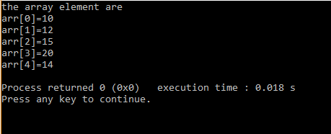
output

Slide 9
Exercise
Program to demonstrate traversal operation on array

