Slide 2
Learning Outcomes
Array insertion
Array deletion

Slide 3
Array insertion
Insertion on array is add a new element in array.
Element can be inserted at any palace in array.

Slide 4
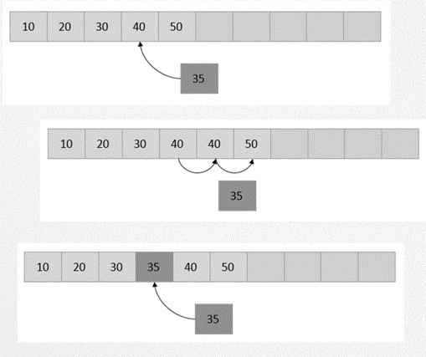
Array insertion

Slide 5
Array insertion
Array insertion can be done in following cases:
Insertion at the beginning of an array
Insertion at the given index of an array
Insertion after the given index of an array
Insertion before the given index of an array

Slide 6
Algorithm
Here A is an array with N elements. The maximum numbers of elements it can store is defined by MAX.
begin
IF N = MAX, return
ELSE
N = N + 1
For All Elements in A
Move to next adjacent location
A[FIRST] = New_Element
end

Slide 7
Program
#include<stdio.h>
#define MAX 5
main()
{
int arr[MAX]= {10,12,15,20},i,val;
printf("the array element are \n");
for(i=0;i<4;i++)
{
printf("arr[%d]=%d \n",i,arr[i]);
}
for(i=4;i>=0;i--){
arr[i+1]= arr[i];
}
val=210;
arr[2]=val;
printf("array after insertion \n");
for(i=0;i<5;i++){
printf("arr[%d]=%d \n",i,arr[i]);
}
}

Slide 8
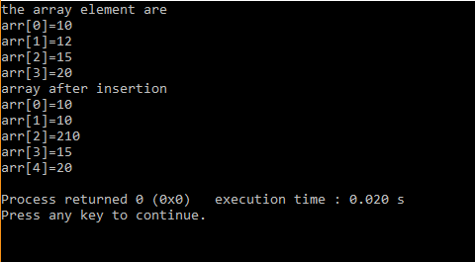
Output

Slide 9
Array Deletion
Array deletion removes an existing element from the array and re-organizing all elements of an array.
Element can be deleted at any palace in array.

Slide 10
Algorithm
A is an array
N is number of elements (size)
Element is a deleted data element
Pos is the location of the element to be deleted. Deletion (A, N, Pos)
Step 1: Element = A [Pos]
Step 2: for i = Pos to N-1 repeat
step 3 Step 3: A[ i ] = A[i+1] End for
Step 4: N = N - 1

Slide 11
Program
#include<stdio.h>
main()
{
int arr[]= {10,12,15,20},i,pos=1;
printf("the array element are \n");
for(i=0;i<4;i++)
{
printf("arr[%d]= %d \n",i,arr[i]);
}
for (i = pos - 1; i < 4 - 1; i++)
arr[i] = arr[i+1];
printf("Resultant array:\n");
for (i = 0; i < 4 - 1; i++)
printf("arr[%d]= %d\n",i, arr[i]);
}

Slide 12
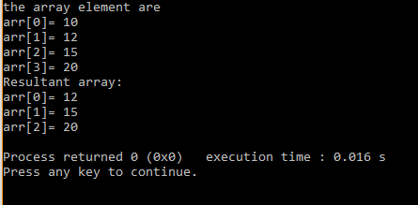
Output

Slide 13
Exercise
Program to demonstrate insertion operation on array
Program to demonstrate deletion operation on array

