Slide 2
Learning Outcomes
search operation on arrays
merging of two arrays

Slide 3
Array Search
Searching is a process in which we find element in the array.
This method accepts only one argument, value. It is non-destructive method, which means it does not affect the array values.
Linear Search
Binary Search

Slide 4
Algorithm
Consider Arr is a linear array with N elements. Following is the algorithm to find an element with a value of ITEM using sequential search.
1. Start
2. Set J = 0
3. Repeat steps 4 and 5 while J < N
4. IF Arr[J] is equal ITEM THEN GOTO STEP 6
5. Set J = J +1
6. PRINT J, ITEM
7. Stop

Slide 5
Program
#include<stdio.h>
main(){
int arr[5]={1,2,3,4,5};
int toS,i,flag=0;
for(i=0;i<5;i++)
{
printf("%d \t ", arr[i]);
}
printf("Enter Element to find \n");
scanf("%d",&toS);
for(i=0;i<5;i++)
{
if(arr[i]==toS){
flag=1;
}
}
if(flag==1){
printf("Element present \n");
}
else{
printf("Element not present");
}
}

Slide 6
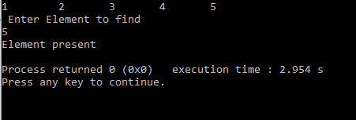
Output

Slide 7
Merging of two arrays
Merging of two arrays means combining two separate arrays into one single array.
To merge two arrays, we need at least three array variables.

Slide 8
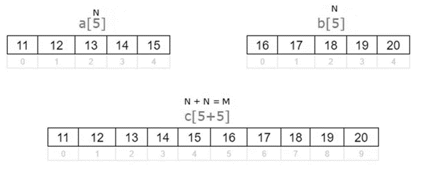
Merging of two arrays

Slide 9
Algorithm
START
Step 1 → Take three array variables A, B, and C
Step 2 → Store even values in array B
Step 3 → Store odd values in array C
Step 4 → Start loop from 0 to sizeof(B)
Step 5 → Copy B[n] to A[index]
Step 6 → Start loop from 0 to sizeof(C)
Step 7 → Copy C[n] to A[index]
Step 8 → Display A
STOP

Slide 10
Program
#include <stdio.h>
main() {
int LA[] = {1,3,5,7,8},i,index=0,c[10];
printf("The array elements are :\n");
for(i=0;i<5;i++)
{
printf("LA[%d] = %d \n", i, LA[i]);
}
int A[] = {10,12,13,14};
printf("The array elements are :\n");
for(i=0;i<5;i++)
{
{
printf("A[%d] = %d \n", i, A[i]);
}
printf("merge array is: \n");
for(i=0;i<5;i++)
c[index++]=LA[i];
for(i=0;i<5;i++)
c[index++]=A[i];
for(i=0;i<10;i++){
printf("%d \t",c[i]);
}
}

Slide 11
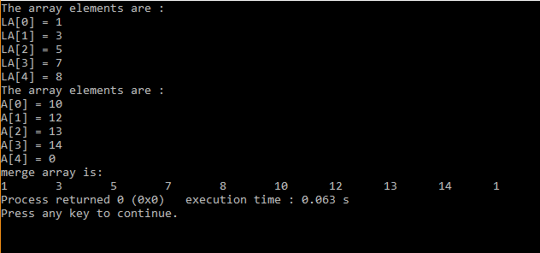
Output

Slide 12
Exercise
Program to demonstrate search operation on array
Program to demonstrate concatenation operation on array

