Slide 2
Learning Outcomes
understand implementation of stacks
Using Array
Using linked list

Slide 3
Stack
A Stack is a linear data structure that follows the LIFO (Last-In-First-Out) or FILO(First In Last Out) principle.
Stack has one end, insertion and deletion can be done from the one end known as the top of the stack.

Slide 4
Stack
Push
Pop
Top
Stack

Slide 5
Stack implementation
Using array
Using linked list

Slide 6
Stack implementation using array
In array implementation, the stack is formed by using the array.
All the operations regarding the stack are performed using arrays.

Slide 7
Adding an element onto the stack
Adding an element into the top of the stack is referred to as push operation.
Increment the variable Top so that it can now refer to the next memory location.
Add element at the position of incremented top. This is referred to as adding new element at the top of the stack.

Slide 8
Algorithm – for push operation
begin
if top = n then stack full
top = top + 1
stack (top) : = item;
end

Slide 9
Implementation of push operation
void push (int val,int n) {
if (top == n )
printf("\n Overflow");
else
{
top = top +1;
stack[top] = val;
}
}

Slide 10
Deletion of an element from a stack
Deletion of an element from the top of the stack is called pop operation. The value of the variable top will be decremented by 1 whenever an item is deleted from the stack. The top most element of the stack is stored in another variable and then the top is decremented by 1.

Slide 11
Algorithm – for pop operation
begin
if top = 0 then stack empty;
item := stack(top);
top = top - 1;
end;

Slide 12
Implementation of pop operation
int pop ()
{
if(top == -1)
{
printf("Underflow");
return 0;
}
else
{
return stack[top - - ];
}
}

Slide 13
Visiting each element of the stack
Peek operation involves returning the element which is present at the top of the stack without deleting it.
An underflow condition can occur if we try to return the top element to an already empty stack.

Slide 14
Algorithm
PEEK (STACK, TOP)
Begin
if top = -1 then stack empty
item = stack[top]
return item
End

Slide 15
Implementation of Peek algorithm
int peek()
{
if (top == -1)
{
printf("Underflow");
return 0;
}
else
{
return stack [top];
}
}

Slide 16
Stack Implementation using linked list
In Linked list memory is allocated dynamically. However, the time complexity in both the scenario is the same for all the operations, i.e. push, pop and peek.

Slide 17
Stack Implementation using linked list
In linked list implementation of the stack, we need to create nodes and the nodes are maintained non-contiguously in the memory.
Each node contains a pointer to its immediate successor node in the stack.
Stack is said to be overflown if the space left in the memory heap is not enough to create a node.

Slide 18
Stack Implementation using linked list
Data next
TOP
A
B next
C next
D next

Slide 19
Adding a node to the stack
Adding a node to the stack is referred to as a push operation.
Create a node first and allocate memory to it.
If the list is empty then the item is to be pushed as the start node of the list. This includes assigning value to the data part of the node and assign null to the address part of the node.

Slide 20
Adding a node to the stack
Head
Data next
A
B
C null
Fig. 1
E
Data next
A
B
C null
Head
Fig. 2
New node
E

Slide 21
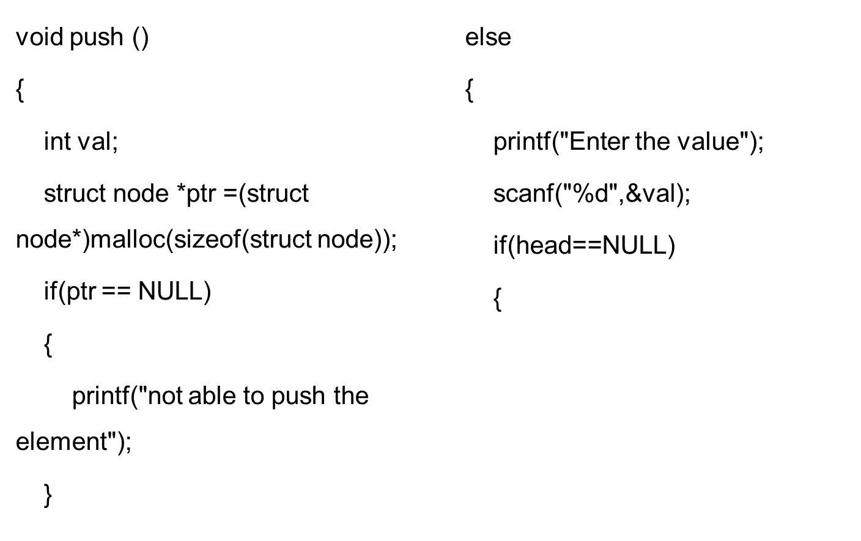
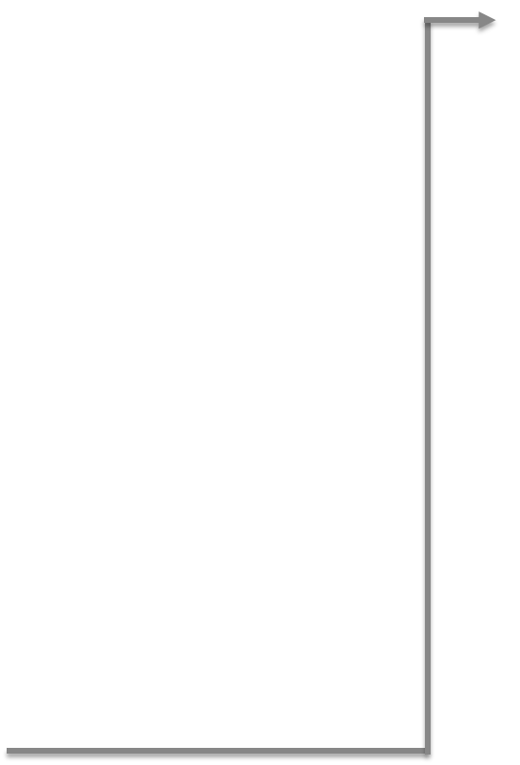
Implementation of Push Operation

Slide 22
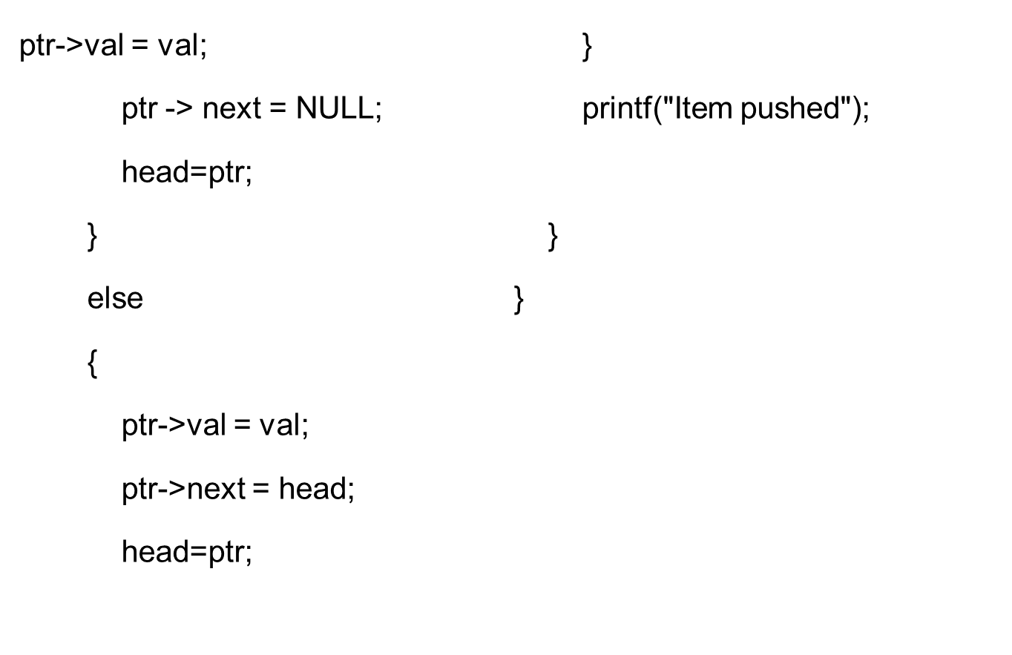

Implementation of Push Operation

Slide 23
Deleting a node from the stack
Deleting a node from the top of stack is referred to as pop operation.
Underflow condition is checked. The underflow condition occurs when we try to pop from an already empty stack.
The stack will be empty if the head pointer of the list points to null.

Slide 24
Deleting a node from the stack
In a stack, the elements are popped only from one end, therefore, the value stored in the head pointer must be deleted and the node must be freed.
The next node of the head node now becomes the head node.

Slide 25
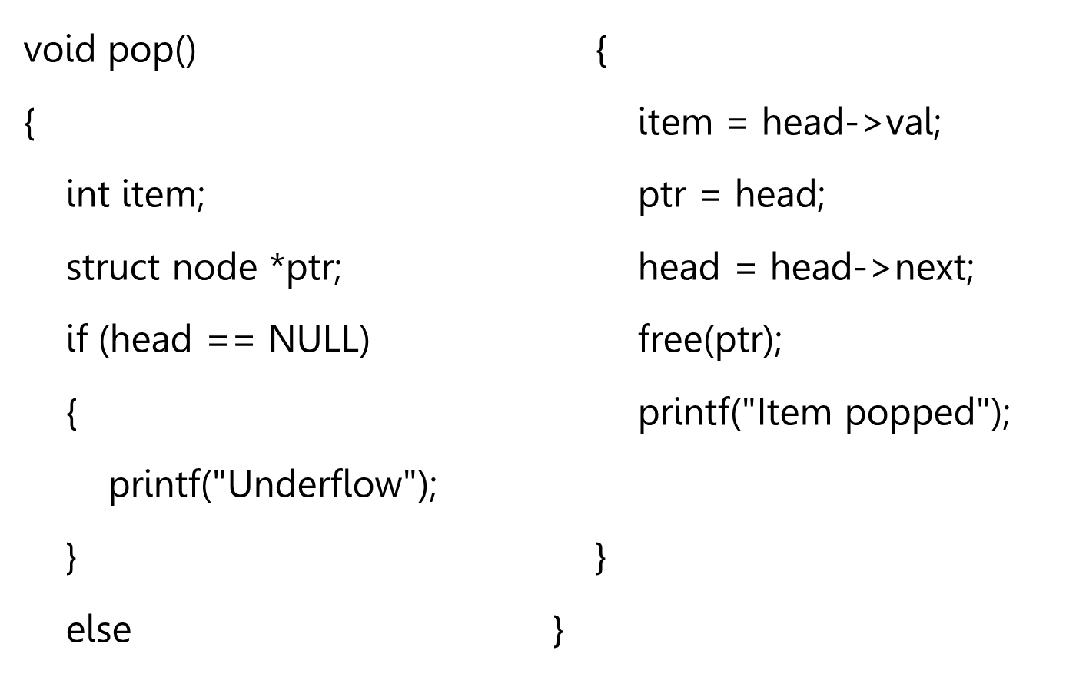

Implementation of Pop Operation

