Slide 1
EMTH403
Mathematical Foundation for Computer Science

Slide 2
Lecture Outcomes
understand what is a Conditional Statements.
understand the use of Conditional Statements in mathematical reasoning.

Slide 3
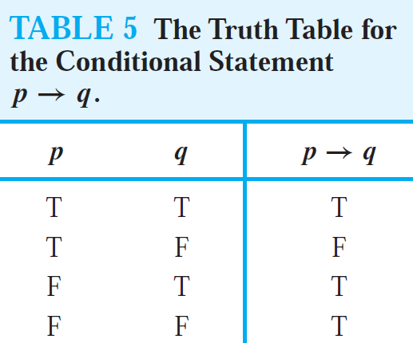
Conditional Statements
Let p and q be propositions. The conditional statement p → q is the proposition “if p, then q.”
The conditional statement p → q is false when p is true and q is false, and true otherwise.

Slide 4
Conditional Statements
In the conditional statement p → q, p is called the hypothesis (or antecedent or premise) and q is called the conclusion (or consequence).

Slide 5
Conditional Statements
A conditional statement is also called an implication.

Slide 6
Conditional Statements
Because conditional statements play such an essential role in mathematical reasoning, a variety of terminology is used to express p → q.
You will encounter most if not all of the following ways to express this conditional statement:
“if p, then q” ,
“p implies q”
“if p, q”, “p only if q”

Slide 7
Conditional Statements
“p is sufficient for q”
“a sufficient condition for q is p”
“q if p” ,
“q whenever p”
“q when p”
“q is necessary for p”
“a necessary condition for p is q”

Slide 8
Conditional Statements
A useful way to understand the truth value of a conditional statement is to think of an obligation or a contract.

Slide 9
Conditional Statements
For example, the pledge many politicians make when running for office is “If I am elected, then I will lower taxes.”
If the politician is elected, voters would expect this politician to lower taxes.

Slide 10
Conditional Statements
Furthermore, if the politician is not elected, then voters will not have any expectation that this person will lower taxes, although the person may have sufficient influence to cause those in power to lower taxes.

Slide 11
Conditional Statements
It is only when the politician is elected but does not lower taxes that voters can say that the politician has broken the campaign pledge.
This last scenario corresponds to the case when p is true but q is false in p → q.

Slide 12
Conditional Statements – Example - 1
Ques:- Let p be the statement “Maria learns discrete mathematics” and q the statement “Maria will find a good job.” Express the statement p → q as a statement in English.
Ans:- From the definition of conditional statements, we see that when p is the statement “Maria learns discrete mathematics”
and q is the statement “Maria will find a good job,”
p → q represents the statement “If Maria learns discrete mathematics, then she will find a good job.”

Slide 13
Conditional Statements - Example - 1
Alternatively when p is the statement “Maria learns discrete mathematics” and q is the statement “Maria will find a good job,” “a sufficient condition for q is p”
“For Maria to get a good job, it is sufficient for her to learn discrete mathematics.”

Slide 14
Conditional Statements - Example - 2
Ques:- Let p and q be the propositions “Swimming at the New Jersey shore is allowed” and “Sharks have been spotted near the shore,” respectively. Express p →¬q compound proposition as an English sentence.
Ans:- If swimming at the New Jersey shore is allowed, then sharks have not been spotted near the shore.

Slide 15
Conditional Statements - Example - 3
Ques:- Let p and q be the propositions “Swimming at the New Jersey shore is allowed” and “Sharks have been spotted near the shore,” respectively. Express ¬q → p compound proposition as an English sentence.
Ans:- If sharks have not been spotted near the shore, then swimming at the New Jersey shore is allowed.

Slide 16
Conditional Statements - Example - 4
Ques:- Let p and q be the propositions
p : It is below freezing.
q : It is snowing.
Write these propositions using p and q and logical connectives (including negations).
If it is below freezing, it is also snowing.
Ans:- This sentence is a conditional statement, p → q.

Slide 17
Conditional Statements - Example - 5
Ques:- Let p and q be the propositions
p : It is below freezing.
q : It is snowing.
Write these propositions using p and q and logical connectives (including negations).
If it is not below freezing, it is also snowing.
Ans:- This sentence is a conditional statement, ¬ p → q.

Slide 18
Conditional Statements - Example - 6
Ques:- Let p and q be the propositions
p : It is below freezing.
q : It is snowing.
Write these propositions using p and q and logical connectives (including negations).
If it is below freezing, it is not snowing.
Ans:- This sentence is a conditional statement, p → ¬ q.

Slide 19
Conditional Statements - Example - 7
Ques:- Let p and q be the propositions
p :You drive over 65 miles per hour.
q :You get a speeding ticket.
Write these propositions using p and q and logical connectives (including negations)
If you do not drive over 65 miles per hour, then you will not get a speeding ticket.
Ans:- ¬p → ¬q

Slide 20
Conditional Statements – Example - 8
Ques:- Let p and q be the propositions
p :You drive over 65 miles per hour.
q :You get a speeding ticket.
Write these propositions using p and q and logical connectives (including negations)
Driving over 65 miles per hour is sufficient for getting a speeding ticket.
Ans:- p → q, (as “p is sufficient for q” )

Slide 21
Conditional Statements - Example - 9
Ques:- Determine whether each of these conditional statements is true or false.
If 1 + 1 = 2, then 2 + 2 = 5.
Ans:- Since the hypothesis is true and the conclusion is false, this conditional statement is false.

Slide 22
Conditional Statements - Example - 10
Ques:- Determine whether each of these conditional statements is true or false.
If 1 + 1 = 3, then 2 + 2 = 4.
Ans:- Since the hypothesis is false and the conclusion is true, this conditional statement is true.

Slide 23
Conditional Statements - Example - 11
Ques:- Determine whether each of these conditional statements is true or false.
If 1 + 1 = 3, then 2 + 2 = 5.
Ans:- Since the hypothesis is false and the conclusion is false, this conditional statement is true.

Slide 24
Conditional Statements - Example - 12
Ques:- Determine whether each of these conditional statements is true or false.
If monkeys can fly, then 1 + 1 = 3.
Ans:- Since the hypothesis is false, this conditional statement is true.

