Slide 1
EMTH403
Mathematical Foundation for Computer Science

Slide 2
Lecture Outcomes
understand what is a pigeonhole principle.
understand how to find total number of functions in the basics of counting.

Slide 3
The Pigeonhole Principle – Example 1
Ques:- Suppose that a flock of 13 pigeons flies into a set of 12 pigeonholes to roost.
Ans:- Because there are 13 pigeons but only 12 pigeonholes, a least one of these 12 pigeonholes must have at least two pigeons in it.

Slide 4
The Pigeonhole Principle

Slide 5
The Pigeonhole Principle - Theorem 1
If k is a positive integer and k + 1 or more objects
are placed into k boxes, then there is at least one box containing two or more of the objects.

Slide 6
The Pigeonhole Principle - Example 2
Among any group of 367 people, there must be at least two with the same birthday, because there are only 366 possible birthdays.

Slide 7
The Pigeonhole Principle - Example 3
In any group of 27 English words, there must be at least two that begin with the same letter, because there are 26 letters in the English alphabet.

Slide 8
The Pigeonhole Principle - Example 4
Ques:- How many students must be in a class to guarantee that at least two students receive the same score on the final exam, if the exam is graded on a scale from 0 to 100 points?
Sol:- There are 101 possible scores on the final. The pigeonhole principle shows that among any 102 students there must be at least 2 students with the same score.

Slide 9
Combination – Example 1
A combination is a selection of objects in which order is not important. For instance, in a drawing for three identical prizes you would use combinations because the order of the winners would not matter.
If the prizes were different, then you would use permutations, because the order would matter. Count the possible combinations of 2 letters chosen from the list A, B, C, D.

Slide 10
Combination – Example 1
Sol:- List all of the permutations of two letters from the list A, B, C, D. Because order is not important in a combination, cross out any duplicate pairs.
AB AC AD BA BC BD
CA CB CD DA DB DC
There are 6 possible combinations of 2 letters from the list A, B, C, D.

Slide 11
Combination – Example 2
Count the possible combinations of three letters chosen from the list A, B, C, D, E.
Total possible combinations = 10
ABC ABD ABE ACD ACE ADE BCD BCE BDE CDE
ACB BAC BCA CBA CAB
ADB BDA BAD DAB DBA

Slide 12
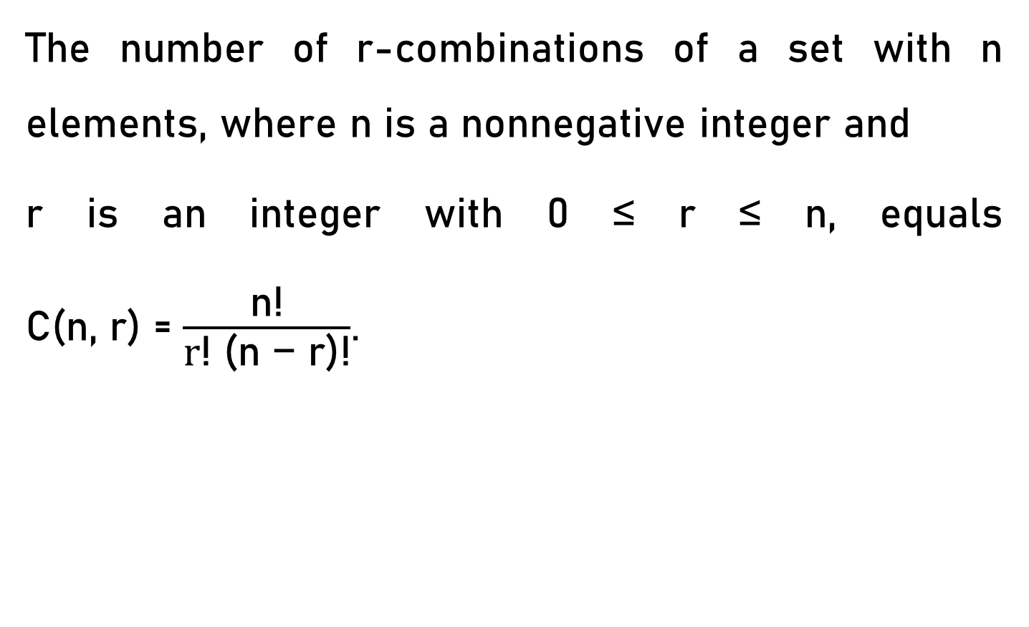
The Pigeonhole Principle
The number of r-combinations of a set with n elements, where n is a nonnegative integer and
r is an integer with 0 ≤ r ≤ n, equals C(n, r) = $\frac{\text{n}\text{!}}{\text{r}\text{!} \text{(}\text{n}\text{ − }\text{r}\text{)!}}$.

Slide 13
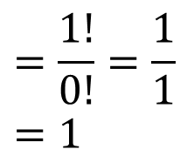
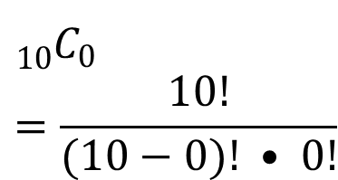
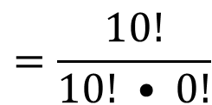
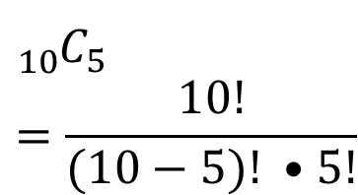
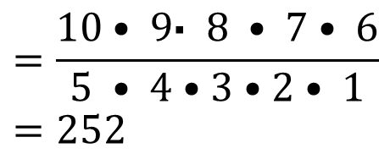
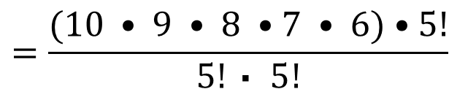
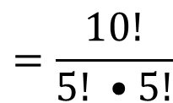
Combination – Example 3
Example: Use the formula to calculate the binomial coefficients ₁₀C₅, ₁₀C₀
0!=1
$${{}_{10}^{}C}_{5}=\frac{10!}{(10−5)! •5!}$$
$$=\frac{10!}{5! •5!}$$
$$=\frac{(10 • 9 • 8 •7 • 6)•5!}{5! \text{• }5!}$$
$$=\frac{10• 9\text{• } 8 • 7• 6}{5 • 4•3•2• 1}=252$$
$${{}_{10}^{}C}_{0}=\frac{10!}{(10−0)! • 0!}$$
$$=\frac{10!}{10! • 0!}$$
$$=\frac{1!}{0!}=\frac{1}{1}=1$$
Example: Binomial coefficients

Slide 14
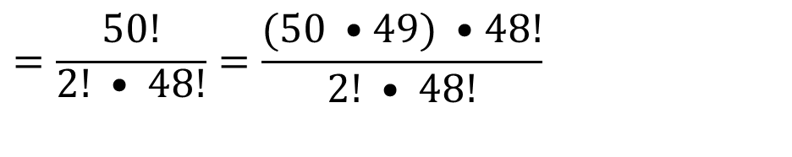
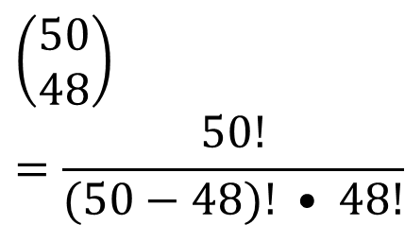
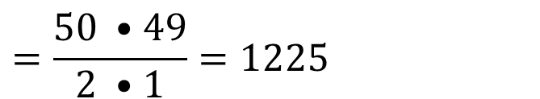
Combination – Example 4
Example: Use the formula to calculate the binomial coefficients and .
0!=1
$$\left(\begin{aligned}&50 \\ &48\end{aligned}\right)=\frac{50!}{(50−48)! • 48!}$$
$$=\frac{50!}{\begin{aligned}2! • 48! \\ \end{aligned}}=\frac{(50 •49) •48!}{2! • 48!}$$
$$=\frac{50 •49}{2 •1}=1225$$
Example: Binomial coefficients

Slide 15
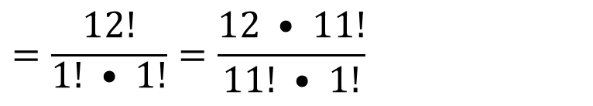
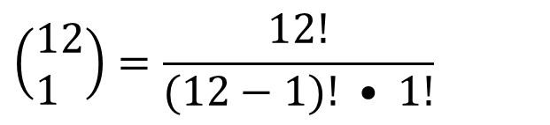
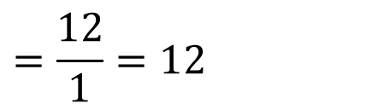
Combination – Example 5
Example: Use the formula to calculate the binomial coefficients and .
0!=1
$$\left(\begin{aligned}&12 \\ &1\end{aligned}\right)=\frac{12!}{(12−1)! • 1!}$$
$$=\frac{12!}{\begin{aligned}1! • 1! \\ \end{aligned}}=\frac{12 • 11!}{11! • 1!}$$
$$=\frac{12}{1}=12$$
Example: Binomial coefficients

Slide 16
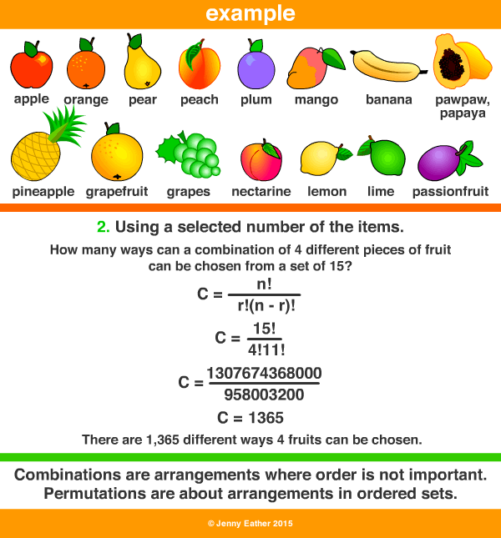
Combination – Example 6
Ques:- How many ways can a combination of 4 different fruit can be chosen from a set of 15?

Slide 17
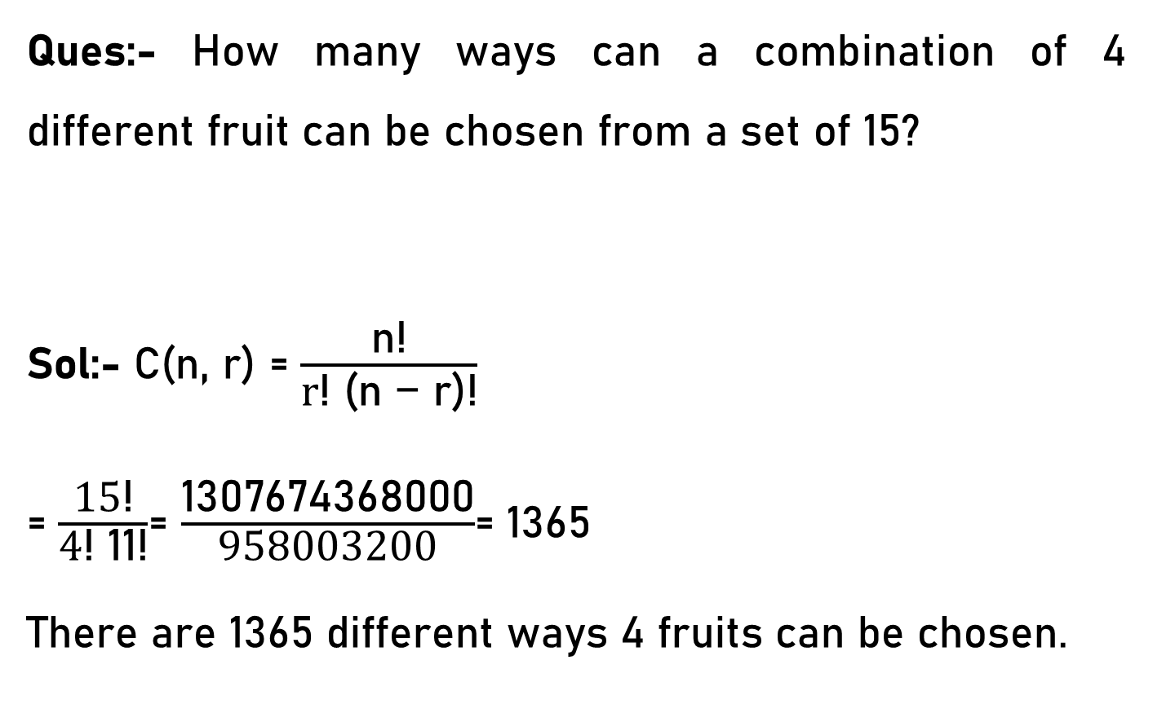
Combination – Example 7
Ques:- How many ways can a combination of 4 different fruit can be chosen from a set of 15?
Sol:- C(n, r) = $\frac{\text{n}\text{!}}{\text{r}\text{!} \text{(}\text{n}\text{ − }\text{r}\text{)!}}$
= $\frac{\text{15}\text{!}}{\text{4}\text{!} \text{11}\text{!}}$= $\frac{\text{1307674368000}}{\text{958003200}}$= 1365
There are 1365 different ways 4 fruits can be chosen.

Slide 18
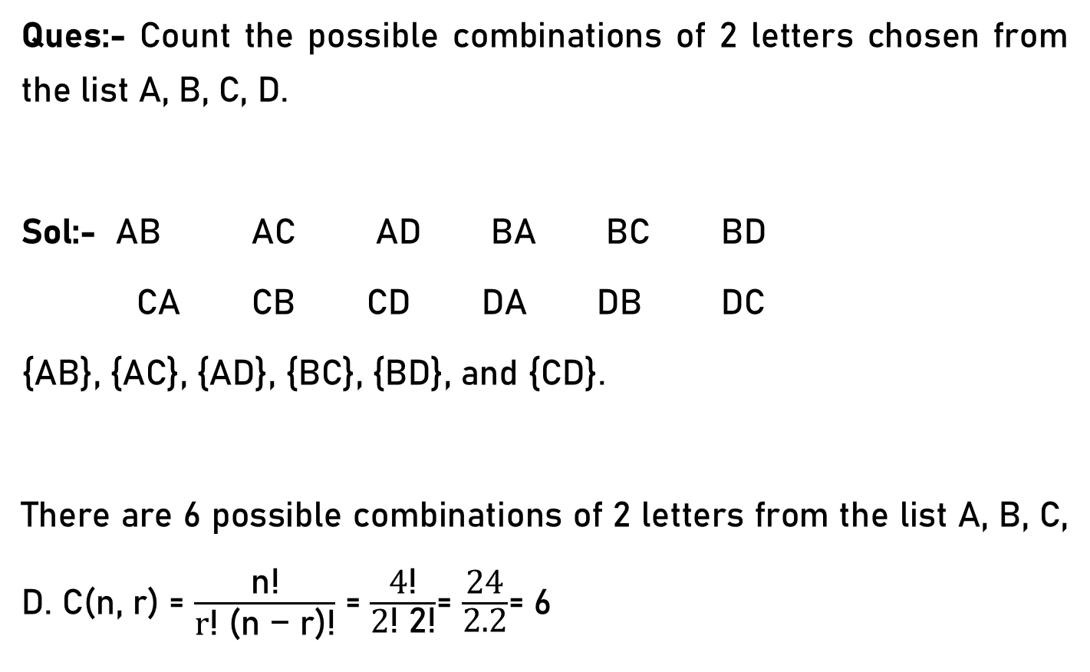
Combination – Example 8
Ques:- Count the possible combinations of 2 letters chosen from the list A, B, C, D.
Sol:- AB AC AD BA BC BD
CA CB CD DA DB DC
{AB}, {AC}, {AD}, {BC}, {BD}, and {CD}.
There are 6 possible combinations of 2 letters from the list A, B, C, D. C(n, r) = $\frac{\text{n}\text{!}}{\text{r}\text{!} \text{(}\text{n}\text{ − }\text{r}\text{)!}}$ = $\frac{\text{4}\text{!}}{\text{2}\text{!} \text{2}\text{!}}$= $\frac{\text{24}}{\text{2.2}}$= 6

Slide 19
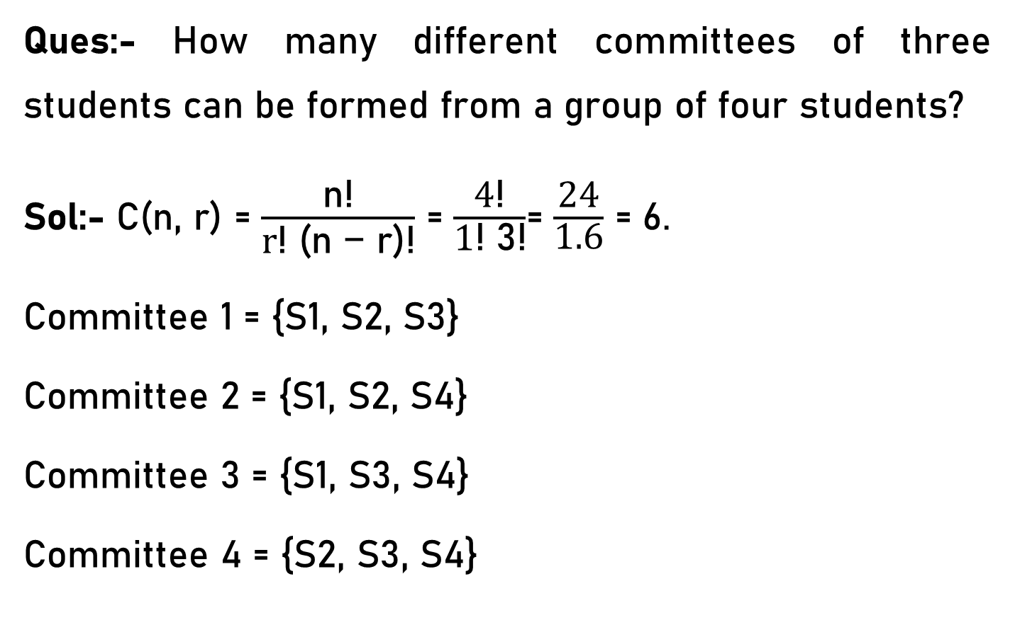
Combination – Example 9
Ques:- How many different committees of three students can be formed from a group of four students?
Sol:- C(n, r) = $\frac{\text{n}\text{!}}{\text{r}\text{!} \text{(}\text{n}\text{ − }\text{r}\text{)!}}$ = $\frac{\text{4}\text{!}}{\text{1}\text{!} \text{3}\text{!}}$= $\frac{\text{24}}{\text{1.6}}$ = 6.
Committee 1 = {S1, S2, S3}
Committee 2 = {S1, S2, S4}
Committee 3 = {S1, S3, S4}
Committee 4 = {S2, S3, S4}

Slide 20
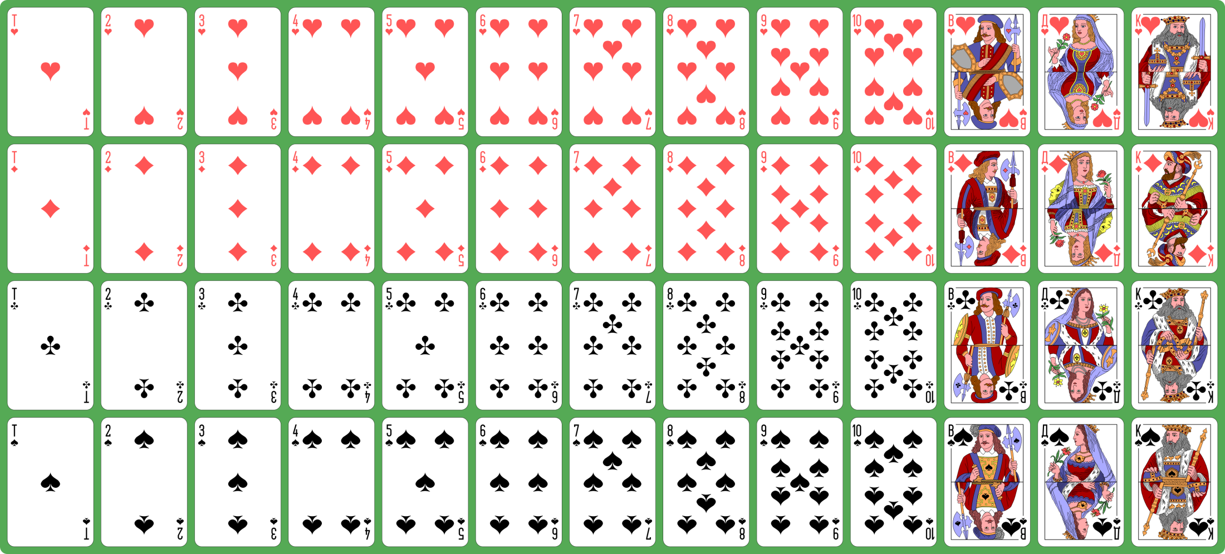
Combination – Example 10

Slide 21
Combination – Example 10
Total = 52
Black = 26
Red = 26
Heart = 13, Diamond = 13, Club = 13, Spade = 13
King = 4, Queen =4, Jack = 4
1 to 10 4 each.

Slide 22
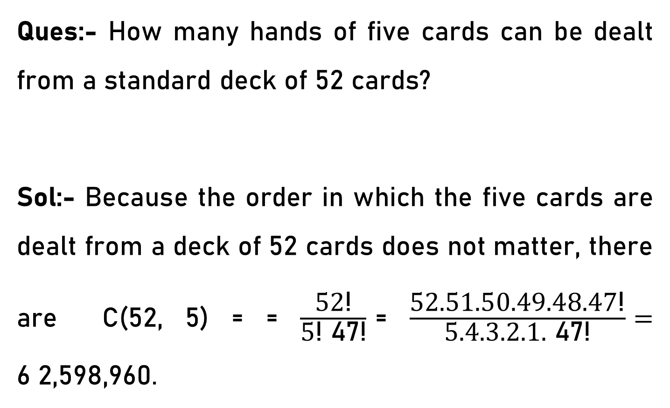
Combination – Example 10
Ques:- How many hands of five cards can be dealt from a standard deck of 52 cards?
Sol:- Because the order in which the five cards are dealt from a deck of 52 cards does not matter, there are C(52, 5) = = $\frac{\text{52}\text{!}}{\text{5}\text{!} \text{47}\text{!}}$= $\frac{\text{52.51.50.49.48.47}\text{!}}{\text{5}\text{.4.3.2.1.}\text{ 47}\text{!}}=$ 6 2,598,960.

