Slide 1
EMTH403
Mathematical Foundation for Computer Science

Slide 2
Lecture Outcomes
understand some counting related to deck of cards
understand with different examples how to count the different possible ways of combination.

Slide 3
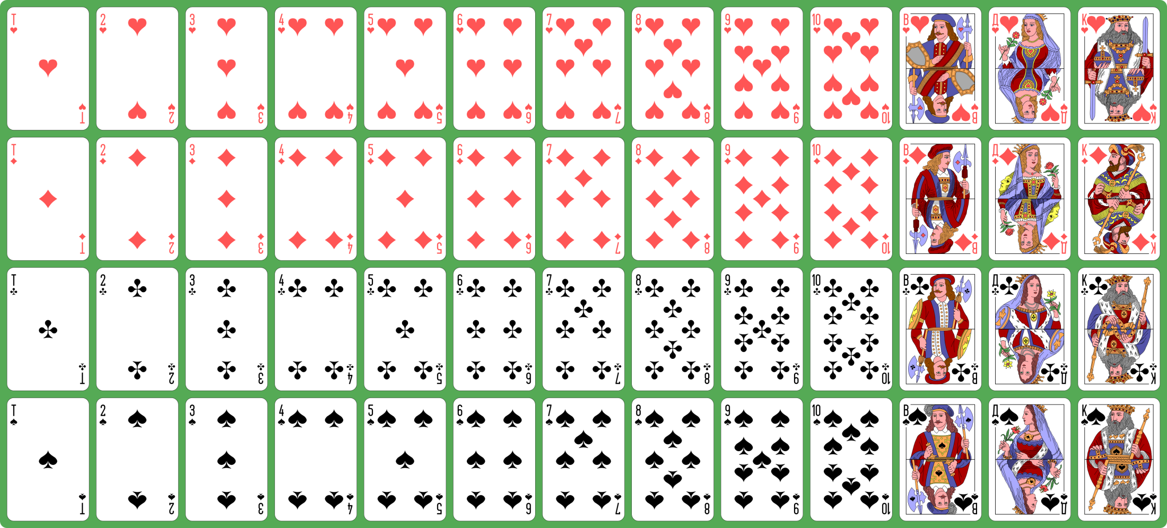
Combination – Example 1

Slide 4
Combination – Example 1
Total = 52
Black = 26
Red = 26
Heart = 13, Diamond = 13, Club = 13, Spade = 13
King = 4, Queen =4, Jack = 4
1 to 10 4 each.

Slide 5
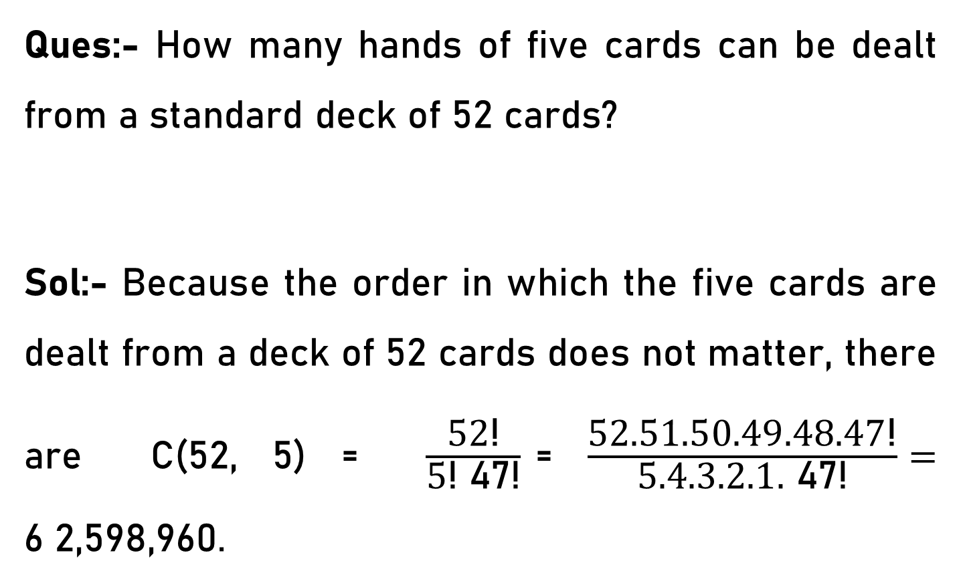
Combination – Example 1
Ques:- How many hands of five cards can be dealt from a standard deck of 52 cards?
Sol:- Because the order in which the five cards are dealt from a deck of 52 cards does not matter, there are C(52, 5) = $\frac{\text{52}\text{!}}{\text{5}\text{!} \text{47}\text{!}}$= $\frac{\text{52.51.50.49.48.47}\text{!}}{\text{5}\text{.4.3.2.1.}\text{ 47}\text{!}}=$ 6 2,598,960.

Slide 6
Combination – Example 2
Ques:- How many ways are there to select five players from a 10-member tennis team to make a trip to a match at another school?
Ans:- C(10, 5) = 252.

Slide 7
Combination – Example 3
Ques:- Suppose that there are 9 faculty members in the mathematics department and 11 in the computer science department.
How many ways are there to select a committee to develop a discrete mathematics course at a school if the committee is to consist of three faculty members from the mathematics department and four from the computer science department?

Slide 8
Combination – Example 3
Sol:- By the product rule, the answer is the product of the number of 3-combinations of a set with nine elements and the number of 4-combinations of a set with 11 elements.
The number of ways to select the committee is
C(9, 3) · C(11, 4)
= 84 · 330
= 27,720.

Slide 9
Combination – Example 4
Ques:- How many bit strings of length 4 contain exactly 2 1s?
Sol:- The positions of 2 1s in a bit string of length 4 form an 2-combination of the set {1, 2, 3,4}.
Hence, there are C(4, 2) bit strings of length n that contain exactly r 1s.

Slide 10
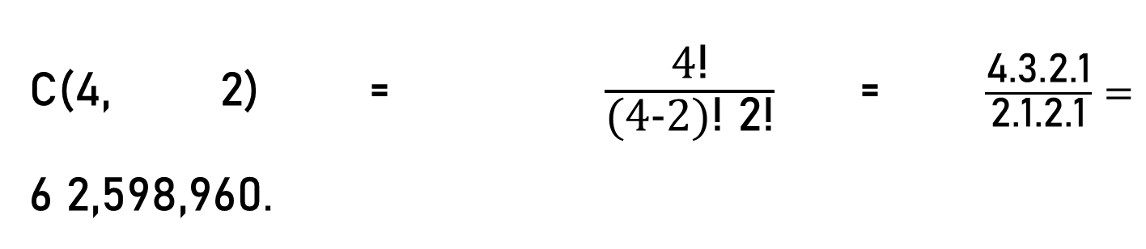
Combination – Example 4
C(4, 2) = $\frac{\text{4}\text{!}}{\text{(4−2)}\text{!} \text{2}\text{!}}$= $\frac{\text{4}\text{.}\text{3.2.}\text{1}}{\text{2.1.}\text{2.1}}=$ 6 2,598,960.
Selecting 2 positions for 1s
1,2
1,3
1,4
2,3
2,4
3,4
Here
1,2 is same as
2,1
1100
1010
1001
0110
0101
0011

Slide 11
Combination – Example 5
Ques:- How many bit strings of length n contain exactly r 1s?
Sol:- The positions of r 1s in a bit string of length n form an r-combination of the set {1, 2, 3, . . . , n}.
Hence, there are C(n, r) bit strings of length n that contain exactly r 1s.

Slide 12
Combination – Example 6
Ques:- How many bit strings of length 10 contain at least three 1s and at least three 0s?
Sol:- The string might contain three 1's and seven O's, four 1's and six O's, five of each, six 1's and four O's, or seven 1's and three O’s.
since we simply need to choose the positions for the 1’s.

Slide 13
Combination – Example 6
Atleast 3 1s And Atleast 3 0s
i.e. 3 1 s, 7 0s
For Example:- 1110000000, 1100000001, 1010100000 etc.
4 1 s, 6 0s
5 1 s, 5 0s
6 1 s, 4 0s
7 1 s, 3 0s
Not to be considered
0 1 s, 10 0s
1 1 s, 9 0s
2 1 s, 8 0s
8 1 s, 2 0s
9 1 s, 1 0s
10 1 s, 0 0s

Slide 14
Combination – Example 6
To select 3 position for 1s out of 10 = C(10, 3).
To select 4 position for 1s out of 10 = C(10, 4)
To select 5 position for 1s out of 10 = C(10, 5)
To select 6 position for 1s out of 10 = C(10, 6)
To select 7 position for 1s out of 10 = C(10, 7).
Therefore the answer is
C(10, 3) + C(10, 4) + C(10, 5) + C(10, 6) + C(10, 7) =
120 + 210 + 252+210+120 = 912.

Slide 15
Combination – Example 7
Ques:- How many bit strings contain exactly eight 0s and 10 1s if every 0 must be immediately followed by a 1?
Ans:- 45.

Slide 16
Combination – Example 7
01 01 01 01 01 01 01 01 11
01 01 01 01 01 01 01 01
C(9, 2)
01 01 01 01 01 01 01 01
C(9, 1)

Slide 17
Combination – Example 8
Ques:- The English alphabet contains 21 consonants and five vowels. How many strings of six lowercase letters of the English alphabet contain a) exactly one vowel?
Sol:- We need to choose the position for the vowel. and this can be done in 6 ways.
Next we need to choose the vowel to use, and this can be done in 5 ways. Each of the other five positions in the string can contain any of the 21 consonants.

Slide 18
Combination – Example 8
{a, b, c, d, … z} – {a, e, i, o, u}
= 26 – 5 = 21 Consonants
V 21 21 21 21 21
21 V 21 21 21 21
21 21 V 21 21 21
21 21 21 V 21 21
21 21 21 21 V 21
21 21 21 21 21 V
= C(6, 1)*C(5, 1)*21*21*21*21*21
= 6 * 5 * 21⁵
= 122,523,030

