Slide 1
EMTH403
Mathematical Foundation for Computer Science

Slide 2
Lecture Outcomes
understand what are trees.
understand what different parts of trees.

Slide 3
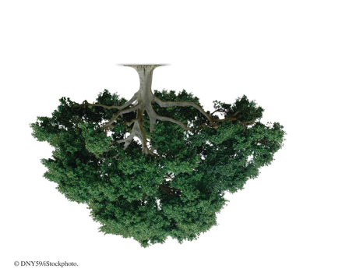
Definition:
A tree is a connected undirected graph with no simple circuits.
Recall: A circuit is a path of length >=1 that begins and ends a the same vertex.

Slide 4

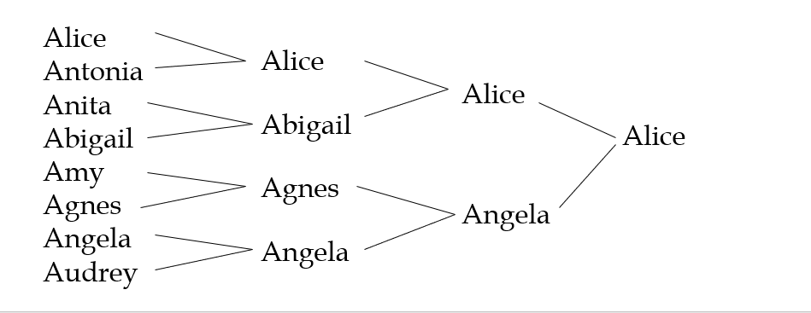
Tournament Trees
A common form of tree used in everyday life is the tournament tree, used to describe the outcome of a series of games, such as a tennis tournament.
A1

Slide 5
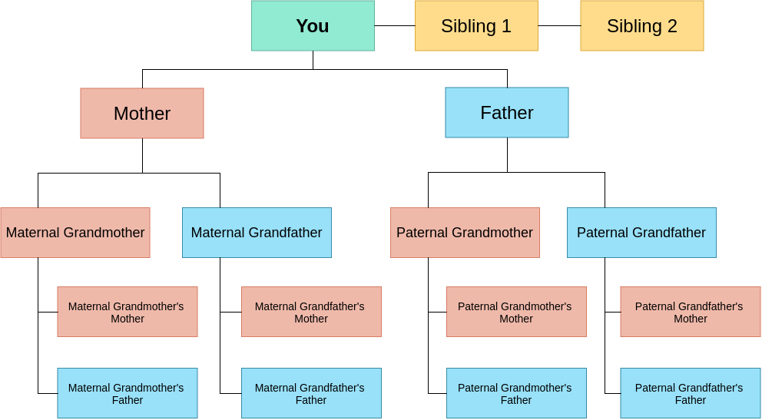
Application

Slide 6
Application: Arithmetic Expression Trees
Example Arithmetic Expression:
A + (B * (C / D) )
+
A
*
B
/
C
D

Slide 7
Theorem
An undirected graph is a tree if and only if there is a unique simple path between any two of its vertices.

Slide 8
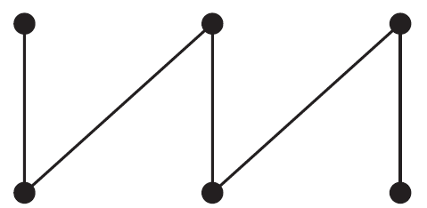
Trees
Which of these graphs are trees?
This graph is connected and has no simple circuits, so it is a tree.

Slide 9
Trees
Which of these graphs are trees?
This graph is connected and has no simple circuits, so it is a tree.

Slide 10
Trees
Which of these graphs are trees?
This graph is not connected, so it is not a tree.

Slide 11
Trees
Which of these graphs are trees?
This graph is connected and has no simple circuits, so it is a tree.

Slide 12
Trees
Which of these graphs are trees?
This graph is connected and has no simple circuits, so it is a tree.

Slide 13
Trees
Which of these graphs are trees?
This graph has a simple circuit, so it is not a tree.

Slide 14
Trees
Which of these graphs are trees?
This graph has a simple circuit, so it is not a tree.

Slide 15
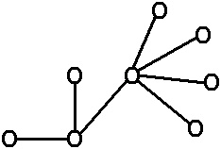


Trees
Definition in terms of Number of Edges and Nodes:
A tree is a finite connected graph such that:
no. of Nodes = no. of Edges + 1
For Example:
3 nodes
2 edges
5 nodes
4 edges
8 nodes
7 edges

Slide 16
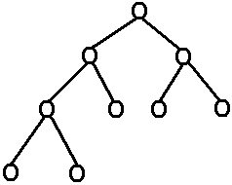
Trees
Defining Parts of a Tree:
Botanical
Generic
Generic
Familial Relations
← root -------tart node
← branch--edge or arc
predecessor
← branch node –
-- internal node
ancestor – parent – father →
successor
descendent – child – son →
← leaf node ---- external node
brothers or siblings
↑
vertex
is another name for node

Slide 17
Trees
root node
a
internal vertex
parent of g
b
c
d
e
f
g
leaf
siblings
h
i

Slide 18
Trees
Answer these questions about the rooted tree illustrated.
Which vertex is the root?
Vertex a is the root, since it is drawn at the top.

Slide 19
Trees
Which vertices are internal?
The internal vertices are the vertices with children, namely a, b, c, d, f, h , j , q, and t.

Slide 20
Trees
Which vertices are leaves?
The leaves are the vertices without children, namely e, g, i, k, l, m, n, o, p, r, s, and u.

Slide 21
Trees
Which vertices are children of j?
The children of j are the vertices adjacent to j and below j, namely q and r.

Slide 22
Trees
Which vertex is the parent of h?
The parent of h is the vertex adjacent to h and above h, namely c.

Slide 23
Trees
Which vertices are siblings of o?
Vertex o has only one sibling, namely p, which is the other child of o's parent, h.

Slide 24
Trees
Which vertices are ancestors of m?
The ancestors of m are all the vertices on the unique simple path from m back to the root, namely f, b and a.

Slide 25
Trees
Which vertices are descendants of b?
The descendants of b are all the vertices that have b as an ancestor, namely e, f, l, m, and n.

Slide 26
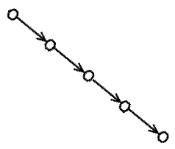
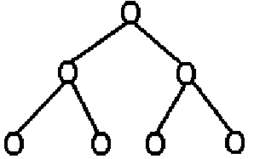
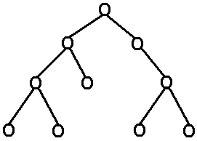
Trees
Kinds of Trees – in terms of branching factor (outdegree).
Unary Trees – outdegree for every node ≤ 1. (a singly linked list)
Binary Trees – outdegree for every node ≤ 2.
Ternary Trees – outdegree for every node ≤ 3.

Slide 27
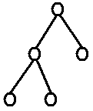
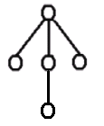
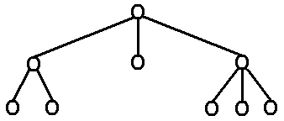

Trees
Ternary Trees – outdegree for every node ≤ 3.
.
.
.
m - ary Trees – outdegree for every node ≤ m.
m
Note: The indegree for every node in a directed tree,
except the root, is 1.

Slide 28
Trees - Example: 3-ary tree
Theorem: A full m - ary tree with i internal vertices contains n = mi +1 vertices
Proof: i internal vertices have m children. Therefore, we have mi vertices. Since the root is not a child we have n = mi + 1 vertices.

