Slide 2
understand chain rule,
enlist types of chain rule,
apply chain rule for solving practical problems.

Slide 3
Chain Rule
Compare Every Item
Term - Found Out

Slide 4
Chain Rule
Types
Direct Proportion
Indirect Proportion

Slide 5
Chain Rule
Direct Proportion
Two Quantities - Directly Proportional
Increase/Decrease - One
Increases/Decreases - Other
Same Extent

Slide 6


Direct Proportion
Two Quantities
Directly Proportional
$\text{Amount} \text{of} \text{Work} \text{Done} α$Number of Men Working
Less Men
More Men
Less Work
More Work

Slide 7
Chain Rule
Indirect Proportion
Two Quantities - Indirectly Proportional
Increase/Decrease - One
Decreases/Increases- Other
Same Extent

Slide 8
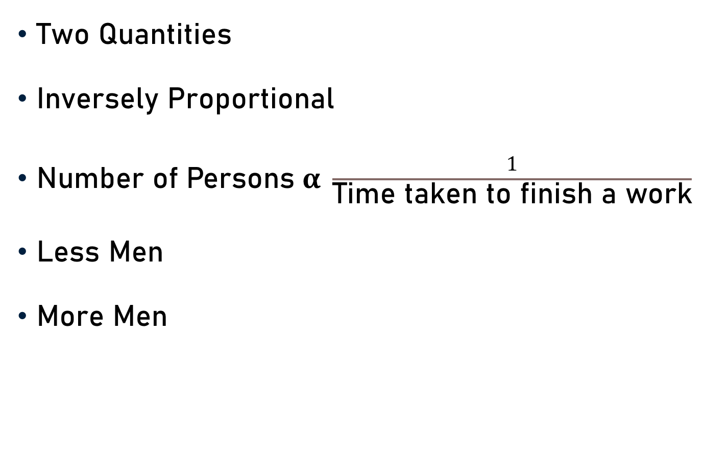
Indirect Proportion
Two Quantities
Inversely Proportional
$\text{Number} \text{of} \text{Persons} α \frac{1}{\text{Time} \text{taken} \text{to} \text{finish} \text{a} \text{work}}$
Less Men
More Men
More Time
Less Time

Slide 9
Fourth Proportion
Fourth proportion to A, B, and C
A : B :: C : X
X – Fourth Proportion
Compare Every Item - Term (Found Out)

Slide 10
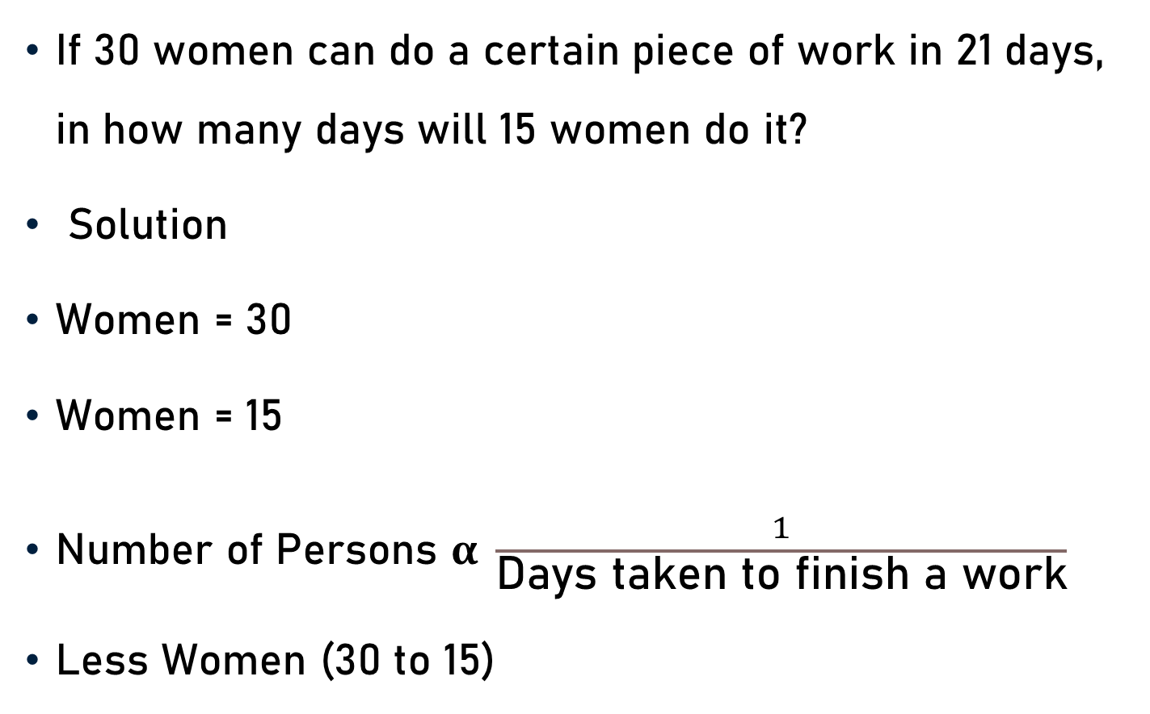
Example 1
If 30 women can do a certain piece of work in 21 days, in how many days will 15 women do it?
Solution
Women = 30
Women = 15
Number of Persons $α \frac{1}{\text{Days} \text{taken} \text{to} \text{finish} \text{a} \text{work}}$
Less Women (30 to 15)
Days = 21
More Days/Time

Slide 11

Example 1 - Indirect Proportion
Number of days = X (Say)
$\text{30} α \frac{\text{1}}{\text{21}}$ and$\text{15} α \frac{\text{1}}{\text{X}}$
$\frac{\text{1}}{\text{30}}$ : $\frac{\text{1}}{\text{15}}$ : : 21 : X
$\frac{\text{30}}{\text{1}\text{5}}$ = $\frac{\frac{1}{21}}{\frac{1}{X}}$
$\frac{\text{30}}{\text{1}\text{5}}$ = $\frac{\text{X}}{\text{21}}$

Slide 12

Example 1 - Indirect Proportion
$\frac{\text{X}}{\text{21}}$ = $\frac{\text{30}}{\text{15}}$
$\text{X}\text{ = }\frac{\text{30 }\text{x}\text{ 21}}{\text{15}}$
X = 42
2
1

Slide 13
Example 2
A kitchen requires 100 kgs of wheat for a week. How many kgs of wheat will it require for 42 days?
Let the required quantity be ‘x’ kg.
A Week
More Days - More Quantity
7 : 42 : : 100 : x
= 7 days
(Direct Proportion)

Slide 14
Example 2
Let the required quantity be ‘x’ kg.
A Week
More Days - More Quantity
7 : 42 : : 100 : x
7 x = 42 × 100
x = 600 Kg
= 7 days
(Direct Proportion)
1
6

Slide 15
Example 3
The price of 5.5 dozen pens is Rs. 1287. What is the price of 16 such pens?
Let the cost of 16 pens be Rs. x.
5.5 dozen pens
Less Pens - Less Cost
66 : 16 : : 1287 : x
= (5.5 × 12) pens
= 66 pens
(Direct Proportion)

Slide 16
Example 3
Let the cost of 16 pens be Rs. x.
5.5 dozen pens
Less Pens - Less Cost
66 : 16 : : 1287 : x
66x = 16 × 1287
x = Rs. 312
= (5.5 × 12) pens
= 66 pens
(Direct Proportion)
1
33
8
39

Slide 17
Example 4
56 men can complete a piece of work in 24 days. In how many days can 42 men complete the same piece of work?
Let the required number of days = x
Less Men - More Days
42 : 56 : : 24 : x
(Indirect Proportion)

Slide 18
Example 4
Let the required number of days = x
Less Men - More Days
42 : 56 : : 24 : x
42x = 56 × 24
x = 32 Days
(Indirect Proportion)
1
6
8
4

Slide 19
Example 5
If 10 men can build a wall 35 meters long in 7 days , what length of a similar wall can be built by 18 men in 4 days?
Solution
Men = 10
Men = 18
Days = 7
Days = 4
Length = 35 m
More Length
Length = 35 m
Less Length

Slide 20
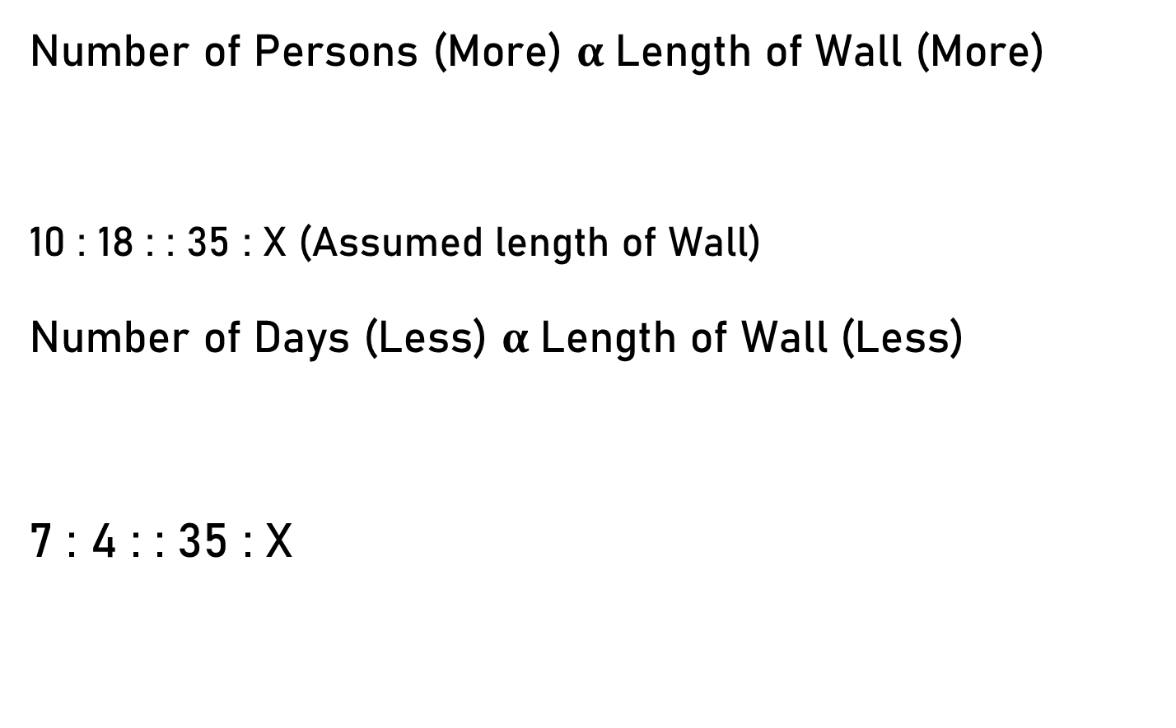
Example 5 - Direct Proportion
Number of Persons (More) $α$Length of Wall (More)
10 : 18 : : 35 : X (Assumed length of Wall)
Number of Days (Less) $α$Length of Wall (Less)
7 : 4 : : 35 : X
(Direct Proportion)
(Direct Proportion)

Slide 21


Example 5 - Direct Proportion
10 : 18
7 : 4
$\frac{\text{10}}{\text{18}}$ and $\frac{\text{7}}{\text{4}}$
X = $\frac{\text{3}\text{5 .18 . 4}}{\text{10 . 7}}$
X = 36
: : 35 : X
=$\frac{\text{35}}{\text{X}}$
1
5
2
= 18 . 2
1
5
1

Slide 22
Example 6
If 6 men working 4 hours a day can reap a field in 10 days, in how many days will 8 men reap the field, working 2 hours a day?
Solution
Men = 6
Men = 8
Hours = 4
Hours = 2
Days = 10
Less days
Days = 10
More days

Slide 23
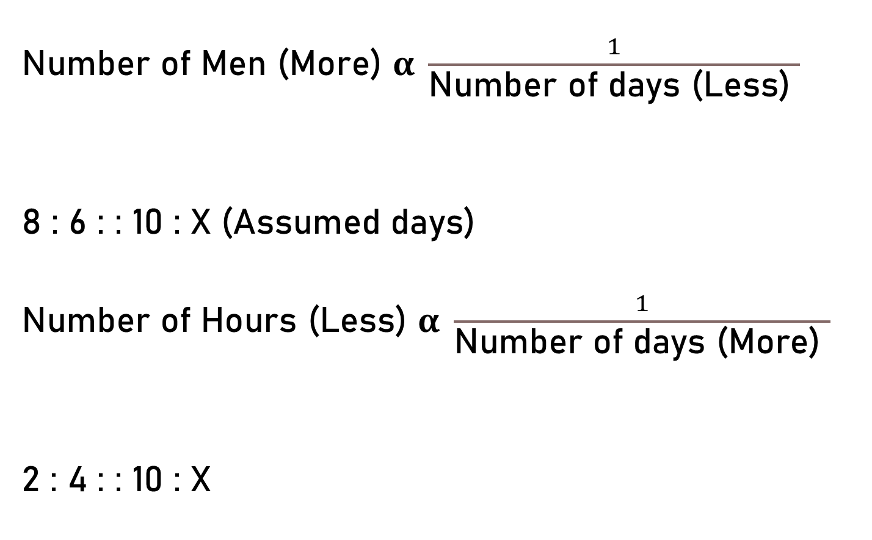
Example 6 - Indirect Proportion
Number of Men (More) $α \frac{1}{\text{Number} \text{of} \text{days}\text{ (}\text{Less}\text{) }}$
8 : 6 : : 10 : X (Assumed days)
Number of Hours (Less) $α \frac{1}{\text{Number} \text{of} \text{days}\text{ (}\text{More}\text{) }}$
2 : 4 : : 10 : X
(Indirect Proportion)
(Indirect Proportion)

Slide 24


Example 6 - Indirect Proportion
8 : 6
2 : 4
$\frac{\text{8}}{\text{6}}$ and $\frac{\text{2}}{\text{4}}$
X = $\frac{\text{10 . 6 . 4}}{\text{8 . 2}}$
X = 15
: : 10 : X
=$\frac{\text{10}}{\text{X}}$
5
3
1
= 5 . 3
1
2
1

Slide 25
Example 7
If 8 men working 9 hours a day can build a wall 18m long, 2m wide and 12m high in 10 days, how many men will be required to build a wall 32m long, 5m wide and 9m high, working 6 hours a day in 8 days?
Solution
More length and breadth, More Men
Less height, Less Men
Less days, More Men
Less hour, More Men
Direct
Direct
Indirect
Indirect

Slide 26
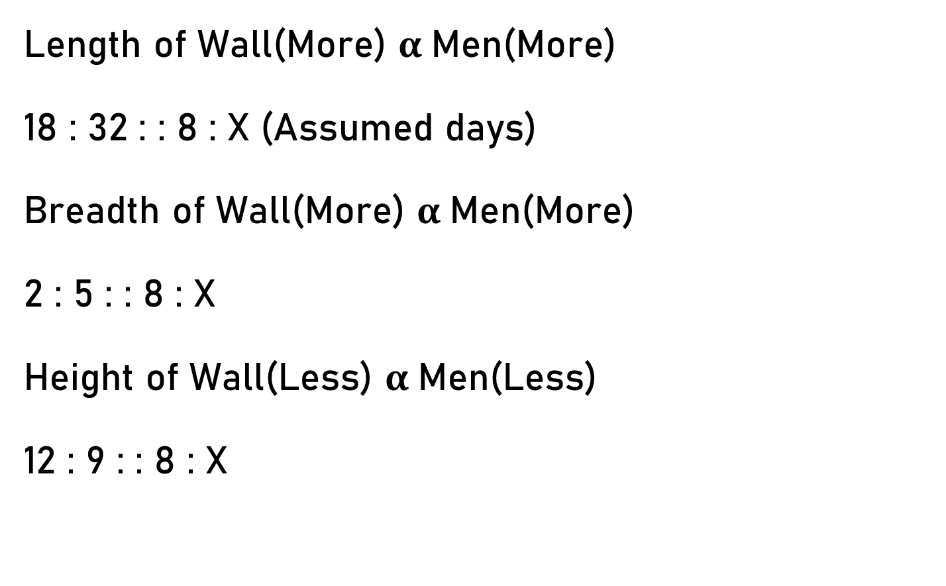
Example 7
Length of Wall(More) $α$Men(More)
18 : 32 : : 8 : X (Assumed days)
Breadth of Wall(More) $α$Men(More)
2 : 5 : : 8 : X
Height of Wall(Less) $α$Men(Less)
12 : 9 : : 8 : X
(Direct Proportion)
(Direct Proportion)
(Direct Proportion)

Slide 27
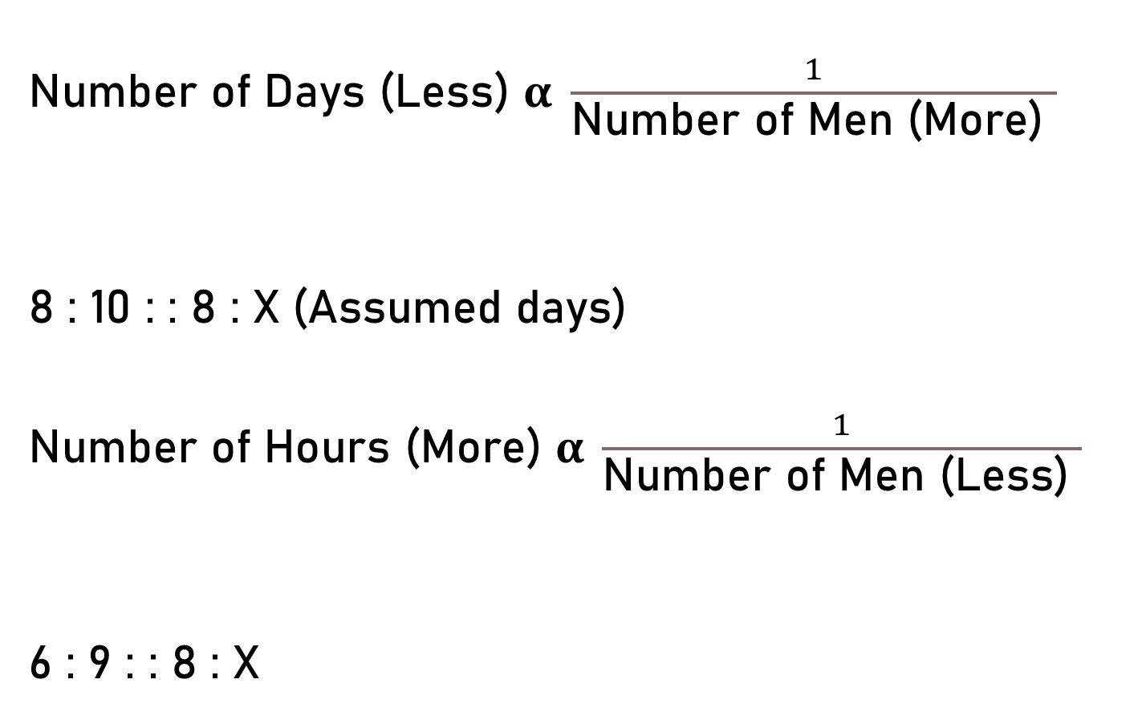
Example 7
Number of Days ($\text{Less}$) $α \frac{1}{\text{Number} \text{of} \text{Men}\text{ (}\text{More}\text{) }}$
8 : 10 : : 8 : X (Assumed days)
Number of Hours ($\text{More}$) $α \frac{1}{\text{Number} \text{of} \text{Men}\text{ (}\text{Less}\text{) }}$
6 : 9 : : 8 : X
(Indirect Proportion)
(Indirect Proportion)

Slide 28

Example 7
18 : 32
2 : 5
12 : 9
8 : 10
6 : 9
$\frac{\text{1}\text{8}}{\text{32}}$, $\frac{\text{2}}{\text{5}}$, $\frac{\text{12}}{\text{9}}$, $\frac{\text{8}}{\text{10}}$, and $\frac{\text{6}}{\text{9}}$ = $\frac{\text{8}}{\text{X}}$
: : 8 : X

Slide 29

Example 7 - Direct Proportion
$\frac{\text{18}}{\text{32}}$, $\frac{\text{2}}{\text{5}}$, $\frac{\text{12}}{\text{9}}$, $\frac{\text{8}}{\text{10}}$, and $\frac{\text{6}}{\text{9}}$ = $\frac{\text{8}}{\text{X}}$
X = $\frac{\text{8 . 32 . 5}\text{ . }\text{9}\text{ . }\text{10}\text{ .}\text{9}}{\text{18 . 2}\text{ . }\text{1}\text{2 .8 . }\text{6}}$
X = 50
1
4
1
16
1
3
1
2
1
3
1
2
1
1
1

Slide 30
Example 8
The cost of 16 packets of salt, each weighing 900 grams is Rs. 28. What will be the cost of 27 packets, if each packet weighs 1 kg?
Let the required cost = Rs. x.
More Packets - More Cost (Direct Proportion)
More Weight - More Cost (Direct Proportion)
Packets - 16 : 27
Weight - 900 : 1000

Slide 31


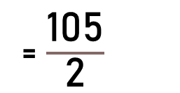
Example 8
16 : 27
900 : 1000
$\frac{\text{1}\text{6}}{\text{27}}$ and $\frac{\text{900}}{\text{1000}}$
X = $\frac{\text{2}\text{8}\text{ . 27 . 1000}}{\text{16 . 900}}$
X = 52.50
Packets
: : 28 : X
Weights
=$\frac{\text{28}}{\text{X}}$
5
10
7
3
= $\frac{\text{105}}{\text{2}}$
2
8
9

Slide 32
Example 9
3 men or 6 women can do a piece of work in 20 days. In how many days will 12 men and 8 women do the same work?
3 men or 6 women – 20 Days
12 men and 8 women – ? Days
More Women - Less Days (Indirect Proportion)
3 men or 6 women – 20 Days
3 x 4 men or 6 x 4 women
Or 12 men or 24 women

Slide 33
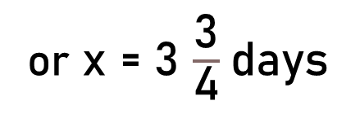

Example 9
12 men or 24 women
12 men and 8 women or (24 + 8) women
Let the required number of days = x
6 women – 20 Days
More Women - Less Days (Indirect Proportion)
32 : 6 : : 20 : x
32 x = 6 × 20
= 32 women
4
3
or x = $\frac{\text{15}}{\text{4}}$
or x = 3 $\frac{\text{3}}{\text{4}}$days
8
5

Slide 34
Example 10
64 persons can dig a trench 50 m long, 2 m wide and 2 m deep in 5 days, working 12 hours daily. In how many days, working 8 hours daily, will 80 persons dig another trench 75 m long, 4 m wide and 3 m deep?
More Persons - Less Days (Indirect Proportion)
More Length - More Days (Direct Proportion)
More Width - More Days (Direct Proportion)
More Depth - More Days (Direct Proportion)
Less Working Hours - More Days (Indirect Proportion)

Slide 35

Example 10
Let the required number of days be x
80 : 64
50 : 75
2 : 4
2 : 3
8 : 12
$\frac{\text{80}}{\text{64}}$, $\frac{\text{50}}{\text{75}}$, $\frac{\text{2}}{\text{4}}$, $\frac{\text{2}}{\text{3}}$, and $\frac{\text{8}}{\text{12}}$ = $\frac{\text{5}}{\text{X}}$
Persons
Length
Width
: : 5 : X
Depth
Working Hours

Slide 36

Example 10
$\frac{\text{80}}{\text{64}}$, $\frac{\text{50}}{\text{75}}$, $\frac{\text{2}}{\text{4}}$, $\frac{\text{2}}{\text{3}}$, and $\frac{\text{8}}{\text{12}}$ = $\frac{\text{5}}{\text{X}}$
X = $\frac{\text{5}\text{ . 64 . 75 . 4 . 3 . 12}}{\text{80 . }\text{50 . 2 . 2}\text{ . }\text{8}}$
X = $\frac{\text{2700}}{\text{10}\text{0}}$
X = 27
8
10
10
27

Slide 37
Example 11
The normal dosage of a particular medicine is ‘t’ tablets per day for each patient. A hospital’s current supply of these tablets will last ‘p’ patients for ‘d’ days. If the recommended dosage increases by 20% and the number of patients decreases by one-third, then for how many days will the hospital’s supply last?
More Dosage - Less Days (Indirect Proportion)
Less Patients - More Days (Indirect Proportion)

Slide 38
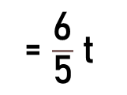
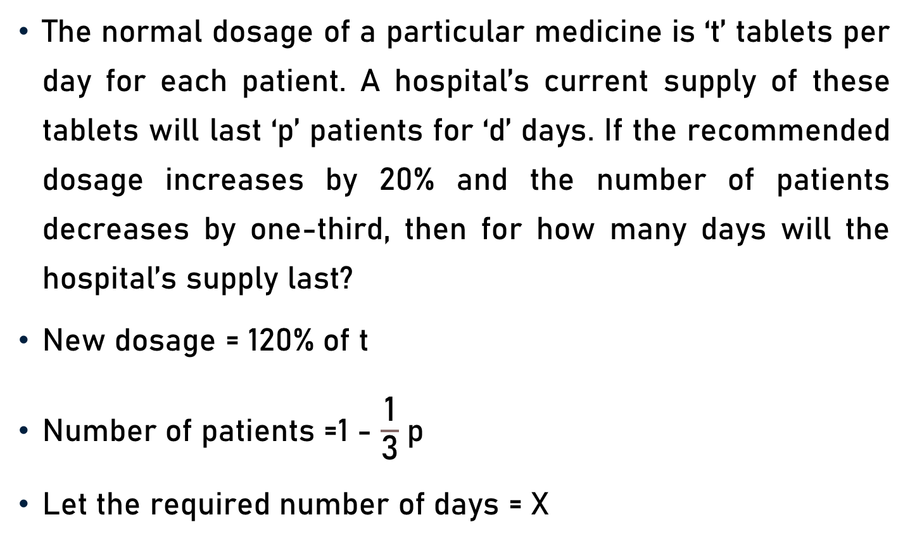

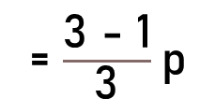

Example 11
The normal dosage of a particular medicine is ‘t’ tablets per day for each patient. A hospital’s current supply of these tablets will last ‘p’ patients for ‘d’ days. If the recommended dosage increases by 20% and the number of patients decreases by one-third, then for how many days will the hospital’s supply last?
New dosage = 120% of t
Number of patients =1 - $\frac{\text{1}}{\text{3}}$p
Let the required number of days = X
6
= $\frac{\text{12}\text{0}}{\text{100}}$x t
= $\frac{\text{6}}{\text{5}}$t
5
= $\frac{\text{3 − 1}}{\text{3}}$p
= $\frac{\text{2}}{\text{3}}$p

Slide 39



Example 11
$\frac{\text{6}}{\text{5}}$t : t
$\frac{\text{2}}{\text{3}}$p : p
$\frac{\frac{\text{6}}{\text{5}} \text{t}}{\text{t}}$ and $\frac{\frac{\text{2}}{\text{3}} \text{p}}{\text{p}}$
X = $\frac{\text{d}\text{ . }\text{t}\text{ . }\text{p}}{\frac{\text{6}}{\text{5}} \text{t}\text{. }\frac{\text{2}}{\text{3}} \text{p}}$
Dosage
: : d : X
Patients
=$\frac{\text{d}}{\text{X}}$
or X = $\frac{\text{5}\text{d}}{\text{4}}$
2

Slide 40
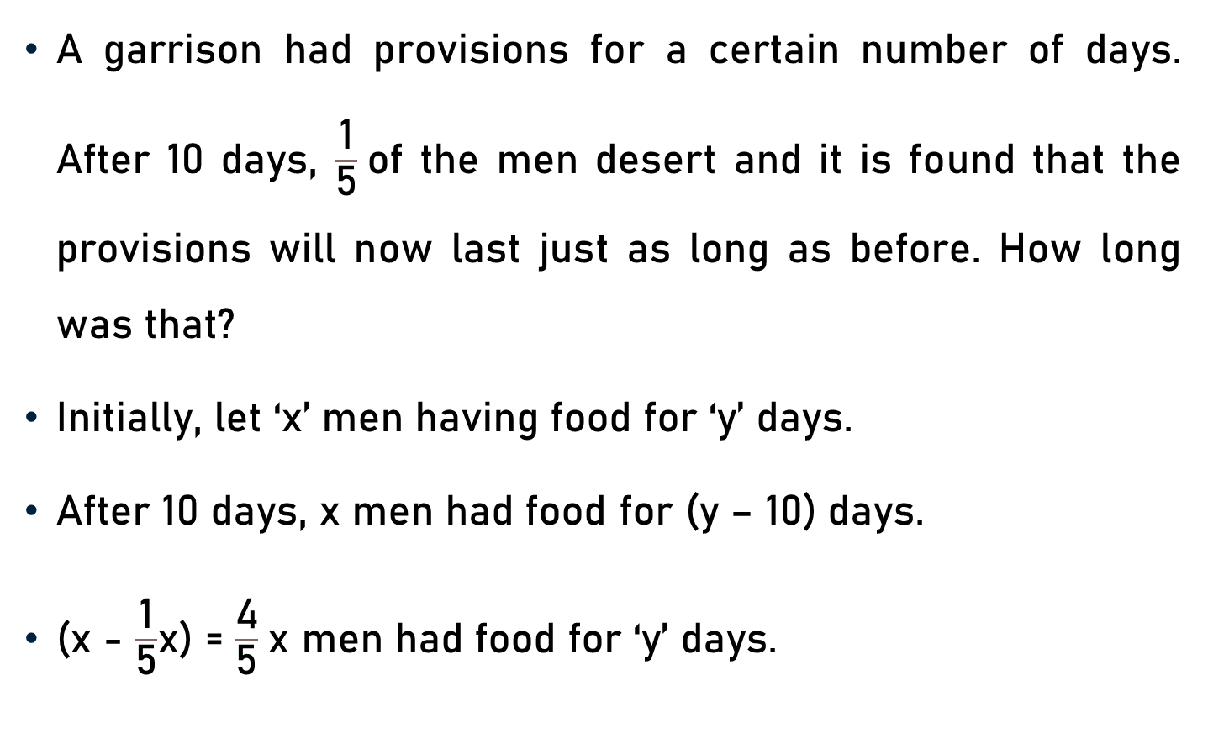
Example 12
A garrison had provisions for a certain number of days. After 10 days, $\frac{\text{1}}{\text{5}}$of the men desert and it is found that the provisions will now last just as long as before. How long was that?
Initially, let ‘x’ men having food for ‘y’ days.
After 10 days, x men had food for (y – 10) days.
(x - $\frac{\text{1}}{\text{5}}$x) = $\frac{\text{4}}{\text{5}}$x men had food for ‘y’ days.

Slide 41
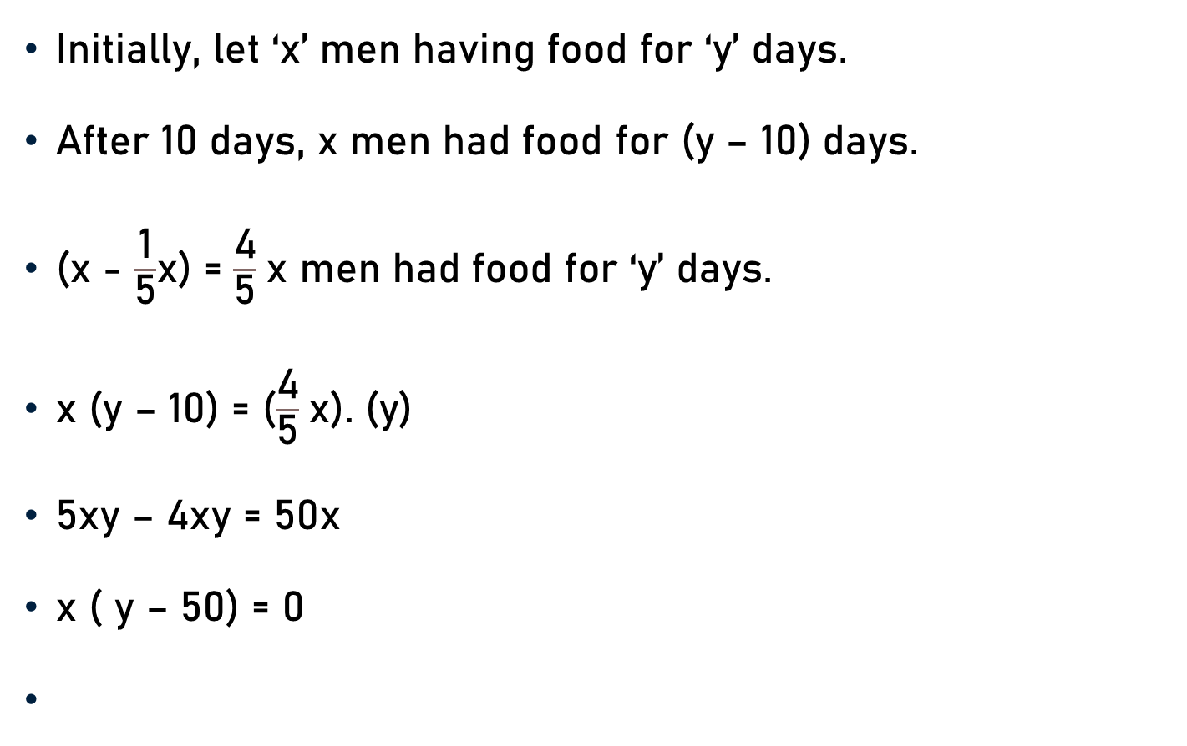
Example 12
Initially, let ‘x’ men having food for ‘y’ days.
After 10 days, x men had food for (y – 10) days.
(x - $\frac{\text{1}}{\text{5}}$x) = $\frac{\text{4}}{\text{5}}$x men had food for ‘y’ days.
x (y – 10) = ($\frac{\text{4}}{\text{5}}$x). (y)
5xy – 4xy = 50x
x ( y – 50) = 0
or 5xy – 50x = 4xy
or xy – 50x = 0
x = 0 or y – 50 = 0
or y = 50

Slide 42
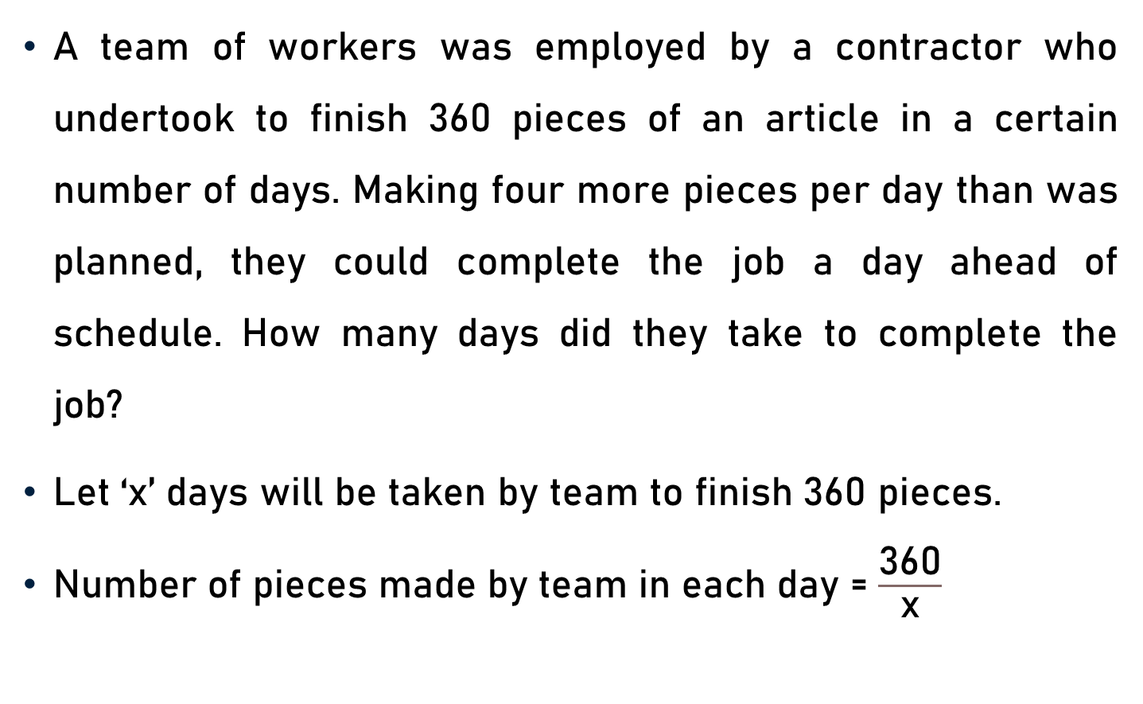
Example 13
A team of workers was employed by a contractor who undertook to finish 360 pieces of an article in a certain number of days. Making four more pieces per day than was planned, they could complete the job a day ahead of schedule. How many days did they take to complete the job?
Let ‘x’ days will be taken by team to finish 360 pieces.
Number of pieces made by team in each day = $\frac{\text{360}}{\text{x}}$

Slide 43
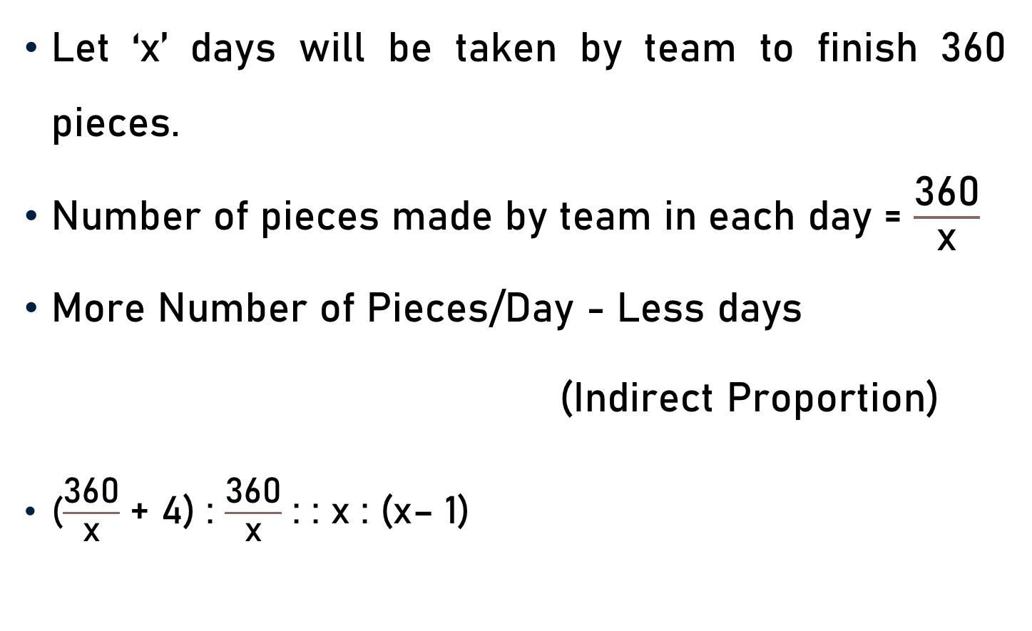
Example 13
Let ‘x’ days will be taken by team to finish 360 pieces.
Number of pieces made by team in each day = $\frac{\text{360}}{\text{x}}$
More Number of Pieces/Day - Less days
(Indirect Proportion)
($\frac{\text{360}}{\text{x}}$ + 4) : $\frac{\text{360}}{\text{x}}$ : : x : (x– 1)

Slide 44
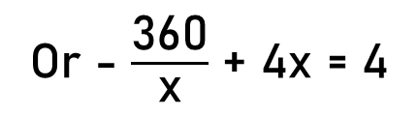

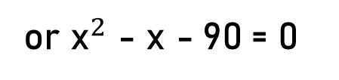
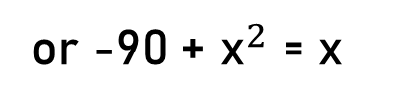
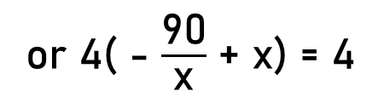
Example 13
($\frac{\text{360}}{\text{x}}$ + 4) : $\frac{\text{360}}{\text{x}}$ : : x : (x– 1)
($\frac{\text{360}}{\text{x}}$ + 4). (x– 1) = $\frac{\text{360}}{\text{x}}$ . x
$\text{360}$ - $\frac{\text{360}}{\text{x}}$ + 4x -4 = 360
- $\frac{\text{90}}{\text{x}}$ + x = 1
x = 10 or -9
x = 10 (Because x = -9 not possible)
Or - $\frac{\text{360}}{\text{x}}$ + 4x = 4
or 4( - $\frac{\text{9}\text{0}}{\text{x}}$ + x) = 4
or -$\text{90}$+ ${\text{x}}^{2}$ = x
or ${\text{x}}^{2}$ - x -$\text{90}$= 0
or (x – 10).(x + 9) = 0

Slide 45
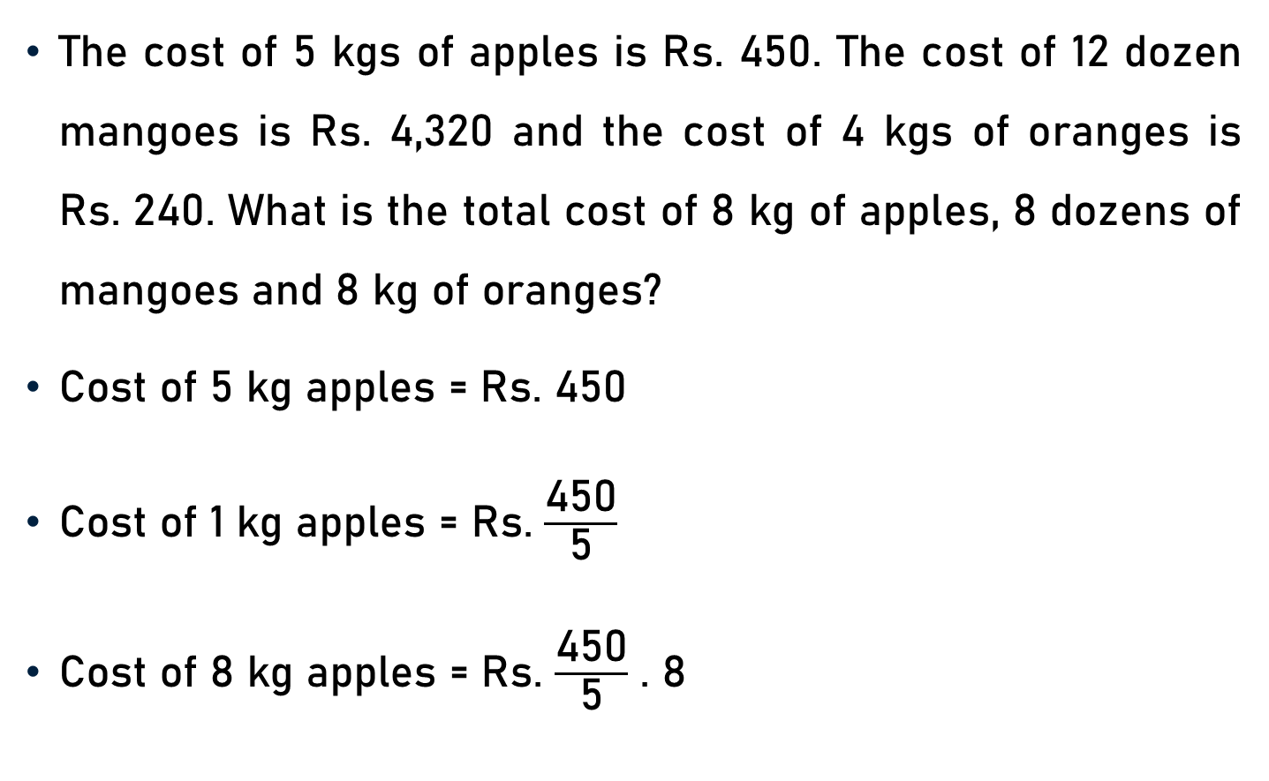
Example 14
The cost of 5 kgs of apples is Rs. 450. The cost of 12 dozen mangoes is Rs. 4,320 and the cost of 4 kgs of oranges is Rs. 240. What is the total cost of 8 kg of apples, 8 dozens of mangoes and 8 kg of oranges?
Cost of 5 kg apples = Rs. 450
Cost of 1 kg apples = Rs. $\frac{\text{450}}{\text{5}}$
Cost of 8 kg apples = Rs. $\frac{\text{450}}{\text{5}}$ . 8
90
= Rs. 720

Slide 46
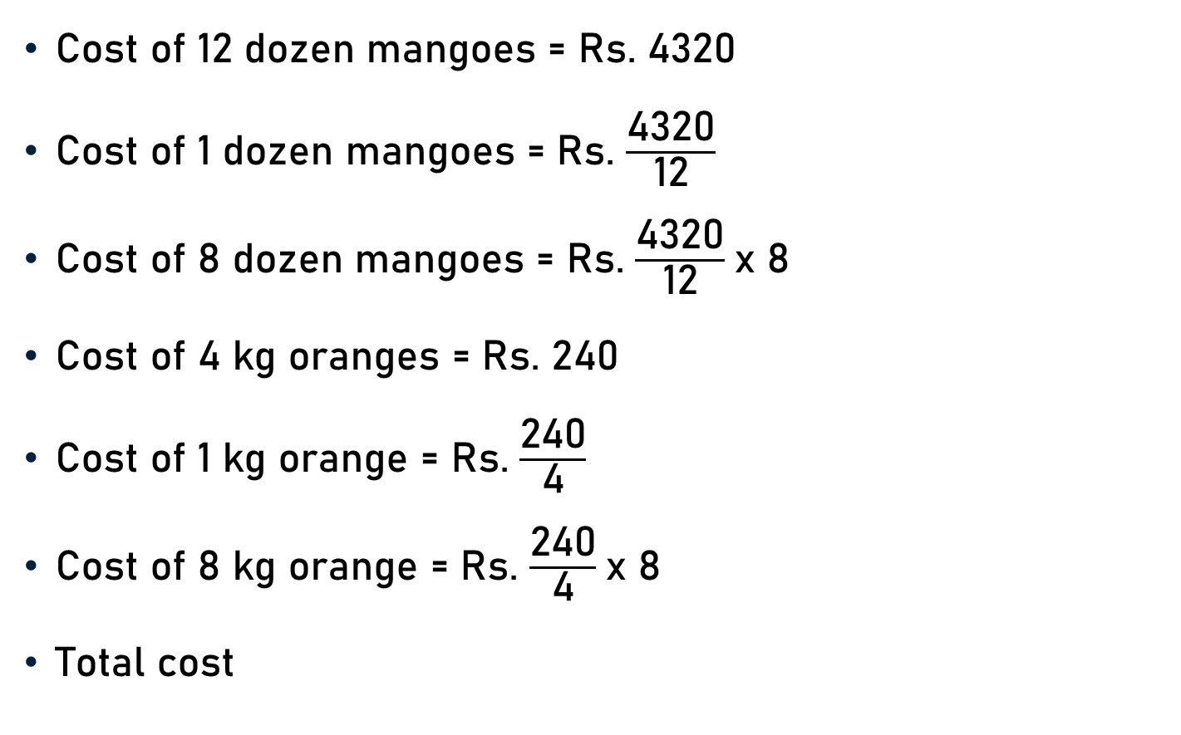
Example 14
Cost of 12 dozen mangoes = Rs. 4320
Cost of 1 dozen mangoes = Rs. $\frac{\text{4}\text{32}\text{0}}{\text{12}}$
Cost of 8 dozen mangoes = Rs. $\frac{\text{4}\text{32}\text{0}}{\text{12}}$x 8
Cost of 4 kg oranges = Rs. 240
Cost of 1 kg orange = Rs. $\frac{\text{24}\text{0}}{\text{4}}$
Cost of 8 kg orange = Rs. $\frac{\text{24}\text{0}}{\text{4}}$x 8
Total cost
360
= Rs. 2880
60
= Rs. 480
= Rs. (720 + 2880 + 480)
= Rs. 4080

Slide 47
Example 15
2 men and 7 boys can do a piece of work in 14 days; 3 men and 8 boys can do the same in 11 days. In how many days 8 men and 6 boys can do the three times the amount of this work ?
More Boys - Less Days (Indirect Proportion)
More Work - More Days (Direct Proportion)
(2 × 14) men + (7 × 14) boys
or (3 × 11) men + (8 × 11) boys

Slide 48
Example 15
33 men + 88 boys
-(28 men + 98 boys)
= 5 men + 10 boys
(2 × 14) men + (7 × 14) boys
(3 × 11) men + (8 × 11) boys
5 men ≡ 10 boys or 1 man ≡ 2 boys
(2 men + 7 boys) ≡ (2 × 2 + 7) boys = 11 boys
(8 men + 6 boys) ≡ (8 × 2 + 6) boys = 22 boys
Let the required number of days be x.
Boys - 22 : 11
Work - 1 : 3
: : 14 : X

Slide 49

Example 15
Boys
$\text{22 }$: 11
$\text{1}$: 3
$\frac{\text{22}}{\text{11}}$ and $\frac{\text{1}}{\text{3}}$ = $\frac{\text{14}}{\text{X}}$
X = $\frac{\text{11 . 3 . 14}}{\text{22} \text{.} \text{1}}$
X =$\text{2}$1
: : 14 : X
Work
7
2

Slide 50
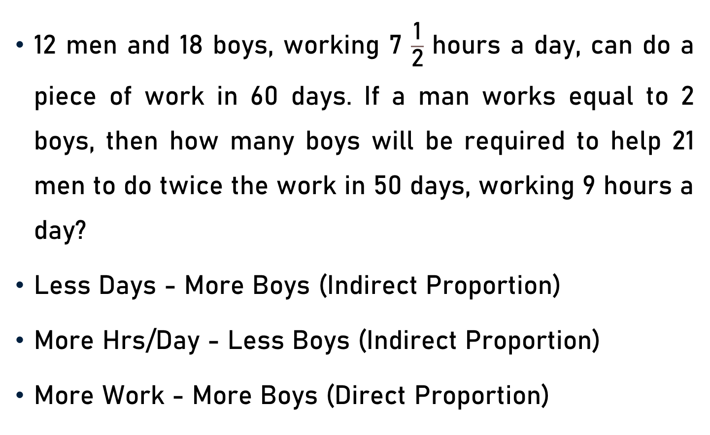
Example 16
12 men and 18 boys, working 7 $\frac{\text{1}}{\text{2}}$ hours a day, can do a piece of work in 60 days. If a man works equal to 2 boys, then how many boys will be required to help 21 men to do twice the work in 50 days, working 9 hours a day?
Less Days - More Boys (Indirect Proportion)
More Hrs/Day - Less Boys (Indirect Proportion)
More Work - More Boys (Direct Proportion)

Slide 51
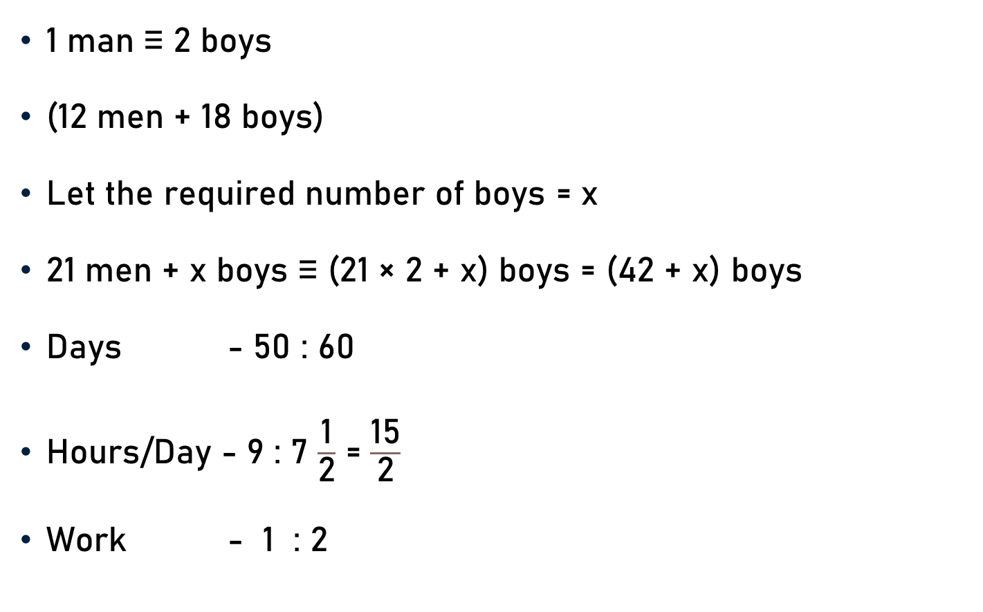
Example 15
1 man ≡ 2 boys
(12 men + 18 boys)
Let the required number of boys = x
21 men + x boys ≡ (21 × 2 + x) boys = (42 + x) boys
Days - 50 : 60
Hours/Day - 9 : 7 $\frac{\text{1}}{\text{2}}$ = $\frac{\text{15}}{\text{2}}$
Work - 1 : 2
≡ (12 × 2 + 18) boys = 42 boys
: : 42 : 42 + x

Slide 52

Example 16
Days - 50 : 60
Hours/Day - 9 : 7 $\frac{\text{1}}{\text{2}}$ = $\frac{\text{15}}{\text{2}}$
Work - 1 : 2
$\frac{\text{50}}{\text{60}}$, $\frac{\text{9}}{\frac{\text{15}}{\text{2}}}$ and $\frac{\text{1}}{\text{2}}$ = $\frac{\text{42}}{\text{42 + }\text{x}}$
($\text{42 + }\text{x}$) = $\frac{\text{42 . 60. 15. 2}}{\text{50. 9. 1. 2}}$
$\text{42 + }\text{x}$= 84
$\text{x}$= $\text{42 }$
: : 42 : 42 + x

Slide 53
Conclusion
Chain Rule
Compare Every Item
Term - Found Out
Direct Proportion
Two Quantities - Directly Proportional
Increase/Decrease (One)- Increase/Decrease (Other)
Indirect Proportion
Two Quantities - Indirectly Proportional
Increase/Decrease (One) - Decreases/Increases (Other)

Slide 54
Summary
Time & Work
Chain Rule

