Slide 2
develop understanding about the basic concepts of wages and work,
solve problems relating to wages and work.

Slide 3
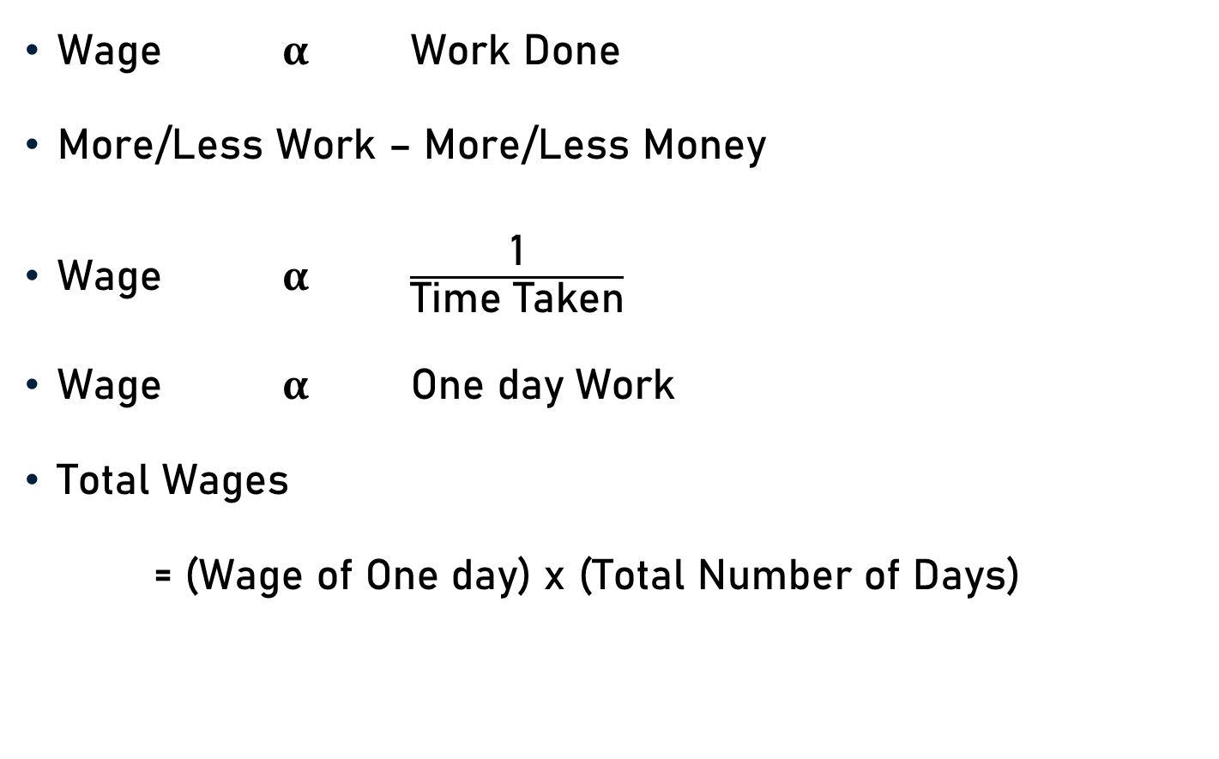
Basic Concepts & Formulae
Wage $α$ Work Done
More/Less Work – More/Less Money
Wage $α$ $\frac{\text{1}}{\text{Time} \text{Taken}}$
Wage $α$ One day Work
Total Wages
= (Wage of One day) x (Total Number of Days)

Slide 4

Basic Concepts & Formulae
If ‘A’ and ‘B’ can do a piece of work in ‘X’ and ‘Y’ days respectively, then the ratio of their wages will be
$\frac{\text{1}}{\text{X}}$ : $\frac{\text{1}}{\text{Y}}$
Y : X

Slide 5
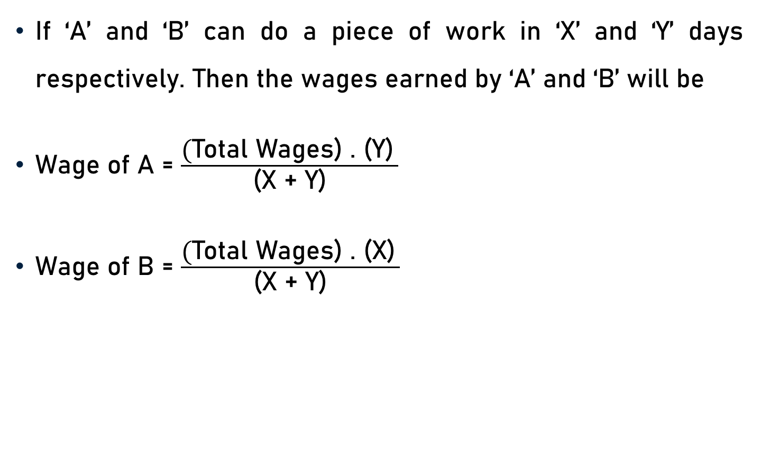
Basic Concepts & Formulae
If ‘A’ and ‘B’ can do a piece of work in ‘X’ and ‘Y’ days respectively. Then the wages earned by ‘A’ and ‘B’ will be
Wage of A = $\frac{\text{(}\text{Total} \text{Wages}\text{) . (}\text{Y}\text{)} }{\text{(}\text{X}\text{ + }\text{Y}\text{)}}$
Wage of B = $\frac{\text{(}\text{Total} \text{Wages}\text{) . (}\text{X}\text{)} }{\text{(}\text{X}\text{ + }\text{Y}\text{)}}$

Slide 6
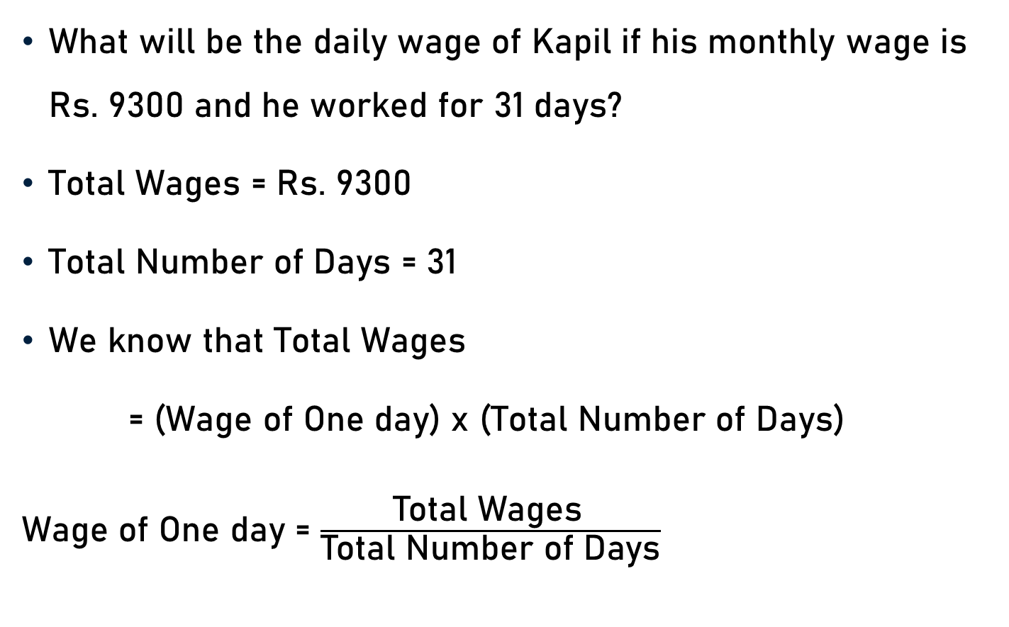
Example 1
What will be the daily wage of Kapil if his monthly wage is Rs. 9300 and he worked for 31 days?
Total Wages = Rs. 9300
Total Number of Days = 31
We know that Total Wages
= (Wage of One day) x (Total Number of Days)
Wage of One day = $\frac{\text{Total} \text{Wages} }{\text{Total} \text{Number} \text{of} \text{Days}}$

Slide 7

Example 1
Total Wages = Rs. 9300
Total Number of Days = 31
Wage of One day = $\frac{\text{Total} \text{Wages} }{\text{Total} \text{Number} \text{of} \text{Days}}$
= $\frac{\text{9300} }{\text{31}}$
= Rs. 300
300

Slide 8
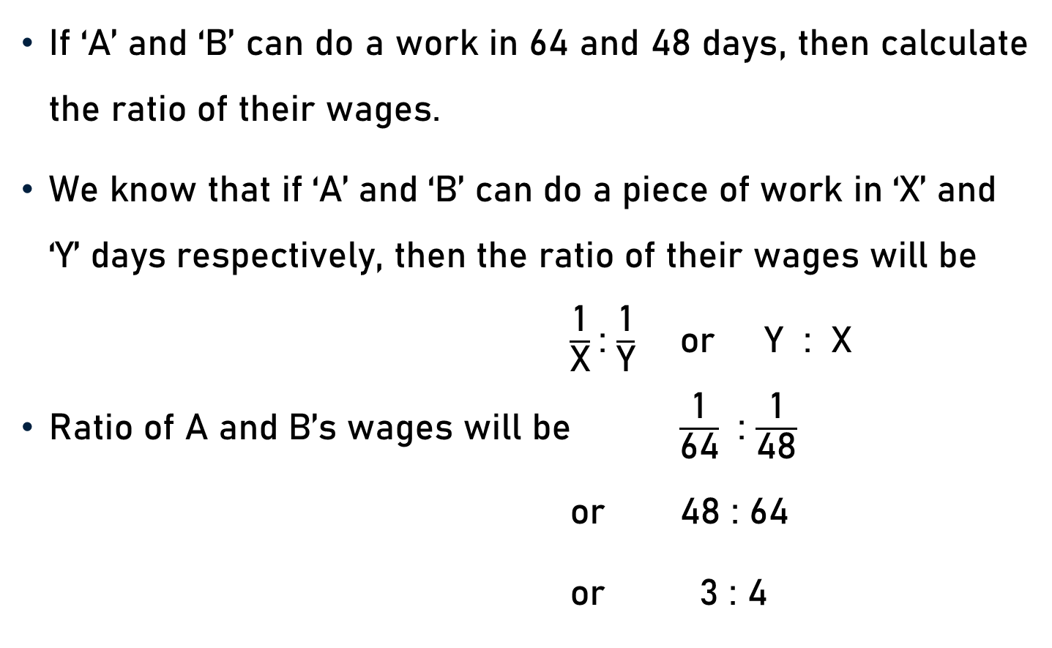
Example 2
If ‘A’ and ‘B’ can do a work in 64 and 48 days, then calculate the ratio of their wages.
We know that if ‘A’ and ‘B’ can do a piece of work in ‘X’ and ‘Y’ days respectively, then the ratio of their wages will be
$\frac{\text{1}}{\text{X}}$: $\frac{\text{1}}{\text{Y}}$ or Y : X
Ratio of A and B’s wages will be $\frac{\text{1}}{\text{64}}$ : $\frac{\text{1}}{\text{48}}$
or 48 : 64
or 3 : 4

Slide 9
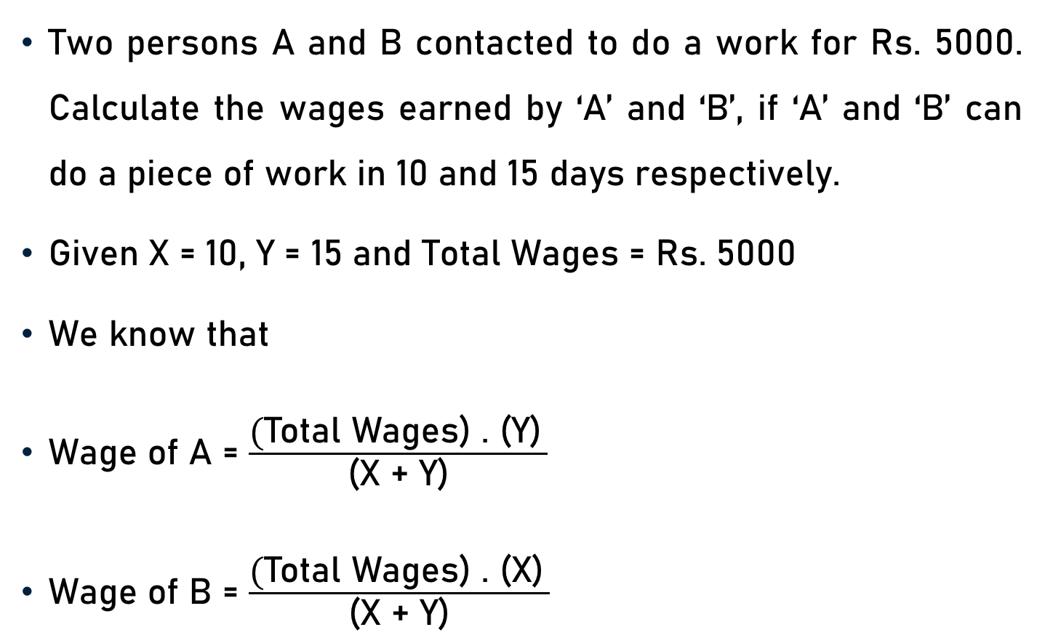
Example 3
Two persons A and B contacted to do a work for Rs. 5000. Calculate the wages earned by ‘A’ and ‘B’, if ‘A’ and ‘B’ can do a piece of work in 10 and 15 days respectively.
Given X = 10, Y = 15 and Total Wages = Rs. 5000
We know that
Wage of A = $\frac{\text{(}\text{Total} \text{Wages}\text{) . (}\text{Y}\text{)} }{\text{(}\text{X}\text{ + }\text{Y}\text{)}}$
Wage of B = $\frac{\text{(}\text{Total} \text{Wages}\text{) . (}\text{X}\text{)} }{\text{(}\text{X}\text{ + }\text{Y}\text{)}}$

Slide 10
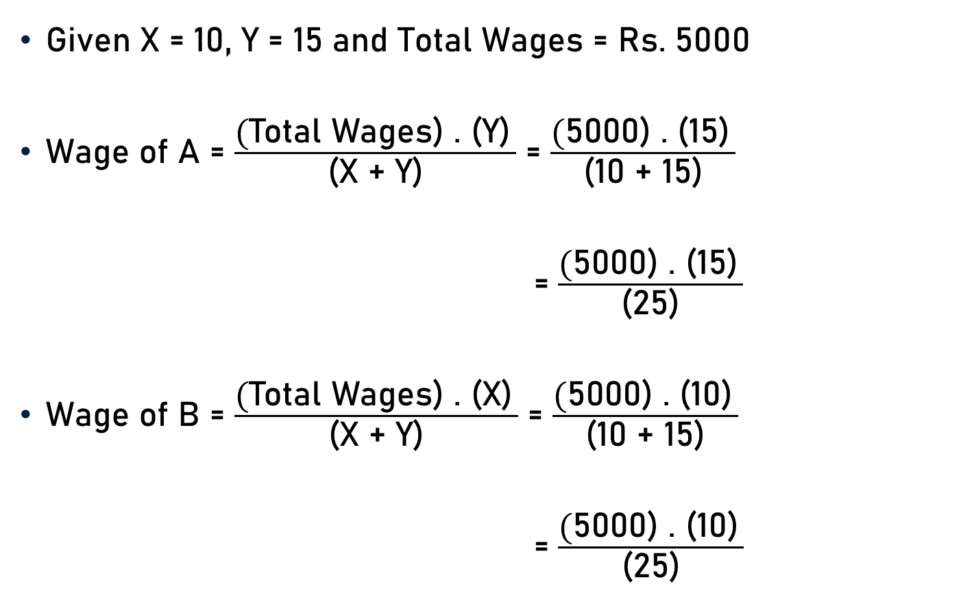
Example 3
Given X = 10, Y = 15 and Total Wages = Rs. 5000
Wage of A = $\frac{\text{(}\text{Total} \text{Wages}\text{) . (}\text{Y}\text{)} }{\text{(}\text{X}\text{ + }\text{Y}\text{)}}$ = $\frac{\text{(}\text{5000}\text{) . (}\text{15}\text{)} }{\text{(}\text{10}\text{ + }\text{15}\text{)}}$
= $\frac{\text{(}\text{5000) . (15)} }{\text{(}\text{25}\text{)}}$
Wage of B = $\frac{\text{(}\text{Total} \text{Wages}\text{) . (}\text{X}\text{)} }{\text{(}\text{X}\text{ + }\text{Y}\text{)}}$ = $\frac{\text{(}\text{5000) . (1}\text{0}\text{)} }{\text{(10 + 15)}}$
= $\frac{\text{(}\text{5000) . (1}\text{0}\text{)} }{\text{(25)}}$
200
= Rs. 3000
200
= Rs. 2000

Slide 11
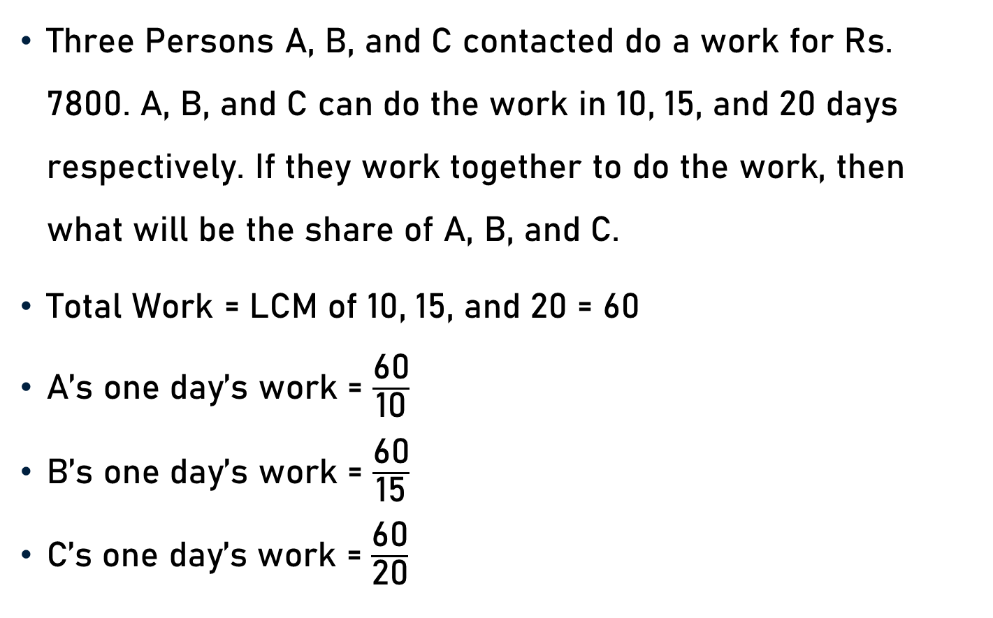
Example 4
Three Persons A, B, and C contacted do a work for Rs. 7800. A, B, and C can do the work in 10, 15, and 20 days respectively. If they work together to do the work, then what will be the share of A, B, and C.
Total Work = LCM of 10, 15, and 20 = 60
A’s one day’s work = $\frac{\text{60}}{\text{10}}$
B’s one day’s work = $\frac{\text{60}}{\text{15}}$
C’s one day’s work = $\frac{\text{60}}{\text{20}}$
6
= 6
4
= 4
3
= 3

Slide 12

Example 4
A’s one day’s work = 6
B’s one day’s work = 4
C’s one day’s work = 3
Share of A = $\frac{\text{6}}{\text{13}}$x 7800
Share of B = $\frac{\text{4}}{\text{13}}$x 7800
Share of C = $\frac{\text{3}}{\text{13}}$x 7800
600
= Rs. 3600
(Because 6 + 4 + 3 = 13)
600
= Rs. 2400
600
= Rs. 1800

Slide 13
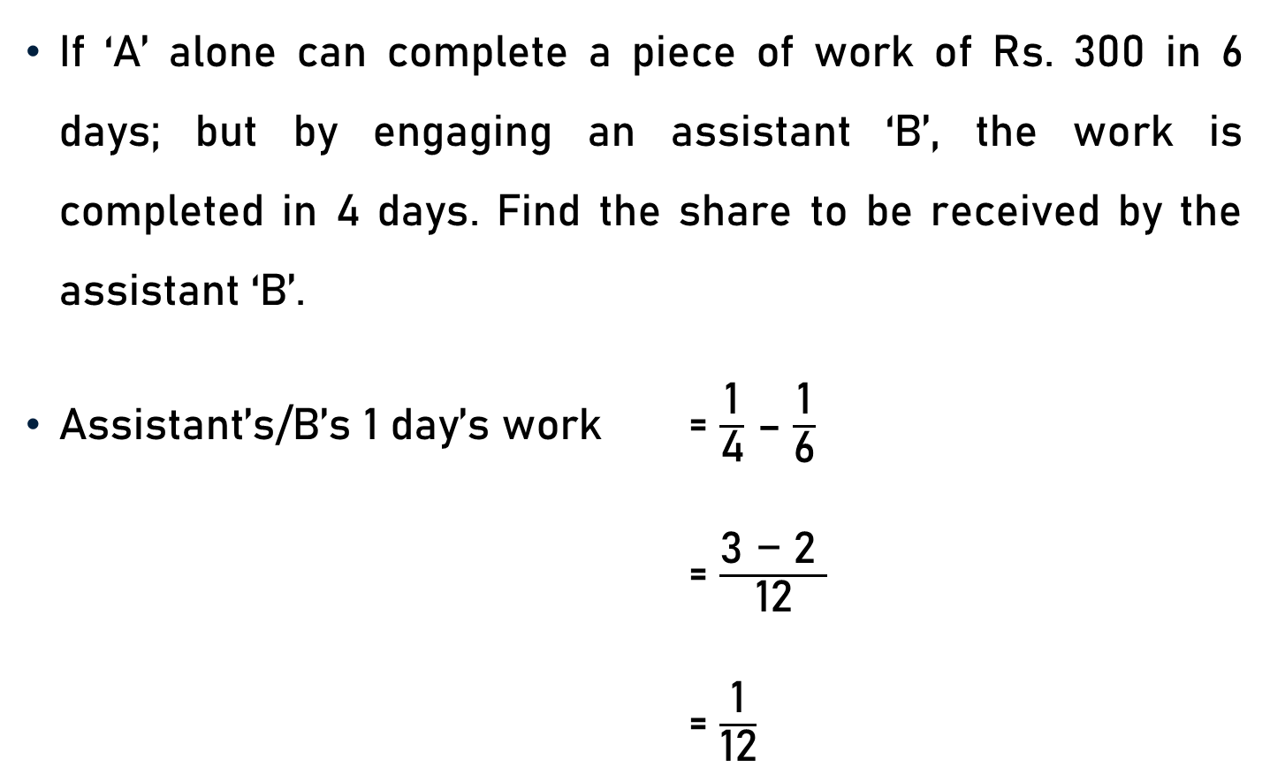
Example 5
If ‘A’ alone can complete a piece of work of Rs. 300 in 6 days; but by engaging an assistant ‘B’, the work is completed in 4 days. Find the share to be received by the assistant ‘B’.
Assistant’s/B’s 1 day’s work = $\frac{\text{1}}{\text{4}}$ – $\frac{\text{1}}{\text{6}}$
= $\frac{\text{3 − 2 }}{\text{12}}$
= $\frac{\text{1}}{\text{1}\text{2}}$

Slide 14
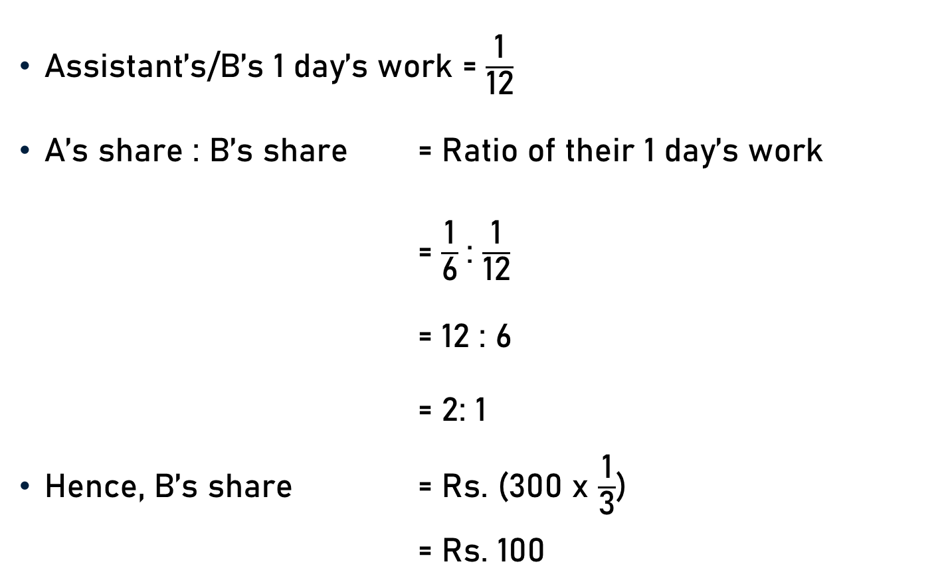
Example 5
Assistant’s/B’s 1 day’s work = $\frac{\text{1}}{\text{1}\text{2}}$
A’s share : B’s share = Ratio of their 1 day’s work
= $\frac{\text{1}}{\text{6}}$: $\frac{\text{1}}{\text{1}\text{2}}$
= 12 : 6
= 2: 1
Hence, B’s share = Rs. (300 x $\frac{\text{1}}{\text{3}}$)
= Rs. 100
100

Slide 15

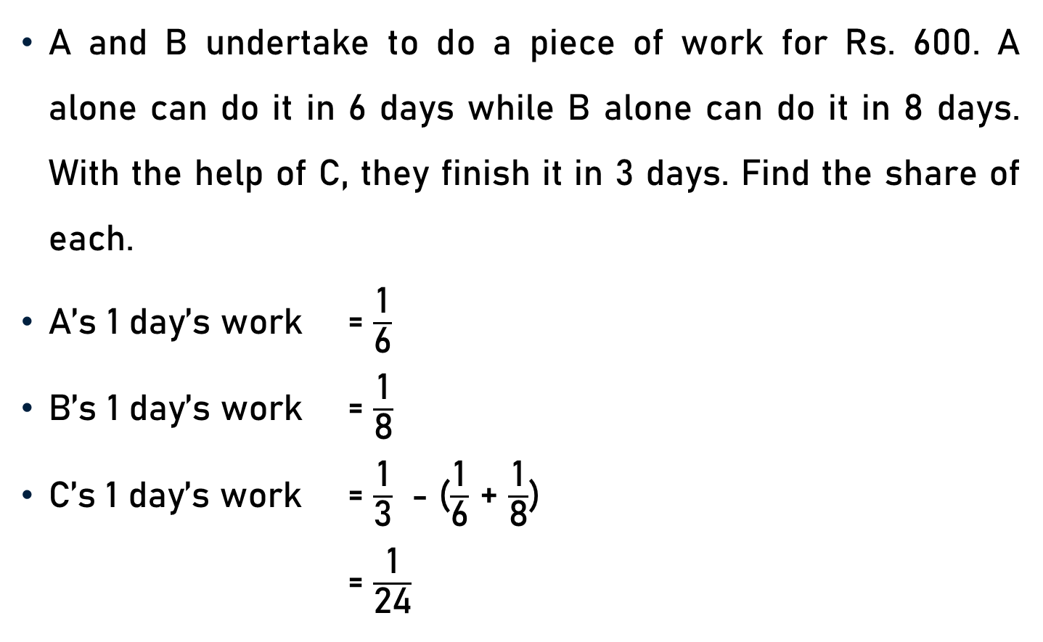

Example 6
A and B undertake to do a piece of work for Rs. 600. A alone can do it in 6 days while B alone can do it in 8 days. With the help of C, they finish it in 3 days. Find the share of each.
A’s 1 day’s work = $\frac{\text{1}}{\text{6}}$
B’s 1 day’s work = $\frac{\text{1}}{\text{8}}$
C’s 1 day’s work = $\frac{\text{1}}{\text{3}}$ - ($\frac{\text{1}}{\text{6}}$ + $\frac{\text{1}}{\text{8}}$)
= $\frac{\text{1}}{\text{24}}$
= $\frac{\text{1}}{\text{3}}$ - $\frac{\text{1}}{\text{6}}$ - $\frac{\text{1}}{\text{8}}$
= $\frac{\text{8 − 4 − 3}}{\text{24}}$

Slide 16
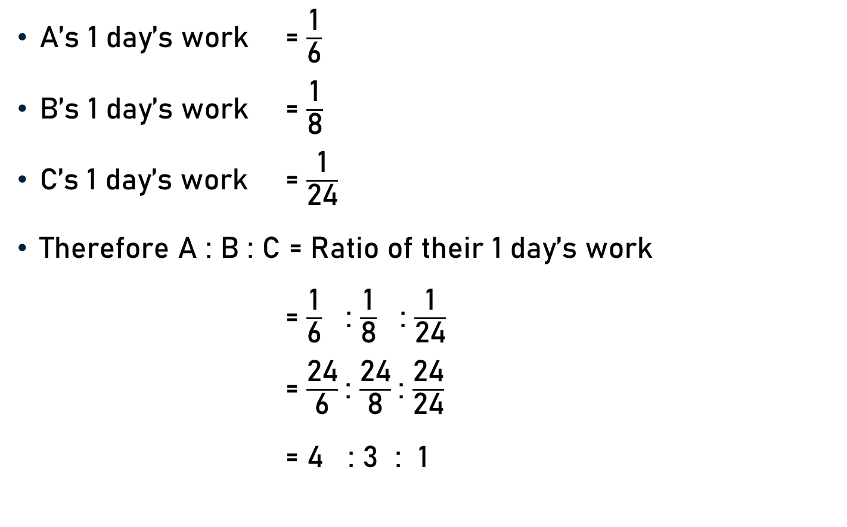
Example 6
A’s 1 day’s work = $\frac{\text{1}}{\text{6}}$
B’s 1 day’s work = $\frac{\text{1}}{\text{8}}$
C’s 1 day’s work = $\frac{\text{1}}{\text{24}}$
Therefore A : B : C = Ratio of their 1 day’s work
= $\frac{\text{1}}{\text{6}}$ : $\frac{\text{1}}{\text{8}}$ : $\frac{\text{1}}{\text{24}}$
= $\frac{\text{24}}{\text{6}}$: $\frac{\text{24}}{\text{8}}$: $\frac{\text{24}}{\text{24}}$
= 4 : 3 : 1
4
3
1

Slide 17
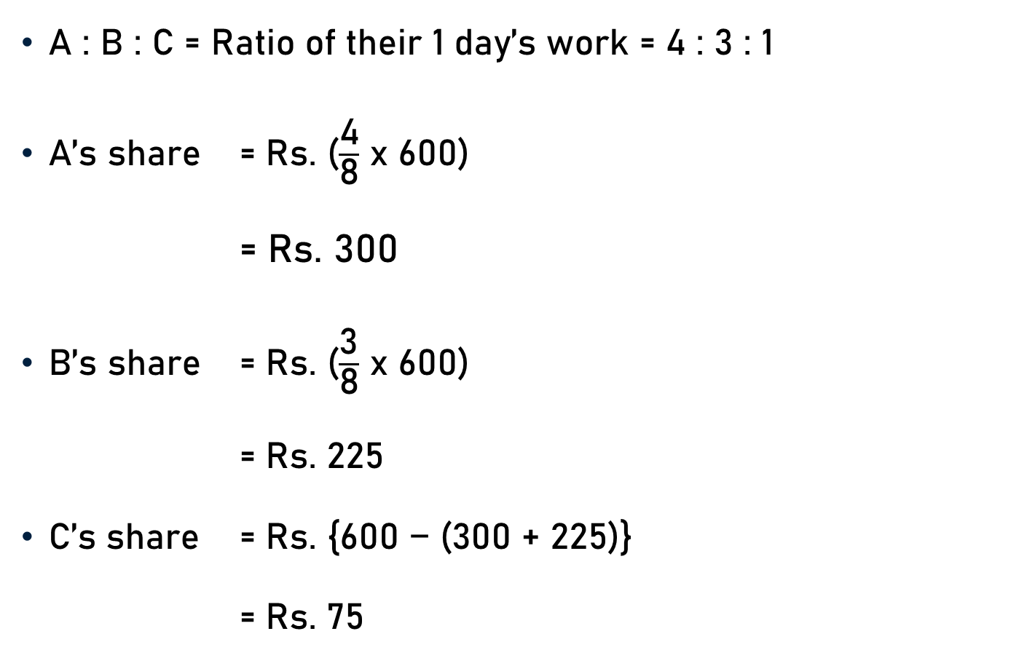
Example 6
A : B : C = Ratio of their 1 day’s work = 4 : 3 : 1
A’s share = Rs. ($\frac{\text{4}}{\text{8}}$ x 600)
= Rs. 300
B’s share = Rs. ($\frac{\text{3}}{\text{8}}$ x 600)
= Rs. 225
C’s share = Rs. {600 − (300 + 225)}
= Rs. 75
75
75

Slide 18
Example 7
A and B together earn Rs. 188 per day. B and C together earn Rs. 152 per day. A, B and C when working together earn Rs. 300 per day. How much does A, B, and C earn daily?
Let A’s 1 day’s wages = Rs. x
B’s 1 day’s wages = Rs. y
C’s 1 day’s wages = Rs. Z
According to Question,
x + y = 188
y + z = 152
x + y + z = 300

Slide 19
Example 7
x + y = 188 ------------ (1)
y + z = 152 ------------ (2)
x + y + z = 300 ------------ (3)
(1) + (2) – (3), we get
x + y + (y + z) – (x + y + z) = 188 + 152 – 300
y = 340 - 300
y = 40

Slide 20
Example 7
Put y = 40 in x + y = 188, we get
x + 40 = 188
x = 188 - 40
x = 148
Put y = 40 in y + z = 152, we get
40 + z = 152
z = 152 - 40
z = 112
A, B, and C earn
Rs. 148, Rs. 40, and Rs. 112 daily.

Slide 21
Example 8
A and B undertake a piece of work for Rs. 300. A can do it in 20 days and B can do it in 60 days. With the help of C, they finish it in 10 days. How much should C be paid for her contribution?
A alone takes 20 days and B alone takes 60 days to finish the work.
A, B, and C all together can finish the work in 10 days.
The total work done is LCM(10, 20, 60) = 60

Slide 22
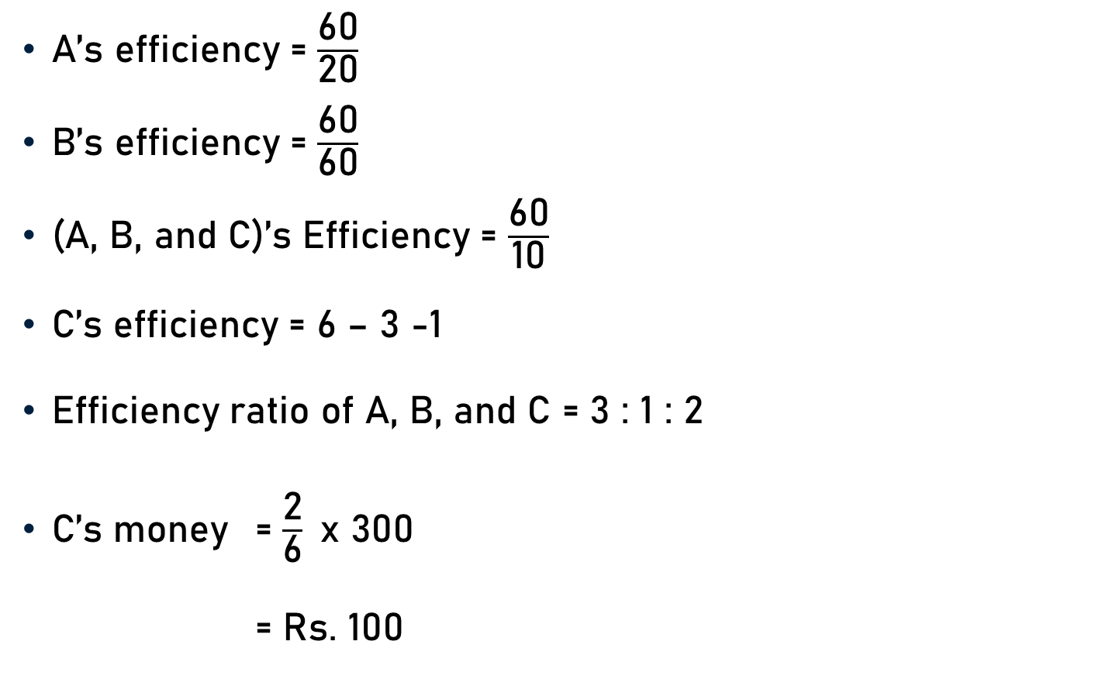
Example 8
3
A’s efficiency = $\frac{\text{60}}{\text{20}}$
B’s efficiency = $\frac{\text{60}}{\text{60}}$
(A, B, and C)’s Efficiency = $\frac{\text{60}}{\text{10}}$
C’s efficiency = 6 – 3 -1
Efficiency ratio of A, B, and C = 3 : 1 : 2
C’s money = $\frac{\text{2}}{\text{6}}$x 300
= Rs. 100
= 3
1
= 1
6
= 6
= 2
50
(Because 3 + 1 + 2 = 6)

Slide 23
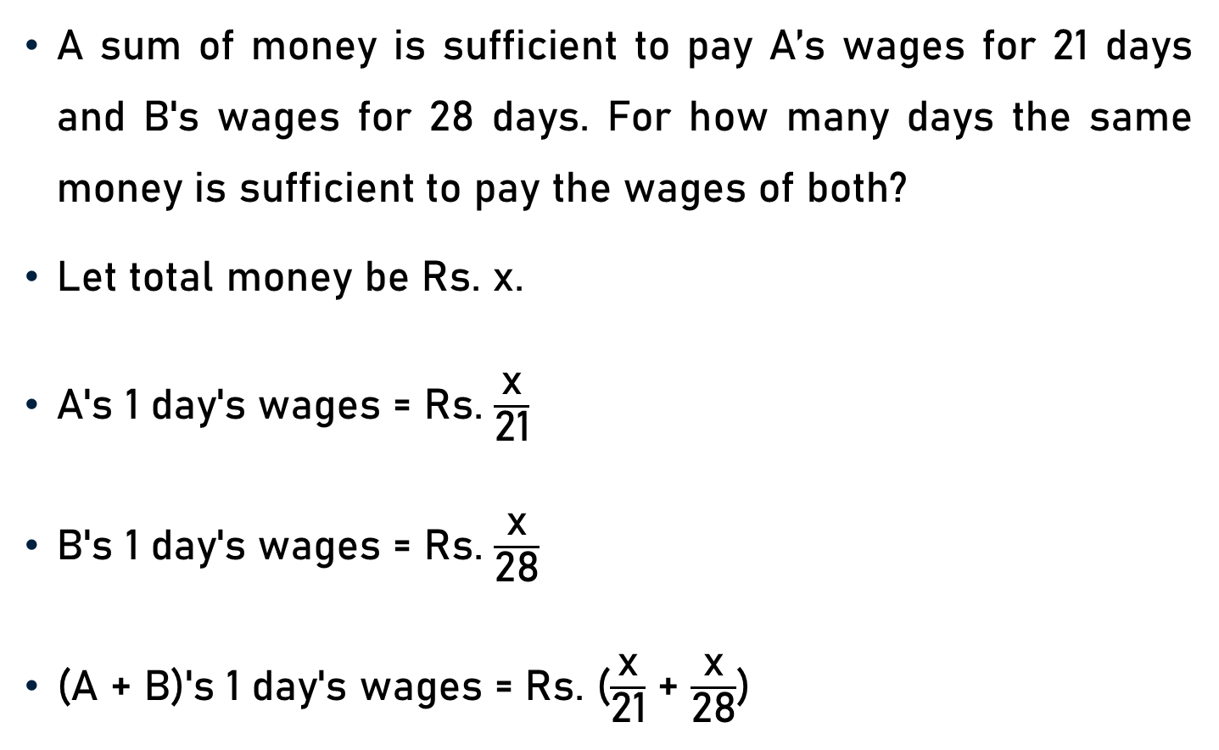
Example 9
A sum of money is sufficient to pay A’s wages for 21 days and B's wages for 28 days. For how many days the same money is sufficient to pay the wages of both?
Let total money be Rs. x.
A's 1 day's wages = Rs. $\frac{\text{x}}{\text{21}}$
B's 1 day's wages = Rs. $\frac{\text{x}}{\text{28}}$
(A + B)'s 1 day's wages = Rs. ($\frac{\text{x}}{\text{21}}$ + $\frac{\text{x}}{\text{2}\text{8}}$)

Slide 24

Example 9
(A + B)'s 1 day's wages = Rs. ($\frac{\text{x}}{\text{21}}$ + $\frac{\text{x}}{\text{2}\text{8}}$)
= Rs. ($\frac{\text{4}\text{x}\text{ + 3}\text{x}}{\text{84}}$)
= Rs. ($\frac{\text{7}\text{x}}{\text{84}}$)
= Rs. $\frac{\text{x}}{\text{12}}$
Money is sufficient to pay the wages of both for 12 days.
12

Slide 25
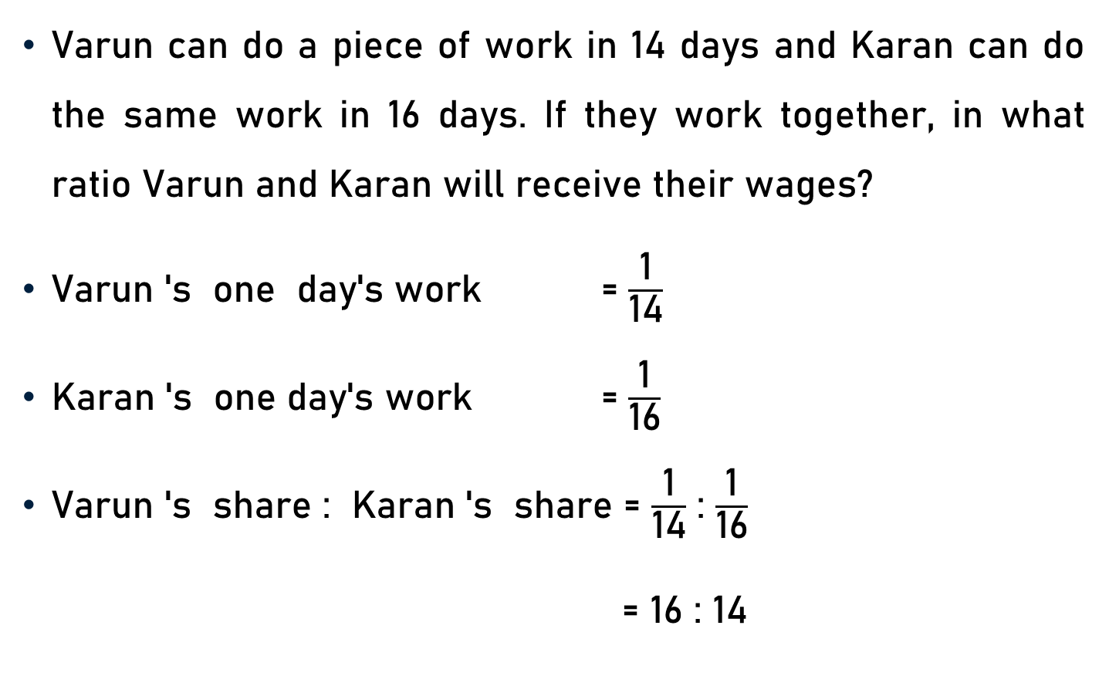
Example 10
Varun can do a piece of work in 14 days and Karan can do the same work in 16 days. If they work together, in what ratio Varun and Karan will receive their wages?
Varun 's one day's work = $\frac{\text{1}}{\text{1}\text{4}}$
Karan 's one day's work = $\frac{\text{1}}{\text{16}}$
Varun 's share : Karan 's share = $\frac{\text{1}}{\text{1}\text{4}}$ : $\frac{\text{1}}{\text{16}}$
= 16 : 14
8
7
= 8 : 7

Slide 26
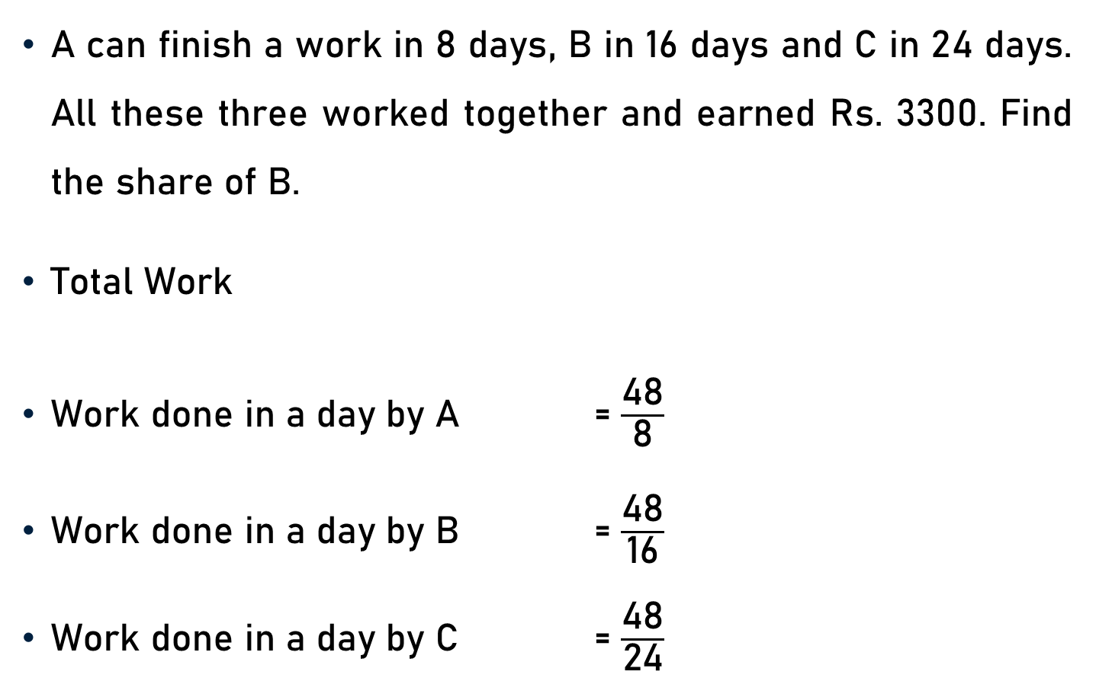
Example 11
A can finish a work in 8 days, B in 16 days and C in 24 days. All these three worked together and earned Rs. 3300. Find the share of B.
Total Work
Work done in a day by A = $\frac{\text{48}}{\text{8}}$
Work done in a day by B = $\frac{\text{48}}{\text{16}}$
Work done in a day by C = $\frac{\text{48}}{\text{24}}$
= LCM of 8, 16 and 24
= 48
6
= 6
3
= 3
2
= 2

Slide 27

Example 11
Work done in a day by A = 6
Work done in a day by B = 3
Work done in a day by C = 2
Share of B = $\frac{\text{3}}{\text{11}}$ x 3300
= 900
300
(Because 6 + 3 + 2 = 11)

Slide 28
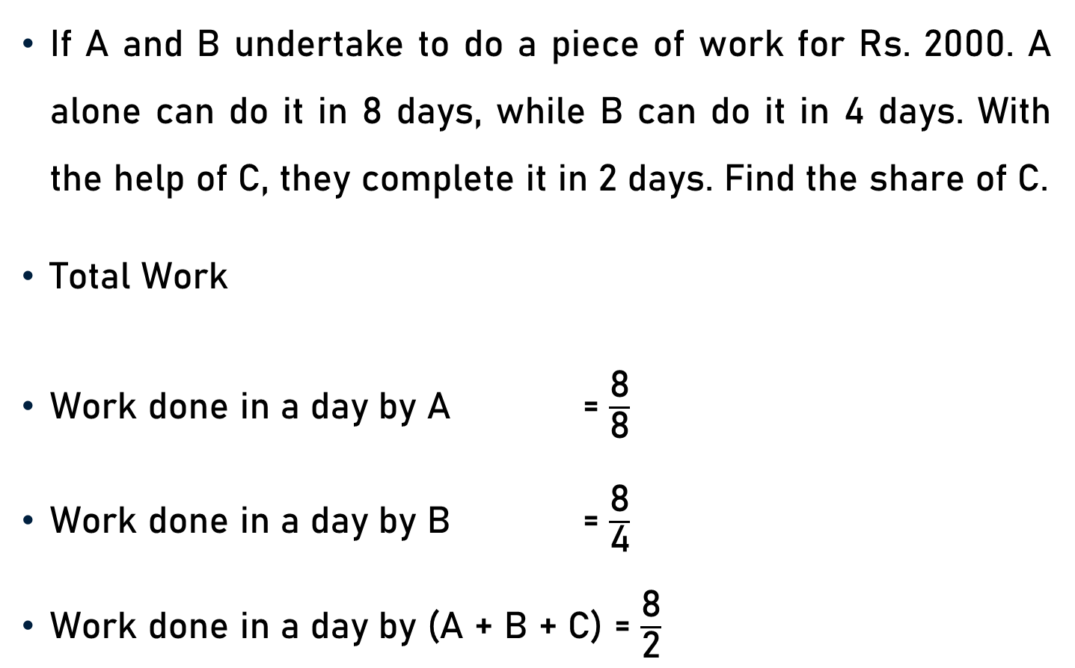
Example 12
If A and B undertake to do a piece of work for Rs. 2000. A alone can do it in 8 days, while B can do it in 4 days. With the help of C, they complete it in 2 days. Find the share of C.
Total Work
Work done in a day by A = $\frac{\text{8}}{\text{8}}$
Work done in a day by B = $\frac{\text{8}}{\text{4}}$
Work done in a day by (A + B + C) = $\frac{\text{8}}{\text{2}}$
= LCM of 8, 4 and 2
= 8
1
= 1
2
= 2
4
= 4

Slide 29
Example 12
Work done in a day by A = 1
Work done in a day by B = 2
Work done in a day by (A + B + C) = 4
Work done in a day by C
= Work done in a day by {(A + B + C) - A – B}
= 4 – 1 – 2
= 1

Slide 30

Example 12
Work done in a day by C = 1
Work done in a day by (A + B + C) = 4
Share of C = $\frac{\text{1}}{\text{4}}$ x 2000
= Rs. 500
500

Slide 31
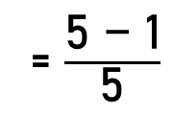
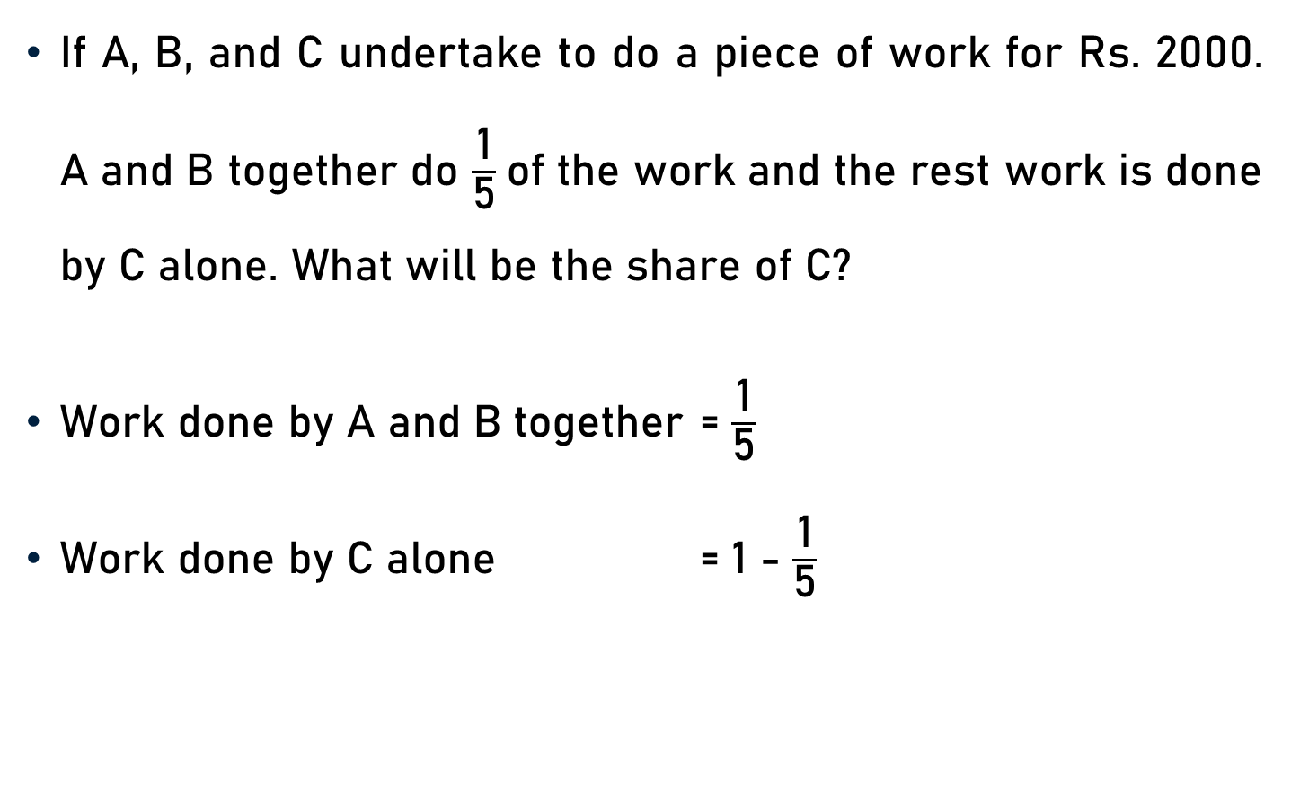
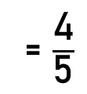
Example 13
If A, B, and C undertake to do a piece of work for Rs. 2000. A and B together do $\frac{\text{1}}{\text{5}}$of the work and the rest work is done by C alone. What will be the share of C?
Work done by A and B together = $\frac{\text{1}}{\text{5}}$
Work done by C alone = 1 - $\frac{\text{1}}{\text{5}}$
= $\frac{\text{5 − 1}}{\text{5}}$
= $\frac{\text{4}}{\text{5}}$

Slide 32

Example 13
Work done by C alone = $\frac{\text{4}}{\text{5}}$
Total Wages = Rs. 2000
Share of C = $\frac{\text{4}}{\text{5}}$ x 2000
= Rs. 1600
400

Slide 33
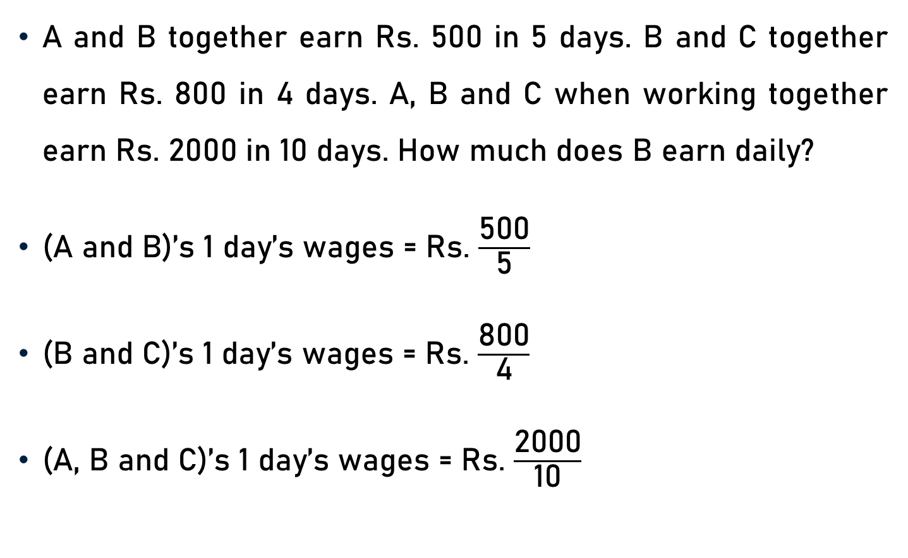
Example 14
A and B together earn Rs. 500 in 5 days. B and C together earn Rs. 800 in 4 days. A, B and C when working together earn Rs. 2000 in 10 days. How much does B earn daily?
(A and B)’s 1 day’s wages = Rs. $\frac{\text{500}}{\text{5}}$
(B and C)’s 1 day’s wages = Rs. $\frac{\text{8}\text{00}}{\text{4}}$
(A, B and C)’s 1 day’s wages = Rs. $\frac{\text{20}\text{00}}{\text{10}}$
100
= 100
200
= 200
200
= 200

Slide 34
Example 14
(A and B)’s 1 day’s wages = Rs. 100 ------------ (1)
(B and C)’s 1 day’s wages = Rs. 200 ------------ (2)
(A, B and C)’s 1 day’s wages = Rs. 200 ------------ (3)
(1) + (2), we get
(A + B) ’s 1 day’s wages + (B + C)’s 1 day’s wages
= Rs. (100 + 200)
(A, B and C)’s 1 day’s wages + B’s 1 day’s wages = Rs. 300

Slide 35
Example 14
(A, B and C)’s 1 day’s wages + B’s 1 day’s wages = Rs. 300
But (A, B and C)’s 1 day’s wages = Rs. 200
Rs. 200 + B’s 1 day’s wages = Rs. 300
B’s 1 day’s wages = Rs. (300 – 200)
B’s 1 day’s wages = Rs. 100

Slide 36
Example 15
A, B, and C can do a piece of work in 20, 24, and 30 days respectively. They under-took to do the piece of work for Rs. 5400. They began the work together but B left 2 days before the completion of work and C left 5 days before the completion of the work. What is the share of A from the assured money?
Total Work
= LCM of 20, 24 and 30
= 120

Slide 37
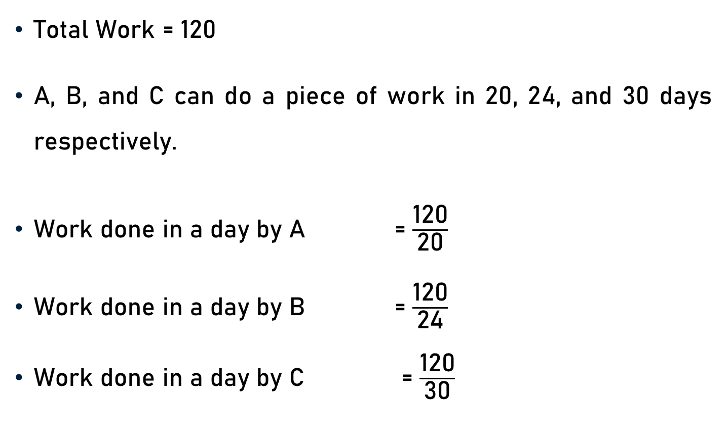
Example 15
Total Work = 120
A, B, and C can do a piece of work in 20, 24, and 30 days respectively.
Work done in a day by A = $\frac{\text{120}}{\text{20}}$
Work done in a day by B = $\frac{\text{120}}{\text{24}}$
Work done in a day by C = $\frac{\text{120}}{\text{30}}$
6
= 6
5
= 5
4
= 4

Slide 38
Example 15
Work done in a day by A = 6, Work done in a day by B = 5, and Work done in a day by C = 4
Let work will be completed in ‘x’ days.
Work done by A = 6x, Work done by B = 5x, and Work done by C = 4x, and Total Work = 120
B left 2 days before the completion of work and C left 5 days before the completion of the work.
6x + 5(x-2) + 4(x-5)
= 120

Slide 39

Example 15
6x + 5(x-2) + 4(x-5) = 120
6x + 5x - 10 + 4x – 20 = 120
15x - 30 = 120
15x = 120 + 30
15x = 150
Work done by A = 6x
Share of A = $\frac{\text{6}\text{0}}{\text{12}\text{0}}$ x 5400
10
Or x = 10
= 6 . (10)
= 60
45
= 2700

Slide 40
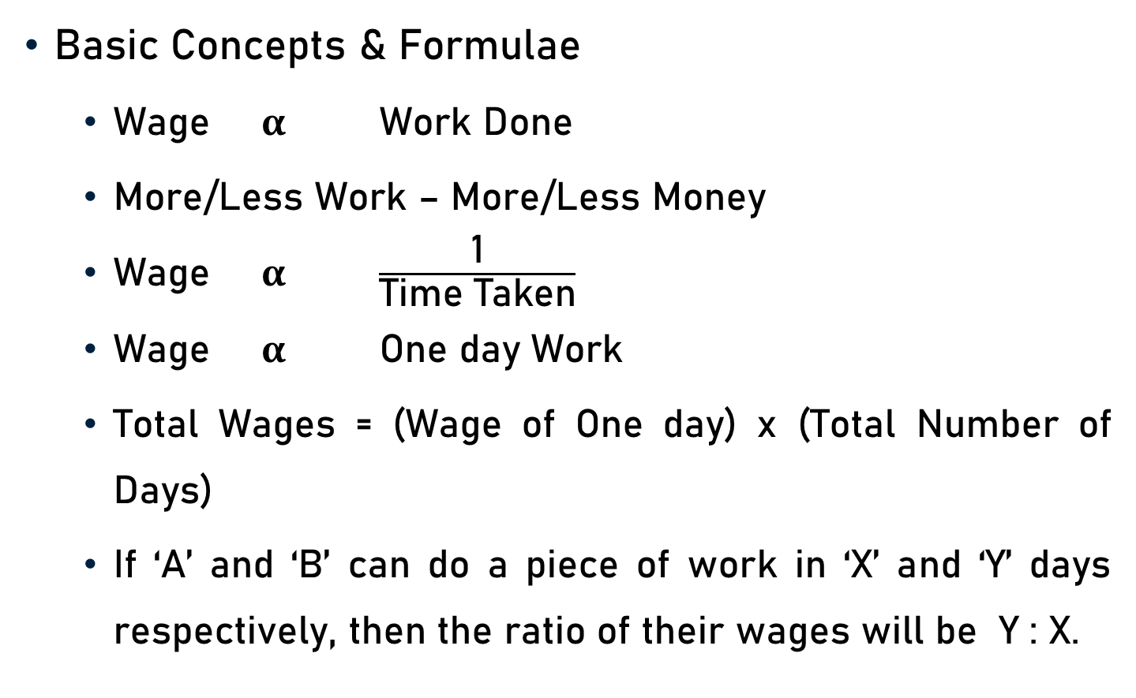
Conclusion
Basic Concepts & Formulae
Wage $α$ Work Done
More/Less Work – More/Less Money
Wage $α$ $\frac{\text{1}}{\text{Time} \text{Taken}}$
Wage $α$ One day Work
Total Wages = (Wage of One day) x (Total Number of Days)
If ‘A’ and ‘B’ can do a piece of work in ‘X’ and ‘Y’ days respectively, then the ratio of their wages will be Y : X.

Slide 41
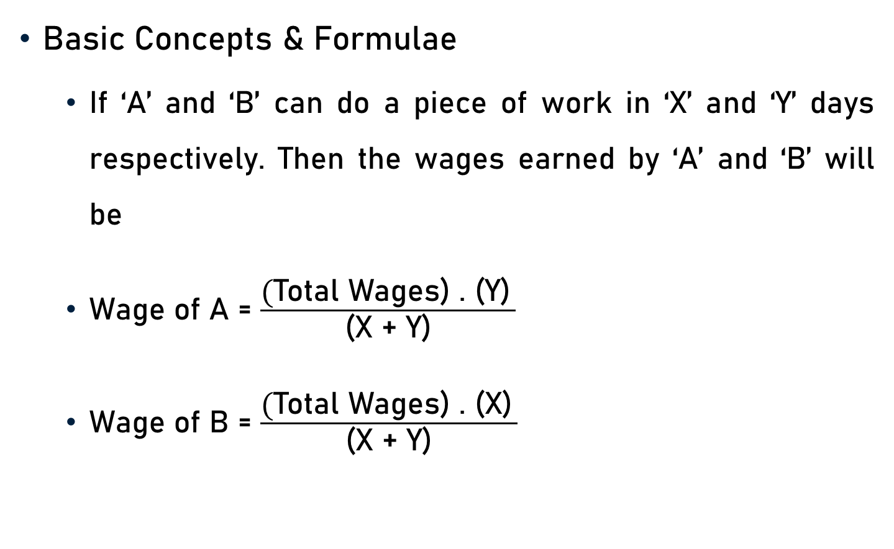
Conclusion
Basic Concepts & Formulae
If ‘A’ and ‘B’ can do a piece of work in ‘X’ and ‘Y’ days respectively. Then the wages earned by ‘A’ and ‘B’ will be
Wage of A = $\frac{\text{(}\text{Total} \text{Wages}\text{) . (}\text{Y}\text{)} }{\text{(}\text{X}\text{ + }\text{Y}\text{)}}$
Wage of B = $\frac{\text{(}\text{Total} \text{Wages}\text{) . (}\text{X}\text{)} }{\text{(}\text{X}\text{ + }\text{Y}\text{)}}$

Slide 42
Summary
Time & Work
Computation of Wages

