Slide 2
define the concept of compound interest,
explore the formulae of compound interest,
differentiate between simple and compound interest.

Slide 3
Compound Interest (C.I.)
Borrower & Lender
Fix up - Unit of time
Yearly/Half-yearly/Quarterly
Amount (after first year/unit of time)
- Principal (for the second year/unit of time)
Compound Interest = Amount - Principal

Slide 4
Basic Formulae
P or p = Principal
R or r = Rate
N or n = Number of years (T or t)
C.I. = Compound interest
A = Amount

Slide 5
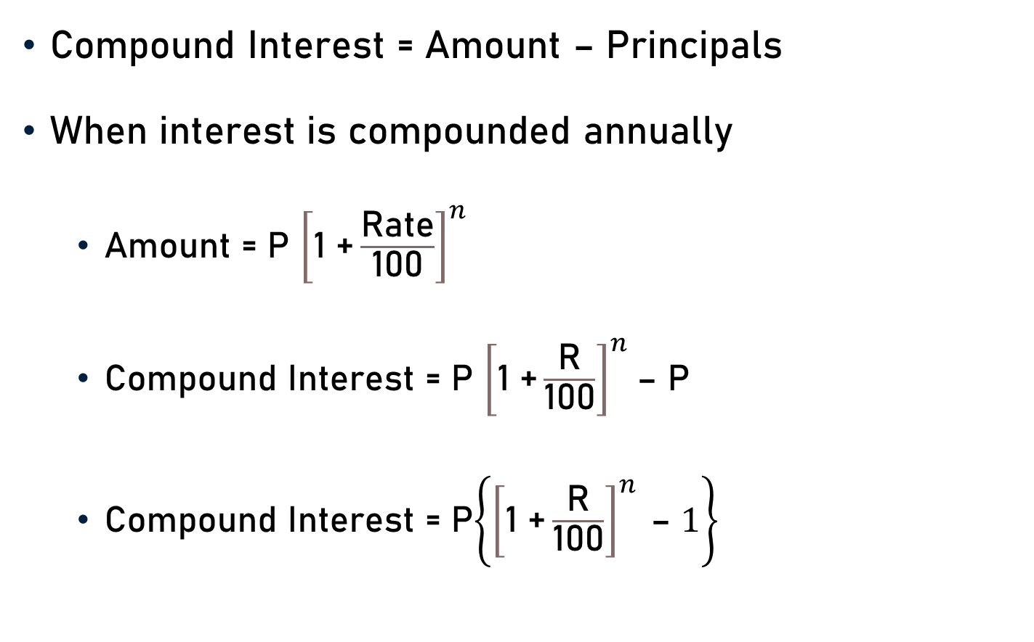
Basic Formulae
Compound Interest = Amount – Principals
When interest is compounded annually
Amount = P ${\left[\text{1 +}\frac{\text{R}\text{ate}}{\text{100}}\right]}^{n}$
Compound Interest = P ${\left[\text{1 +}\frac{\text{R}}{\text{100}}\right]}^{n}$– P
Compound Interest = P$\left\{{\left[\text{1 +}\frac{\text{R}}{\text{100}}\right]}^{n} \text{– }1\right\}$

Slide 6

Basic Formulae
Rate of interest
A = P ${\left[\text{1 +}\frac{\text{R}}{\text{100}}\right]}^{n}$
$\frac{\text{A}}{\text{P}}$ = ${\left[\text{1 +}\frac{\text{R}}{\text{100}}\right]}^{n}$
${\left[\frac{\text{A}}{\text{P}}\right]}^{1/n}$= $\left[\text{1 +}\frac{\text{R}}{\text{100}}\right]$

Slide 7

Basic Formulae
Rate of interest
${\left[\frac{\text{A}}{\text{P}}\right]}^{1/n}$ - 1 = $\frac{\text{R}}{\text{100}}$
$\left\{{\left[\frac{\text{A}}{\text{P}}\right]}^{1/n}\text{ − 1 }\right\}$ x 100 = R
Rate of interest (R) = $\left\{{\left[\frac{\text{A}}{\text{P}}\right]}^{1/n}\text{ − 1 }\right\}$x 100
$or \left\{{\left[\frac{\text{A}}{\text{P}}\right]}^{1/n}\text{ − 1 }\right\}$% p.a.

Slide 8
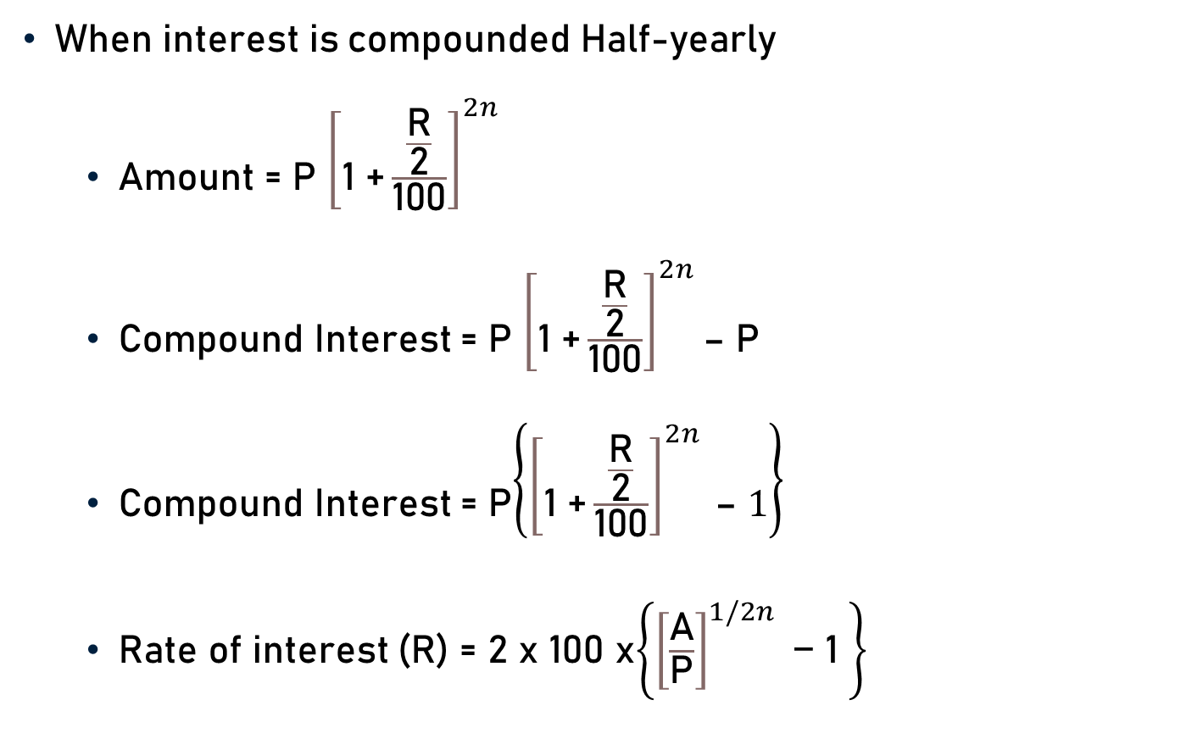
Basic Formulae
When interest is compounded Half-yearly
Amount = P ${\left[\text{1 +}\frac{\frac{\text{R}}{\text{2}}}{\text{100}}\right]}^{2n}$
Compound Interest = P ${\left[\text{1 +}\frac{\frac{\text{R}}{\text{2}}}{\text{100}}\right]}^{2n}$– P
Compound Interest = P$\left\{{\left[\text{1 +}\frac{\frac{\text{R}}{\text{2}}}{\text{100}}\right]}^{2n} \text{– }1\right\}$
Rate of interest (R) = 2 x 100 x$\left\{{\left[\frac{\text{A}}{\text{P}}\right]}^{1/2n}\text{ − 1 }\right\}$

Slide 9
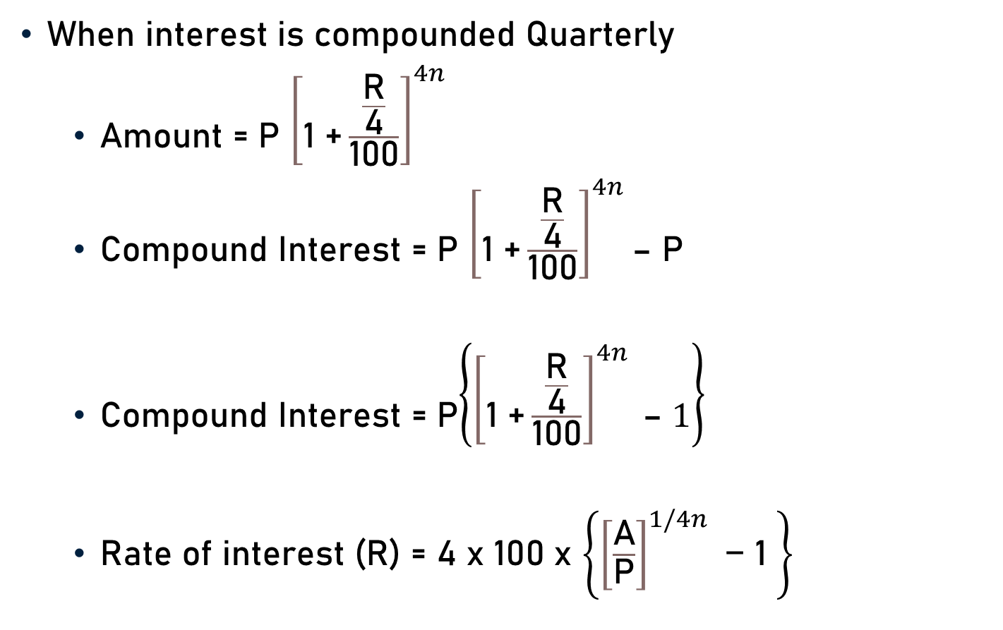
Basic Formulae
When interest is compounded Quarterly
Amount = P ${\left[\text{1 +}\frac{\frac{\text{R}}{\text{4}}}{\text{100}}\right]}^{4n}$
Compound Interest = P ${\left[\text{1 +}\frac{\frac{\text{R}}{\text{4}}}{\text{100}}\right]}^{4n}$– P
Compound Interest = P$\left\{{\left[\text{1 +}\frac{\frac{\text{R}}{\text{4}}}{\text{100}}\right]}^{4n} \text{– }1\right\}$
Rate of interest (R) = 4 x 100 x $\left\{{\left[\frac{\text{A}}{\text{P}}\right]}^{1/4n}\text{ − 1 }\right\}$

Slide 10
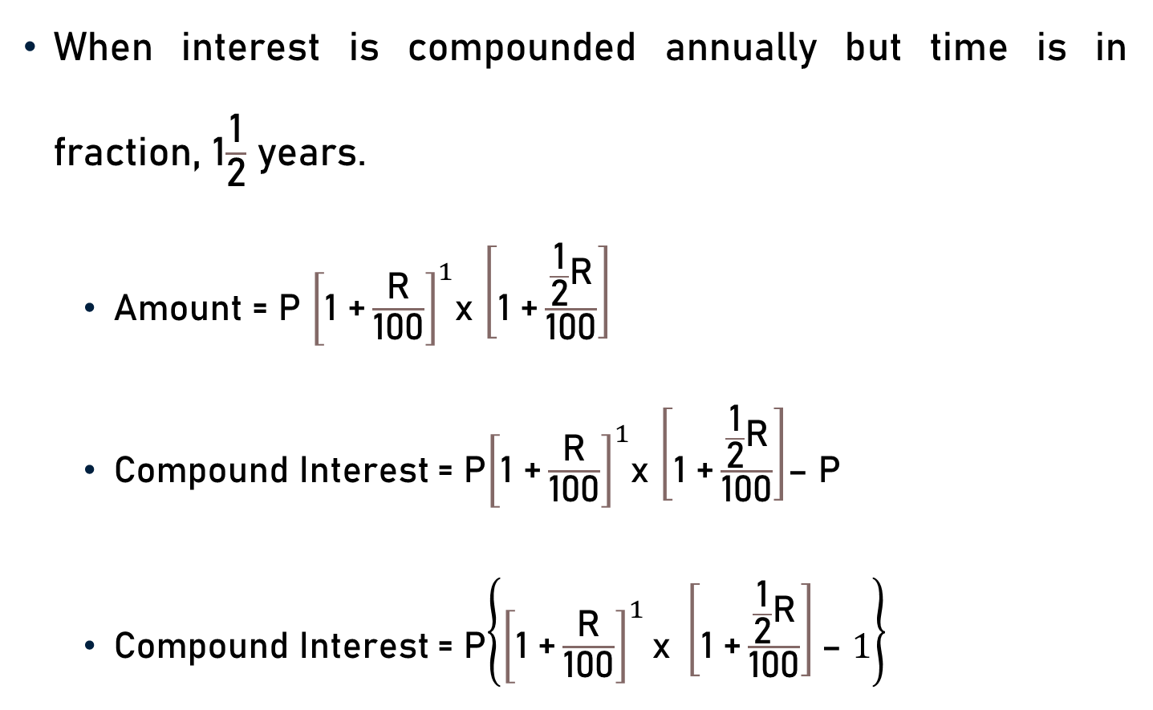
Basic Formulae
When interest is compounded annually but time is in fraction, 1$\frac{\text{1}}{\text{2}}$ years.
Amount = P ${\left[\text{1 +}\frac{\text{R}}{\text{100}}\right]}^{1}$x $\left[\text{1 +}\frac{\frac{\text{1}}{\text{2}}\text{R}}{\text{100}}\right]$
Compound Interest = P${\left[\text{1 +}\frac{\text{R}}{\text{100}}\right]}^{1}$x $\left[\text{1 +}\frac{\frac{\text{1}}{\text{2}}\text{R}}{\text{100}}\right]$– P
Compound Interest = P$\left\{{\left[\text{1 +}\frac{\text{R}}{\text{100}}\right]}^{1}\text{x} \left[\text{1 +}\frac{\frac{\text{1}}{\text{2}}\text{R}}{\text{100}}\right]\text{– }1\right\}$

Slide 11
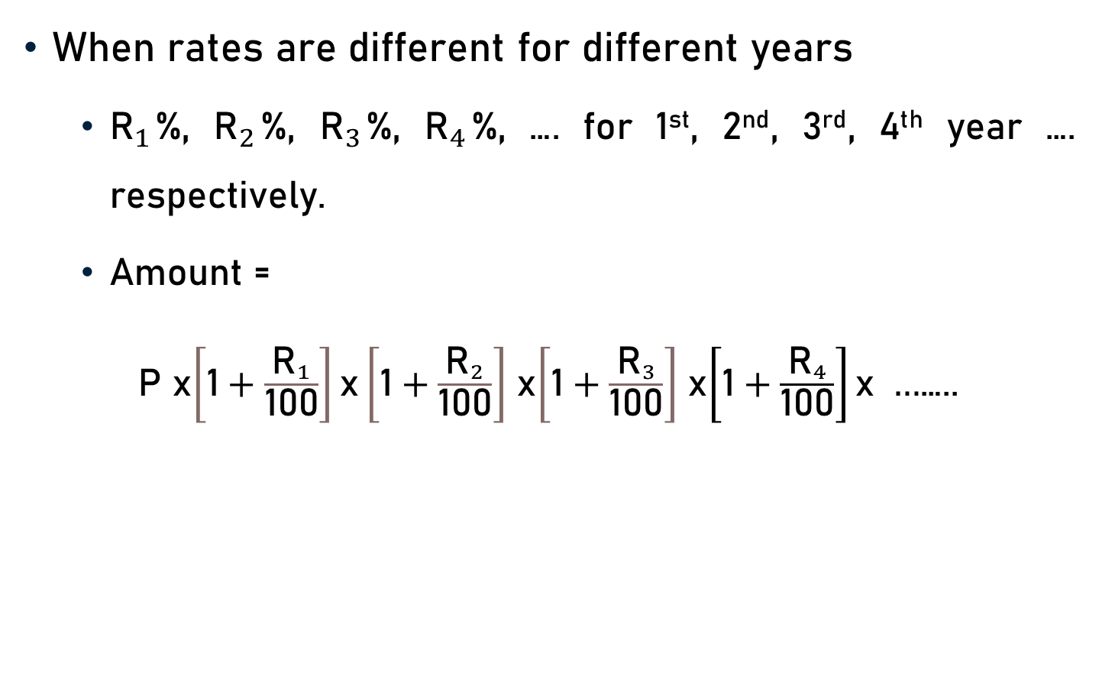
Basic Formulae
When rates are different for different years
${\text{R}}_{1}$%, ${\text{R}}_{2}$%, ${\text{R}}_{3}$%, ${\text{R}}_{4}$%, …. for 1st, 2nd, 3rd, 4th year …. respectively.
Amount =
P x$\left[\text{1}+\frac{{\text{R}}_{1}}{\text{100}}\right]\text{x}\left[\text{1}+\frac{{\text{R}}_{2}}{\text{100}}\right]$ x$\left[\text{1}+\frac{{\text{R}}_{3}}{\text{100}}\right]$ x$\left[\text{1}+\frac{{\text{R}}_{4}}{\text{100}}\right]\text{x} …$…..

Slide 12

Basic Formulae
Present worth of Rs. x due n years hence
Present Worth = $\frac{\text{x}}{{\left[\text{1 +}\frac{\text{R}}{\text{100}}\right]}^{n}}$

Slide 13
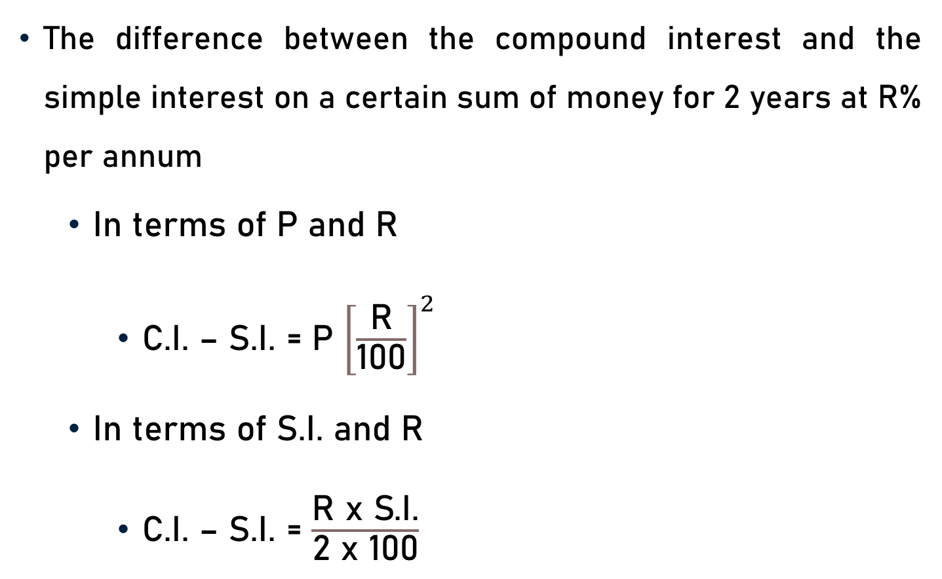
Basic Formulae
The difference between the compound interest and the simple interest on a certain sum of money for 2 years at R% per annum
In terms of P and R
C.I. – S.I. = P ${\left[\frac{\text{R}}{\text{100}}\right]}^{2}$
In terms of S.I. and R
C.I. – S.I. = $\frac{\text{R} \text{x} \text{S}\text{.}\text{I}\text{.}}{\text{2 }\text{x}\text{ 100}}$

Slide 14
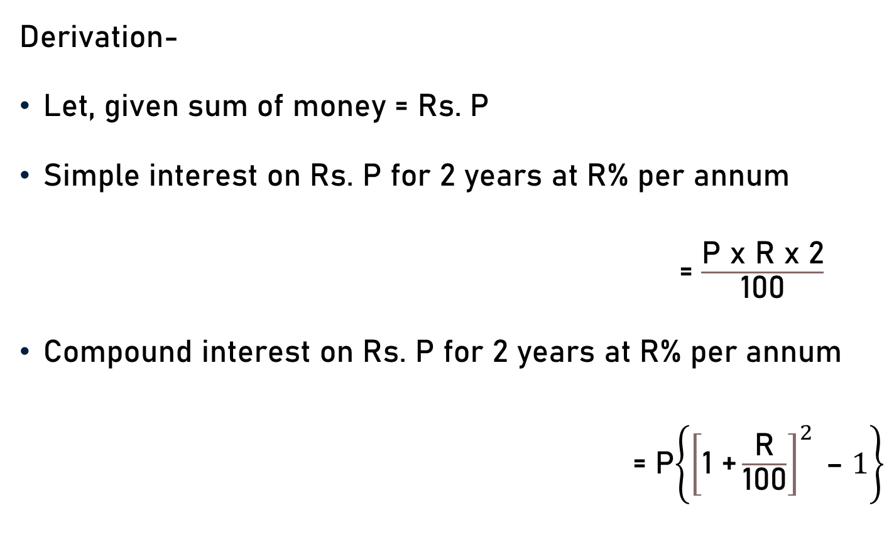
Basic Formulae
Derivation-
Let, given sum of money = Rs. P
Simple interest on Rs. P for 2 years at R% per annum
= $\frac{\text{P} \text{x} \text{R} \text{x}\text{ 2}}{\text{100}}$
Compound interest on Rs. P for 2 years at R% per annum
= P$\left\{{\left[\text{1 +}\frac{\text{R}}{\text{100}}\right]}^{2} \text{– }1\right\}$

Slide 15

Basic Formulae
C.I. – S.I. =P$\left\{{\left[\text{1 +}\frac{\text{R}}{\text{100}}\right]}^{2} \text{– }1\right\}$ - $\frac{\text{P} \text{x} \text{R} \text{x}\text{ 2}}{\text{100}}$
C.I. – S.I. =P$\left\{\text{1 +}{\left[\frac{\text{R}}{\text{100}}\right]}^{2}\text{+}\frac{\text{2}\text{R}}{\text{100}}\text{– }1\text{− }\frac{\text{2}\text{R}}{\text{100}}\right\}$
C.I. – S.I. =P$\left\{{\left[\frac{\text{R}}{\text{100}}\right]}^{2}\right\}$

Slide 16
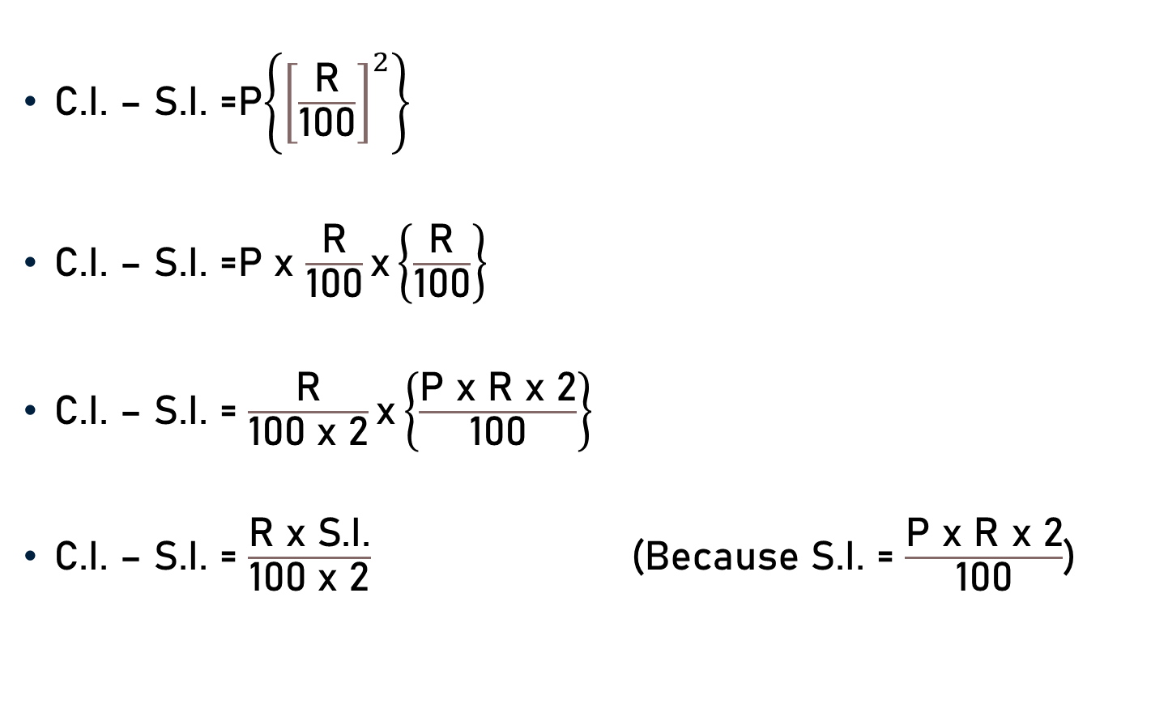
Basic Formulae
C.I. – S.I. =P$\left\{{\left[\frac{\text{R}}{\text{100}}\right]}^{2}\right\}$
C.I. – S.I. =P x $\frac{\text{R}}{\text{100}}\text{x}\left\{\frac{ \text{R} }{\text{100}}\right\}$
C.I. – S.I. = $\frac{\text{R}}{\text{100} \text{x}\text{ 2}}\text{x}\left\{\frac{\text{P} \text{x} \text{R} \text{x}\text{ 2}}{\text{100}}\right\}$
C.I. – S.I. = $\frac{\text{R} \text{x} \text{S}\text{.}\text{I}\text{.}}{\text{100 }\text{x}\text{ 2}}$ (Because S.I. = $\frac{\text{P} \text{x} \text{R} \text{x}\text{ 2}}{\text{100}}$)

Slide 17
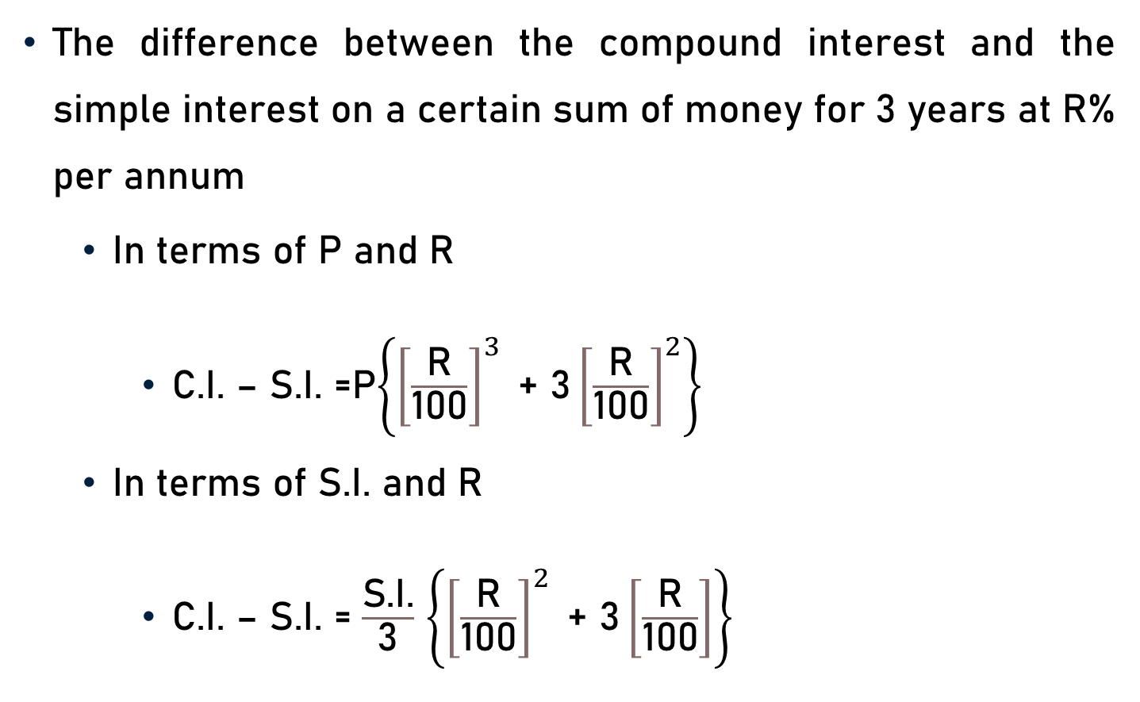
Basic Formulae
The difference between the compound interest and the simple interest on a certain sum of money for 3 years at R% per annum
In terms of P and R
C.I. – S.I. =P$\left\{{\left[\frac{\text{R}}{\text{100}}\right]}^{3}\text{ + 3}{\left[\frac{\text{R}}{\text{100}}\right]}^{2}\right\}$
In terms of S.I. and R
C.I. – S.I. = $\frac{\text{S}\text{.}\text{I}\text{.}}{\text{3}}$ $\left\{{\left[\frac{\text{R}}{\text{100}}\right]}^{2}\text{ + 3}\left[\frac{\text{R}}{\text{100}}\right]\right\}$

Slide 18

Basic Formulae
Derivation-
Let, given sum of money = Rs. P
Simple interest on Rs. P for 3 years at R% per annum
= $\frac{\text{P} \text{x} \text{R} \text{x}\text{ 3}}{\text{100}}$
Compound interest on Rs. P for 3 years at R% per annum
= P$\left\{{\left[\text{1 +}\frac{\text{R}}{\text{100}}\right]}^{3} \text{– }1\right\}$

Slide 19
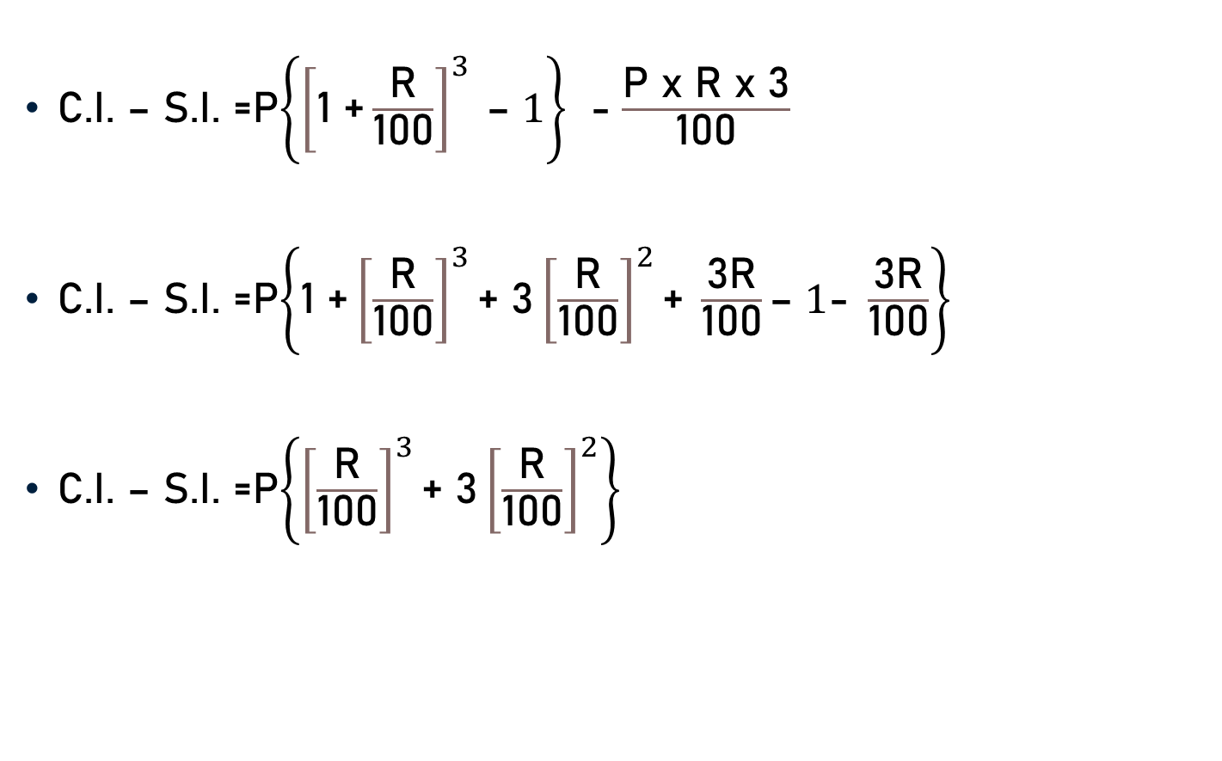
Basic Formulae
C.I. – S.I. =P$\left\{{\left[\text{1 +}\frac{\text{R}}{\text{100}}\right]}^{3} \text{– }1\right\}$ - $\frac{\text{P} \text{x} \text{R} \text{x}\text{ 3}}{\text{100}}$
C.I. – S.I. =P$\left\{\text{1 +}{\left[\frac{\text{R}}{\text{100}}\right]}^{3}\text{+} \text{3}{\left[\frac{\text{R}}{\text{100}}\right]}^{2}\text{+} \frac{\text{3}\text{R}}{\text{100}}\text{– }1\text{− }\frac{\text{3}\text{R}}{\text{100}}\right\}$
C.I. – S.I. =P$\left\{{\left[\frac{\text{R}}{\text{100}}\right]}^{3}\text{+ }\text{3}{\left[\frac{\text{R}}{\text{100}}\right]}^{2}\right\}$

Slide 20
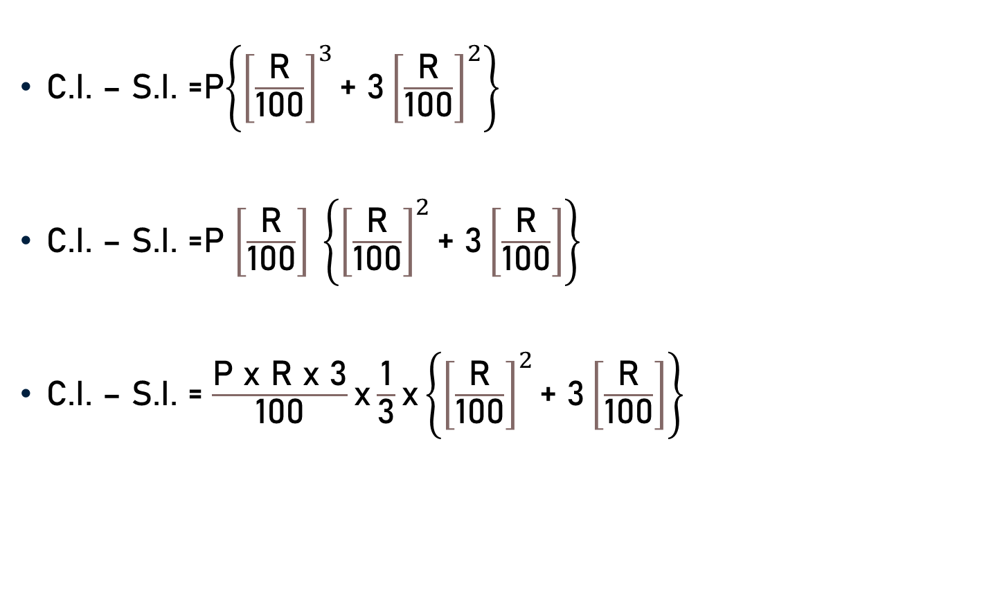
Basic Formulae
C.I. – S.I. =P$\left\{{\left[\frac{\text{R}}{\text{100}}\right]}^{3}\text{+ }\text{3}{\left[\frac{\text{R}}{\text{100}}\right]}^{2}\right\}$
C.I. – S.I. =P $\left[\frac{\text{R}}{\text{100}}\right] \left\{{\left[\frac{\text{R}}{\text{100}}\right]}^{2}\text{+ }\text{3}\left[\frac{\text{R}}{\text{100}}\right]\right\}$
C.I. – S.I. = $\frac{\text{P} \text{x} \text{R} \text{x}\text{ 3}}{\text{100}}\text{x}\frac{\text{1}}{\text{3}}\text{x}\left\{{\left[\frac{\text{R}}{\text{100}}\right]}^{2}\text{+ }\text{3}\left[\frac{\text{R}}{\text{100}}\right]\right\}$

Slide 21
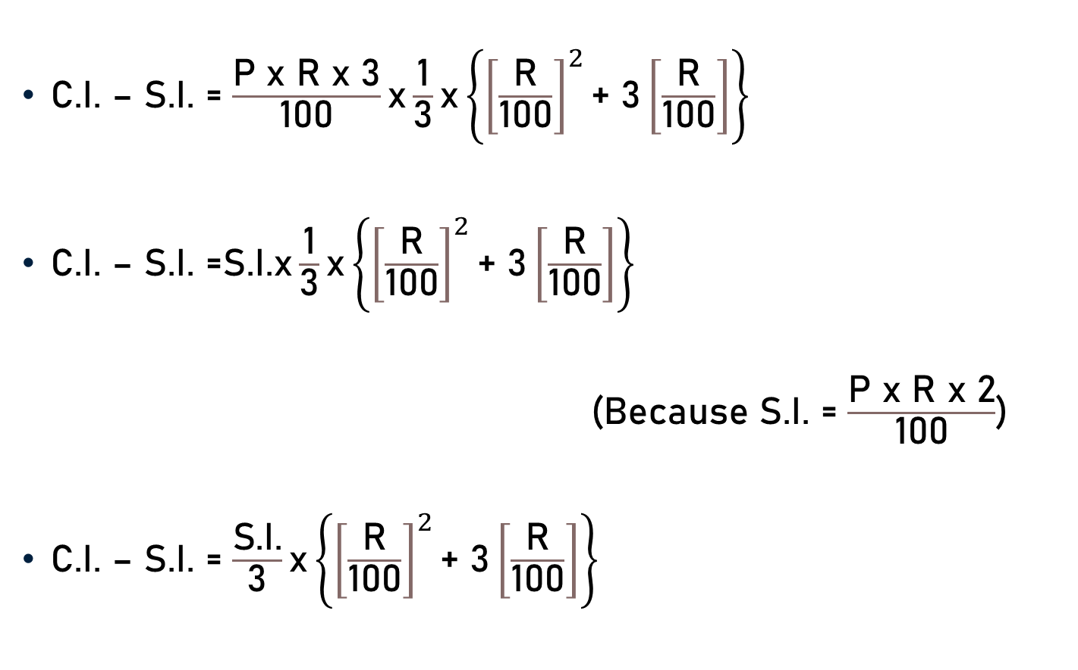
Basic Formulae
C.I. – S.I. = $\frac{\text{P} \text{x} \text{R} \text{x}\text{ 3}}{\text{100}}\text{x}\frac{\text{1}}{\text{3}}\text{x}\left\{{\left[\frac{\text{R}}{\text{100}}\right]}^{2}\text{+ }\text{3}\left[\frac{\text{R}}{\text{100}}\right]\right\}$
C.I. – S.I. =S.I.$\text{x}\frac{\text{1}}{\text{3}}\text{x}\left\{{\left[\frac{\text{R}}{\text{100}}\right]}^{2}\text{+ }\text{3}\left[\frac{\text{R}}{\text{100}}\right]\right\}$
(Because S.I. = $\frac{\text{P} \text{x} \text{R} \text{x}\text{ 2}}{\text{100}}$)
C.I. – S.I. = $\frac{\text{S}\text{.}\text{I}\text{.}}{\text{3}}\text{x}\left\{{\left[\frac{\text{R}}{\text{100}}\right]}^{2}\text{+ }\text{3}\left[\frac{\text{R}}{\text{100}}\right]\right\}$

Slide 22
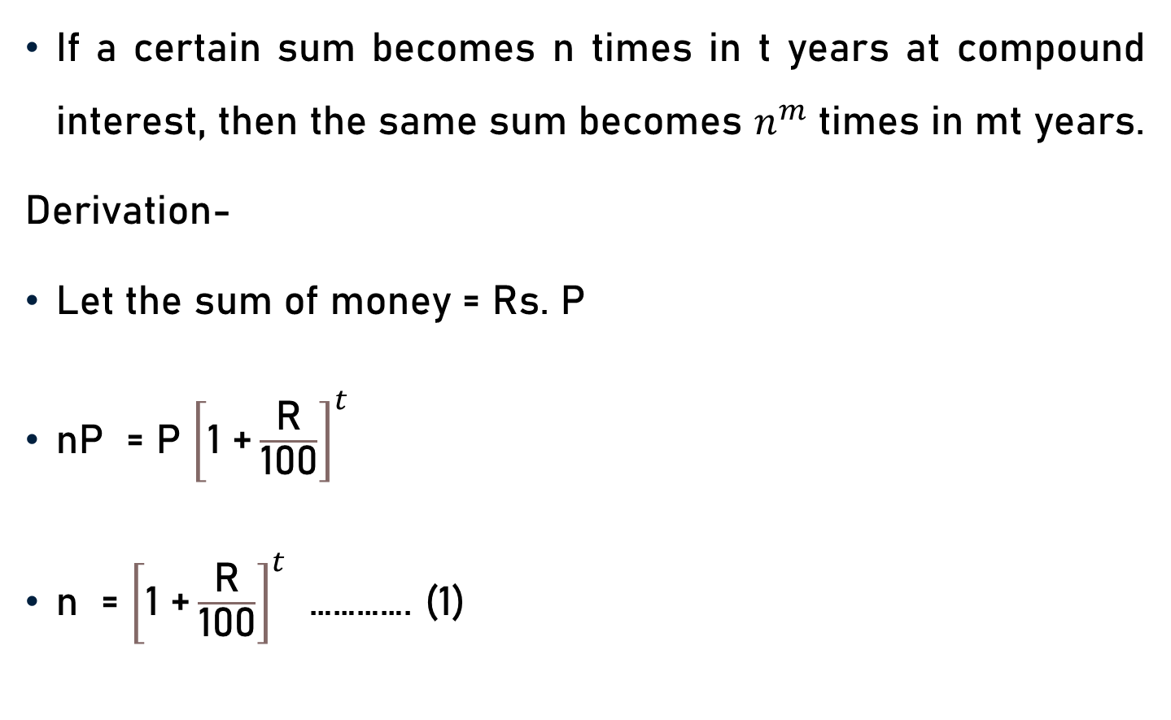
Basic Formulae
If a certain sum becomes n times in t years at compound interest, then the same sum becomes $n^{m}$ times in mt years.
Derivation-
Let the sum of money = Rs. P
nP = P ${\left[\text{1 +}\frac{\text{R}}{\text{100}}\right]}^{t}$
n = ${\left[\text{1 +}\frac{\text{R}}{\text{100}}\right]}^{t}$ …………. (1)

Slide 23

Basic Formulae
Let the sum become $n^{m}$ times in T years.
$n^{m}$ = ${\left[\text{1 +}\frac{\text{R}}{\text{100}}\right]}^{T}$
n = ${\left[\text{1 +}\frac{\text{R}}{\text{100}}\right]}^{T/m}$ …………. (2)
From (1) and (2)
${\left[\text{1 +}\frac{\text{R}}{\text{100}}\right]}^{t}$ = ${\left[\text{1 +}\frac{\text{R}}{\text{100}}\right]}^{T/m}$

Slide 24

Basic Formulae
${\left[\text{1 +}\frac{\text{R}}{\text{100}}\right]}^{t}$ = ${\left[\text{1 +}\frac{\text{R}}{\text{100}}\right]}^{T/m}$
t = $\frac{\text{T}}{\text{m}}$
T = mt years
Sum becomes $n^{m}$ times in mt years.

Slide 25

Basic Formulae
If a certain sum becomes n times in t years, then the rate of compound interest is
R = 100[${(\text{n})}^{1/t}$ - 1]

Slide 26
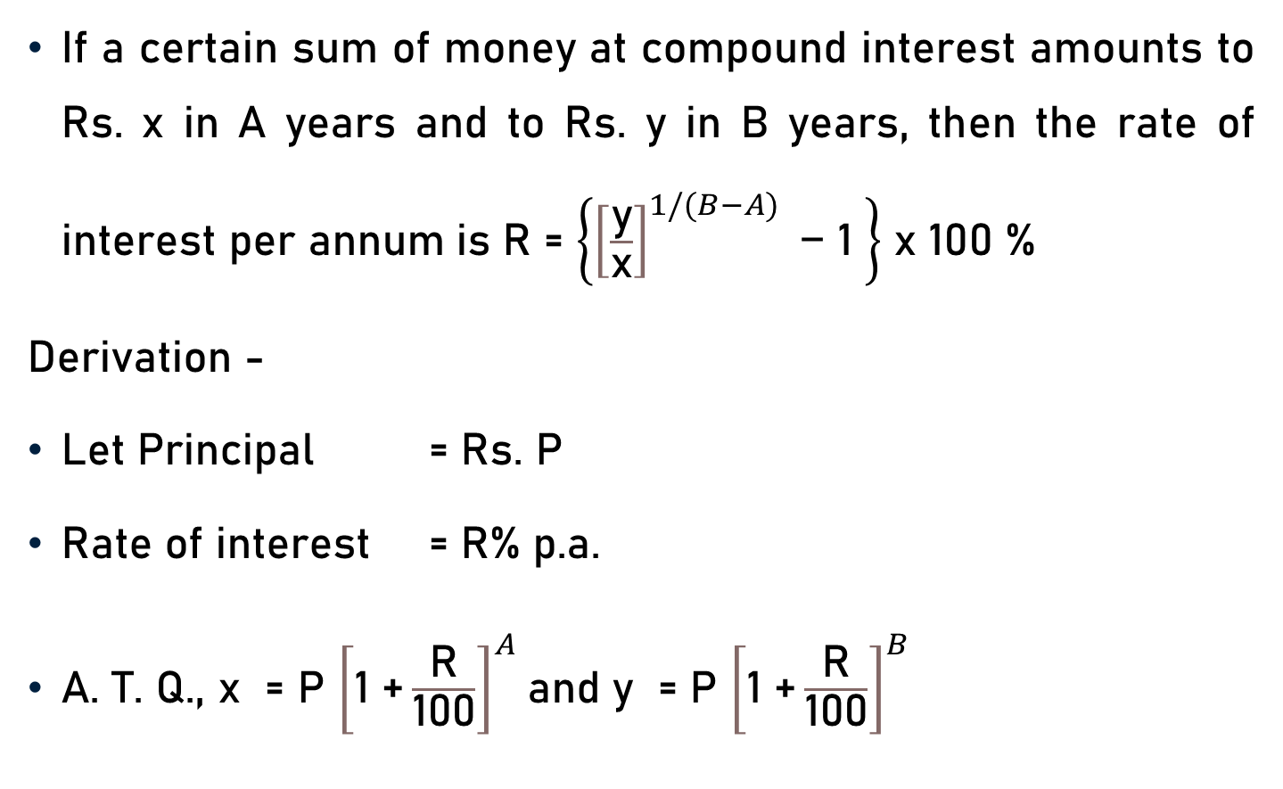
Basic Formulae
If a certain sum of money at compound interest amounts to Rs. x in A years and to Rs. y in B years, then the rate of interest per annum is R = $\left\{{\left[\frac{\text{y}}{\text{x}}\right]}^{1/(B−A)}\text{ − 1 }\right\}$ x 100 %
Derivation -
Let Principal = Rs. P
Rate of interest = R% p.a.
A. T. Q., x = P ${\left[\text{1 +}\frac{\text{R}}{\text{100}}\right]}^{A}$and y = P ${\left[\text{1 +}\frac{\text{R}}{\text{100}}\right]}^{B}$

Slide 27

Basic Formulae
y = P ${\left[\text{1 +}\frac{\text{R}}{\text{100}}\right]}^{B}$
x = P ${\left[\text{1 +}\frac{\text{R}}{\text{100}}\right]}^{A}$
$\frac{\text{y}}{\text{x}}$ = $\frac{\text{P} {\left[\text{1 +}\frac{\text{R}}{\text{100}}\right]}^{B}}{\text{P} {\left[\text{1 +}\frac{\text{R}}{\text{100}}\right]}^{A}}$
$\frac{\text{y}}{\text{x}}$ = ${\left[\text{1 +}\frac{\text{R}}{\text{100}}\right]}^{B−A}$
$\text{1 +}\frac{\text{R}}{\text{100}}$= ${\left[\frac{\text{y}}{\text{x}}\right]}^{1/(B−A)}$

Slide 28

Basic Formulae
$\text{1 +}\frac{\text{R}}{\text{100}}$= ${\left[\frac{\text{y}}{\text{x}}\right]}^{1/(B−A)}$
$\frac{\text{R}}{\text{100}}$= ${\left[\frac{\text{y}}{\text{x}}\right]}^{1/(B−A)}$ $\text{− }\text{1}$
$\text{R}$ = $\left\{{\left[\frac{\text{y}}{\text{x}}\right]}^{1/(B−A)}\text{ − 1 }\right\}$ x 100

Slide 29
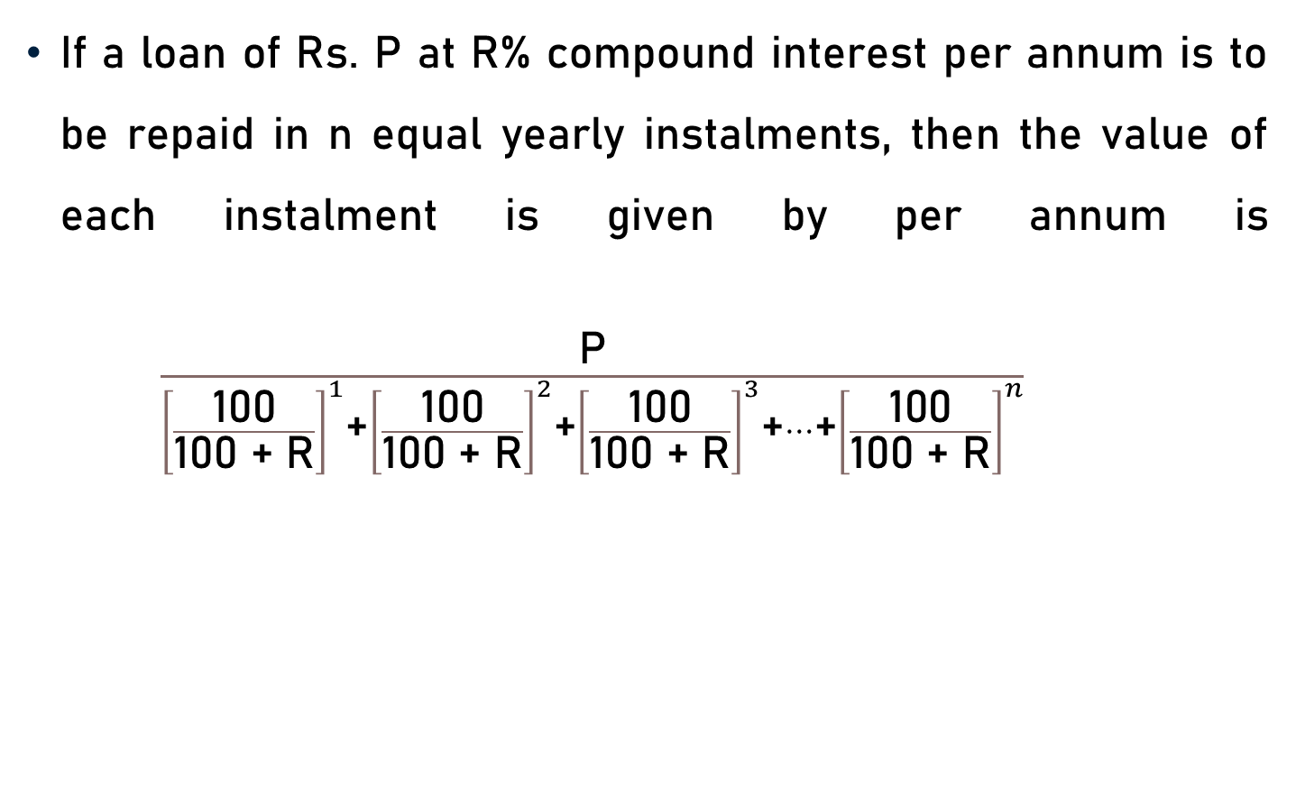
Basic Formulae
If a loan of Rs. P at R% compound interest per annum is to be repaid in n equal yearly instalments, then the value of each instalment is given by per annum is $\frac{\text{P}}{{\left[\frac{\text{100}}{\text{100 + }\text{R}}\right]}^{1}\text{+}{\left[\frac{\text{100}}{\text{100 + }\text{R}}\right]}^{2}\text{+}{\left[\frac{\text{100}}{\text{100 + }\text{R}}\right]}^{3}\text{+}…\text{+}{\left[\frac{\text{100}}{\text{100 + }\text{R}}\right]}^{n}}$

Slide 30
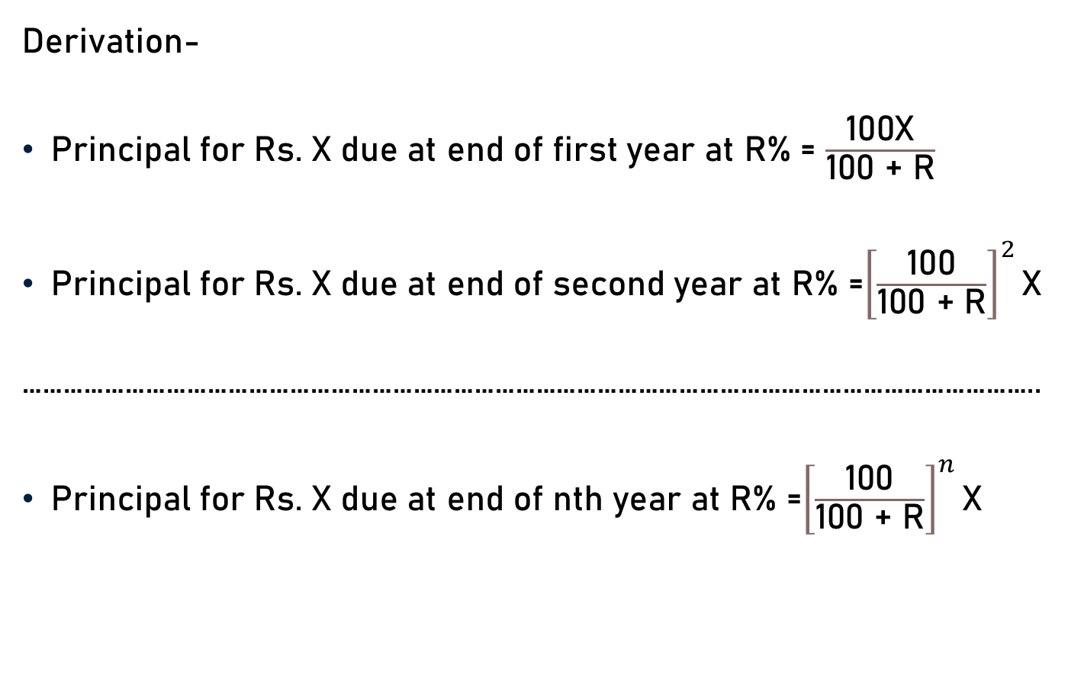
Basic Formulae
Derivation-
Principal for Rs. X due at end of first year at R% = $\frac{\text{100}\text{X}}{\text{100 + }\text{R}}$
Principal for Rs. X due at end of second year at R% =${\left[\frac{\text{100}}{\text{100 + }\text{R}}\right]}^{2}\text{X}$
…………………………………………………………………………………………………………………………………..
Principal for Rs. X due at end of nth year at R% =${\left[\frac{\text{100}}{\text{100 + }\text{R}}\right]}^{n}\text{X}$

Slide 31
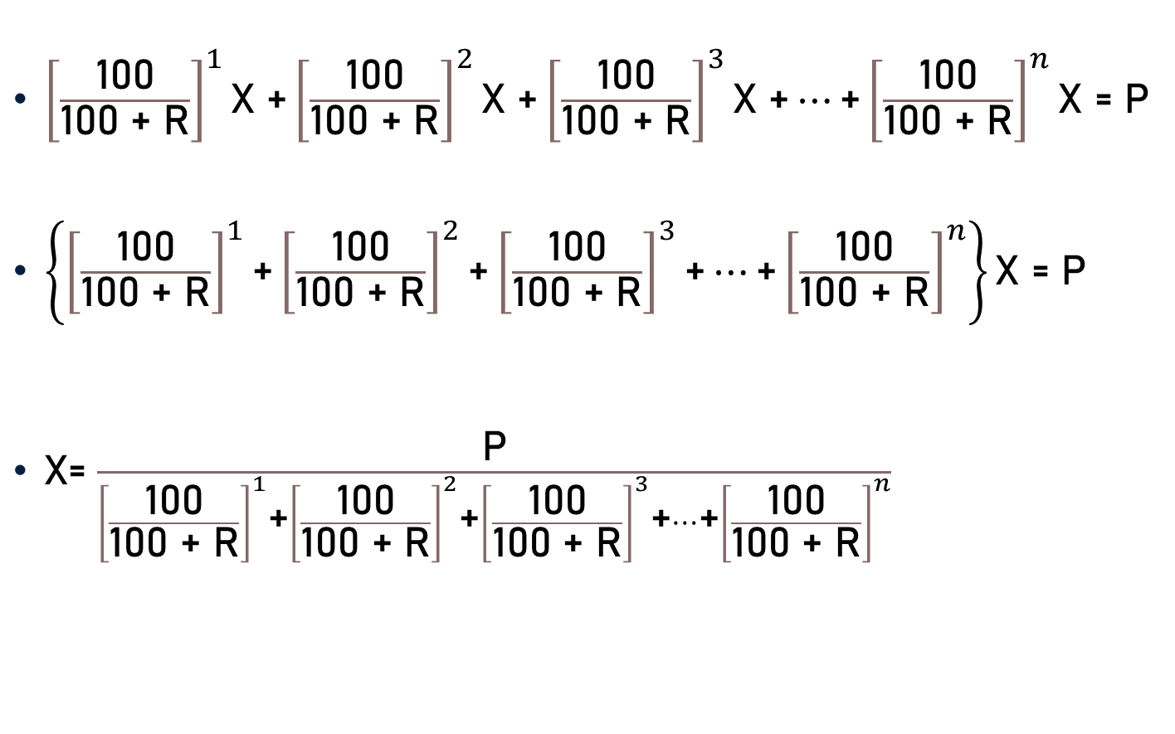
Basic Formulae
${\left[\frac{\text{100}}{\text{100 + }\text{R}}\right]}^{1}\text{X} \text{+}{\left[\frac{\text{100}}{\text{100 + }\text{R}}\right]}^{2}\text{X} \text{+}{\left[\frac{\text{100}}{\text{100 + }\text{R}}\right]}^{3}\text{X} \text{+}…\text{+}{\left[\frac{\text{100}}{\text{100 + }\text{R}}\right]}^{n}\text{X}$ = P
$\left\{{\left[\frac{\text{100}}{\text{100 + }\text{R}}\right]}^{1}\text{+}{\left[\frac{\text{100}}{\text{100 + }\text{R}}\right]}^{2}\text{+}{\left[\frac{\text{100}}{\text{100 + }\text{R}}\right]}^{3}\text{+}…\text{+}{\left[\frac{\text{100}}{\text{100 + }\text{R}}\right]}^{n}\right\}\text{X}$ = P
$\text{X}$= $\frac{\text{P}}{{\left[\frac{\text{100}}{\text{100 + }\text{R}}\right]}^{1}\text{+}{\left[\frac{\text{100}}{\text{100 + }\text{R}}\right]}^{2}\text{+}{\left[\frac{\text{100}}{\text{100 + }\text{R}}\right]}^{3}\text{+}…\text{+}{\left[\frac{\text{100}}{\text{100 + }\text{R}}\right]}^{n}}$

Slide 32
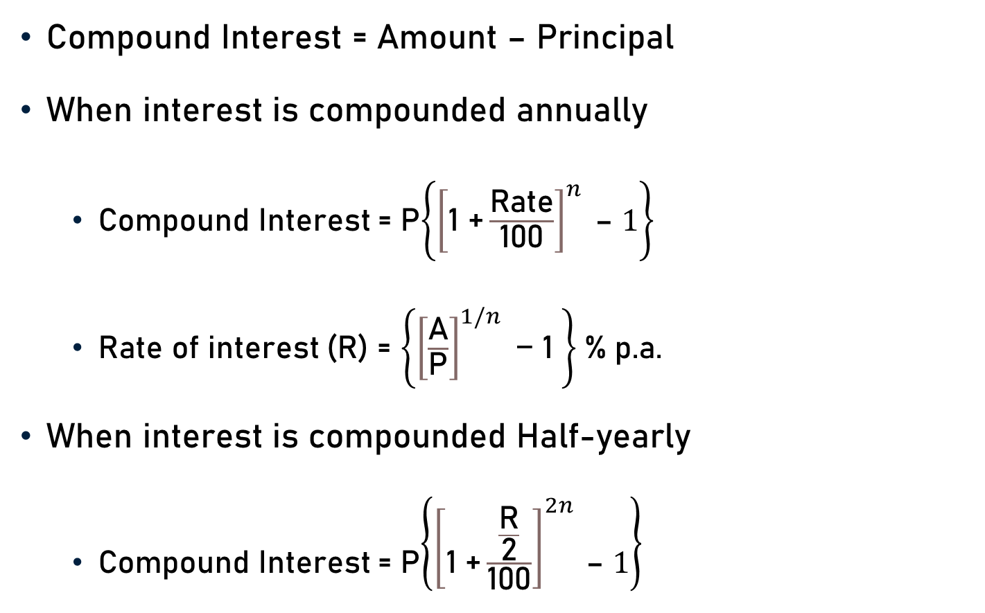
Conclusion
Compound Interest = Amount – Principal
When interest is compounded annually
Compound Interest = P$\left\{{\left[\text{1 +}\frac{\text{Rate}}{\text{100}}\right]}^{n} \text{– }1\right\}$
Rate of interest (R) = $\left\{{\left[\frac{\text{A}}{\text{P}}\right]}^{1/n}\text{ − 1 }\right\}$% p.a.
When interest is compounded Half-yearly
Compound Interest = P$\left\{{\left[\text{1 +}\frac{\frac{\text{R}}{\text{2}}}{\text{100}}\right]}^{2n} \text{– }1\right\}$

Slide 33
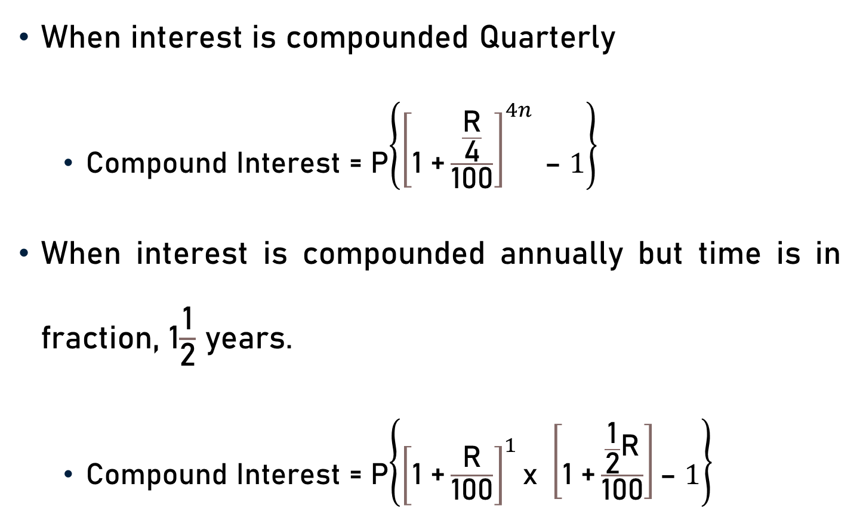
Conclusion
When interest is compounded Quarterly
Compound Interest = P$\left\{{\left[\text{1 +}\frac{\frac{\text{R}}{\text{4}}}{\text{100}}\right]}^{4n} \text{– }1\right\}$
When interest is compounded annually but time is in fraction, 1$\frac{\text{1}}{\text{2}}$ years.
Compound Interest = P$\left\{{\left[\text{1 +}\frac{\text{R}}{\text{100}}\right]}^{1}\text{x} \left[\text{1 +}\frac{\frac{\text{1}}{\text{2}}\text{R}}{\text{100}}\right]\text{– }1\right\}$

Slide 34
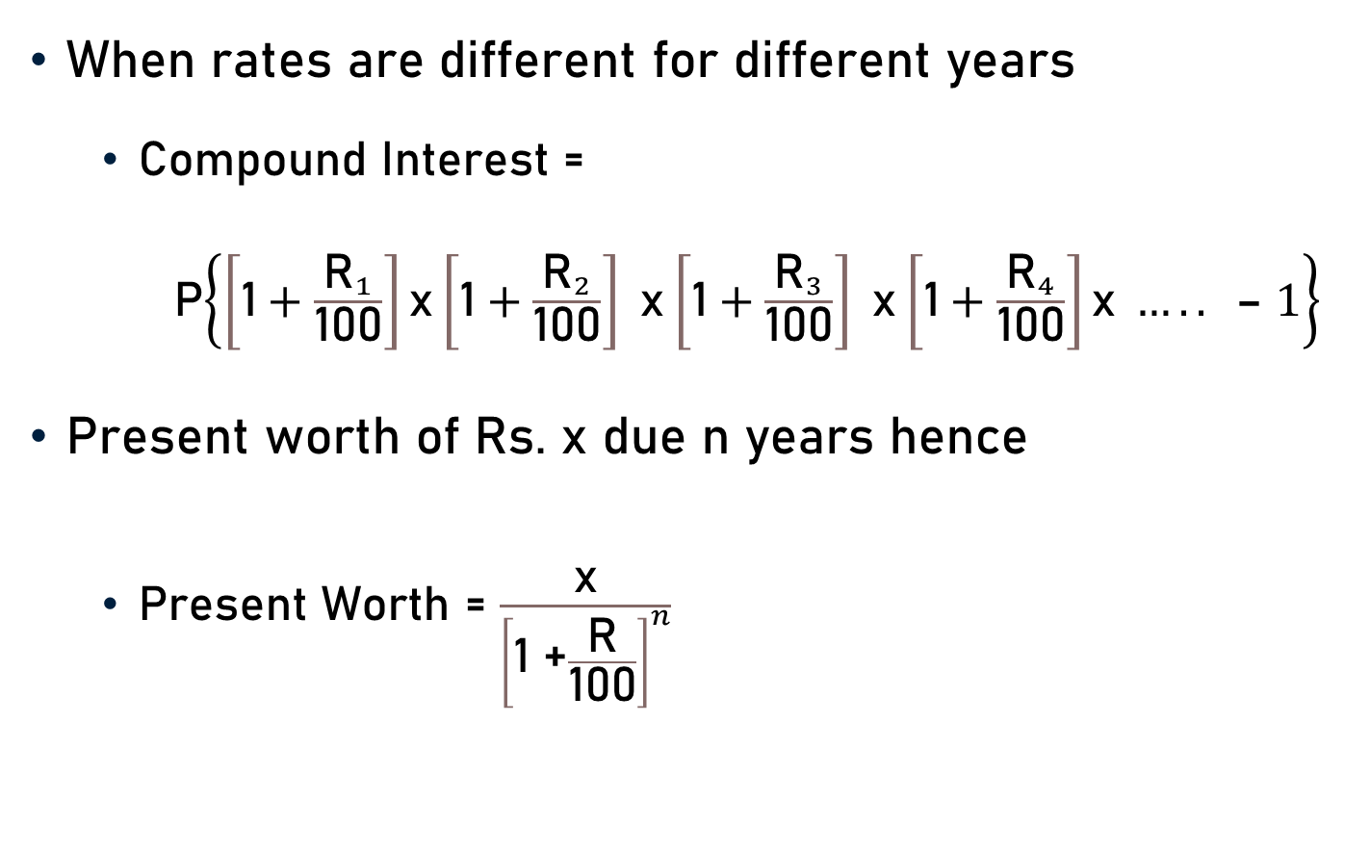
Conclusion
When rates are different for different years
Compound Interest =
P$\left\{\left[\text{1}+\frac{{\text{R}}_{1}}{\text{100}}\right]\text{x}\left[\text{1}+\frac{{\text{R}}_{2}}{\text{100}}\right] \text{x}\left[\text{1}+\frac{{\text{R}}_{3}}{\text{100}}\right] \text{x}\left[\text{1}+\frac{{\text{R}}_{4}}{\text{100}}\right]\text{x} ….. \text{– }1\right\}$
Present worth of Rs. x due n years hence
Present Worth = $\frac{\text{x}}{{\left[\text{1 +}\frac{\text{R}}{\text{100}}\right]}^{n}}$

Slide 35

Conclusion
For 2 years at R% per annum
In terms of P and R
C.I. – S.I. = P ${\left[\frac{\text{R}}{\text{100}}\right]}^{2}$
In terms of S.I. and R
C.I. – S.I. = $\frac{\text{R} \text{x} \text{S}\text{.}\text{I}\text{.}}{\text{2 }\text{x}\text{ 100}}$

Slide 36
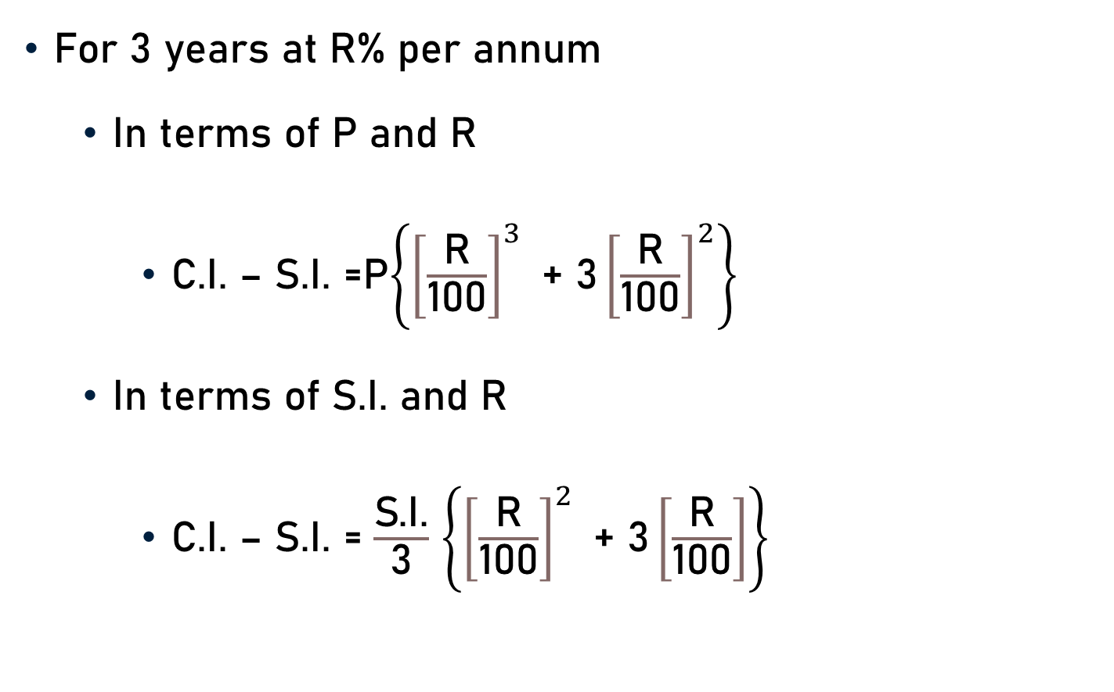
Conclusion
For 3 years at R% per annum
In terms of P and R
C.I. – S.I. =P$\left\{{\left[\frac{\text{R}}{\text{100}}\right]}^{3}\text{ + 3}{\left[\frac{\text{R}}{\text{100}}\right]}^{2}\right\}$
In terms of S.I. and R
C.I. – S.I. = $\frac{\text{S}\text{.}\text{I}\text{.}}{\text{3}}$ $\left\{{\left[\frac{\text{R}}{\text{100}}\right]}^{2}\text{ + 3}\left[\frac{\text{R}}{\text{100}}\right]\right\}$

Slide 37
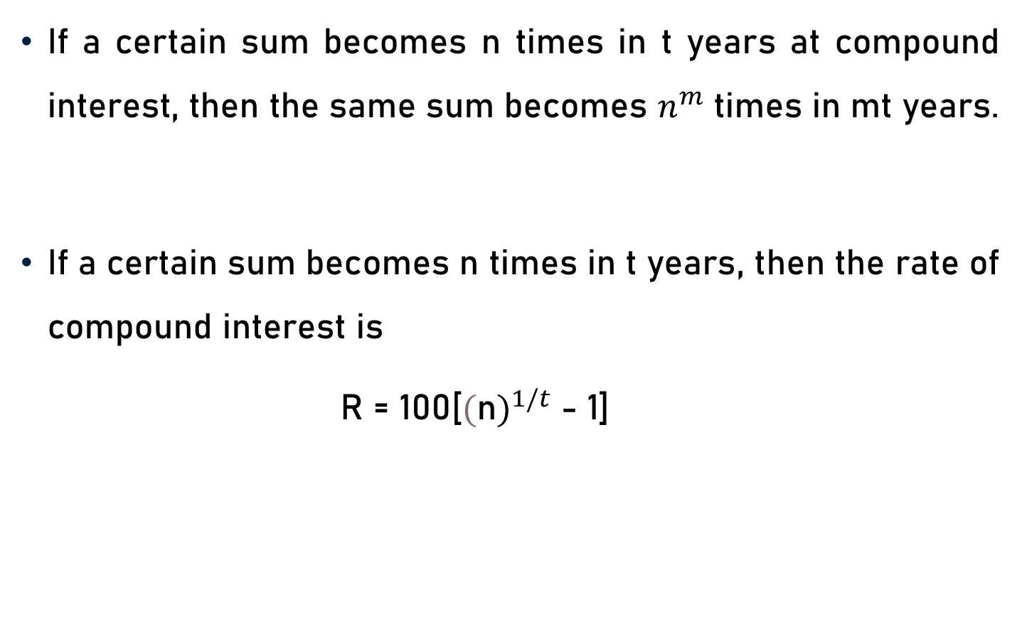
Conclusion
If a certain sum becomes n times in t years at compound interest, then the same sum becomes $n^{m}$ times in mt years.
If a certain sum becomes n times in t years, then the rate of compound interest is
R = 100[${(\text{n})}^{1/t}$ - 1]

Slide 38
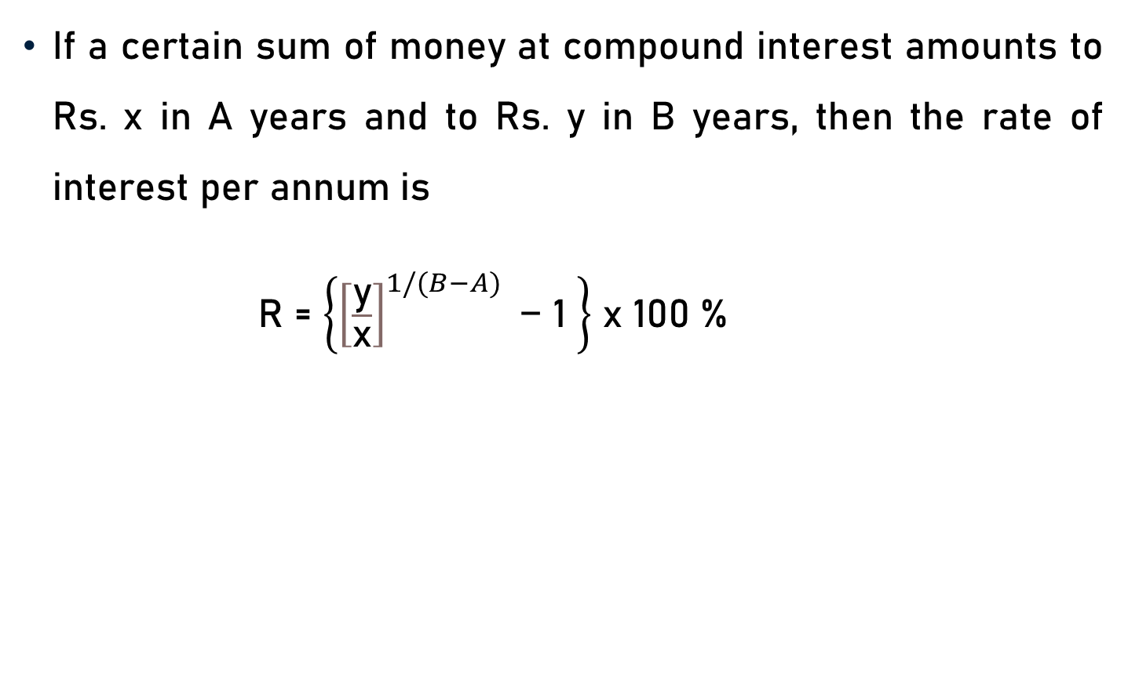
Conclusion
If a certain sum of money at compound interest amounts to Rs. x in A years and to Rs. y in B years, then the rate of interest per annum is
R = $\left\{{\left[\frac{\text{y}}{\text{x}}\right]}^{1/(B−A)}\text{ − 1 }\right\}$ x 100 %

Slide 39
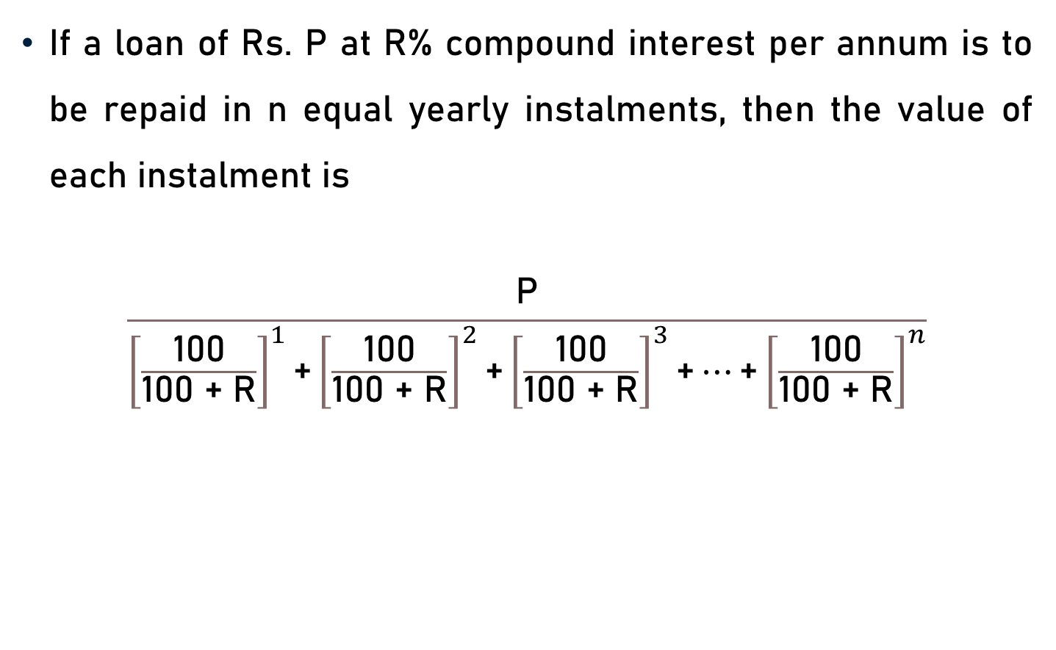
Conclusion
If a loan of Rs. P at R% compound interest per annum is to be repaid in n equal yearly instalments, then the value of each instalment is
$$\frac{\text{P}}{{\left[\frac{\text{100}}{\text{100 + }\text{R}}\right]}^{1}\text{+}{\left[\frac{\text{100}}{\text{100 + }\text{R}}\right]}^{2}\text{+}{\left[\frac{\text{100}}{\text{100 + }\text{R}}\right]}^{3}\text{+}…\text{+}{\left[\frac{\text{100}}{\text{100 + }\text{R}}\right]}^{n}}$$

Slide 40
Summary
Concept and Formulae
Compound Interest
Yearly
Half-yearly
Quarterly
Compounded annually but time is in fractions
Different rate of interest for different years
Present worth of Rs. x due n years hence

Slide 41
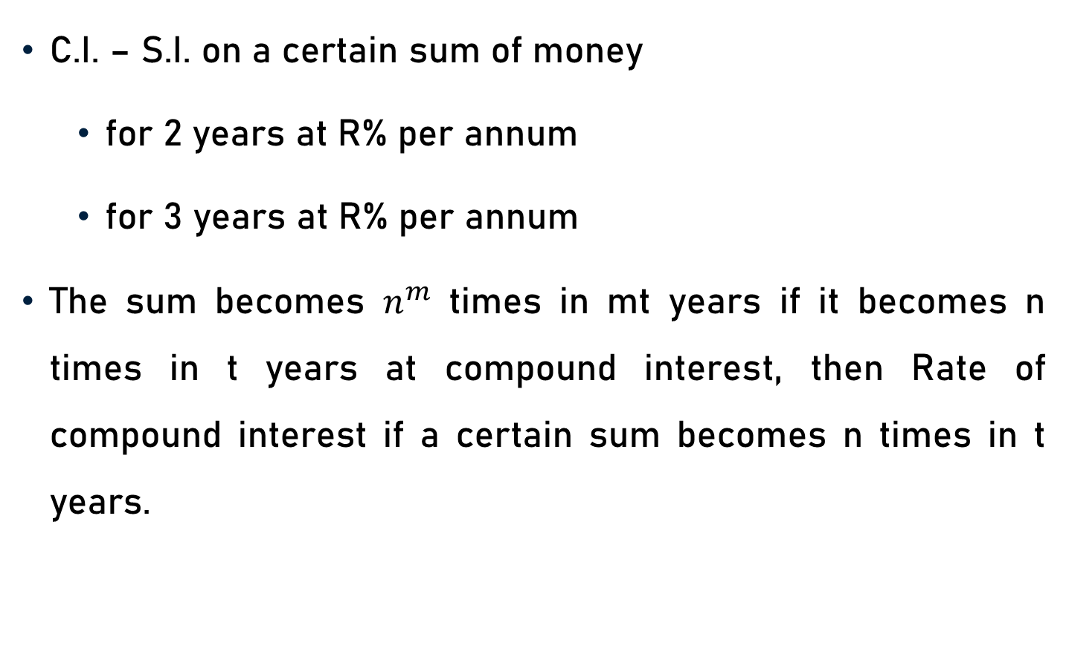
Summary
C.I. – S.I. on a certain sum of money
for 2 years at R% per annum
for 3 years at R% per annum
The sum becomes $n^{m}$ times in mt years if it becomes n times in t years at compound interest, then Rate of compound interest if a certain sum becomes n times in t years.

Slide 42
Summary
Rate of interest per annum if a certain sum of money at compound interest amounts to Rs. x in A years and to Rs. y in B years.
Value of each instalment if a loan of Rs. P at R% compound interest per annum is to be repaid in n equal yearly instalments.

