Slide 2
solve problems based on compound interest computation.

Slide 3
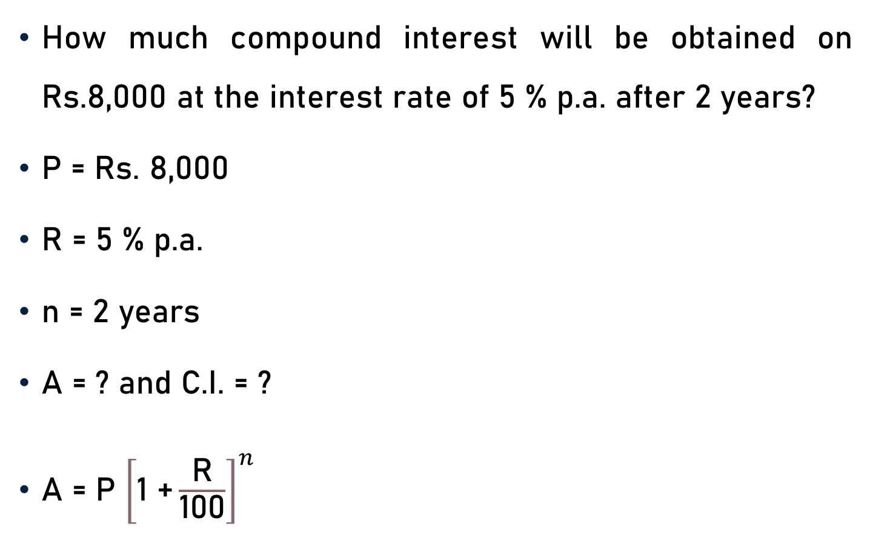
Problem 1
How much compound interest will be obtained on Rs.8,000 at the interest rate of 5 % p.a. after 2 years?
P = Rs. 8,000
R = 5 % p.a.
n = 2 years
A = ? and C.I. = ?
A = P ${\left[\text{1 +}\frac{\text{R}}{\text{100}}\right]}^{n}$

Slide 4
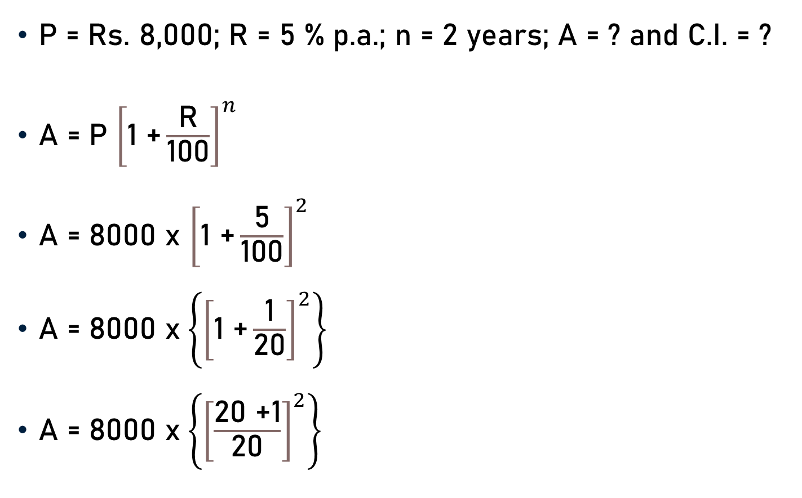
Problem 1
P = Rs. 8,000; R = 5 % p.a.; n = 2 years; A = ? and C.I. = ?
A = P ${\left[\text{1 +}\frac{\text{R}}{\text{100}}\right]}^{n}$
A = 8000 x ${\left[\text{1 +}\frac{\text{5}}{\text{100}}\right]}^{2}$
A = 8000 x$\left\{{\left[\text{1 +}\frac{\text{1}}{\text{20}}\right]}^{2}\right\}$
A = 8000 x$\left\{{\left[\frac{\text{20 +1}}{\text{20}}\right]}^{2}\right\}$
20

Slide 5
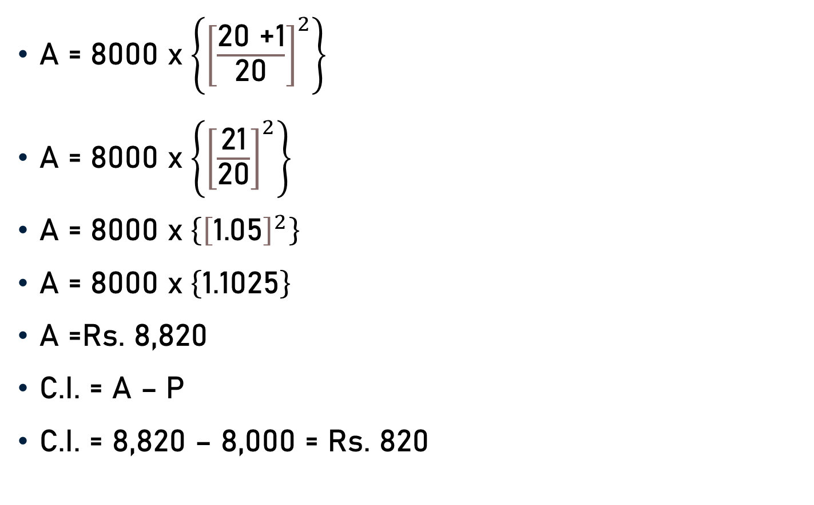
Problem 1
A = 8000 x$\left\{{\left[\frac{\text{20 +1}}{\text{20}}\right]}^{2}\right\}$
A = 8000 x$\left\{{\left[\frac{\text{21}}{\text{20}}\right]}^{2}\right\}$
A = 8000 x$\left\{{\left[\text{1.05}\right]}^{2}\right\}$
A = 8000 x$\left\{\text{1.1025}\right\}$
A =Rs. 8,820
C.I. = A – P
C.I. = 8,820 – 8,000 = Rs. 820
1.05

Slide 6
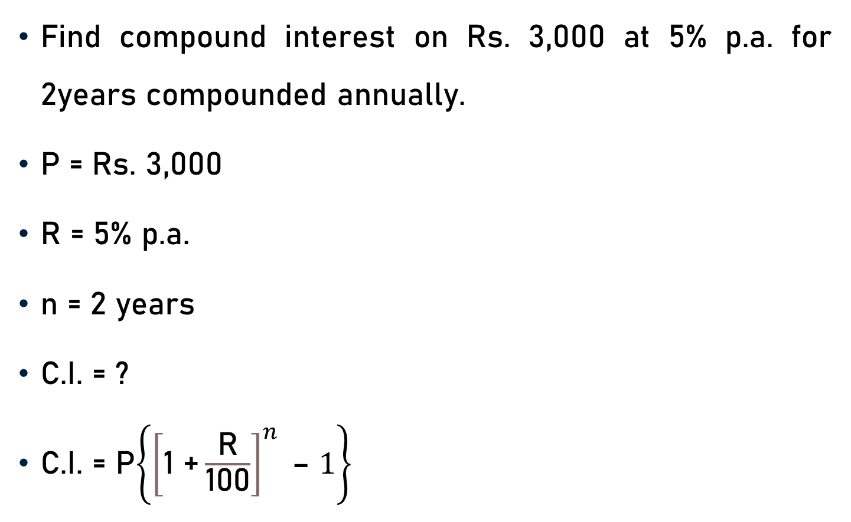
Problem 2
Find compound interest on Rs. 3,000 at 5% p.a. for 2years compounded annually.
P = Rs. 3,000
R = 5% p.a.
n = 2 years
C.I. = ?
C.I. = P$\left\{{\left[\text{1 +}\frac{\text{R}}{\text{100}}\right]}^{n} \text{– }1\right\}$

Slide 7
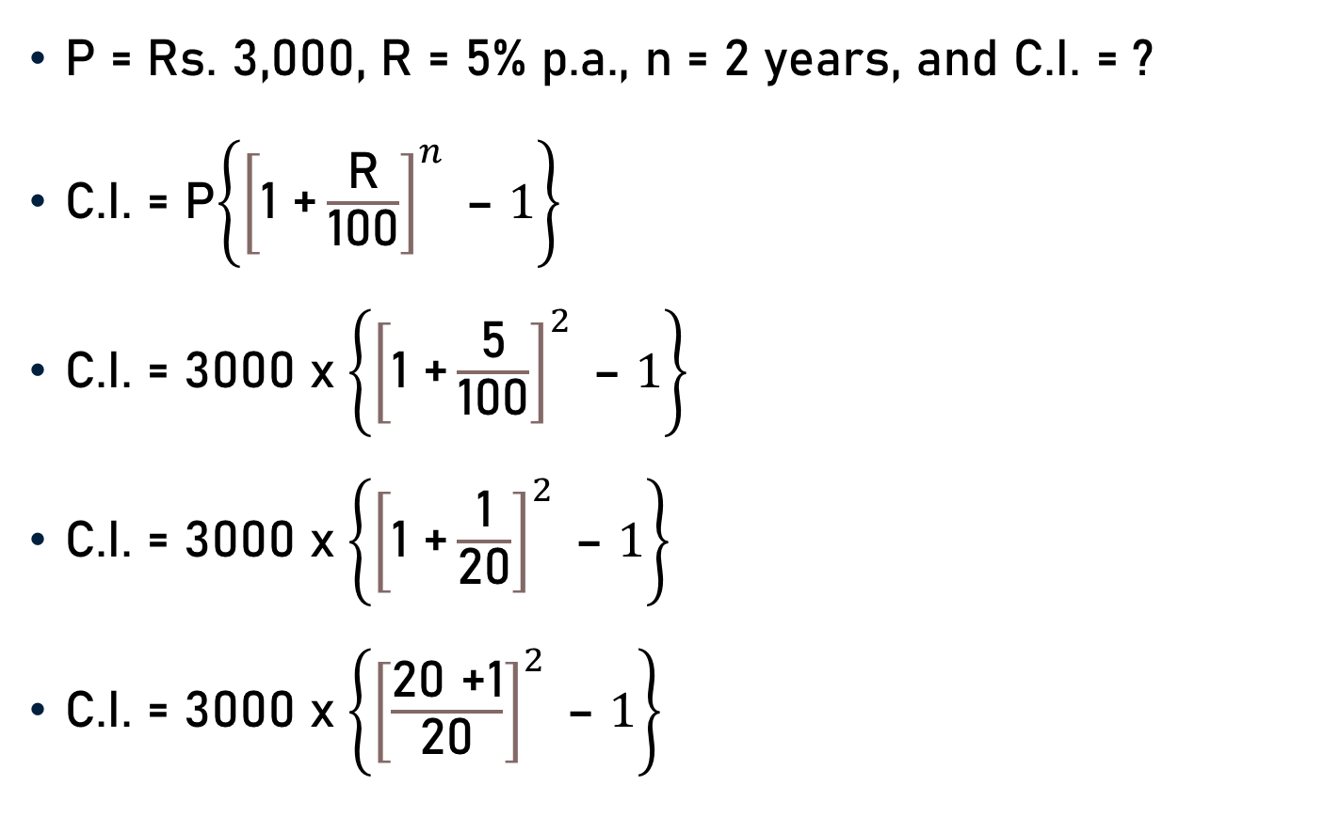
Problem 2
P = Rs. 3,000, R = 5% p.a., n = 2 years, and C.I. = ?
C.I. = P$\left\{{\left[\text{1 +}\frac{\text{R}}{\text{100}}\right]}^{n} \text{– }1\right\}$
C.I. = 3000 x$\left\{{\left[\text{1 +}\frac{\text{5}}{\text{100}}\right]}^{2} \text{– }1\right\}$
C.I. = 3000 x$\left\{{\left[\text{1 +}\frac{\text{1}}{\text{2}\text{0}}\right]}^{2} \text{– }1\right\}$
C.I. = 3000 x$\left\{{\left[\frac{\text{20}\text{ +1}}{\text{20}}\right]}^{2} \text{– }1\right\}$
20

Slide 8

Problem 2
C.I. = 3000 x$\left\{{\left[\frac{\text{20 +1}}{\text{20}}\right]}^{2} \text{– }1\right\}$
C.I. = 3000 x$\left\{{\left[\frac{\text{21}}{\text{20}}\right]}^{2} \text{– }1\right\}$
C.I. = 3000 x$\left\{{\left[\text{1.05}\right]}^{2} \text{– }1\right\}$
C.I. = 3000 x$\left\{\text{1.1025 }\text{– }1\right\}$
C.I. = 3000 x$\left\{\text{0}\text{.1025}\right\}$
C.I. = 3000 x$\left\{\frac{\text{1025}}{\text{1000}\text{0}}\right\}$
C.I. = Rs. 307.5
1.05
3
10

Slide 9
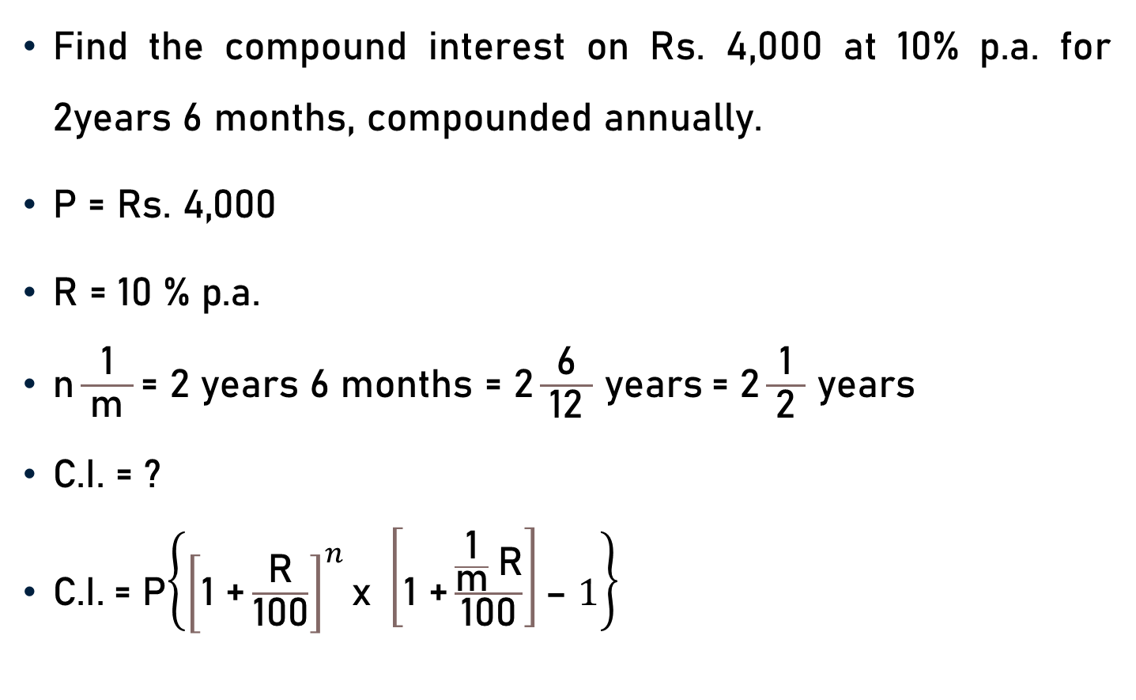
Problem 3
Find the compound interest on Rs. 4,000 at 10% p.a. for 2years 6 months, compounded annually.
$\text{P}\text{ = }\text{Rs}\text{. 4,000 }$
$\text{R}\text{ = 10 \% }\text{p}\text{.}\text{a}\text{. }$
$\text{n}\frac{\text{1}}{ \text{m} }\text{=} \text{2 }\text{years}\text{ 6 }\text{months} \text{=}\text{ 2}\frac{\text{6}}{ \text{12 }}$ $\text{years}$= $\text{2}\frac{\text{1}}{ \text{2} }$ $\text{y}\text{ear}\text{s}$
$\text{C}\text{.}\text{I}\text{. = ?}$
$\text{C}\text{.}\text{I}\text{.}$= P$\left\{{\left[\text{1 +}\frac{\text{R}}{\text{100}}\right]}^{n}\text{x} \left[\text{1 +}\frac{\frac{\text{1}}{\text{m}} \text{R}}{\text{100}}\right]\text{– }1\right\}$
2

Slide 10
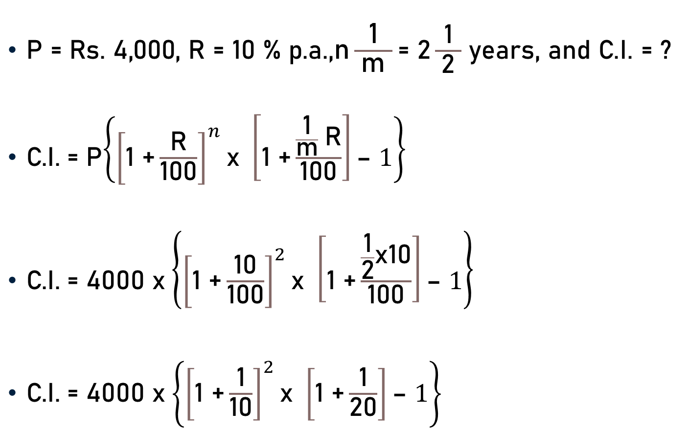
Problem 3
$\text{P}\text{ = }\text{Rs}\text{. 4,000, }\text{R}\text{ = 10 \% }\text{p}\text{.}\text{a}\text{.,}\text{n}\frac{\text{1}}{ \text{m} }\text{=}$ $\text{2}\frac{\text{1}}{ \text{2} }$ years, and $\text{C}\text{.}\text{I}\text{. = ?}$
$\text{C}\text{.}\text{I}\text{.}$= P$\left\{{\left[\text{1 +}\frac{\text{R}}{\text{100}}\right]}^{n}\text{x} \left[\text{1 +}\frac{\frac{\text{1}}{\text{m}} \text{R}}{\text{100}}\right]\text{– }1\right\}$
$\text{C}\text{.}\text{I}\text{.}$= 4000 x$\left\{{\left[\text{1 +}\frac{\text{10}}{\text{100}}\right]}^{2}\text{x} \left[\text{1 +}\frac{\frac{\text{1}}{\text{2}}\text{x}\text{10}}{\text{100}}\right]\text{– }1\right\}$
$\text{C}\text{.}\text{I}\text{.}$= 4000 x$\left\{{\left[\text{1 +}\frac{\text{1}}{\text{10}}\right]}^{2}\text{x} \left[\text{1 +}\frac{\text{1}}{\text{2}\text{0}}\right]\text{– }1\right\}$
5
10
20

Slide 11
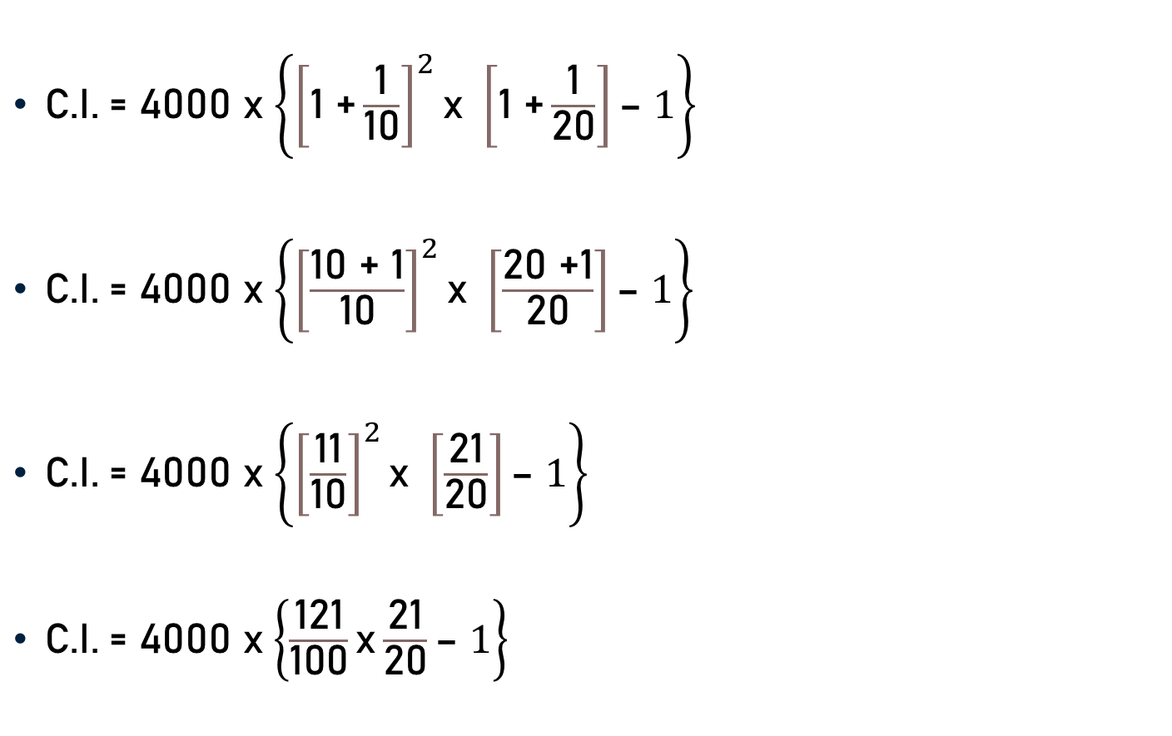
Problem 3
$\text{C}\text{.}\text{I}\text{.}$= 4000 x$\left\{{\left[\text{1 +}\frac{\text{1}}{\text{10}}\right]}^{2}\text{x} \left[\text{1 +}\frac{\text{1}}{\text{2}\text{0}}\right]\text{– }1\right\}$
$\text{C}\text{.}\text{I}\text{.}$= 4000 x$\left\{{\left[\frac{\text{1}\text{0}\text{ +}\text{ 1}}{\text{10}}\right]}^{2}\text{x} \left[\frac{\text{20}\text{ +}\text{1}}{\text{2}\text{0}}\right]\text{– }1\right\}$
$\text{C}\text{.}\text{I}\text{.}$= 4000 x$\left\{{\left[\frac{\text{11}}{\text{10}}\right]}^{2}\text{x} \left[\frac{\text{21}}{\text{20}}\right]\text{– }1\right\}$
$\text{C}\text{.}\text{I}\text{.}$= 4000 x$\left\{\frac{\text{1}\text{2}\text{1}}{\text{1}\text{0}\text{0}}\text{x}\frac{\text{21}}{\text{20}}\text{– }1\right\}$

Slide 12

Problem 3
$\text{C}\text{.}\text{I}\text{.}$= 4000 x$\left\{\frac{\text{1}\text{2}\text{1}}{\text{1}\text{0}\text{0}}\text{x}\frac{\text{21}}{\text{20}}\text{– }1\right\}$
$\text{C}\text{.}\text{I}\text{.}$= 4000 x$\left\{\frac{\text{121}}{\text{1}\text{0}\text{0}}\text{x}\frac{\text{21}}{\text{20}}\text{– }1\right\}$
$\text{C}\text{.}\text{I}\text{.}$= 4000 x$\left\{\frac{\text{2541}}{\text{20}\text{0}\text{0}}\text{– }1\right\}$
$\text{C}\text{.}\text{I}\text{.}$= 4000 x$\left\{\text{1}\text{.}\text{2705}\text{– }1\right\}$
$\text{C}\text{.}\text{I}\text{.}$= 4000 x$\left\{\text{0}\text{.}\text{2}\text{705}\right\}$
$\text{C}\text{.}\text{I}\text{.}$= Rs. 1,082
1.2705

Slide 13
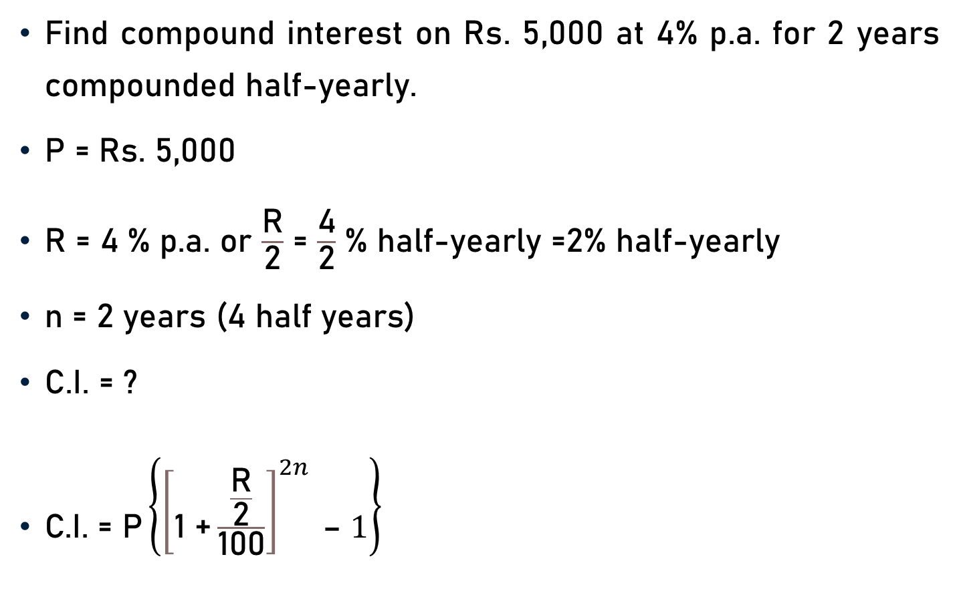
Problem 4
Find compound interest on Rs. 5,000 at 4% p.a. for 2 years compounded half-yearly.
P = Rs. 5,000
R = 4 % p.a. or $\frac{\text{R}}{\text{2}}$ = $\frac{\text{4}}{\text{2}}$ % half-yearly =2% half-yearly
n = 2 years (4 half years)
C.I. = ?
$\text{C}\text{.}\text{I}\text{.}\text{ = }\text{P}\left\{{\left[\text{1 +}\frac{\frac{\text{R}}{\text{2}}}{\text{100}}\right]}^{2n} \text{– }1\right\}$

Slide 14

Problem 4
P = Rs. 5,000, $\frac{\text{R}}{\text{2}}$ = 2, 2n = 4, & C.I. = ?
$\text{C}\text{.}\text{I}\text{.}\text{ = }\text{P}\left\{{\left[\text{1 +}\frac{\frac{\text{R}}{\text{2}}}{\text{100}}\right]}^{2n} \text{– }1\right\}$
$\text{C}\text{.}\text{I}\text{. = 5000 }\text{x}\left\{{\left[\text{1 +}\frac{\text{2}}{\text{100}}\right]}^{4} \text{– }1\right\}$
$\text{C}\text{.}\text{I}\text{. = 5000 }\text{x}\left\{{\left[\text{1 +}\frac{\text{1}}{\text{5}\text{0}}\right]}^{4} \text{– }1\right\}$
50

Slide 15

Problem 4
$\text{C}\text{.}\text{I}\text{. = 5000 }\text{x}\left\{{\left[\text{1 +}\frac{\text{1}}{\text{5}\text{0}}\right]}^{4} \text{– }1\right\}$
$\text{C}\text{.}\text{I}\text{. = 5000 }\text{x}\left\{{\left[\frac{\text{50}\text{ +} \text{1}}{\text{50}}\right]}^{4} \text{– }1\right\}$
$\text{C}\text{.}\text{I}\text{. = 5000 }\text{x}\left\{{\left[\frac{\text{51}}{\text{50}}\right]}^{4} \text{– }1\right\}$
$\text{C}\text{.}\text{I}\text{. = 5000 }\text{x}\left\{{\left[\text{1.02} \right]}^{4} \text{– }1\right\}$
$\text{C}\text{.}\text{I}\text{. = 5000 }\text{x}\left\{\text{1.0}\text{8}\text{2– }1\right\}$
1.02

Slide 16

Problem 4
$\text{C}\text{.}\text{I}\text{. = 5000 }\text{x}\left\{\text{1.0}\text{8}\text{2– }1\right\}$
C$\text{.}\text{I}\text{. = 5000 }\text{x}\left\{\text{0.082}\right\}$
C$\text{.}\text{I}\text{. = }\text{Rs}\text{. 410}$

Slide 17
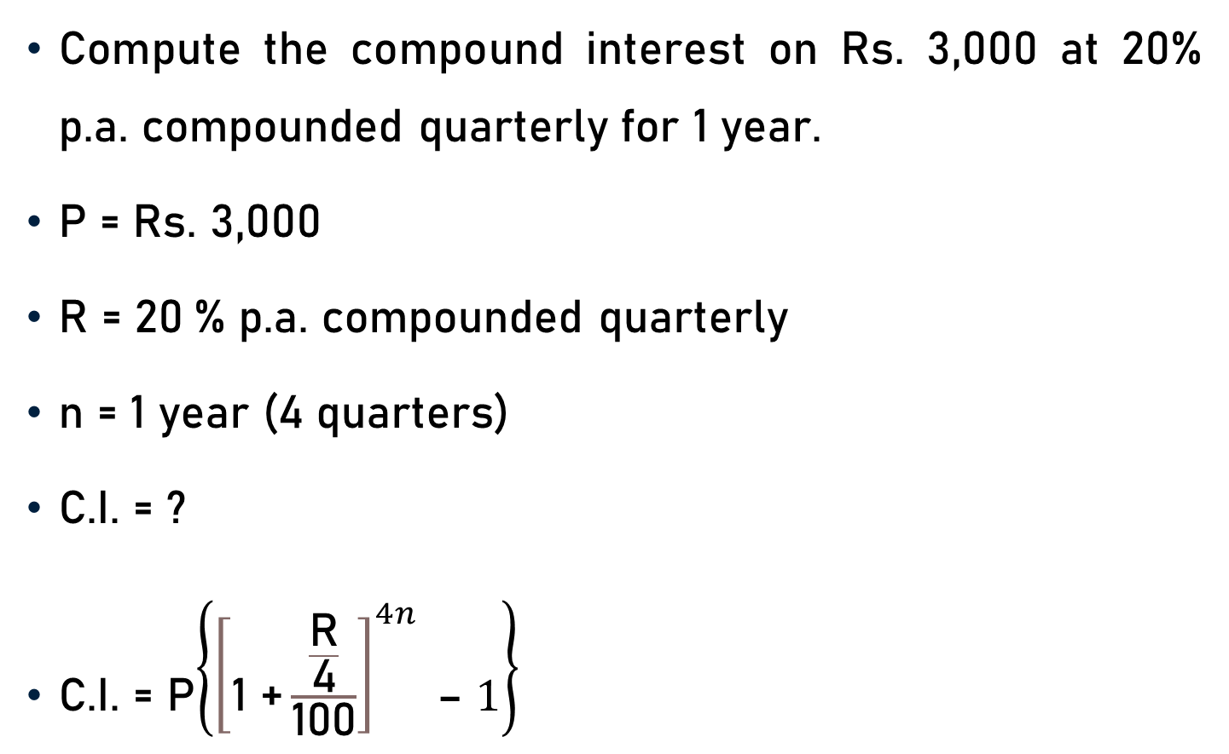
Problem 5
Compute the compound interest on Rs. 3,000 at 20% p.a. compounded quarterly for 1 year.
P = Rs. 3,000
R = 20 % p.a. compounded quarterly
n = 1 year (4 quarters)
C.I. = ?
C.I. = P$\left\{{\left[\text{1 +}\frac{\frac{\text{R}}{\text{4}}}{\text{100}}\right]}^{4n} \text{– }1\right\}$

Slide 18
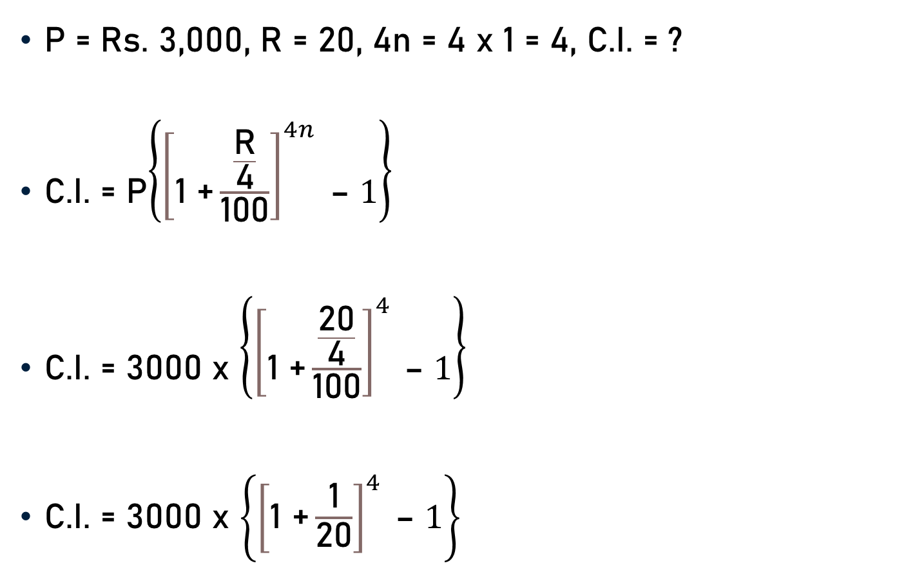
Problem 5
P = Rs. 3,000, R = 20, 4n = 4 x 1 = 4, C.I. = ?
C.I. = P$\left\{{\left[\text{1 +}\frac{\frac{\text{R}}{\text{4}}}{\text{100}}\right]}^{4n} \text{– }1\right\}$
C.I. = 3000 x $\left\{{\left[\text{1 +}\frac{\frac{\text{20}}{\text{4}}}{\text{100}}\right]}^{4} \text{– }1\right\}$
C.I. = 3000 x $\left\{{\left[\text{1 +}\frac{\text{1}}{\text{2}\text{0}}\right]}^{4} \text{– }1\right\}$
5
20

Slide 19

Problem 5
C.I. = 3000 x $\left\{{\left[\text{1 +}\frac{\text{1}}{\text{2}\text{0}}\right]}^{4} \text{– }1\right\}$
C.I. = 3000 x $\left\{{\left[\frac{\text{20}\text{+1}}{\text{20}}\right]}^{4} \text{– }1\right\}$
C.I. = 3000 x $\left\{{\left[\frac{\text{21}}{\text{20}}\right]}^{4} \text{– }1\right\}$
C.I. = 3000 x $\left\{{\left[\text{1.05}\right]}^{4} \text{– }1\right\}$
C.I. = 3000 x $\left\{\text{1.22} \text{– }1\right\}$
1.05

Slide 20

Problem 5
C.I. = 3000 x $\left\{\text{1.22} \text{– }1\right\}$
C.I. = 3000 x $\left\{\text{0}\text{.22}\right\}$
C.I. = Rs. 660

Slide 21
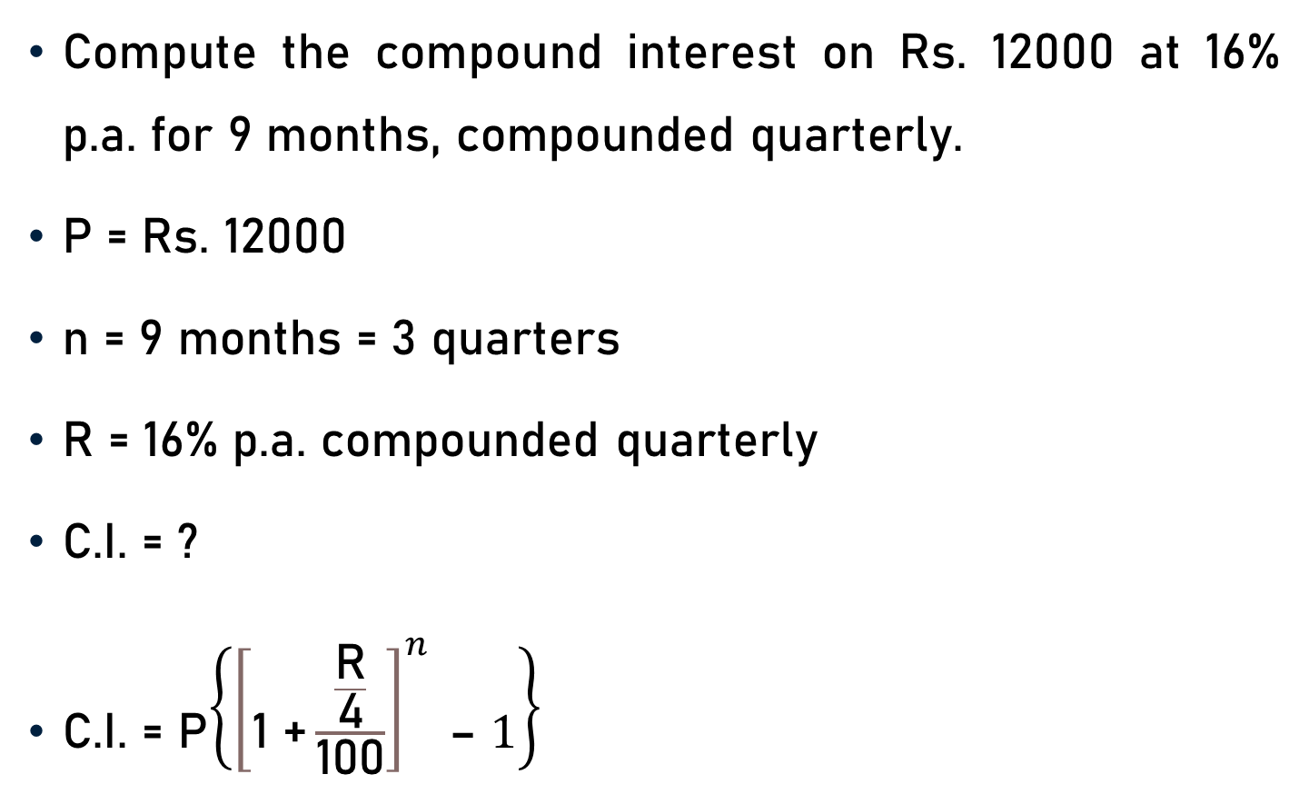
Problem 6
Compute the compound interest on Rs. 12000 at 16% p.a. for 9 months, compounded quarterly.
P = Rs. 12000
n = 9 months = 3 quarters
R = 16% p.a. compounded quarterly
C.I. = ?
C.I. = P$\left\{{\left[\text{1 +}\frac{\frac{\text{R}}{\text{4}}}{\text{100}}\right]}^{n} \text{– }1\right\}$

Slide 22
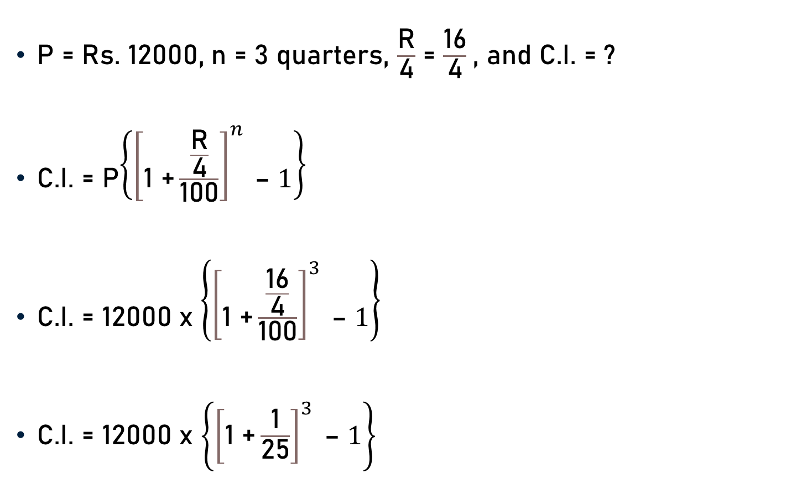
Problem 6
P = Rs. 12000, n = 3 quarters, $\frac{\text{R}}{\text{4}}$ = $\frac{\text{16}}{\text{4}}$, and C.I. = ?
C.I. = P$\left\{{\left[\text{1 +}\frac{\frac{\text{R}}{\text{4}}}{\text{100}}\right]}^{n} \text{– }1\right\}$
C.I. = 12000 x $\left\{{\left[\text{1 +}\frac{\frac{\text{16}}{\text{4}}}{\text{100}}\right]}^{3} \text{– }1\right\}$
C.I. = 12000 x $\left\{{\left[\text{1 +}\frac{\text{1}}{\text{25}}\right]}^{3} \text{– }1\right\}$
4
25

Slide 23
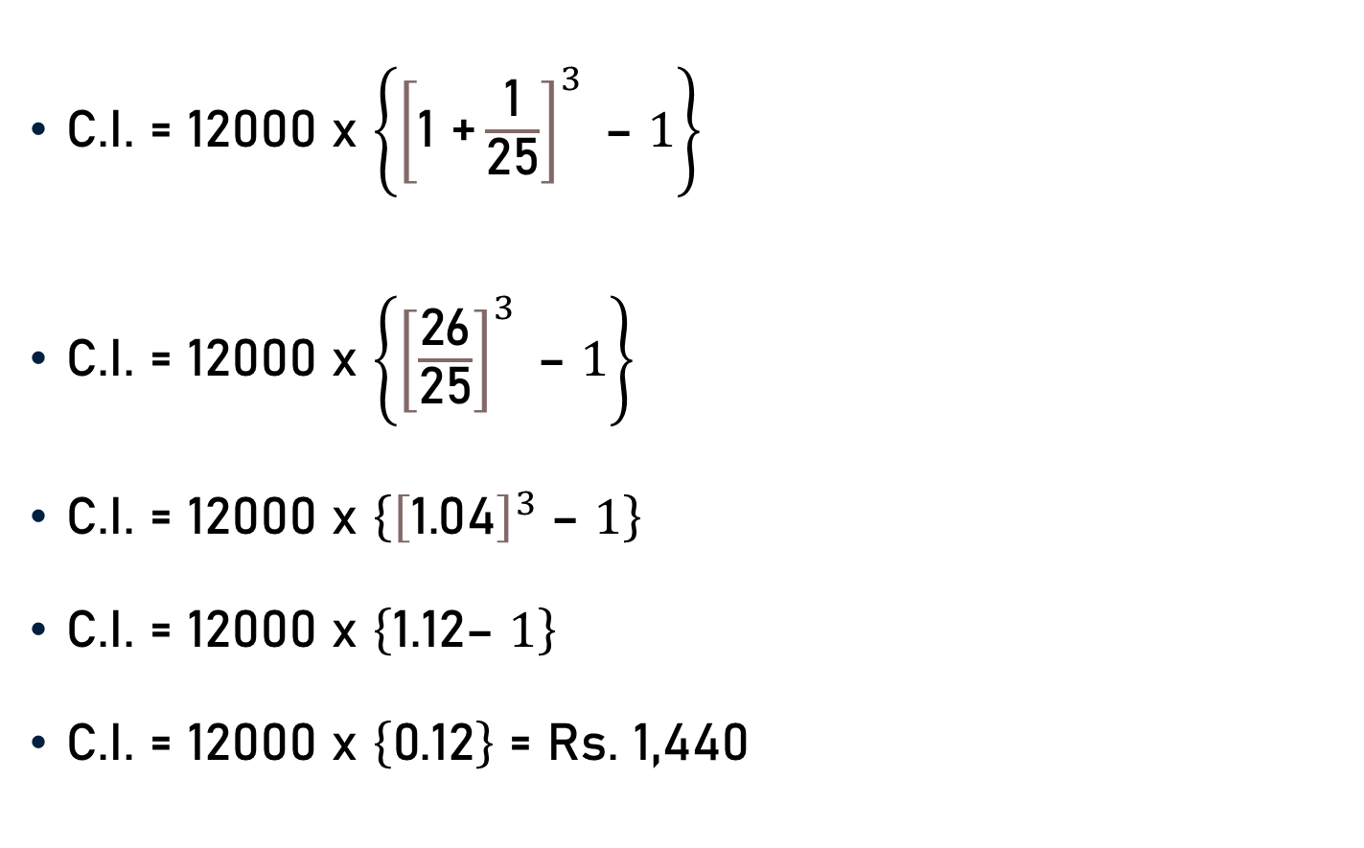
Problem 6
C.I. = 12000 x $\left\{{\left[\text{1 +}\frac{\text{1}}{\text{25}}\right]}^{3} \text{– }1\right\}$
C.I. = 12000 x $\left\{{\left[\frac{\text{26}}{\text{25}}\right]}^{3} \text{– }1\right\}$
C.I. = 12000 x $\left\{{\left[\text{1}\text{.}\text{0}\text{4}\right]}^{3} \text{– }1\right\}$
C.I. = 12000 x $\left\{\text{1}\text{.}\text{12}\text{– }1\right\}$
C.I. = 12000 x $\left\{\text{0}\text{.12}\right\}$ = Rs. 1,440

Slide 24
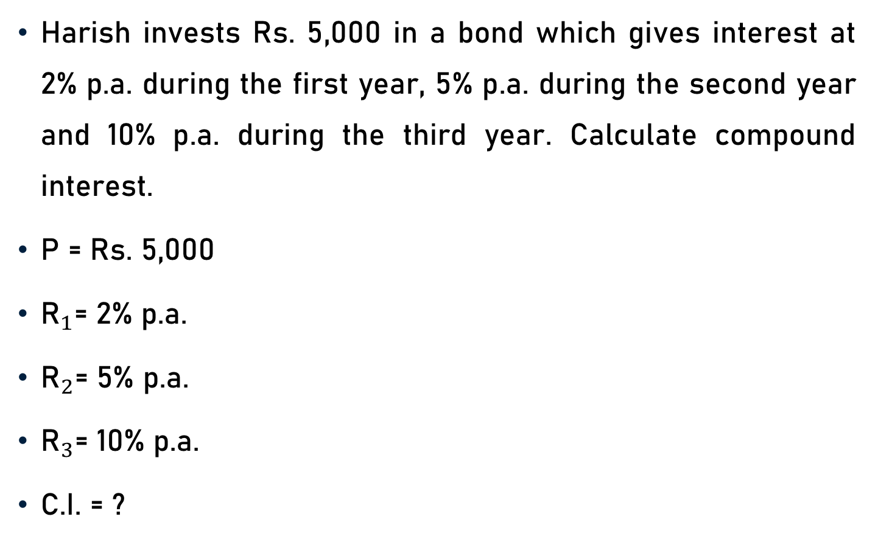
Problem 7
Harish invests Rs. 5,000 in a bond which gives interest at 2% p.a. during the first year, 5% p.a. during the second year and 10% p.a. during the third year. Calculate compound interest.
P = Rs. 5,000
${\text{R}}_{1}$= 2% p.a.
${\text{R}}_{2}$= 5% p.a.
${\text{R}}_{3}$= 10% p.a.
C.I. = ?

Slide 25
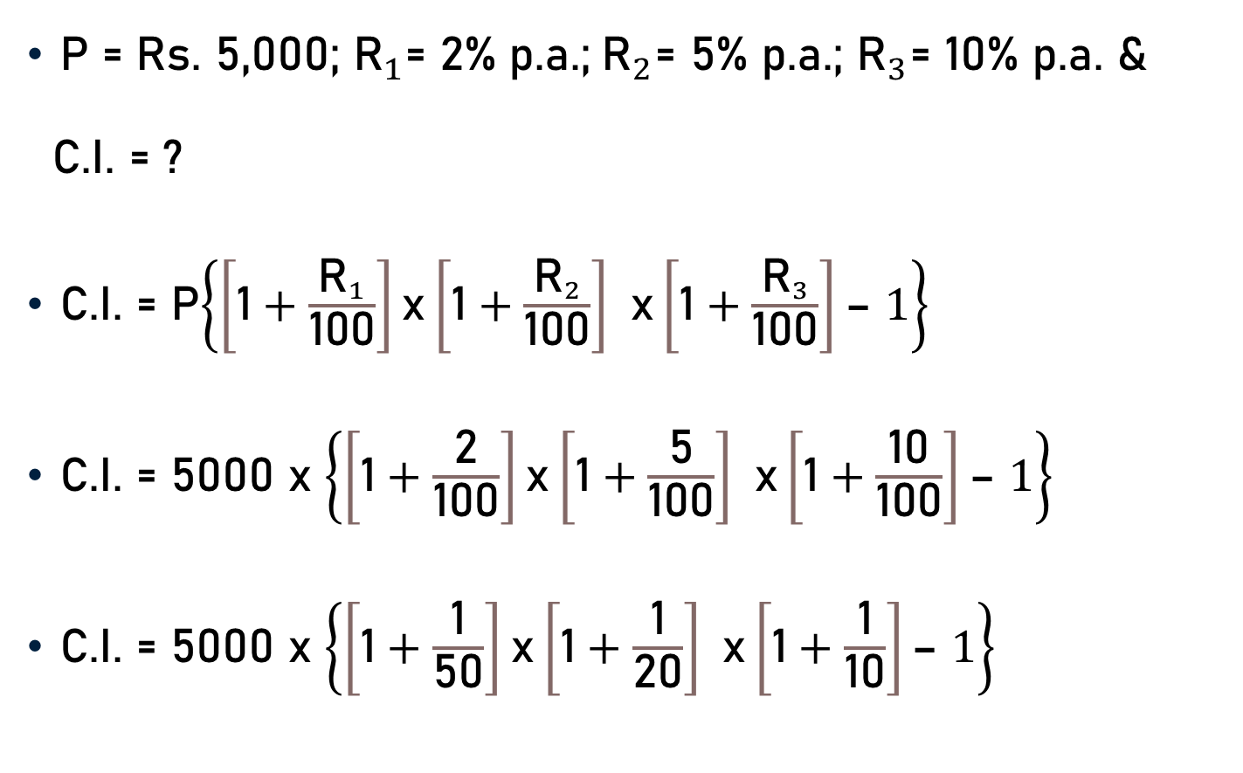
Problem 7
P = Rs. 5,000; ${\text{R}}_{1}$= 2% p.a.;${\text{R}}_{2}$= 5% p.a.; ${\text{R}}_{3}$= 10% p.a. &
C.I. = ?
C.I. = P$\left\{\left[\text{1}+\frac{{\text{R}}_{1}}{\text{100}}\right]\text{x}\left[\text{1}+\frac{{\text{R}}_{2}}{\text{100}}\right] \text{x}\left[\text{1}+\frac{{\text{R}}_{3}}{\text{100}}\right]\text{– }1\right\}$
C.I. = 5000 x $\left\{\left[\text{1}+\frac{\text{2}}{\text{100}}\right]\text{x}\left[\text{1}+\frac{\text{5}}{\text{100}}\right] \text{x}\left[\text{1}+\frac{\text{10}}{\text{100}}\right]\text{– }1\right\}$
C.I. = 5000 x $\left\{\left[\text{1}+\frac{\text{1}}{\text{5}\text{0}}\right]\text{x}\left[\text{1}+\frac{\text{1}}{\text{2}\text{0}}\right] \text{x}\left[\text{1}+\frac{\text{1}}{\text{10}}\right]\text{– }1\right\}$
50
20
10

Slide 26
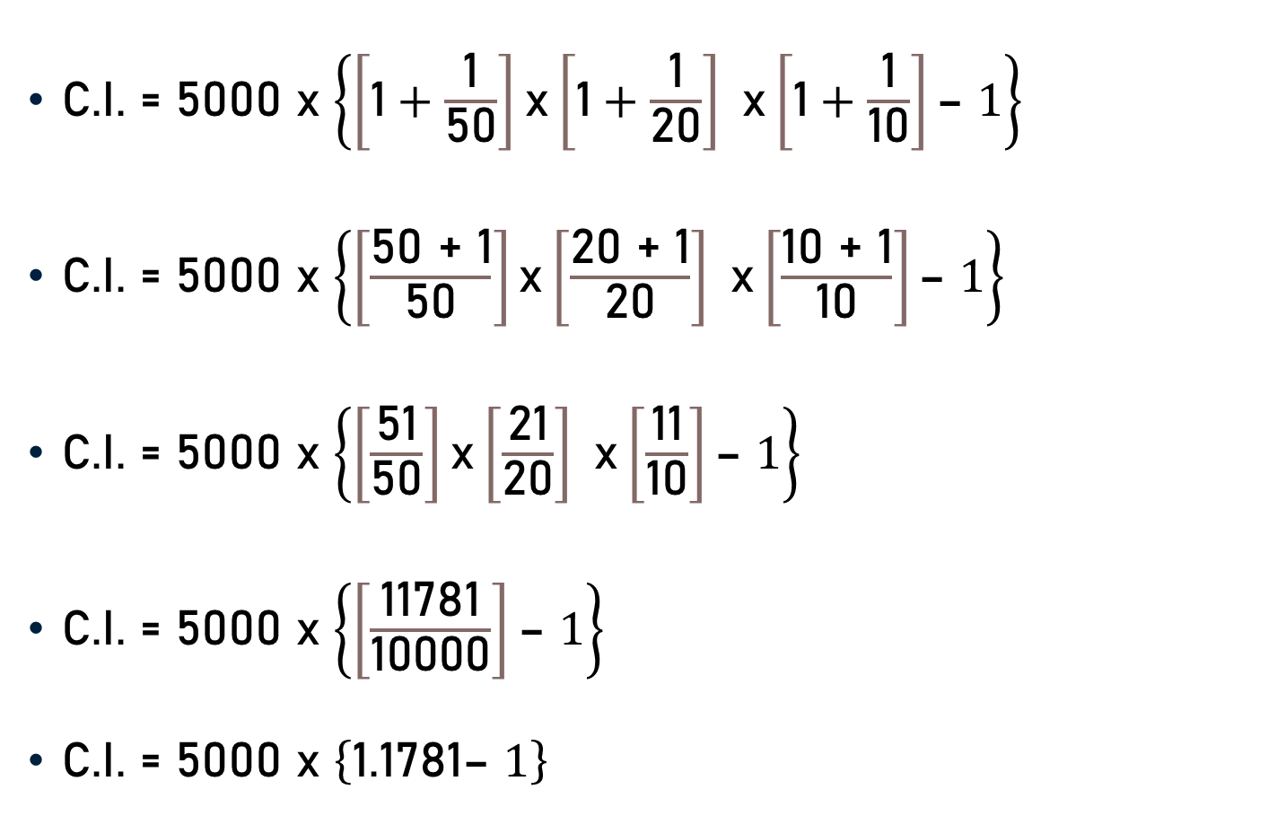
Problem 7
C.I. = 5000 x $\left\{\left[\text{1}+\frac{\text{1}}{\text{5}\text{0}}\right]\text{x}\left[\text{1}+\frac{\text{1}}{\text{2}\text{0}}\right] \text{x}\left[\text{1}+\frac{\text{1}}{\text{10}}\right]\text{– }1\right\}$
C.I. = 5000 x $\left\{\left[\frac{\text{50 + }\text{1}}{\text{50}}\right]\text{x}\left[\frac{\text{20 + }\text{1}}{\text{20}}\right] \text{x}\left[\frac{\text{1}\text{0 + }\text{1}}{\text{10}}\right]\text{– }1\right\}$
C.I. = 5000 x $\left\{\left[\frac{\text{51}}{\text{50}}\right]\text{x}\left[\frac{\text{21}}{\text{20}}\right] \text{x}\left[\frac{\text{11}}{\text{10}}\right]\text{– }1\right\}$
C.I. = 5000 x $\left\{\left[\frac{\text{11781}}{\text{1000}\text{0}}\right]\text{– }1\right\}$
C.I. = 5000 x $\left\{\text{1.1781}\text{– }1\right\}$

Slide 27

Problem 7
C.I. = 5000 x $\left\{\text{1.1781}\text{– }1\right\}$
C.I. = 5000 x $\left\{\text{0}\text{.1781}\right\}$
C.I. = Rs. 890.50

Slide 28
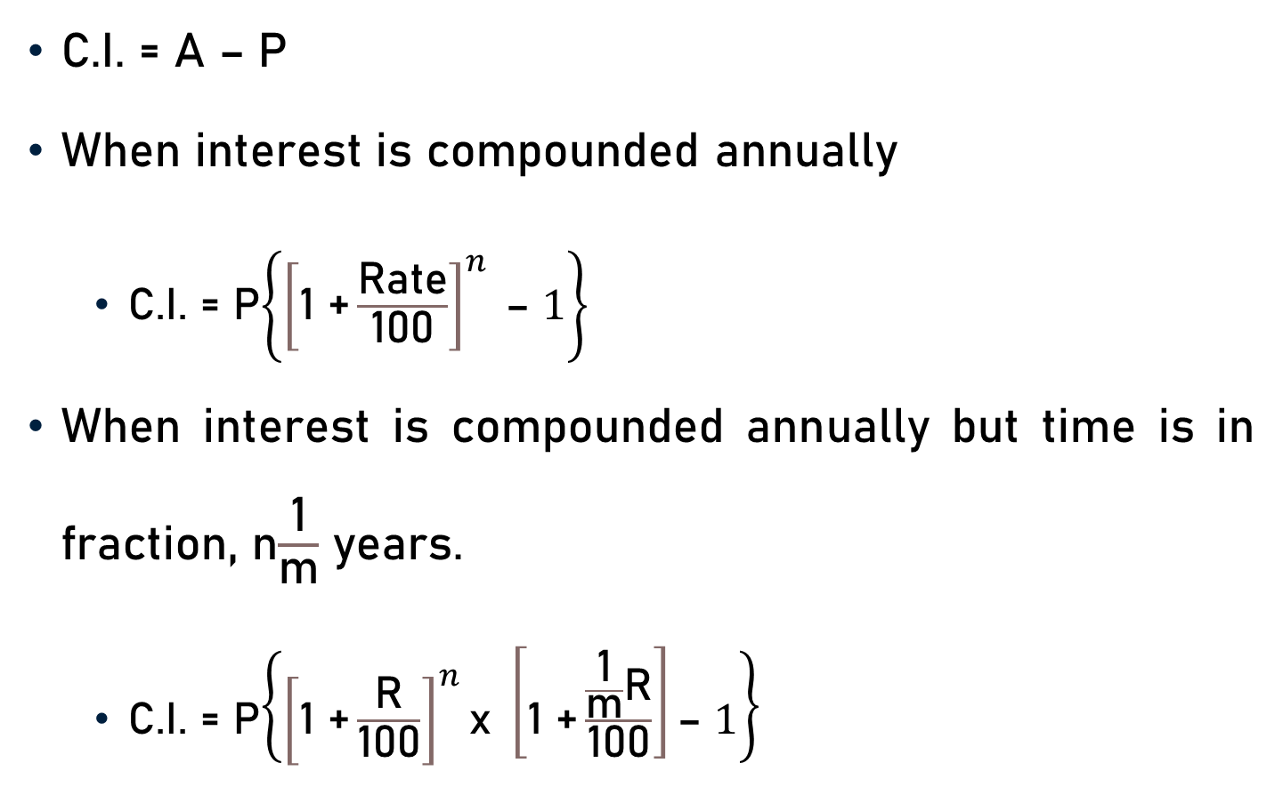
Conclusion
C.I. = A – P
When interest is compounded annually
C.I. = P$\left\{{\left[\text{1 +}\frac{\text{Rate}}{\text{100}}\right]}^{n} \text{– }1\right\}$
When interest is compounded annually but time is in fraction, n$\frac{\text{1}}{\text{m}}$ years.
C.I. = P$\left\{{\left[\text{1 +}\frac{\text{R}}{\text{100}}\right]}^{n}\text{x} \left[\text{1 +}\frac{\frac{\text{1}}{\text{m}}\text{R}}{\text{100}}\right]\text{– }1\right\}$

Slide 29
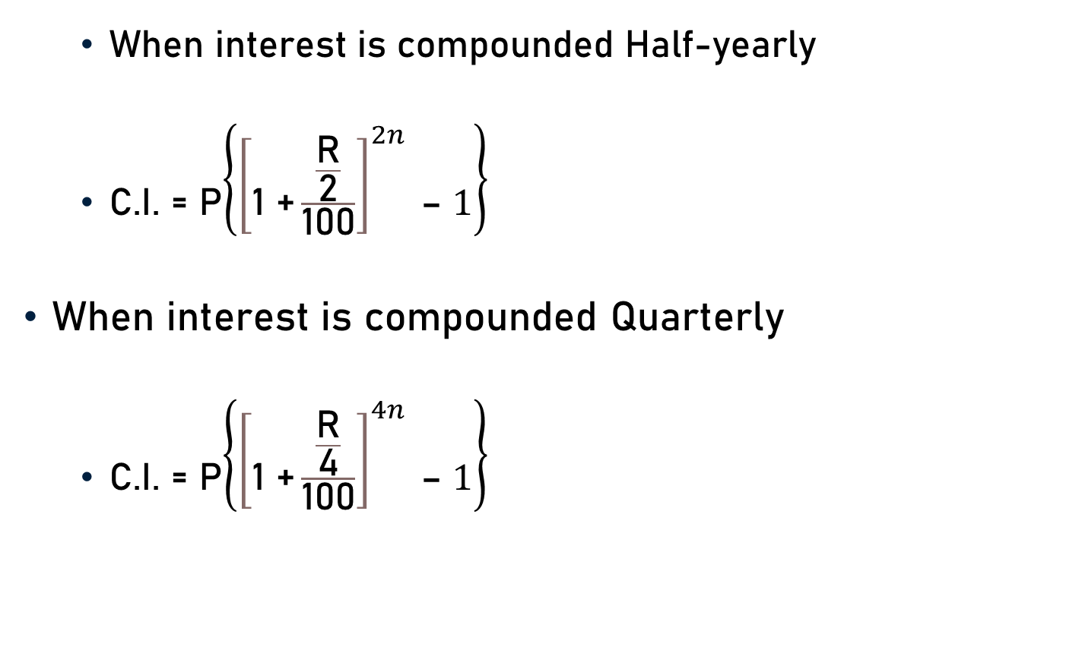
Conclusion
When interest is compounded Half-yearly
C.I. = P$\left\{{\left[\text{1 +}\frac{\frac{\text{R}}{\text{2}}}{\text{100}}\right]}^{2n} \text{– }1\right\}$
When interest is compounded Quarterly
C.I. = P$\left\{{\left[\text{1 +}\frac{\frac{\text{R}}{\text{4}}}{\text{100}}\right]}^{4n} \text{– }1\right\}$

Slide 30

Conclusion
When rates are different for different years
C.I. = P$\left\{\left[\text{1}+\frac{{\text{R}}_{1}}{\text{100}}\right]\text{x}\left[\text{1}+\frac{{\text{R}}_{2}}{\text{100}}\right] \text{x}\left[\text{1}+\frac{{\text{R}}_{3}}{\text{100}}\right]\text{x} …\text{– }1\right\}$

Slide 31
Summary
Computation of Compound Interest

