Slide 2
solve problems based on principal and rate computation.

Slide 3
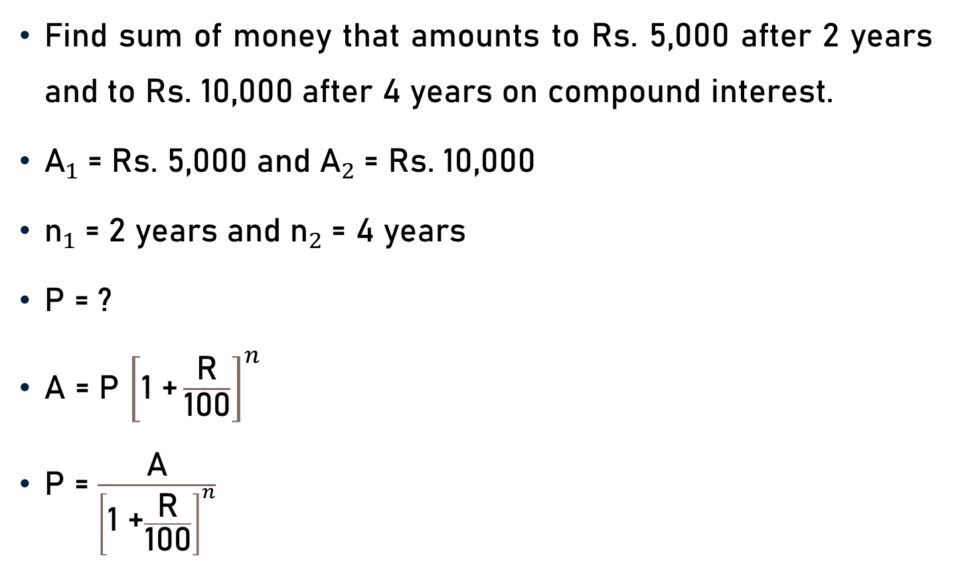
Problem 1
Find sum of money that amounts to Rs. 5,000 after 2 years and to Rs. 10,000 after 4 years on compound interest.
${\text{A}}_{1}$= Rs. 5,000 and ${\text{A}}_{2}$= Rs. 10,000
${\text{n}}_{1}$= 2 years and ${\text{n}}_{2}$= 4 years
P = ?
A = P ${\left[\text{1 +}\frac{\text{R}}{\text{100}}\right]}^{n}$
P = $\frac{\text{A}}{{\left[\text{1 +}\frac{\text{R}}{\text{100}}\right]}^{n}}$

Slide 4
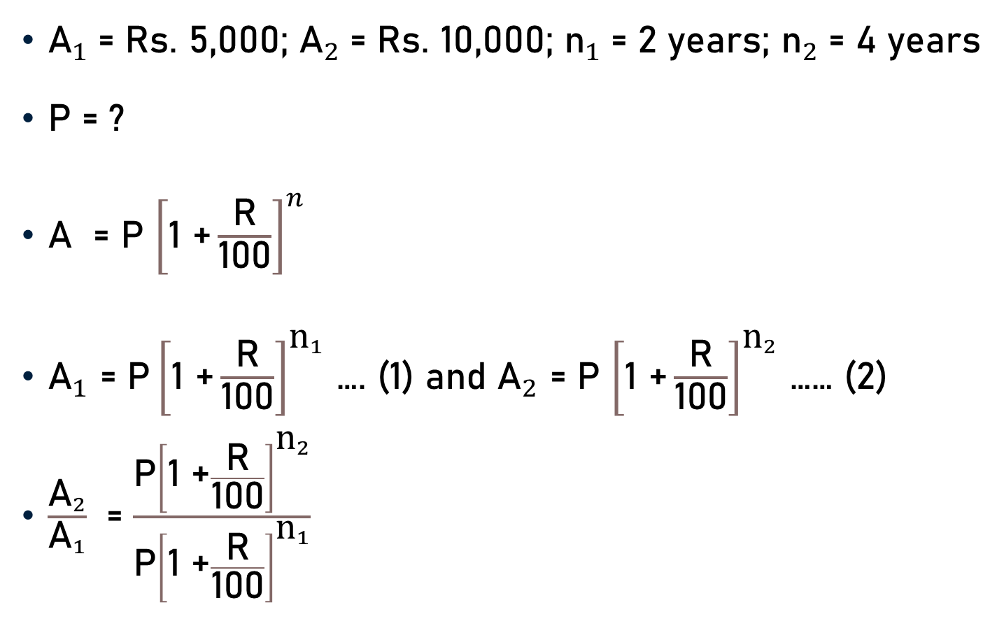
Problem 1
${\text{A}}_{1}$= Rs. 5,000; ${\text{A}}_{2}$= Rs. 10,000; ${\text{n}}_{1}$= 2 years; ${\text{n}}_{2}$= 4 years
P = ?
A = P ${\left[\text{1 +}\frac{\text{R}}{\text{100}}\right]}^{n}$
${\text{A}}_{1}$ = ${\text{P}\left[\text{1 +}\frac{\text{R}}{\text{100}}\right]}^{{\text{n}}_{1}}$ …. (1) and ${\text{A}}_{2}$ = P ${\left[\text{1 +}\frac{\text{R}}{\text{100}}\right]}^{{\text{n}}_{2}}$ …… (2)
$\frac{{\text{A}}_{2}}{{\text{A}}_{1}}$ = $\frac{\text{P}{\left[\text{1 +}\frac{\text{R}}{\text{100}}\right]}^{{\text{n}}_{2}}}{{\text{P}\left[\text{1 +}\frac{\text{R}}{\text{100}}\right]}^{{\text{n}}_{1}}}$

Slide 5
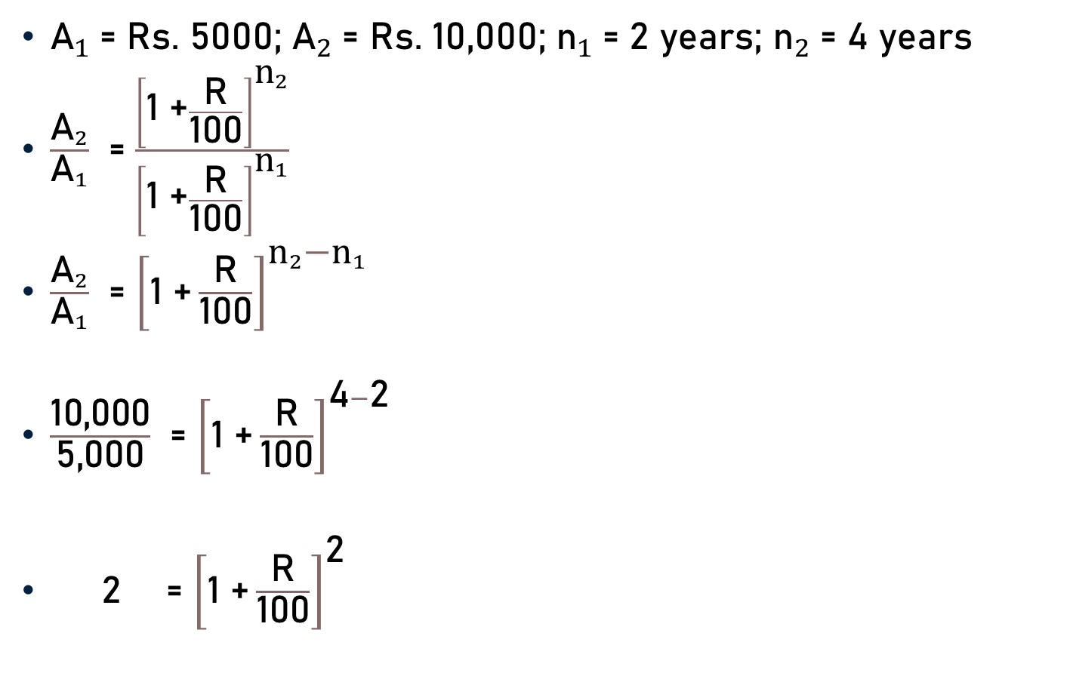
Problem 1
${\text{A}}_{1}$= Rs. 5000; ${\text{A}}_{2}$= Rs. 10,000; ${\text{n}}_{1}$= 2 years; ${\text{n}}_{2}$= 4 years
$\frac{{\text{A}}_{2}}{{\text{A}}_{1}}$ = $\frac{{\left[\text{1 +}\frac{\text{R}}{\text{100}}\right]}^{{\text{n}}_{2}}}{{\left[\text{1 +}\frac{\text{R}}{\text{100}}\right]}^{{\text{n}}_{1}}}$
$\frac{{\text{A}}_{2}}{{\text{A}}_{1}}$ = ${\left[\text{1 +}\frac{\text{R}}{\text{100}}\right]}^{{\text{n}}_{2}{\text{−}\text{n}}_{1}}$
$\frac{\text{10}\text{,}\text{000}}{\text{5}\text{,}\text{000}}$ = ${\left[\text{1 +}\frac{\text{R}}{\text{100}}\right]}^{\text{4}−\text{2}}$
2 = ${\left[\text{1 +}\frac{\text{R}}{\text{100}}\right]}^{\text{2}}$
2

Slide 6

Problem 1
2 = ${\left[\text{1 +}\frac{\text{R}}{\text{100}}\right]}^{\text{2}}$
${\text{A}}_{1}$= Rs. 5,000 and ${\text{n}}_{1}$= 2 years
P = $\frac{\text{5000}}{{\left[\text{1 +}\frac{\text{R}}{\text{100}}\right]}^{\text{2}}}$
P = $\frac{\text{5,000}}{\text{2}}$
P = Rs. 2,500
2500

Slide 7
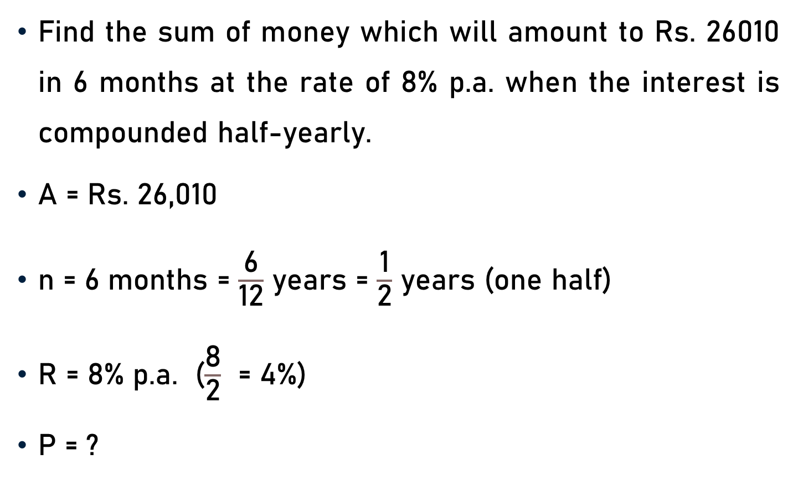
Problem 2
Find the sum of money which will amount to Rs. 26010 in 6 months at the rate of 8% p.a. when the interest is compounded half-yearly.
$\text{A}$ = Rs. 26,010
$\text{n}$ = 6 months = $\frac{\text{6}}{\text{12}}$ years = $\frac{\text{1}}{\text{2}}$ years (one half)
$\text{R}$ = 8% p.a. ($\frac{\text{8}}{\text{2}}$ = 4%)
P = ?

Slide 8

Problem 2
$\text{A}$ = Rs. 26,010; 2$\text{n}$ = 2 x $\frac{\text{1}}{\text{2}}$ = 1; $\frac{\text{R}}{\text{2}}$ = 4%; and P = ?
P = $\frac{\text{A}}{{\left[\text{1 +}\frac{\frac{\text{R}}{\text{2}}}{\text{100}}\right]}^{2n}}$
P = $\frac{\text{26010}}{{\left[\text{1 +}\frac{\text{4}}{\text{100}}\right]}^{1}}$
P = $\frac{\text{26010}}{{\left[\frac{\text{26}}{\text{25}}\right]}^{1}}$
25

Slide 9

Problem 2
P = $\frac{\text{26010}}{{\left[\frac{\text{26}}{\text{25}}\right]}^{1}}$
P = $\frac{\text{26010 }\text{x}\text{ 25}}{\text{26}}$
P = Rs. 25009.62 (approx.)

Slide 10
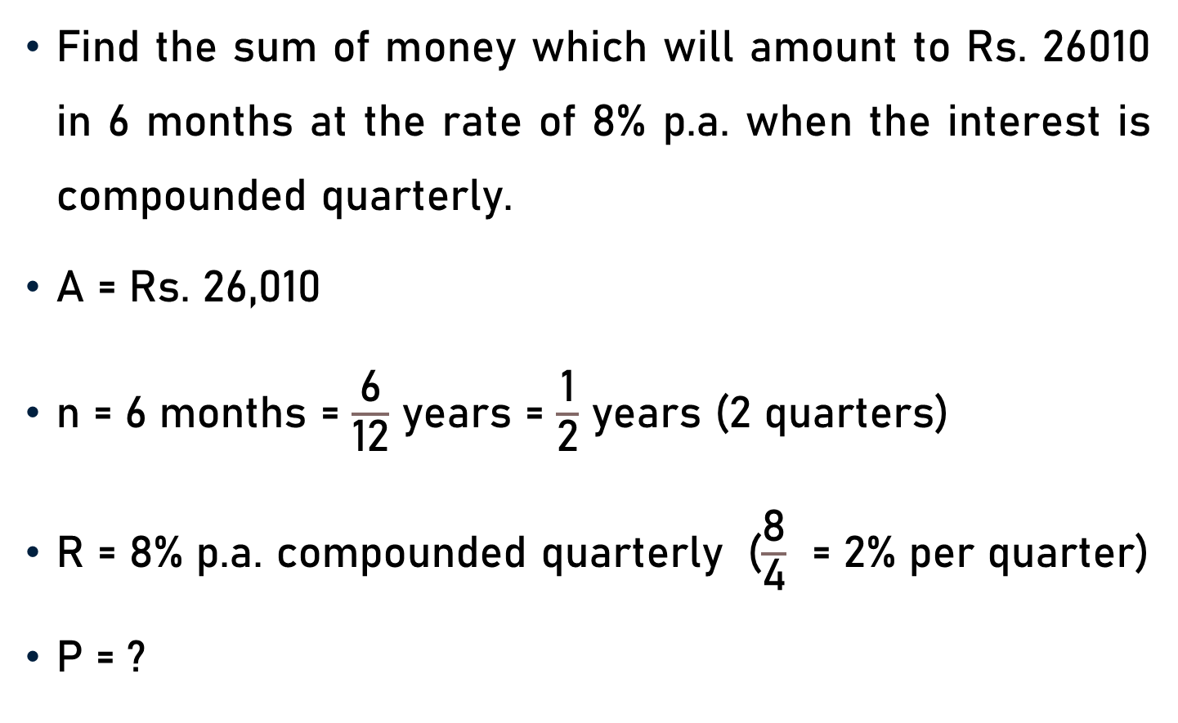
Problem 3
Find the sum of money which will amount to Rs. 26010 in 6 months at the rate of 8% p.a. when the interest is compounded quarterly.
$\text{A}$ = Rs. 26,010
$\text{n}$ = 6 months = $\frac{\text{6}}{\text{12}}$ years = $\frac{\text{1}}{\text{2}}$ years (2 quarters)
$\text{R}$ = 8% p.a. compounded quarterly ($\frac{\text{8}}{\text{4}}$ = 2% per quarter)
P = ?

Slide 11
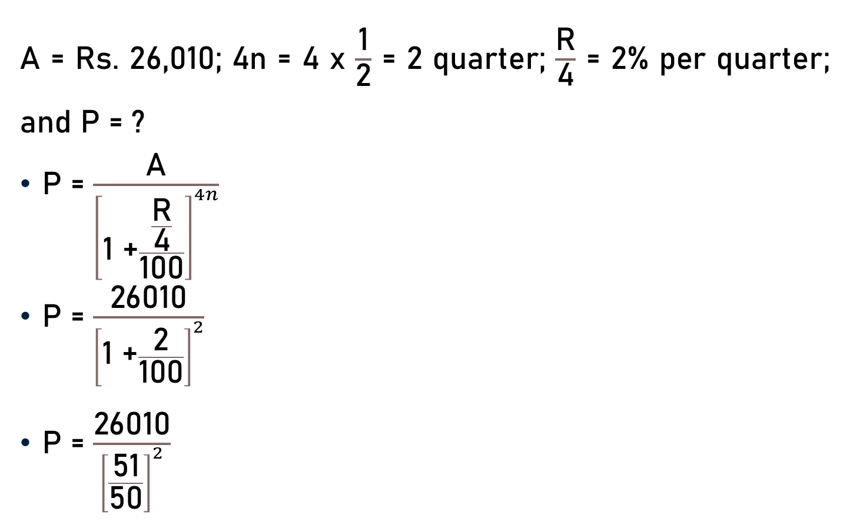
Problem 3
$\text{A}$ = Rs. 26,010; 4$\text{n}$ = 4 x $\frac{\text{1}}{\text{2}}$ = 2 quarter; $\frac{\text{R}}{\text{4}}$ = 2% per quarter; and P = ?
P = $\frac{\text{A}}{{\left[\text{1 +}\frac{\frac{\text{R}}{\text{4}}}{\text{100}}\right]}^{4n}}$
P = $\frac{\text{26010}}{{\left[\text{1 +}\frac{\text{2}}{\text{100}}\right]}^{2}}$
P = $\frac{\text{26010}}{{\left[\frac{\text{51}}{\text{5}\text{0}}\right]}^{2}}$
50

Slide 12

Problem 3
P = $\frac{\text{26010}}{{\left[\frac{\text{51}}{\text{5}\text{0}}\right]}^{2}}$
P = $\frac{\text{26010 }\text{x}\text{ 50 }\text{x}\text{ 50}}{\text{5}\text{1} \text{x}\text{ 51}}$
P = Rs. 25,000
510
10

Slide 13
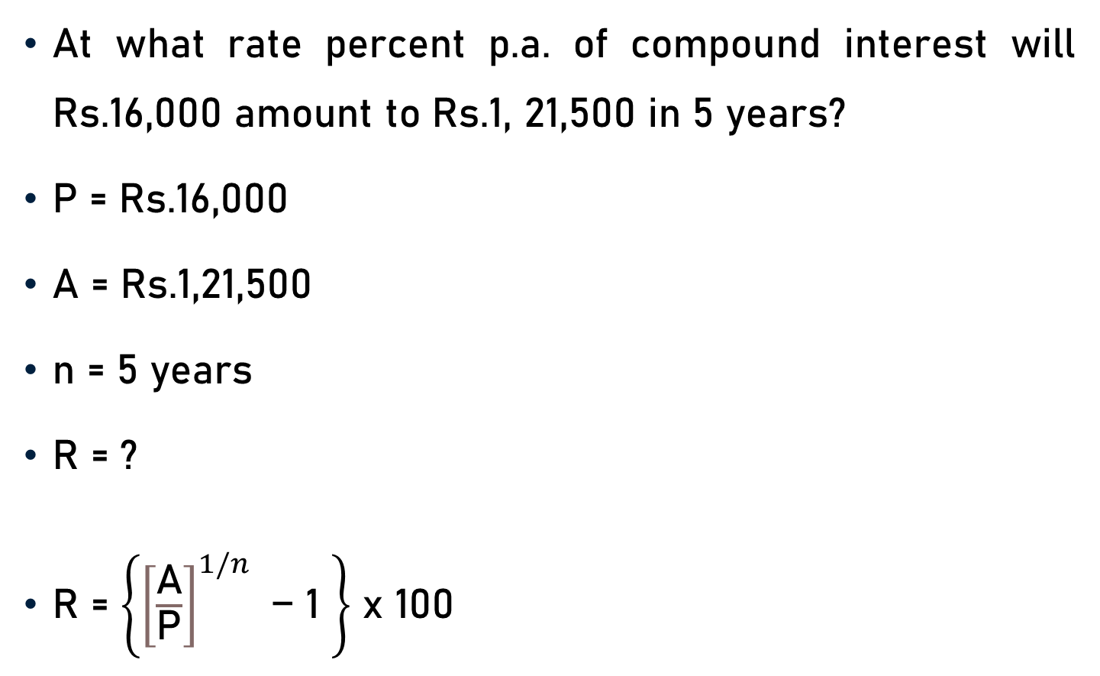
Problem 4
At what rate percent p.a. of compound interest will Rs.16,000 amount to Rs.1, 21,500 in 5 years?
P = Rs.16,000
A = Rs.1,21,500
n = 5 years
R = ?
R = $\left\{{\left[\frac{\text{A}}{\text{P}}\right]}^{1/n}\text{ − 1 }\right\}$ x 100

Slide 14
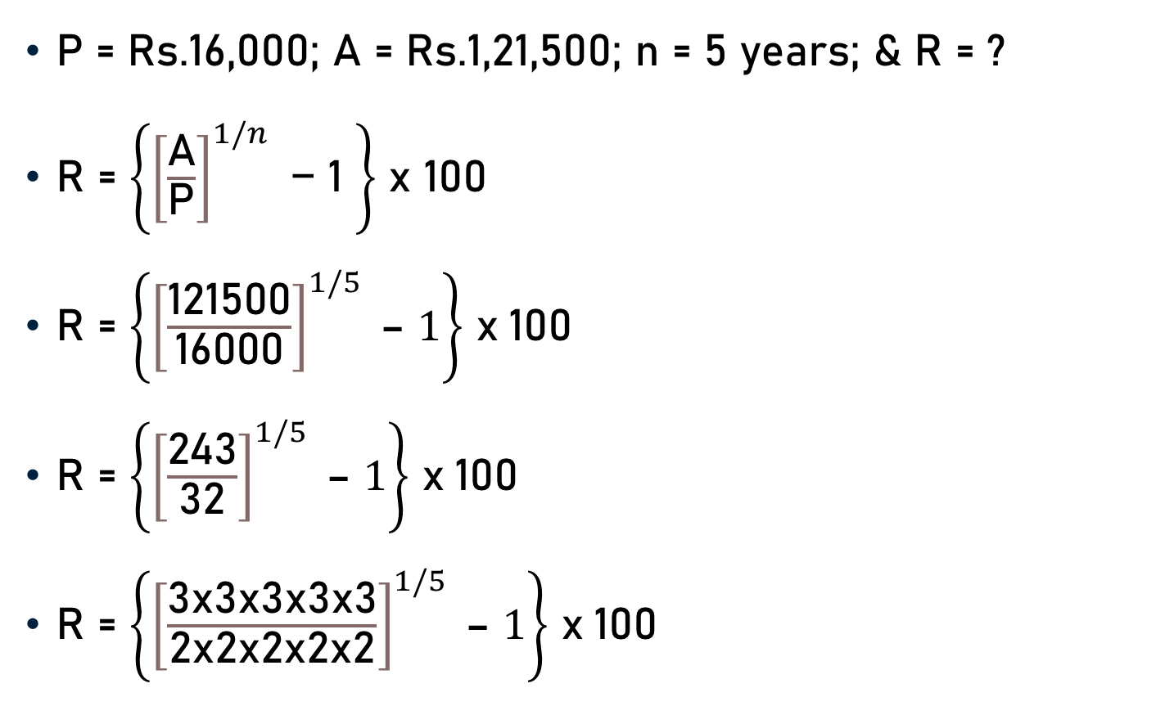
Problem 4
P = Rs.16,000; A = Rs.1,21,500; n = 5 years; & R = ?
R = $\left\{{\left[\frac{\text{A}}{\text{P}}\right]}^{1/n}\text{ − 1 }\right\}$ x 100
R = $\left\{{\left[\frac{\text{121500}}{\text{1}\text{60}\text{00}}\right]}^{1/5} \text{– }1\right\}$ x 100
R = $\left\{{\left[\frac{\text{243}}{\text{32}}\right]}^{1/5} \text{– }1\right\}$ x 100
R = $\left\{{\left[\frac{\text{3}\text{x}\text{3}\text{x}\text{3}\text{x}\text{3}\text{x}\text{3}}{\text{2}\text{x}\text{2}\text{x}\text{2}\text{x}\text{2}\text{x}\text{2}}\right]}^{1/5} \text{– }1\right\}$ x 100
243
32

Slide 15
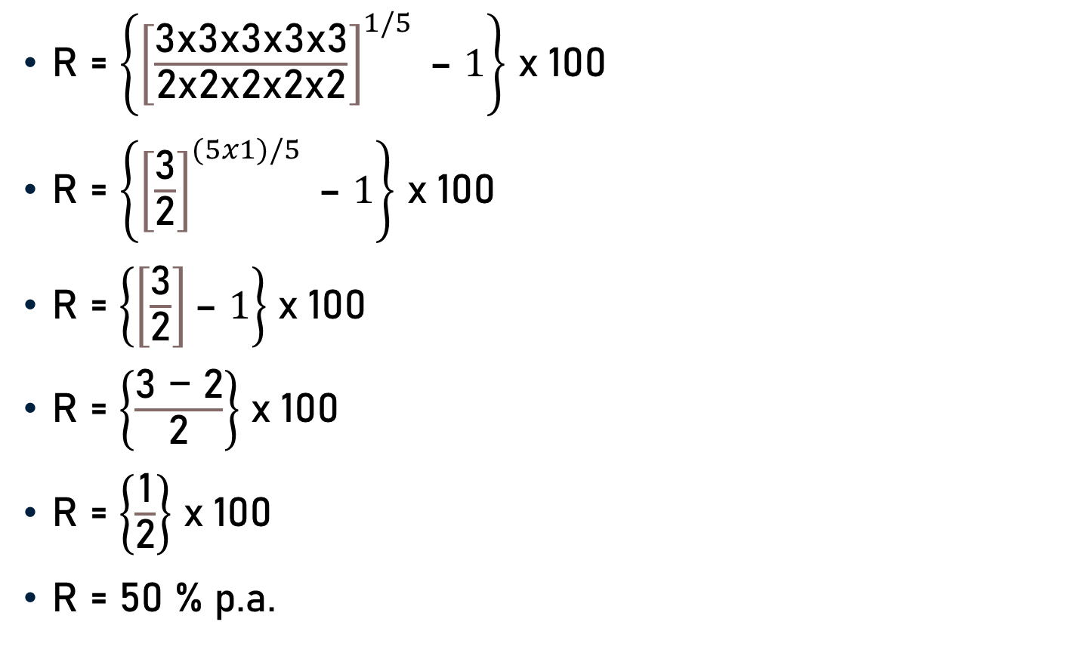
Problem 4
R = $\left\{{\left[\frac{\text{3}\text{x}\text{3}\text{x}\text{3}\text{x}\text{3}\text{x}\text{3}}{\text{2}\text{x}\text{2}\text{x}\text{2}\text{x}\text{2}\text{x}\text{2}}\right]}^{1/5} \text{– }1\right\}$ x 100
R = $\left\{{\left[\frac{\text{3}}{\text{2}}\right]}^{(5x1)/5} \text{– }1\right\}$ x 100
R = $\left\{\left[\frac{\text{3}}{\text{2}}\right]\text{– }1\right\}$ x 100
R = $\left\{\frac{\text{3}\text{ − 2}}{\text{2}}\right\}$ x 100
R = $\left\{\frac{\text{1}}{\text{2}}\right\}$ x 100
R = 50 % p.a.
50

Slide 16
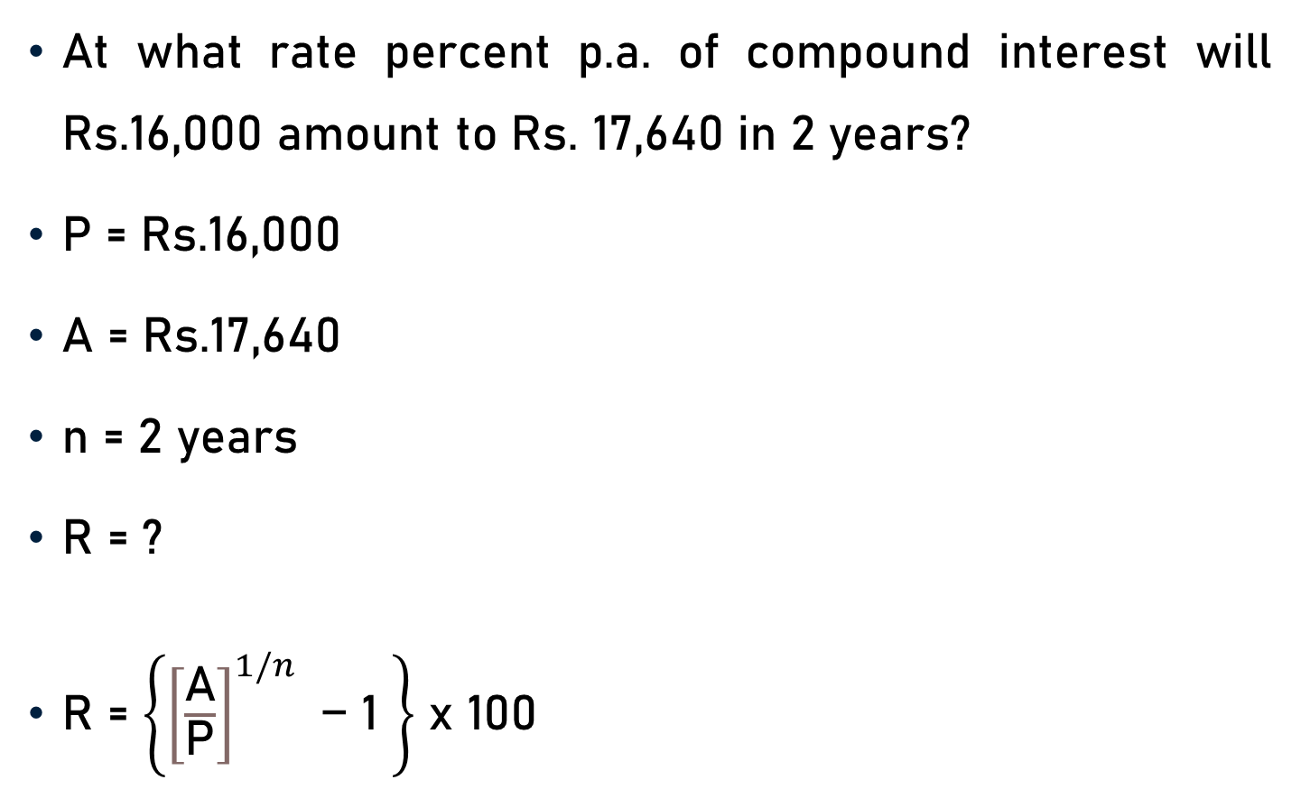
Problem 5
At what rate percent p.a. of compound interest will Rs.16,000 amount to Rs. 17,640 in 2 years?
P = Rs.16,000
A = Rs.17,640
n = 2 years
R = ?
R = $\left\{{\left[\frac{\text{A}}{\text{P}}\right]}^{1/n}\text{ − 1 }\right\}$ x 100

Slide 17
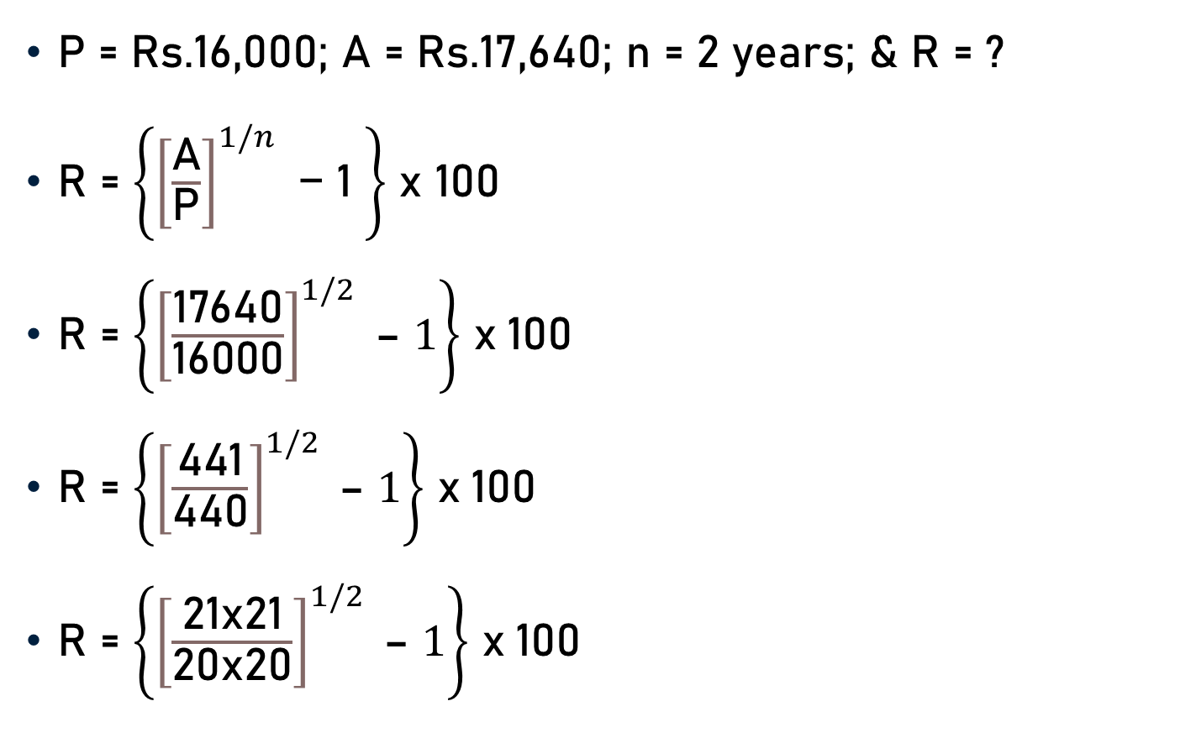
Problem 5
P = Rs.16,000; A = Rs.17,640; n = 2 years; & R = ?
R = $\left\{{\left[\frac{\text{A}}{\text{P}}\right]}^{1/n}\text{ − 1 }\right\}$ x 100
R = $\left\{{\left[\frac{\text{17640}}{\text{1}\text{60}\text{00}}\right]}^{1/2} \text{– }1\right\}$ x 100
R = $\left\{{\left[\frac{\text{441}}{\text{440}}\right]}^{1/2} \text{– }1\right\}$ x 100
R = $\left\{{\left[\frac{\text{21}\text{x}\text{21}}{\text{2}\text{0}\text{x}\text{20}}\right]}^{1/2} \text{– }1\right\}$ x 100
441
400

Slide 18

Problem 5
R = $\left\{{\left[\frac{\text{21}\text{x}\text{21}}{\text{2}\text{0}\text{x}\text{20}}\right]}^{1/2} \text{– }1\right\}$ x 100
R = $\left\{{\left[\frac{\text{21}}{\text{2}\text{0}}\right]}^{(2x1)/2} \text{– }1\right\}$ x 100
R = $\left\{\left[\frac{\text{21}}{\text{2}\text{0}}\right]\text{– }1\right\}$ x 100
R = $\left\{\frac{\text{21 − 20}}{\text{20}}\right\}$ x 100
R = $\left\{\frac{\text{1}}{\text{2}\text{0}}\right\}$ x 100
R = 5 % p.a.
5

Slide 19
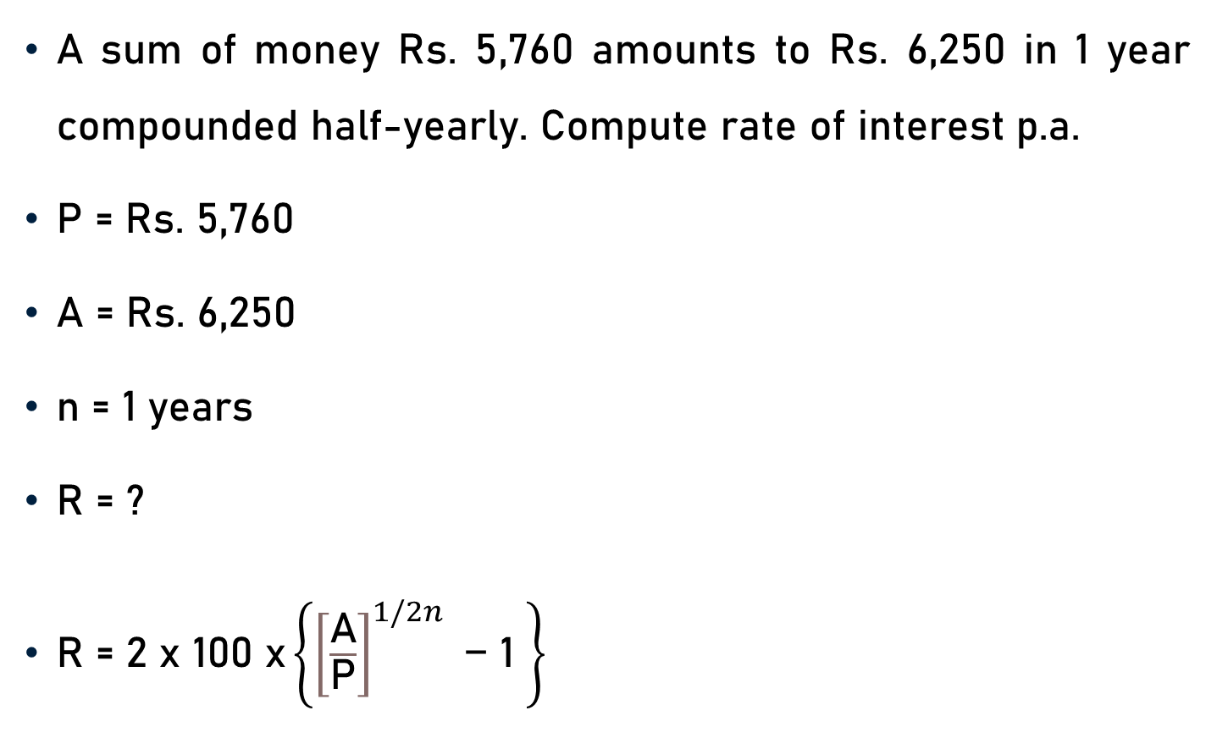
Problem 6
A sum of money Rs. 5,760 amounts to Rs. 6,250 in 1 year compounded half-yearly. Compute rate of interest p.a.
P = Rs. 5,760
A = Rs. 6,250
n = 1 years
R = ?
$\text{R}\text{ = }\text{2 }\text{x}\text{ 100 }\text{x}\left\{{\left[\frac{\text{A}}{\text{P}}\right]}^{1/2n}\text{ − 1 }\right\}$

Slide 20
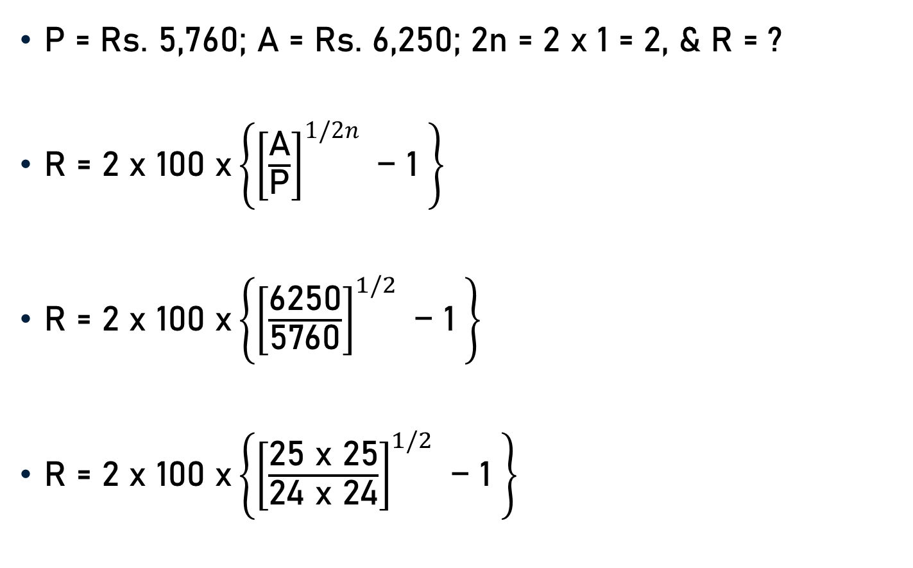
Problem 6
P = Rs. 5,760; A = Rs. 6,250; 2n = 2 x 1 = 2, & R = ?
$\text{R}\text{ = }\text{2 }\text{x}\text{ 100 }\text{x}\left\{{\left[\frac{\text{A}}{\text{P}}\right]}^{1/2n}\text{ − 1 }\right\}$
$\text{R}\text{ = }\text{2 }\text{x}\text{ 100 }\text{x}\left\{{\left[\frac{\text{6250}}{\text{5760}}\right]}^{1/2}\text{ − 1 }\right\}$
$\text{R}\text{ = }\text{2 }\text{x}\text{ 100 }\text{x}\left\{{\left[\frac{\text{25 }\text{x}\text{ 25}}{\text{24 }\text{x}\text{ 24}}\right]}^{1/2}\text{ − 1 }\right\}$

Slide 21

Problem 6
$\text{R}\text{ = }\text{2 }\text{x}\text{ 100 }\text{x}\left\{{\left[\frac{\text{25 }\text{x}\text{ 25}}{\text{24 }\text{x}\text{ 24}}\right]}^{1/2}\text{ − 1 }\right\}$
$\text{R}\text{ = }\text{2 }\text{x}\text{ 100 }\text{x}\left\{{\left[\frac{\text{25}}{\text{24}}\right]}^{(2 x 1)/2}\text{ − 1 }\right\}$
$\text{R}\text{ = }\text{2 }\text{x}\text{ 100 }\text{x}\left\{\frac{\text{25}}{\text{24}}\text{− 1 }\right\}$
$\text{R}\text{ = }\text{2 }\text{x}\text{ 100 }\text{x}\left\{\frac{\text{1}}{\text{24}}\right\}$

Slide 22

Problem 6
$\text{R}\text{ = }\text{2 }\text{x}\text{ 100 }\text{x}\left\{\frac{\text{1}}{\text{24}}\right\}$
$\text{R}\text{ =}\frac{\text{200}}{\text{24}}$
$\text{R}\text{ = 8.33}\text{\% }\text{p}\text{.}\text{a}\text{.}$

Slide 23
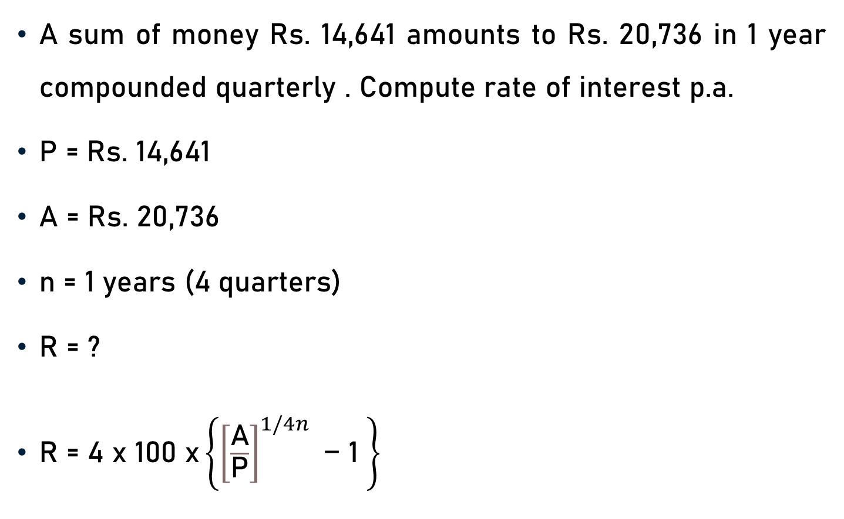
Problem 7
A sum of money Rs. 14,641 amounts to Rs. 20,736 in 1 year compounded quarterly . Compute rate of interest p.a.
P = Rs. 14,641
A = Rs. 20,736
n = 1 years (4 quarters)
R = ?
$\text{R}\text{ = 4} \text{x}\text{ 100 }\text{x}\left\{{\left[\frac{\text{A}}{\text{P}}\right]}^{1/4n}\text{ − 1 }\right\}$

Slide 24
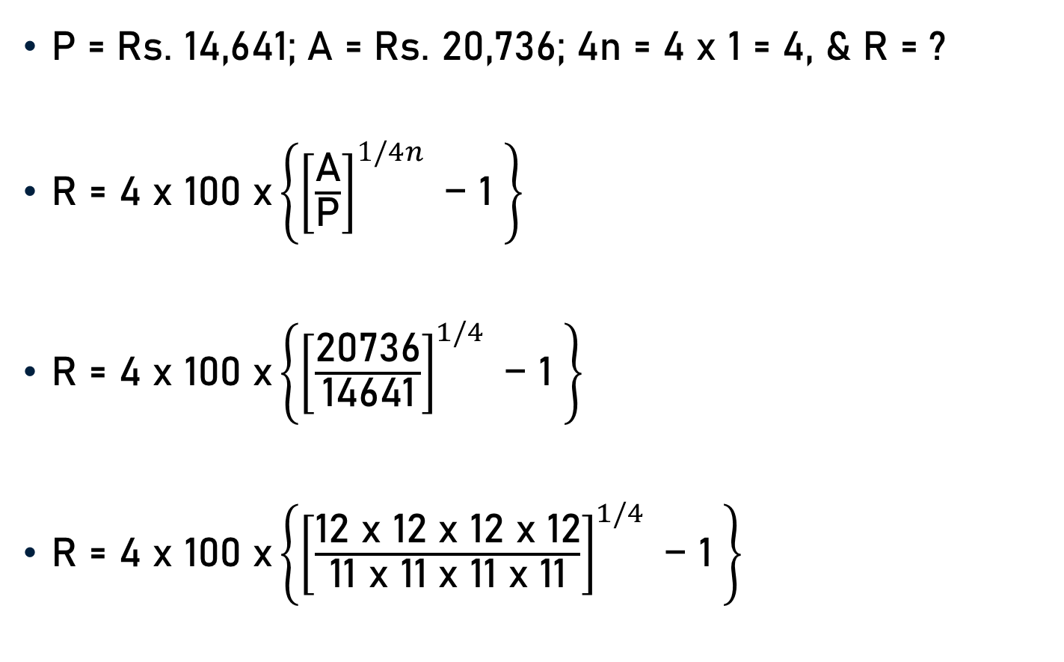
Problem 7
P = Rs. 14,641; A = Rs. 20,736; 4n = 4 x 1 = 4, & R = ?
$\text{R}\text{ = 4} \text{x}\text{ 100 }\text{x}\left\{{\left[\frac{\text{A}}{\text{P}}\right]}^{1/4n}\text{ − 1 }\right\}$
$\text{R}\text{ = 4} \text{x}\text{ 100 }\text{x}\left\{{\left[\frac{\text{20736}}{\text{14641}}\right]}^{1/4}\text{ − 1 }\right\}$
$\text{R}\text{ = 4} \text{x}\text{ 100 }\text{x}\left\{{\left[\frac{\text{12 }\text{x}\text{ 12 }\text{x}\text{ 12 }\text{x}\text{ 12}}{\text{11 }\text{x}\text{ 11 }\text{x}\text{ 11 }\text{x}\text{ 11}}\right]}^{1/4}\text{ − 1 }\right\}$

Slide 25
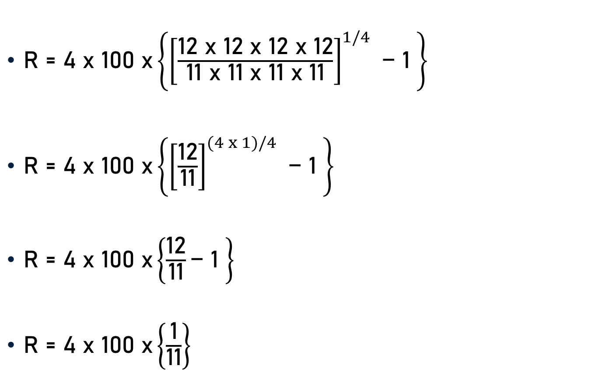
Problem 7
$\text{R}\text{ = 4} \text{x}\text{ 100 }\text{x}\left\{{\left[\frac{\text{12 }\text{x}\text{ 12 }\text{x}\text{ 12 }\text{x}\text{ 12}}{\text{11 }\text{x}\text{ 11 }\text{x}\text{ 11 }\text{x}\text{ 11}}\right]}^{1/4}\text{ − 1 }\right\}$
$\text{R}\text{ = 4} \text{x}\text{ 100 }\text{x}\left\{{\left[\frac{\text{12}}{\text{11}}\right]}^{(4 x 1)/4}\text{ − 1 }\right\}$
$\text{R}\text{ = 4} \text{x}\text{ 100 }\text{x}\left\{\frac{\text{12}}{\text{11}}\text{− 1 }\right\}$
$\text{R}\text{ = 4} \text{x}\text{ 100 }\text{x}\left\{\frac{\text{1}}{\text{11}}\right\}$

Slide 26

Problem 7
$\text{R}\text{ = 4} \text{x}\text{ 100 }\text{x}\left\{\frac{\text{1}}{\text{11}}\right\}$
$\text{R}\text{ =}\frac{\text{4}\text{00}}{\text{11}}$
$\text{R}\text{ = 36.3}\text{6\% }\text{p}\text{.}\text{a}\text{. (}\text{approx}\text{.)}$

Slide 27
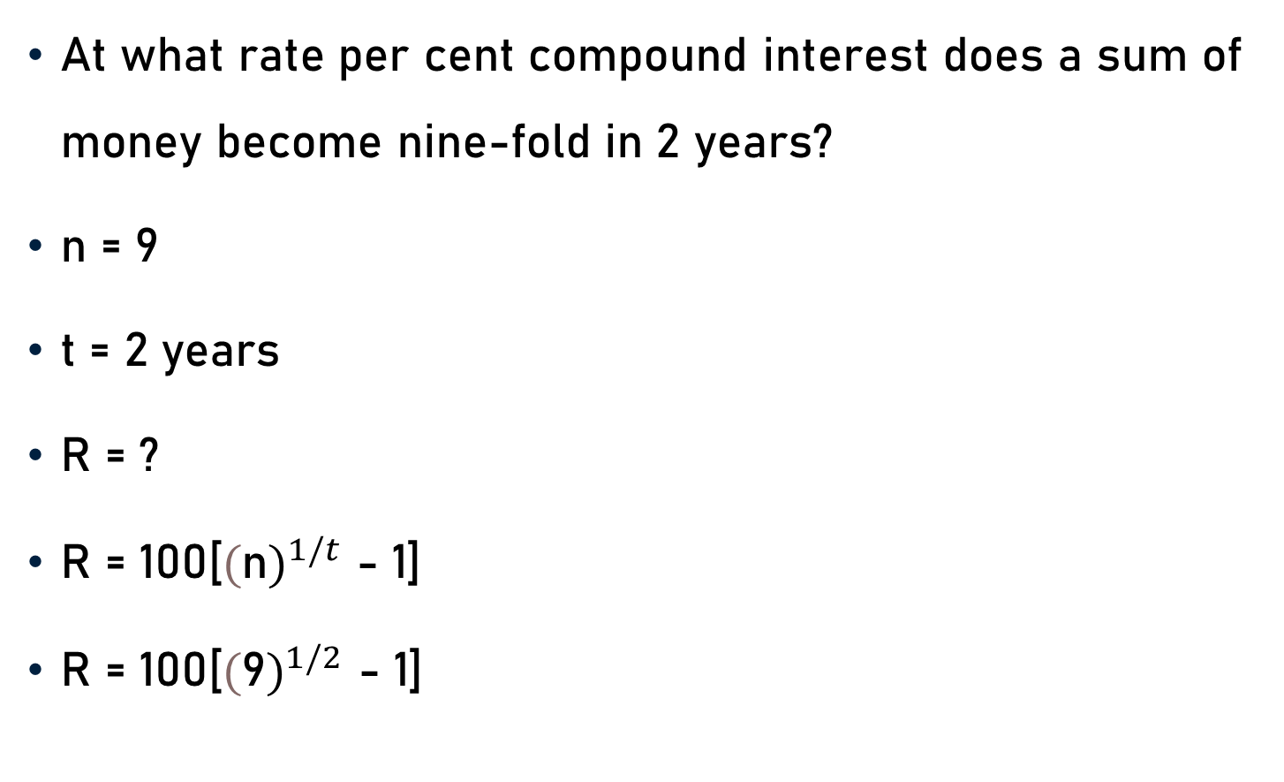
Problem 8
At what rate per cent compound interest does a sum of money become nine-fold in 2 years?
n = 9
t = 2 years
R = ?
R = 100[${(\text{n})}^{1/t}$ - 1]
R = 100[${(\text{9})}^{1/2}$ - 1]

Slide 28

Problem 8
R = 100[${(\text{9})}^{1/2}$ - 1]
R = 100[${(\text{3 }\text{x}\text{ 3})}^{1/2}$ - 1]
R = 100[${(\text{3})}^{(2 x 1)/2}$ - 1]
R = 100[$\text{3}$- 1]
R = 100[$\text{2}$]
R = 200 % p.a.

Slide 29
Problem 9
A sum of money at compound interest amounts to Rs.8,00 in three year and to Rs.1,250 in five years. Find the rate of interest p.a.
x = Rs.800
A = 3 years
y = Rs.1,250
B = 5 years
R = ?

Slide 30
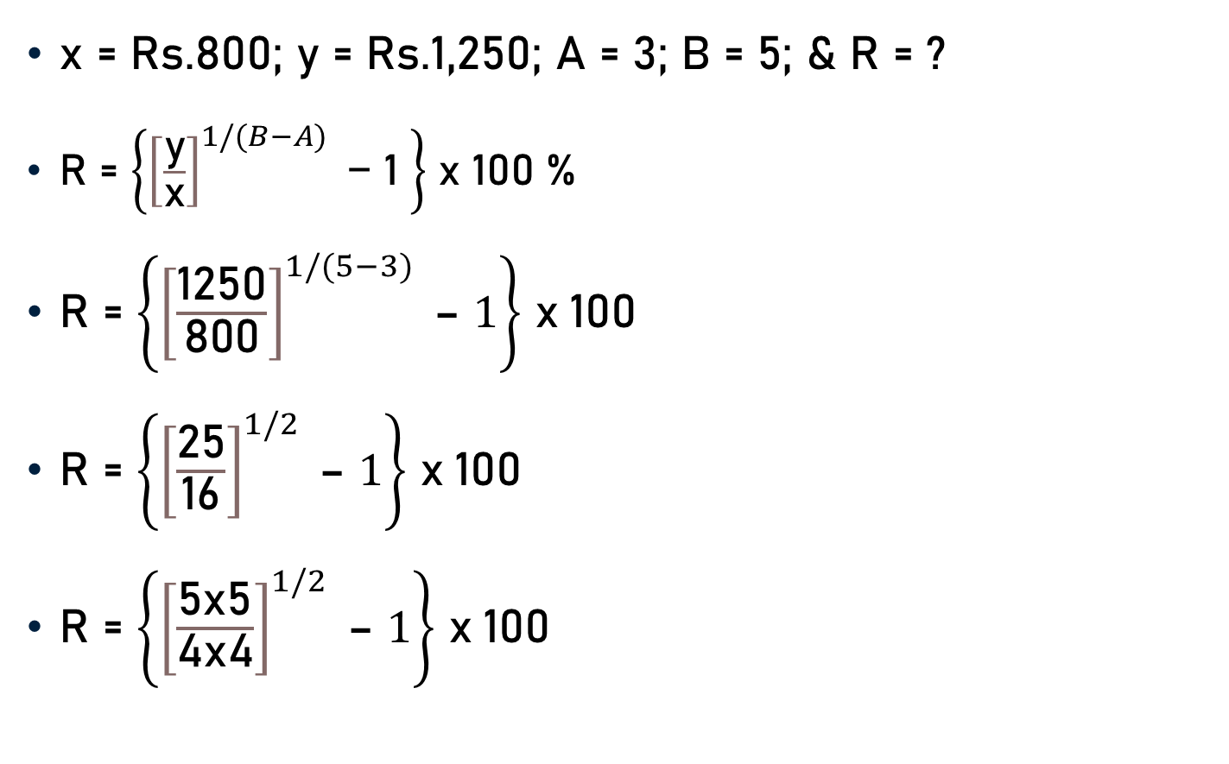
Problem 9
x = Rs.800; y = Rs.1,250; A = 3; B = 5; & R = ?
R = $\left\{{\left[\frac{\text{y}}{\text{x}}\right]}^{1/(B−A)}\text{ − 1 }\right\}$ x 100 %
R = $\left\{{\left[\frac{\text{1250}}{\text{8}\text{00}}\right]}^{1/(5−3)} \text{– }1\right\}$ x 100
R = $\left\{{\left[\frac{\text{25}}{\text{16}}\right]}^{1/2} \text{– }1\right\}$ x 100
R = $\left\{{\left[\frac{\text{5}\text{x}\text{5}}{\text{4}\text{x}\text{4}}\right]}^{1/2} \text{– }1\right\}$ x 100
25
16

Slide 31

Problem 9
R = $\left\{{\left[\frac{\text{5}\text{x}\text{5}}{\text{4}\text{x}\text{4}}\right]}^{1/2} \text{– }1\right\}$ x 100
R = $\left\{{\left[\frac{\text{5}}{\text{4}}\right]}^{(2x1)/2} \text{– }1\right\}$ x 100
R = $\left\{\left[\frac{\text{5}}{\text{4}}\right]\text{– }1\right\}$ x 100
R = $\left\{\frac{\text{5 − 4}}{\text{4}}\right\}$ x 100
R = $\left\{\frac{\text{1}}{\text{4}}\right\}$ x 100
R = 25 % p.a.
25

Slide 32
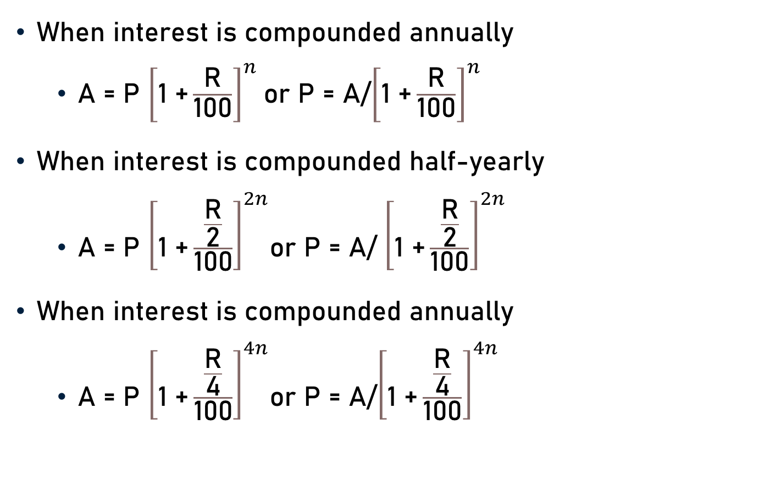
Conclusion
When interest is compounded annually
A = P ${\left[\text{1 +}\frac{\text{R}}{\text{100}}\right]}^{n}$or P = A/${\left[\text{1 +}\frac{\text{R}}{\text{100}}\right]}^{n}$
When interest is compounded half-yearly
A = P ${\left[\text{1 +}\frac{\frac{\text{R}}{\text{2}}}{\text{100}}\right]}^{2n}$or P = A/ ${\left[\text{1 +}\frac{\frac{\text{R}}{\text{2}}}{\text{100}}\right]}^{2n}$
When interest is compounded annually
A = P ${\left[\text{1 +}\frac{\frac{\text{R}}{\text{4}}}{\text{100}}\right]}^{4n}$or P = A/${\left[\text{1 +}\frac{\frac{\text{R}}{\text{4}}}{\text{100}}\right]}^{4n}$

Slide 33
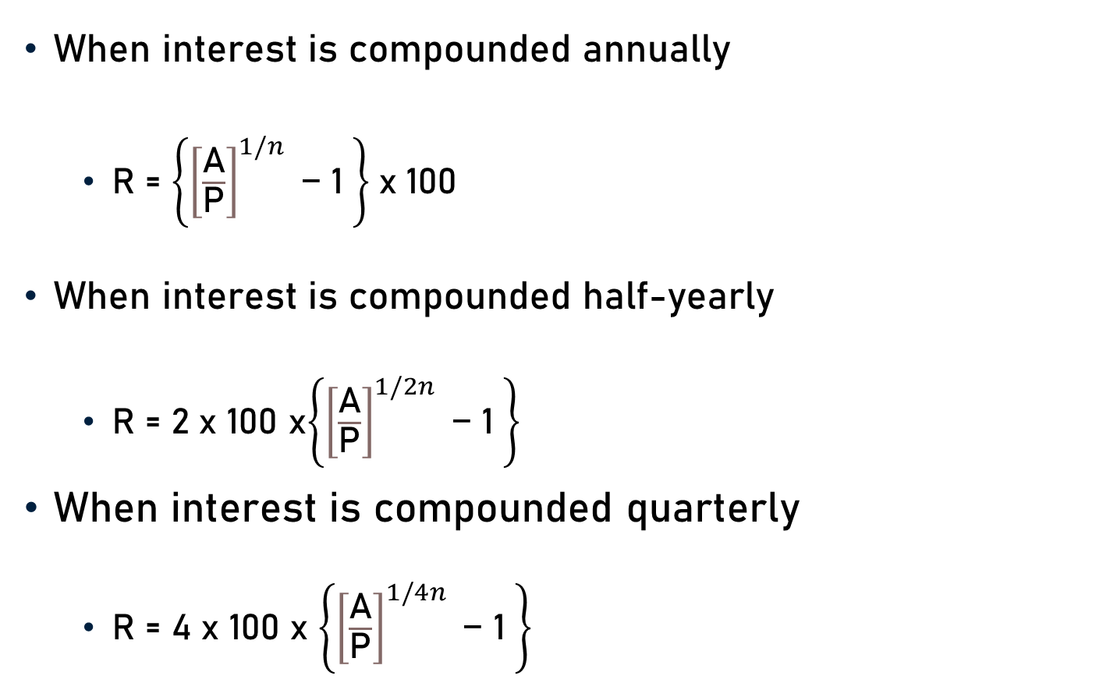
Conclusion
When interest is compounded annually
R = $\left\{{\left[\frac{\text{A}}{\text{P}}\right]}^{1/n}\text{ − 1 }\right\}$x 100
When interest is compounded half-yearly
R = 2 x 100 x$\left\{{\left[\frac{\text{A}}{\text{P}}\right]}^{1/2n}\text{ − 1 }\right\}$
When interest is compounded quarterly
R = 4 x 100 x $\left\{{\left[\frac{\text{A}}{\text{P}}\right]}^{1/4n}\text{ − 1 }\right\}$

Slide 34
Summary
Computation of
Principal
Rate

