Slide 2
Understand CSS Box Model.
Go over opacity property .

Slide 3
The CSS Box Model
In CSS, the term "box model" is used when talking about design and layout.
The CSS box model is essentially a box that wraps around every HTML element. It consists of: margins, borders, padding, and the actual content.
The components that can be depicted on the web page consist of one or more than one rectangular box

Slide 4
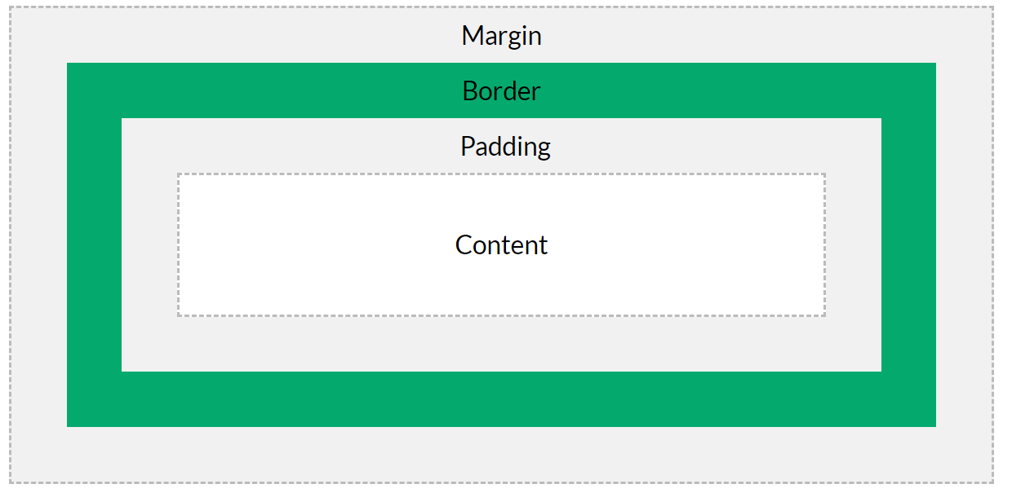
Example

Slide 5
CSS box model
A CSS box model is a compartment that includes numerous assets, such as edge, border, padding and material. It is used to develop the design and structure of a web page. It can be used as a set of tools to personalize the layout of different components. According to the CSS box model, the web browser supplies each element as a square prism.

Slide 6
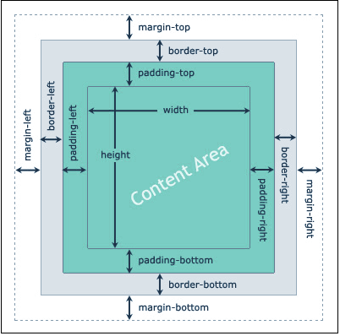
CSS box model

Slide 7
Explanation of the different parts:
The content of the box, where text and images appear
Content
Clears an area around the content. The padding is transparent
Padding
A border that goes around the padding and content
Border
Clears an area outside the border. The margin is transparent
Margin

Slide 8
The Box Model
The box model allows us to add a border around elements, and to define space between elements.

Slide 9
Example
div {
width: 300px;
border: 15px solid green;
padding: 50px;
margin: 20px;
}

Slide 10
Width and Height of an Element
In order to set the width and height of an element correctly in all browsers, you need to know how the box model works.
Important: When you set the width and height properties of an element with CSS, you just set the width and height of the content area. To calculate the full size of an element, you must also add padding, borders and margins.

Slide 11
Example
This <div> element will have a total width of 350px:
div {
width: 320px;
padding: 10px;
border: 5px solid gray;
margin: 0;
}

Slide 12
Here is the calculation
320px (width)
+ 20px (left + right padding)
+ 10px (left + right border)
+ 0px (left + right margin)
= 350px

Slide 13
Total width of an element
The total width of an element should be calculated like this:
Total element width = width + left padding + right padding + left border + right border + left margin + right margin
The total height of an element should be calculated like this:
Total element height = height + top padding + bottom padding + top border + bottom border + top margin + bottom margin

Slide 14
CSS Outline
An outline is a line drawn outside the element's border.
An outline is a line that is drawn around elements, OUTSIDE the borders, to make the element "stand out".

Slide 15
CSS has the following outline properties:
outline-style
outline-color
outline-width
outline-offset
outline

Slide 16
CSS Opacity / Transparency
The opacity property specifies the opacity/transparency of an element.
The opacity property can take a value from 0.0 - 1.0. The lower value, the more transparent:

Slide 17
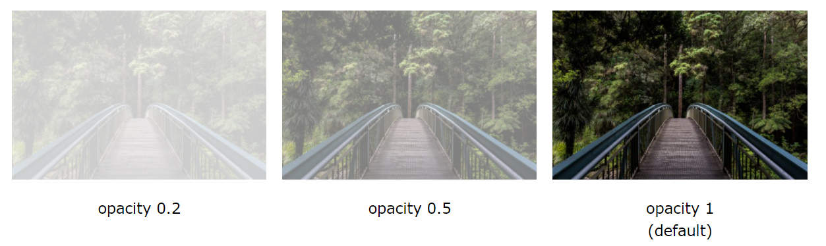
Opacity

Slide 18
Transparent Hover Effect
The opacity property is often used together with the :hover selector to change the opacity on mouse-over

