Slide 2
understand HTML entities .
practical implementation of hyperlinks in Html.

Slide 3
HTML Entities
Reserved characters in HTML must be replaced with character entities.
Some characters are reserved in HTML.
If you use the less than (<) or greater than (>) signs in your text, the browser might mix them with tags.
Character entities are used to display reserved characters in HTML.

Slide 4
HTML Entities
Reserved characters in HTML must be replaced with character entities.
Some characters are reserved in HTML.
If you use the less than (<) or greater than (>) signs in your text, the browser might mix them with tags.
Character entities are used to display reserved characters in HTML.

Slide 5
HTML Entities
Reserved characters in HTML must be replaced with character entities.
Some characters are reserved in HTML.
If you use the less than (<) or greater than (>) signs in your text, the browser might mix them with tags.
Character entities are used to display reserved characters in HTML.

Slide 6
HTML Entities
Reserved characters in HTML must be replaced with character entities.
Some characters are reserved in HTML.
If you use the less than (<) or greater than (>) signs in your text, the browser might mix them with tags.
Character entities are used to display reserved characters in HTML.

Slide 7
A character entity
A character entity looks like this:
&entity_name;
OR
&#entity_number;

Slide 8
Advantage & Disadvantage
To display a less than sign (<) we must write: &lt; or &#60.
Advantage of using an entity name: An entity name is easy to remember.
Disadvantage of using an entity name: Browsers may not support all entity names, but the support for entity numbers is good.

Slide 9
Advantage & Disadvantage
To display a less than sign (<) we must write: &lt; or &#60.
Advantage of using an entity name: An entity name is easy to remember.
Disadvantage of using an entity name: Browsers may not support all entity names, but the support for entity numbers is good.

Slide 10
Advantage & Disadvantage
To display a less than sign (<) we must write: &lt; or &#60.
Advantage of using an entity name: An entity name is easy to remember.
Disadvantage of using an entity name: Browsers may not support all entity names, but the support for entity numbers is good.

Slide 11
Non-breaking Space
A commonly used entity in HTML is the non-breaking space: &nbsp;
A non-breaking space is a space that will not break into a new line.
Two words separated by a non-breaking space will stick together (not break into a new line). This is handy when breaking the words might be disruptive.

Slide 12
Non-breaking Space
Examples:
§ 10
10 km/h
10 PM
The non-breaking hyphen (&#8209;) is used to define a hyphen character (‑) that does not break into a new line.

Slide 13
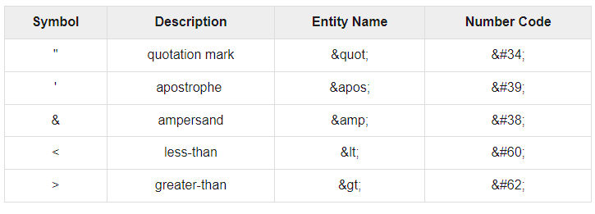
HTML processors must support following five special characters

Slide 14
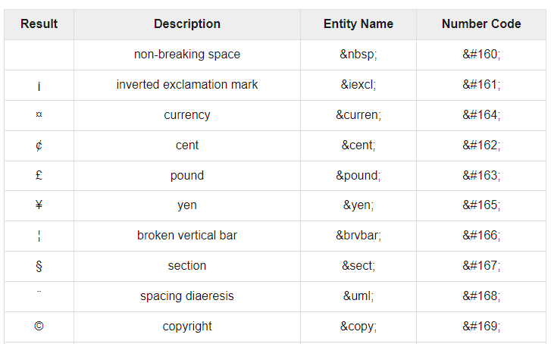
Symbol Entities

Slide 15
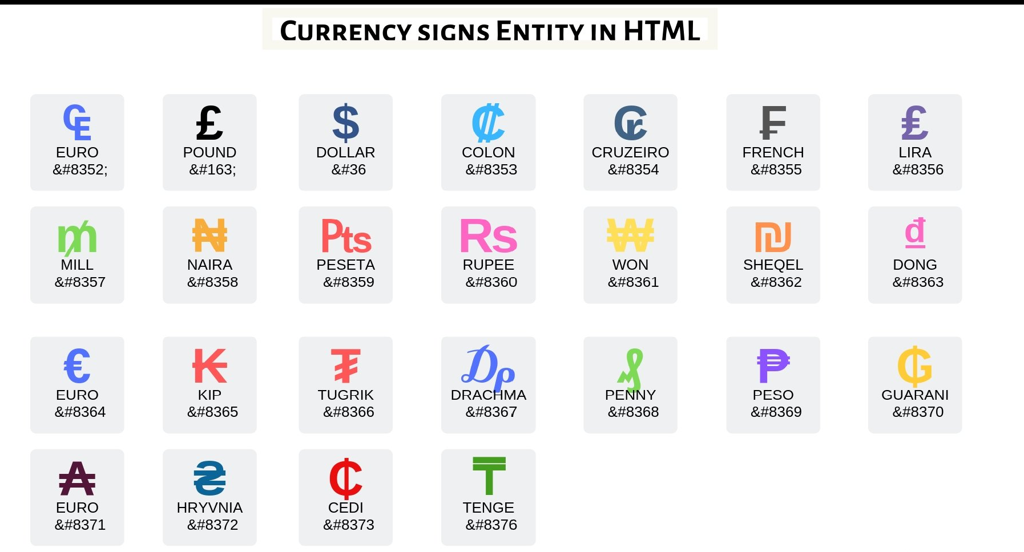
Currency signs

Slide 16
HTML Links - Hyperlinks
Links are found in nearly all web pages. Links allow users to click their way from page to page.
HTML links are hyperlinks.
You can click on a link and jump to another document.
When you move the mouse over a link, the mouse arrow will turn into a little hand.

Slide 17
HTML Links - Hyperlinks
Links are found in nearly all web pages. Links allow users to click their way from page to page.
HTML links are hyperlinks.
You can click on a link and jump to another document.
When you move the mouse over a link, the mouse arrow will turn into a little hand.

Slide 18
HTML Links - Hyperlinks
Links are found in nearly all web pages. Links allow users to click their way from page to page.
HTML links are hyperlinks.
You can click on a link and jump to another document.
When you move the mouse over a link, the mouse arrow will turn into a little hand.

Slide 19

HTML Links - Hyperlinks
Links are found in nearly all web pages. Links allow users to click their way from page to page.
HTML links are hyperlinks.
You can click on a link and jump to another document.
When you move the mouse over a link, the mouse arrow will turn into a little hand.

Slide 20
HTML Links - Syntax
The HTML <a> tag defines a hyperlink. It has the following syntax:
<a href="url">link text</a>
The most important attribute of the <a> element is the href attribute, which indicates the link's destination.

Slide 21
HTML Links - Syntax
The link text is the part that will be visible to the reader.
Clicking on the link text, will send the reader to the specified URL address.

Slide 22
Example
This example shows how to create a link to W3Schools.com.
<a href="https://www.w3schools.com/">Visit W3Schools.com!</a>

Slide 23
By default
By default, links will appear as follows in all browsers:
An unvisited link is underlined and blue
A visited link is underlined and purple
An active link is underlined and red

Slide 24
HTML Links - The target Attribute
By default, the linked page will be displayed in the current browser window. To change this, you must specify another target for the link.
The target attribute specifies where to open the linked document.

Slide 25
Target attribute
The target attribute can have one of the following values:
_self - Default. Opens the document in the same window/tab as it was clicked
_blank - Opens the document in a new window or tab
_parent - Opens the document in the parent frame
_top - Opens the document in the full body of the window

Slide 26
Absolute URLs vs. Relative URLs
Example
<h2>Absolute URLs</h2> <p><a href="https://www.w3.org/">W3C</a></p> <p><a href="https://www.google.com/">Google</a></p> <h2>Relative URLs</h2> <p><a href="html_images.asp">HTML Images</a></p> <p><a href="/css/default.asp">CSS Tutorial</a></p>

Slide 27
Absolute URLs vs. Relative URLs
A local link (a link to a page within the same website) is specified with a relative URL (without the "https://www" part):

Slide 28
HTML Links - Use an Image as a Link
To use an image as a link, just put the <img> tag inside the <a> tag:
Example
<a href="default.asp"> <img src="smiley.gif" alt="HTMLtutorial" style="width:42px;height:42px;"> </a>

Slide 29
Link Titles
The title attribute specifies extra information about an element. The information is most often shown as a tooltip text when the mouse moves over the element.
Example
<a href="https://www.w3schools.com/html/" title="Go to W3Schools HTML section">Visit our HTML Tutorial</a>

Slide 30

Practical

