Slide 2
understand HTML content models.
insert multimedia files in webpage.

Slide 3
Content Model
Content Model refers to the set of rules that define what type of content each element is allowed to have. Mostly, this translates into what other elements are allowed to be nested inside which other elements.
Prior to the modern HTML specification, HTML elements were either block-level or inline elements. Modern HTML specification split these two content models into seven models

Slide 4
Content Model
Content Model refers to the set of rules that define what type of content each element is allowed to have. Mostly, this translates into what other elements are allowed to be nested inside which other elements.
Prior to the modern HTML specification, HTML elements were either block-level or inline elements. Modern HTML specification split these two content models into seven models

Slide 5
In HTML5, there are seven content models
Metadata content
Flow content
Sectioning content
Heading content
Phrasing content
Embedded content
Interactive content

Slide 6
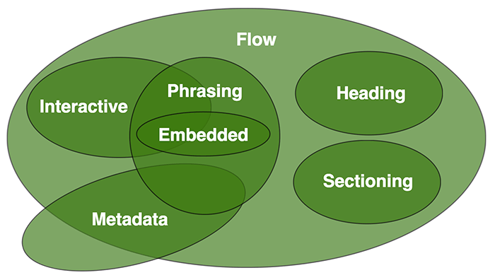
Modern HTML Content Models

Slide 7
Metadata Content
Metadata content is responsible for setting up the presentation (look) or behavior to the rest of the HTML page. It can also set up the relationship of the HTML document with other documents.

Slide 8
Flow Content
Most contents of HTML document are in this type. These contents influence other contents to flow.
Sectioning content represents a section in the current document. Each sectioning content potentially has a heading content and footer.

Slide 9
Heading Content
Heading content is the titles or headers of a section in the document.
The HTML elements that can contain heading content are-
h1,h2, h3, h4, h5, h6, hgroup

Slide 10
Phrasing Content
Phrasing content refers to those small pieces of texts that are surrounded by other texts. For example, links. A link is often surrounded by texts.
Element that contains phrasing content should contain either text or embedded content. Elements that contain this type of contents are inline level and must have end tag.

Slide 11
Embedded Content
Embedded content embeds resources from other sources or add contents from another mark-up languages. Example, image video etc.

Slide 12
Embedded Content
The HTML elements that can contain embedded content are-
audio, canvas, embed, iframe, img, math, object, svg, video

Slide 13
Interactive Content
The contents in the web page that can interact with users are interactive content. For example, links, button etc. Interactive contents are seen inside form.

Slide 14
Difference between HTML and HTML5?
HTML5 supports both audio and video .
HTML cannot allow JavaScript to run within the web browser, while HTML5 provides full support for running JavaScript.
In HTML5, inline mathML and SVG can be used in a text, while in HTML it is not possible.

Slide 15
The HTML <audio> Element
To play an audio file in HTML, use the <audio> element:
<audio controls>
<source src="horse.ogg" type="audio/ogg">
<source src="horse.mp3" type="audio/mpeg">
Your browser does not support the audio element.
</audio>

Slide 16
HTML Audio - How It Works
The controls attribute adds audio controls, like play, pause, and volume.
The <source> element allows you to specify alternative audio files which the browser may choose from. The browser will use the first recognized format.
The text between the <audio> and </audio> tags will only be displayed in browsers that do not support the <audio> element.

Slide 17
HTML <audio> Autoplay
To start an audio file automatically, use the autoplay attribute:
Example
<audio controls autoplay>
<source src="horse.ogg" type="audio/ogg">
<source src="horse.mp3" type="audio/mpeg">
Your browser does not support the audio element.
</audio>

Slide 18
HTML Audio Formats
There are three supported audio formats: MP3, WAV, and OGG. The browser support for the different formats is:
Browser MP3 WAV OGG
Edge/IE YES YES* YES*
Chrome YES YES YES
Firefox YES YES YES
Safari YES YES NO
Opera YES YES YES

Slide 19
HTML Video
The HTML <video> element is used to show a video on a web page.
To show a video in HTML, use the <video> element:
Example
<video width="320" height="240" controls>
<source src="movie.mp4" type="video/mp4">
<source src="movie.ogg" type="video/ogg">
</video>

Slide 20
How it Works
The controls attribute adds video controls, like play, pause, and volume.
It is a good idea to always include width and height attributes. If height and width are not set, the page might flicker while the video loads.

Slide 21
How it Works
The <source> element allows you to specify alternative video files which the browser may choose from. The browser will use the first recognized format.
The text between the <video> and </video> tags will only be displayed in browsers that do not support the <video> element.

Slide 22
HTML <video> Autoplay
To start a video automatically, use the autoplay attribute:
Example
<video width="320" height="240" autoplay>
<source src="movie.mp4" type="video/mp4">
</video>

Slide 23

Practical

