Slide 2
understand concept of successive increase/decrease of percentage,
solve problems based on price and expenditure,
solve comparison based questions.

Slide 3
Successive increase/decrease:
Example: A car is moving at some constant speed. At first it increases its speed by 25% and then again it increases its speed by 20%. What is the overall percentage increase.
Method 1:
Initial speed of the car = x
Speed of the car after 1st increase = x + 0.25x = 1.25x
Speed of the car after 2nd increase = 1.25x + 0.25x = 1.50x
Initial speed = x
Final speed = 1.50x
Percentage increase = 50%

Slide 4
Method 2:
Assume the initial speed of the car as 100kmph
Initial speed of the car = 100
Speed of the car after the 1st increase = 125
Speed of the car after the 2nd increase = 150
Initial speed = 100
Final speed = 150
Percentage increase = 50%

Slide 5
Method 3: Shortcut
If the 1st increase/ decrease is a% and the 2nd increase/decrease is b% the overall increase/decrease % will be
a + b + ab/100 %
In this question a = 25% and b= 20%
Overall increase/decrease = 25 + 20 + (25)(20)/100
= 25 + 20 + 5= 50 %
Note: If a or b is increase, then include +ve sign
If a or b is decrease, then include -ve sign.
Note : The final answer will be in percentage

Slide 6
Important application of a + b + ab/100 % shortcut:
If the price of a commodity increases/decreases by a% and the consumption increases/reduces by b% then the expenditure will increase/decrease by a + b + ab/100 %
Expenditure = Price * Consumption
This can be applied in many other topics like time speed and distance in the formula D = S * T etc.

Slide 7
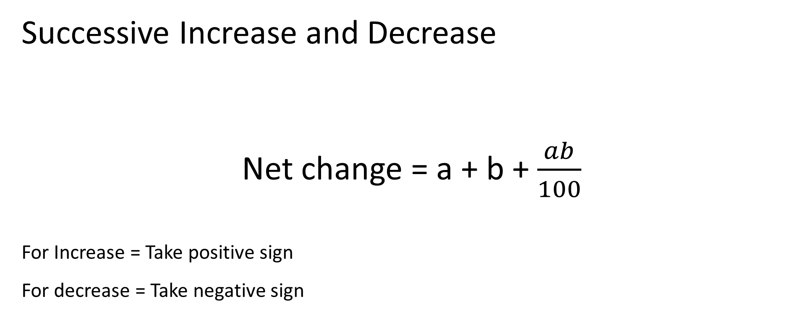

Slide 8
Q.1. Price of petrol first increased by 20% and then it is decreased by 10% . Find the net change in the price.
8 % increase
2 % decrease
10 % increase
8 % decrease
Ans. (A)

Slide 9
Q.2. Demand of a car went down by 25 % in 2016 and 20 % in 2017. What is net % decrease in demand?
45 %
40 %
50 %
60 %
Ans. (B)

Slide 10
Q.3. If the length of a rectangle is increased by 20 % and width is decreased by 30% then find the resultant change in area.
16 %
20 %
24 %
28 %
Ans. (A)

Slide 11
Q.4. A number is first increased by 15% and then decreased by 20%. The number so obtained is 64 less than the original number. What is the original number?
600
750
800
860
Ans. (C)

Slide 12
Q.5. If the price of petrol is raised by 20% then the percentage by which a car owner must reduce his consumption so that there is no change in expenditure.
16.66 %
18 %
15 %
25 %
Ans. (A)

Slide 13
Important Application of 1/n shortcut:
If the price of a commodity increases by 1/n, then the consumption should be reduced by 1/n+1 to make the expenditure same.
Expenditure = Price * Consumption
a/b a/a+b
This can be applied in many other topics like time speed and distance in the formula D = S * T etc.

Slide 14
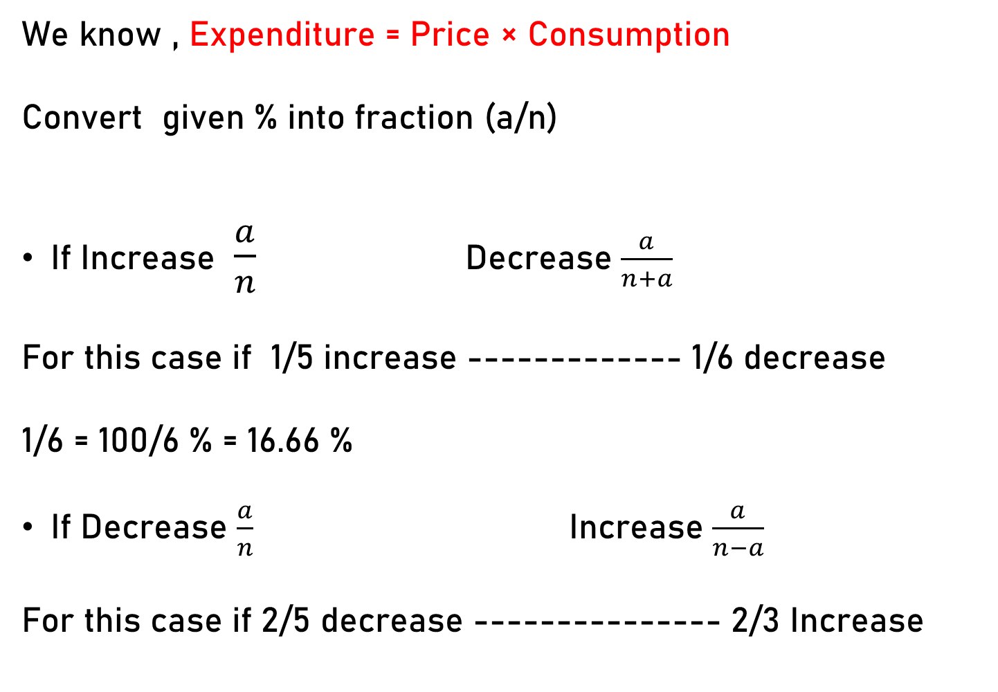
We know , Expenditure = Price × Consumption
Convert given % into fraction (a/n)
If Increase $\frac{a}{n}$ Decrease $\frac{a}{n+a}$
For this case if 1/5 increase ------------- 1/6 decrease
1/6 = 100/6 % = 16.66 %
If Decrease $\frac{a}{n}$ Increase $\frac{a}{n−a}$
For this case if 2/5 decrease --------------- 2/3 Increase

Slide 15
Q.6. If the price of commodity is decreased by 20% and its consumption increased by 20%, what will be the change in expenditure.
4 % increase
4 % decrease
8 % decrease
8 % increase
Ans. (B)

Slide 16
Q.7. If the price of sugar is increased by 25% then by how much percent consumption should be reduced so that the expenditure will increase by only 5%
(a) 25%
(b) 15%
(c) 16%
(d) 20%
Ans. (C)

Slide 17
Q.8. If the price of sugar is reduced by 20% due to which a person can buy 2kg more sugar for Rs. 200. Find the original price of sugar per kg.
Rs. 25 per Kg
Rs. 20 per Kg
Rs. 22 per Kg
Rs. 16 per Kg
Ans. (A)

Slide 18
Q.9. The price of sugar is increased by 30% due to this a housewife purchase 12 kg less sugar so that her expenditure will increase by 10% only. Find her original consumption.
(a) 70 kg
(b) 80 kg
(c) 75 kg
(d) 78 kg
Ans. (D)

Slide 19
Q.10. A student scored 140 Marks and still failed by 35 marks. If the passing criteria of that exam is 35%. Then find the maximum marks of that exam.
500
600
1000
700
Ans. (A)

Slide 20
Q.11. A student scored 25 % in an examination and still failed by 30 marks while another candidate scored 50% marks and get 20 marks more than the passing marks. Then find the passing percentage.
30 %
40 %
45 %
50 %
Ans. (B)

Slide 21
Q.12. A student scored 30 % in an examination and still failed by 12 marks while another candidate scored 40% marks and got 28 marks more than the passing marks. Then find the maximum marks in the examination.
300
400
500
700
Ans. (B)

Slide 22
Q.13. In an Exam, 52% candidates failed in English, 42% in mathematics and 17% in both. What was the number of percentage of passed students in both subjects?
(a) 23
(b) 77
(c) 6
(d) 94
Ans. (A)

