Slide 1
Networking 6 More on WeensyDB
Minlan Yu
Harvard University
Notes:
We’re going to use some of our additional lectures to highlight our own research work and advanced topics. I work in super-fast networked systems! I make data centers, like Google's or Amazon's, work better and transfer data faster. And to do that I use data representation all the time.

Slide 2
Condition Variable
Std::condition_variable_any
cv.wait(m): In one atomic step, effectively:
(1) Unlocks `m` via `m.unlock()`
(2) Blocks until another thread calls `cv.notify*()`.
Then, when this thread is woken up, it re-locks `m` via `m.lock()` before returning
cv.notify_all()
Wakes up all threads blocked in `cv.wait()`.
Notes:
Why atomic?
The atomicity of the unlocking and the blocking guarantees that a thread that blocks can't miss a notify_all() message.
Because when you unlock, somewhere else may change the condition, so you may miss the notify_all message.
And need to combine with mutex… Need to lock before you do the wait, to protect the condition variable

Slide 3
Condition Variable
Cv.wait(mutex)
Associated with a mutex
Need a lock before wait to check on conditions
Need to release lock before blocking
Need to avoid race conditions by atomic operations of lock and block
Cv.notify_all()
Not associated with a mutex
Wait and notify are often under the same mutex
Because they are related to the same shared condition variable

Slide 4
Condition Variable
Cv.wait(mutex)
On the places where you need blocking on conditions
Cv.notify_all()
Placed whenever condition changes, can be put in many places

Slide 5
WeensyDB thread bound
Notes:
Stress again about usage pattern for wait and notify:
wait() is almost always used in a loop because of what we call spurious wakeups. Since notify_all() wakes up all threads blocking on a certain wait() call, by the time when a particular blocking thread locks the mutex and gets to run, it's possible that some other blocking thread has already unblocked, made some progress, and changed the unblocking condition back to false. For this reason, a woken-up thread must revalidate the unblocking condition before proceeding further, and if the unblocking condition is not met it must go back to blocking. The while loop achieves exactly this.
Need to talk about scoped_lock
We may find it very common that we write some synchronized function where we need to lock the mutex first, and then unlock it before the function returns. Doing this repeatedly can be tedious. Also, if the function can return at multiple points, it is possible to forget a unlock statement before a return, resulting in errors. C++ has a pattern to help us deal with these problems and simplify programming: a scoped lock.
Note that in the first line of the function body we declared a std::unique_lock object, which is a scoped lock that locks the mutex for the scope of the function. Upon initialization of the std::unique_lock object, the mutex is automatically locked, and when this object goes out of scope, the mutex is automatically unlocked. These special scoped lock objects lock and unlock mutexes in their constructors and destructors to achieve this effect. This design pattern is also called Resource Acquisition is Initialization (or RAII), and is a common pattern in C++ software engineering in general. The use of RAII simplify coding and also avoids certain programming errors.
You should try to leverage these scoped lock objects for your synchronization tasks in the problem set as well.

Slide 6
Weensydb05: fine-grained vs course-grained locks
Coarse-grained locks
On the entire hash table
Limits concurrency
Fine-grained locks
On each hash bucket
Different bucket has different keys

Slide 7
Exchange
Swap the values of two keys
But now we need to lock two keys [weensydb07]

Slide 8
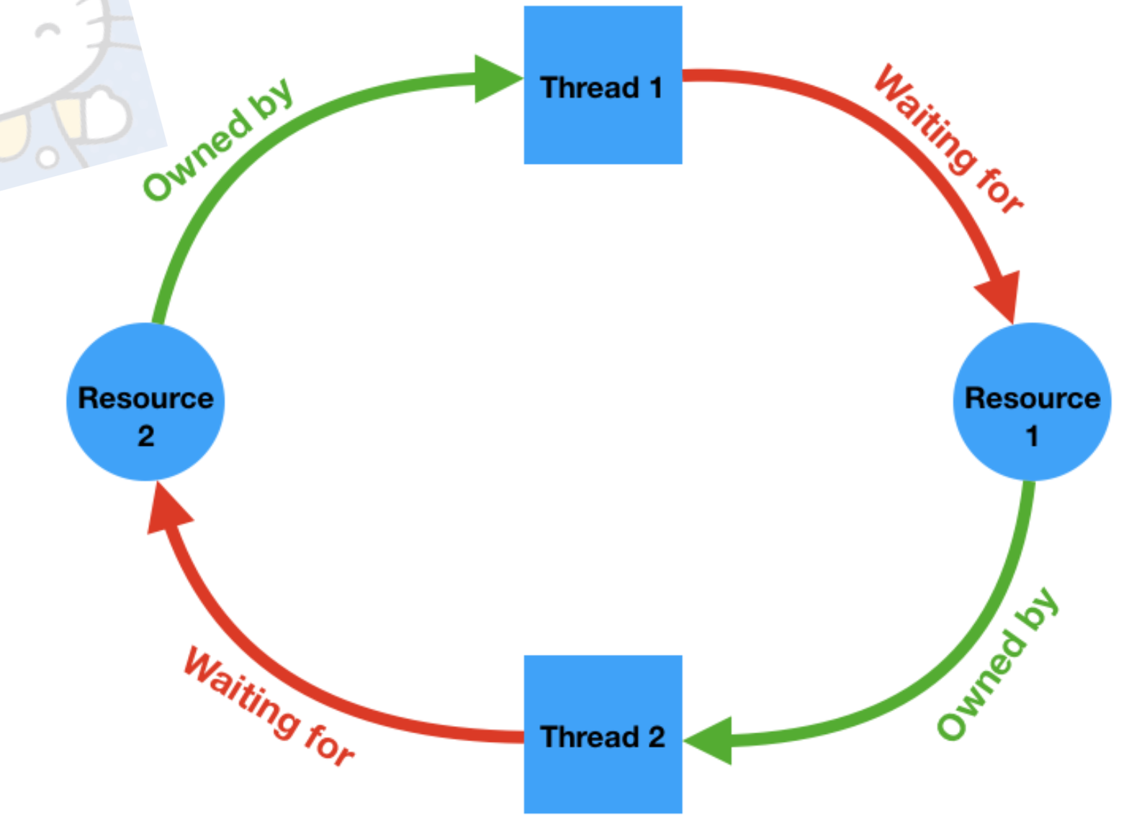
deadlock
A situation in a multi-threaded process where each thread is waiting (forever) for a resource that is held by another thread.
Notes:
It is necessary to have a cycle in a resource ownership-wait diagram to have a deadlock. The following diagram illustrates a deadlock where two threads are waiting for some resources held by each other and are therefore unable to ever make progress.
Cycles like this can potentially be detected by the runtime system and it can intervene to break the deadlock, for example by forcing one of the threads to release the resources it owns. The C++ runtime does not perform these checks for performance reasons, therefore it's the programmer's responsibility to make sure the program is free of deadlocks.

Slide 9
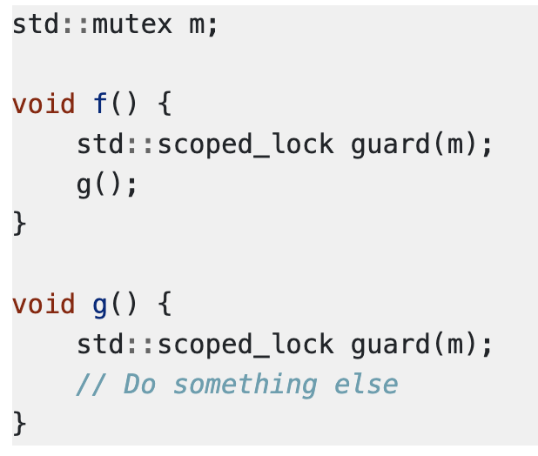
Deadlock with a single mutex and a single thread
Notes:
Draw the graph again

Slide 10
Other resources can cause deadlock too
Any examples can you think about?

Slide 11
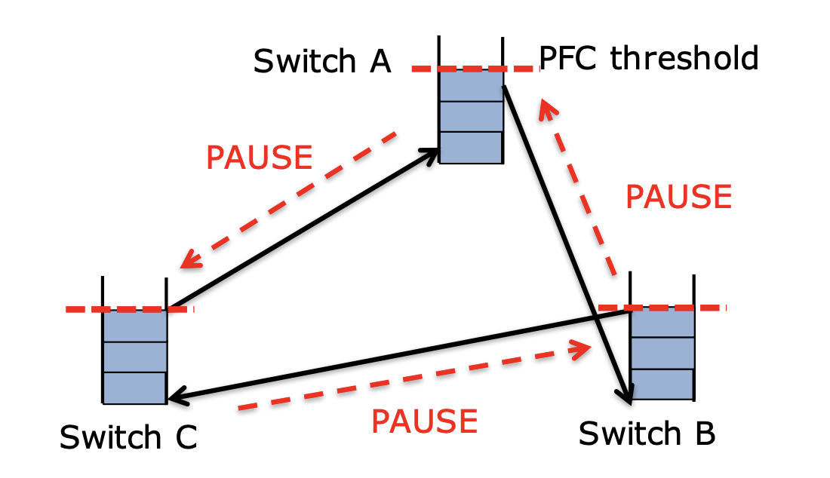
Network deadlock

Slide 12
Now let’s get back to weensydb
How to solve the deadlock issue

