Slide 1
Networking 7 10K connections
Minlan Yu
Harvard University

Slide 2
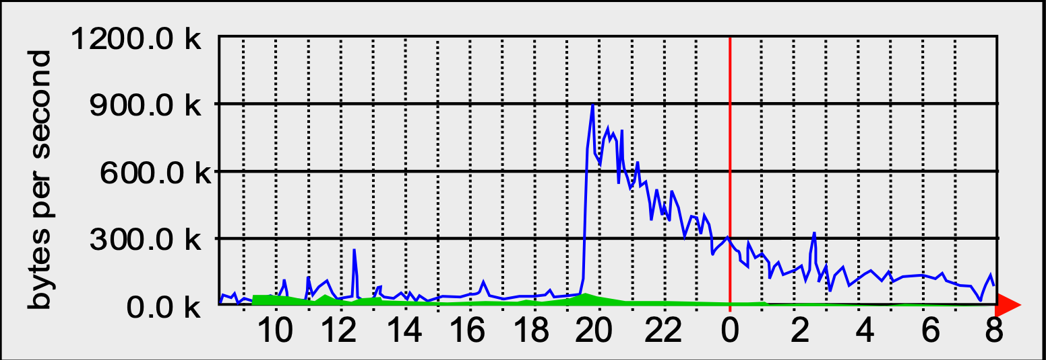
Slashdot effect (or flashcrowds)
- a moderate Slashdot effect in action in 2005 ( copied from wikipedia)
Notes:
The Slashdot effect, also known as slashdotting, occurs when a popular website links to a smaller website, causing a massive increase in traffic. This overloads the smaller site, causing it to slow down or even temporarily become unavailable. This has the same effect as a denial-of-service attack, albeit accidentally. The name stems from the huge influx of web traffic which would result from the technology news site Slashdot linking to websites.

Slide 3
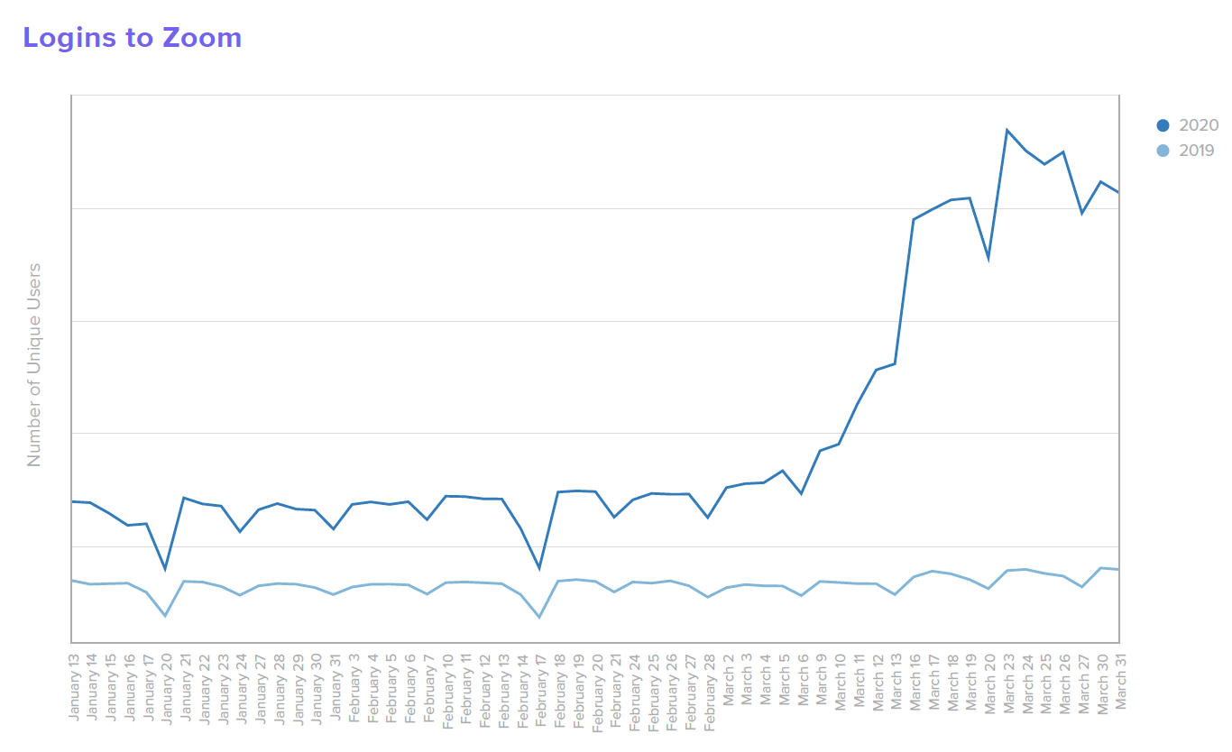

Slide 4
C10K problem
Can you build a server that handle 10K connections at a time?
How to design OS and software to scale?
Notes:
How many connections can we handle on a single piece of hardware today?

Slide 5
Thread-based parallelism
- Pros/cons
+ Handle multiple connections
+ Easy to implement
+ Sharing data across threads
- Locks for shared data
- Scalability
Notes:
One connection per thread

Slide 6
Resources associated for each thread?
Notes:
Registers (stored in the kernel)
Stacks in (takes up user-space memory)
What are your guesses for the size of each things?
Socket buffer: pipe buffer 65KB
Pid, pagetable (shared across threads), pointers to the page table, 64Bytes
4KB for task struct and 4KB for thread stack
Threadstack: why large thread stack? In c++, fixed stack size, in go, dynamic thread size
Contiguous virtual memory, call a function, substract rsp
Designed for speed, function sequence

Slide 7
Overhead of threading
Every thread
Socket buffers: ~ 32KB each
Stack: ~ 8MB
its own set of registers
Task struct + kernel thread stack: ~ 8KB
10K threads have around 80GB memory
More: context switching overhead of running 10K threads say on 40 cores.
Notes:
Registers (stored in the kernel)
Stacks in (takes up user-space memory)
What are your guesses for the size of each things?
Socket buffer: pipe buffer 65KB
Pid, pagetable (shared across threads), pointers to the page table, just a
4KB for task struct and 4KB for thread stack
Threadstack: why large thread stack? In c++, fixed stack size, in go, dynamic thread size
Contiguous virtual memory, call a function, substract rsp
Designed for speed, function sequence

Slide 8
How to solve C10K?
Many connections per thread
What’s the problem of our existing system calls?
Read, write, accept?
Notes:
What problems do we have with existing system calls? Blocking?
Deadlock and starvation (some process gets handled but others do not)

Slide 9
Non-blocking I/O: >1 connections per thread
Set socket as non-blocking
Read/write will return -1
with errno set to EAGAIN
int cfd[10K];
while (true) {
for (int c: cfd) {
int r = read(c);
if (EAGAIN) continue;
}
}
Notes:
EAGAIN: check back later
Does not block
High CPU overhead, busy check all the connections

Slide 10
Non-blocking I/O: >1 connections per thread
Problem:
Polling (block on 1 fd at a time)
Solution:
Block on multiple fds
int cfd[10K];
while (true) {
for (int c: cfd) {
int r = read(c);
if (EAGAIN) continue;
}
}
Notes:
EAGAIN: check back later
Does not block
High CPU overhead, busy check all the connections

Slide 11
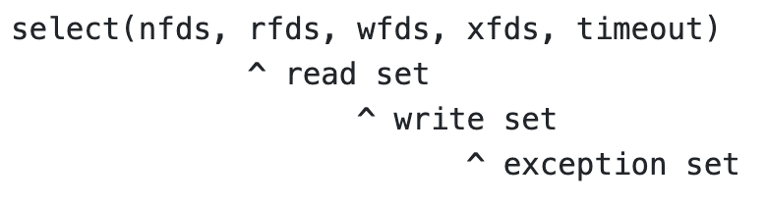
select
Blocks until
Timeouts
Some fd in rfds becomes readable, …
For sockets
If listenfd has input,
we can accept a new connection
If connfd has input
Handle these inputs
Need to maintain more states
for partial read/write
while (true) {
select (..,cfd,..);
for (int c: cfd) {
if (c in rfds)…
}
}
Notes:
States (like buffer used in previous thread) now have to be maintained explicitly in the heap
EOF is also considered readable, absence of EAGAIN

Slide 12
Select code

Slide 13
Event-driven programming
A loop that listens for events
Maintain a queue of events
Calls for event handler for each event
Harder to write, but more efficient
Use event-driven programming when you are frequently blocked by IO
Keyboard, disk, network…

Slide 14
Use of select in the real-world

Slide 15
Select applications
Grading server for pset 6: Node.js
Select to pick student HTTP requests
Telnet to google.com
Select between terminal input and remote responses
Timewait example in process session
Select from childexit events or timeout

Slide 16
Overhead of select?
while (true) {
select (..,cfd,..);
for (int c: cfd) {
if (c in rfds)…
}
}
Notes:
If there’s only 1 connection at a time, what’s the CPU overhead, looping through all the connections
Kernel: effective for a small number of connnections: the kernel has go through 10K, and blocks, remove the entries, and then everytime, go through the number of 10K connection again. We would love some API that allows 1 unit of work for 1 interesting connection
The kernel keep a persistent

Slide 17
Epoll
Problems of select?
Select operation takes O(n) time where n is #fds
A loop that search for readable fds
High overhead during many idle connections
Idle connections are common (why?)
Epoll
Maintain a persistent list of fds, and their states in the kernel
Only need to navigate the active list of fds
Notes:
Shared across system calls.
Returns just active connections
Interesting:
Active connections:
Browsers hold open a bunch of connections,

Slide 18
Epoll
epoll_create()
Returns a new epoll file descriptor representing the persistent read set in kernel.
epoll_ctl()
Adds/Removes fds to/from the read set.
epoll_wait()
The blocking system call. Returns information about active fds in the read set.
Used in nginx web servers
Notes:
A good tradeoffs between maintaining all the fds or not fds

Slide 19
Some demonstration

Slide 20
Facebook Memcached
A distributed key-value store
Trillions of items
Billions of requests/second
Network-attached in-memory hash table (like WeensyDB)
https://www.usenix.org/system/files/conference/nsdi13/nsdi13-final170_update.pdf

Slide 21
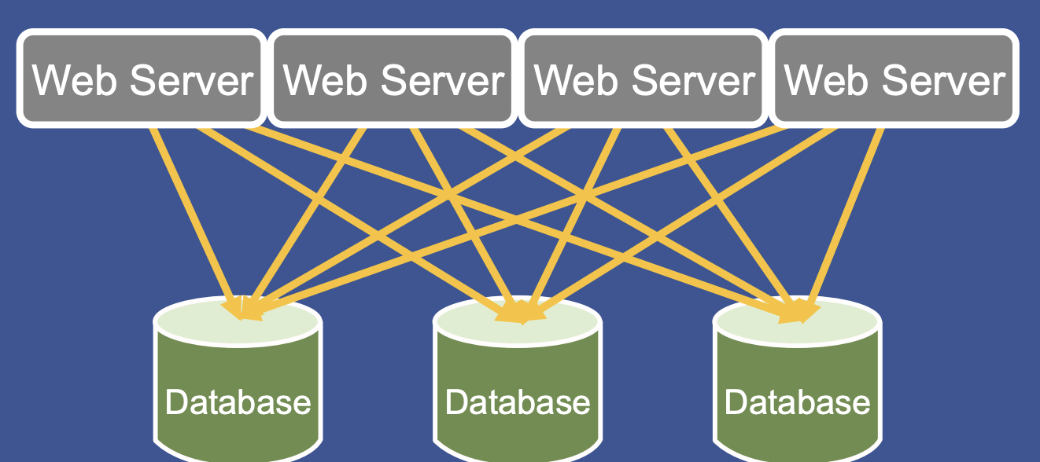
Why Memcached?
Notes:
One request need to navigate many places in databases (sequentially)

Slide 22
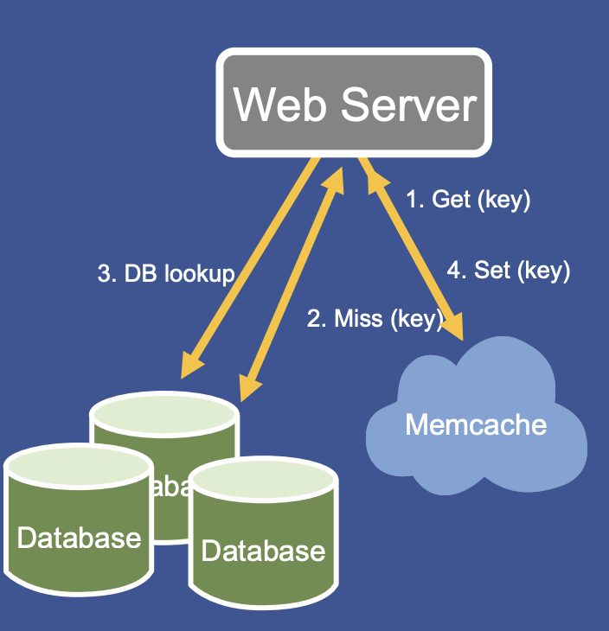
With Memcached
Memcached to increase read capacity
Two orders of magnitude more reads than write
LRU based eviction

Slide 23
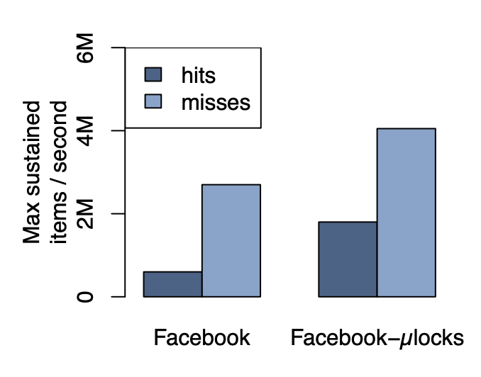
Memcached server performance
Most optimizations as discussed in WeensyDB
Multi-threaded
Fine-grained locking
Notes:
Multiget hit and miss performance
an Intel Xeon CPU (X5650) running at 2.67GHz (12 cores and 12 hyperthreads), an Intel 82574L gigabit ethernet controller and 12GB of memory
Employing fine-grained locking triples the peak get rate for hits from 600k to 1.8M items per second. Performance for misses also increased from 2.7M to 4.5M items per second.

Slide 24
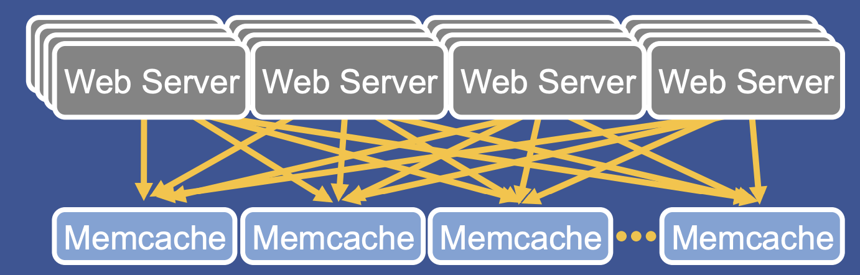
Distributed Memcached for more read capacity
Distributed keys on multiple memcached (based on hash)
Two orders of magnitude more reads than write
All webservers talk to all memcached
One user request can access 100s of memcached
Notes:
How many connections do we have here

Slide 25
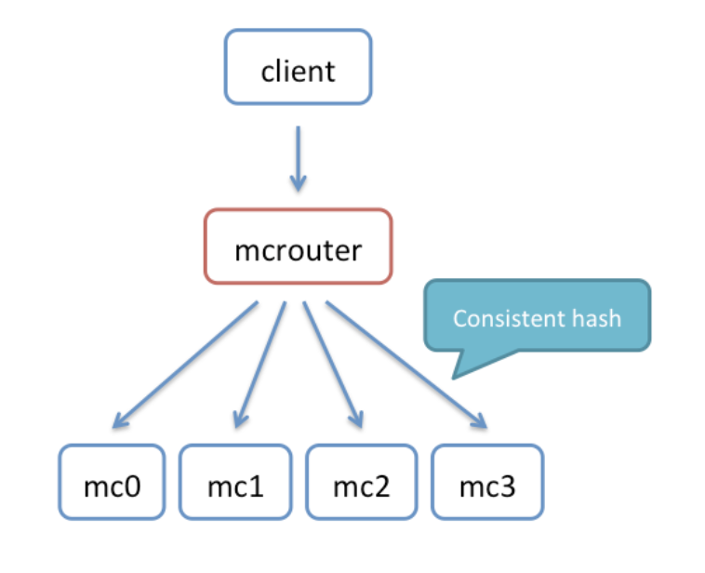
mcRouter
Connection pooling:
Multiple clients can connect to a single mcrouter instance
share the outgoing connections
reducing the number of open connections to memcached instances.

Slide 26
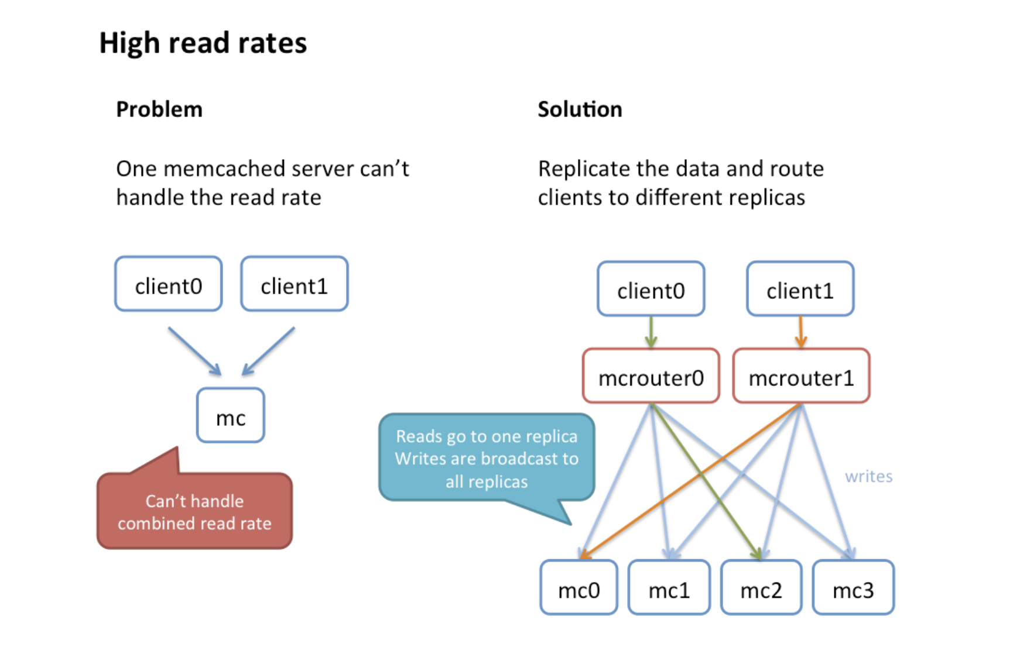
Notes:
Handle traffic to/from/between memcache servers

Slide 27
Breakouts: Design the mcRouter
Is MCRouter the client or the server?
What types of connections do you setup at mcrouter
How do you parallelize the connection handling?
Threads, select, epoll?

Slide 28
