Slide 1




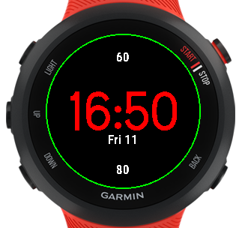










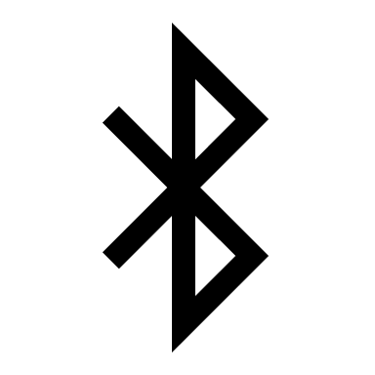
Sketch for Watch Face
Sketch Icons for Cal/Distance
Sketch Icons for Battery
153
16:51
Sketch Icons for Heart
Fri 11 Dec
Sketch Icons for Bluetooth
*Icons used aren’t the ones from PowerPoint.

