Slide 1
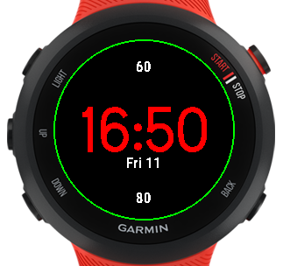










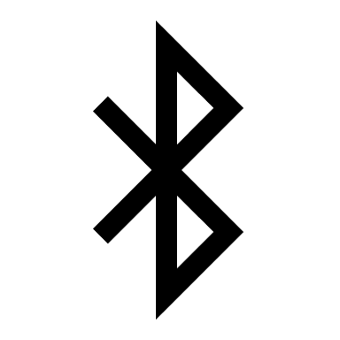
Sketch for Watch Face
Sketch Icons for Battery
153
16:51
Sketch Icons for Heart
Fri 11 Dec
Sketch Icons for Bluetooth
*Icons used aren’t the once from PowerPoint.

