Slide 1
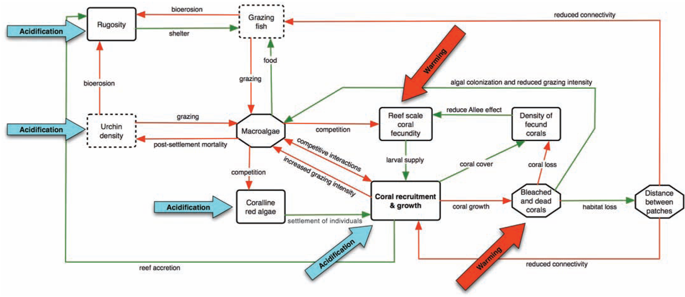
Question 5 start here
Large arrows: impact points of acidification or warming.
Red lines: negative relationship.
Green lines: positive relationship.
Rectangles: decreasing levels (dashed boxes may respond to local management).
Hexagons: increasing levels.
Hoegh-Guldberg et al. 2007. Science 318: 1737.

