Slide 1
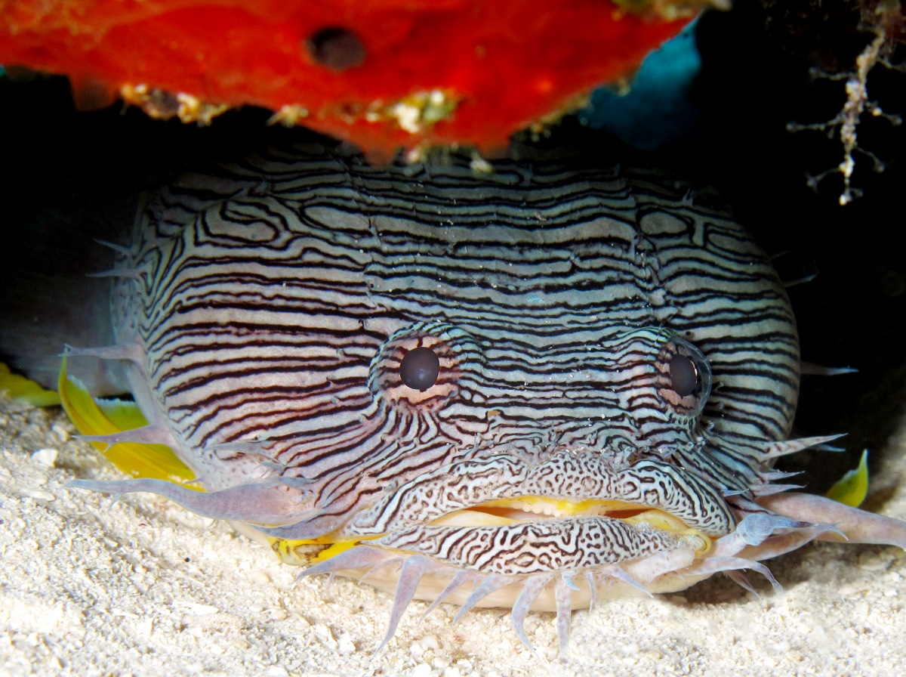
Sanopus splendidus, the splendid toadfish, in its typical posture. This species is endemic to the reefs of Cozumel, Mexico.

Slide 2
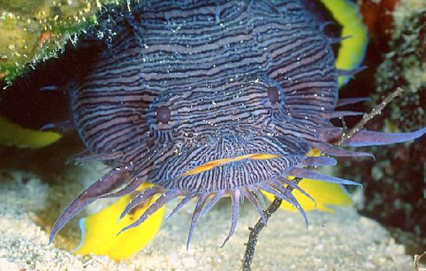
Sanopus splendidus, the splendid toadfish, in its typical posture. This species is endemic to the reefs of Cozumel, Mexico.

Slide 3
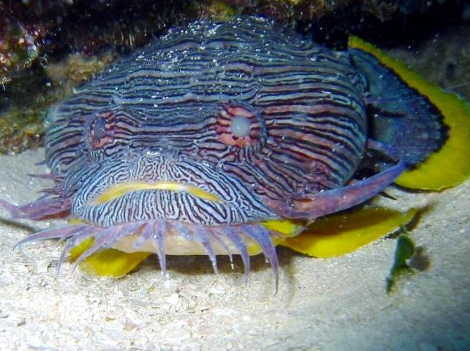
Sanopus splendidus, the splendid toadfish, in its typical posture. This species is endemic to the reefs of Cozumel, Mexico.

Slide 4
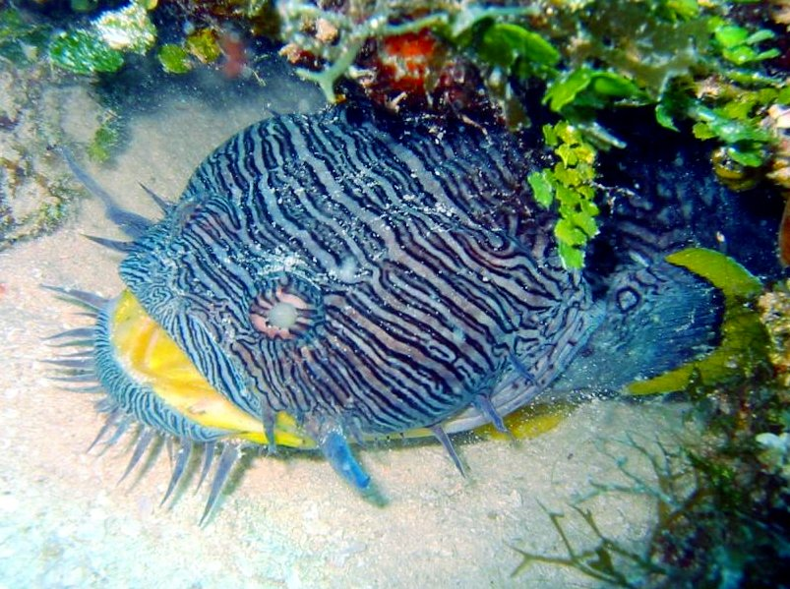
Sanopus splendidus, the splendid toadfish, in its typical posture. This species is endemic to the reefs of Cozumel, Mexico.

Slide 5
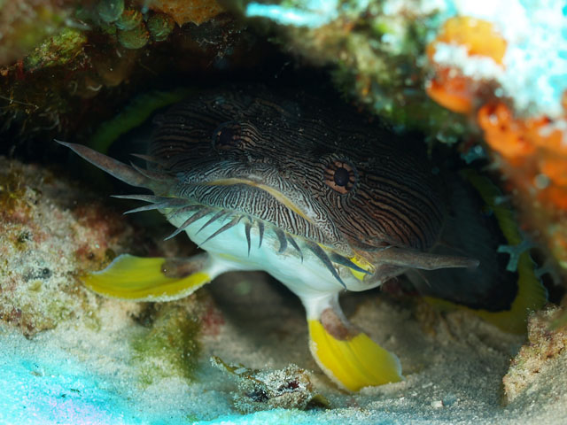
Sanopus splendidus, the splendid toadfish, in its typical posture. This species is endemic to the reefs of Cozumel, Mexico.

Slide 6
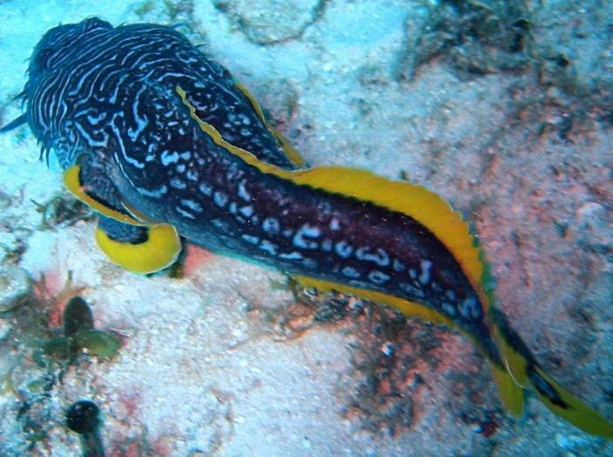
Sanopus splendidus, the splendid toadfish, in its typical posture. This species is endemic to the reefs of Cozumel, Mexico.

Slide 7
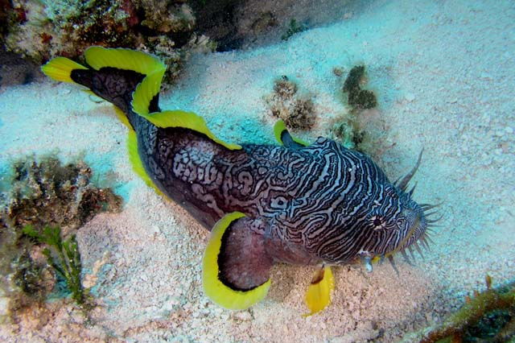
Sanopus splendidus, the splendid toadfish, in its typical posture. This species is endemic to the reefs of Cozumel, Mexico.

Slide 8
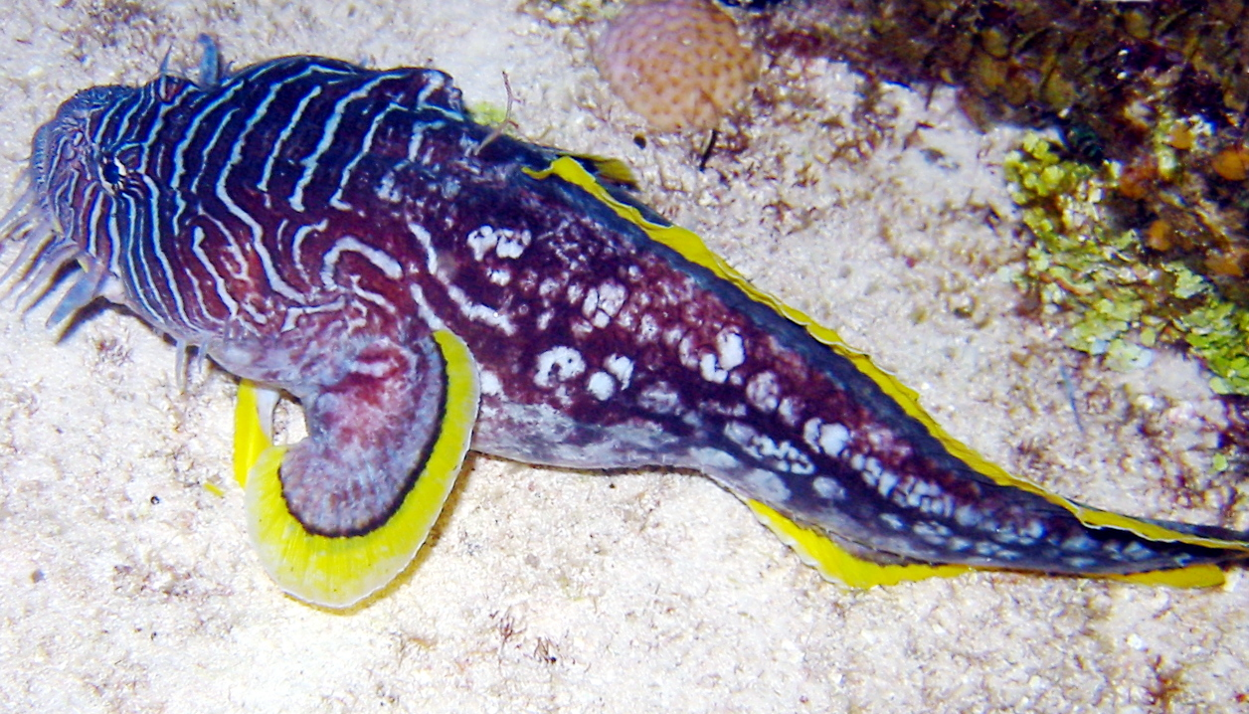
Sanopus splendidus, the splendid toadfish, in its typical posture. This species is endemic to the reefs of Cozumel, Mexico.

Slide 9
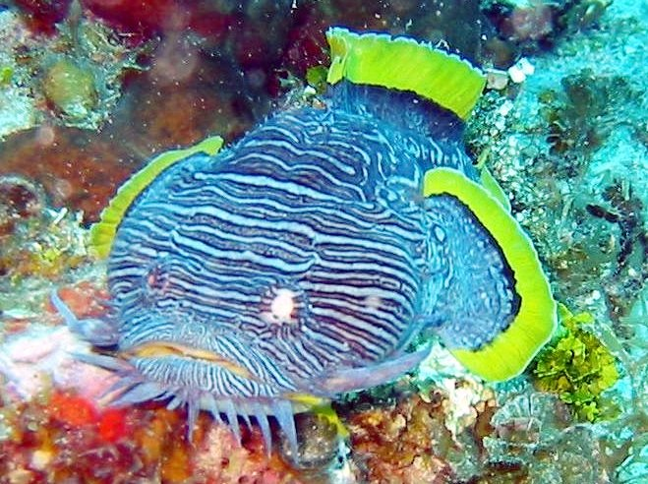
Sanopus splendidus, the splendid toadfish, in its typical posture. This species is endemic to the reefs of Cozumel, Mexico.

