Slide 1
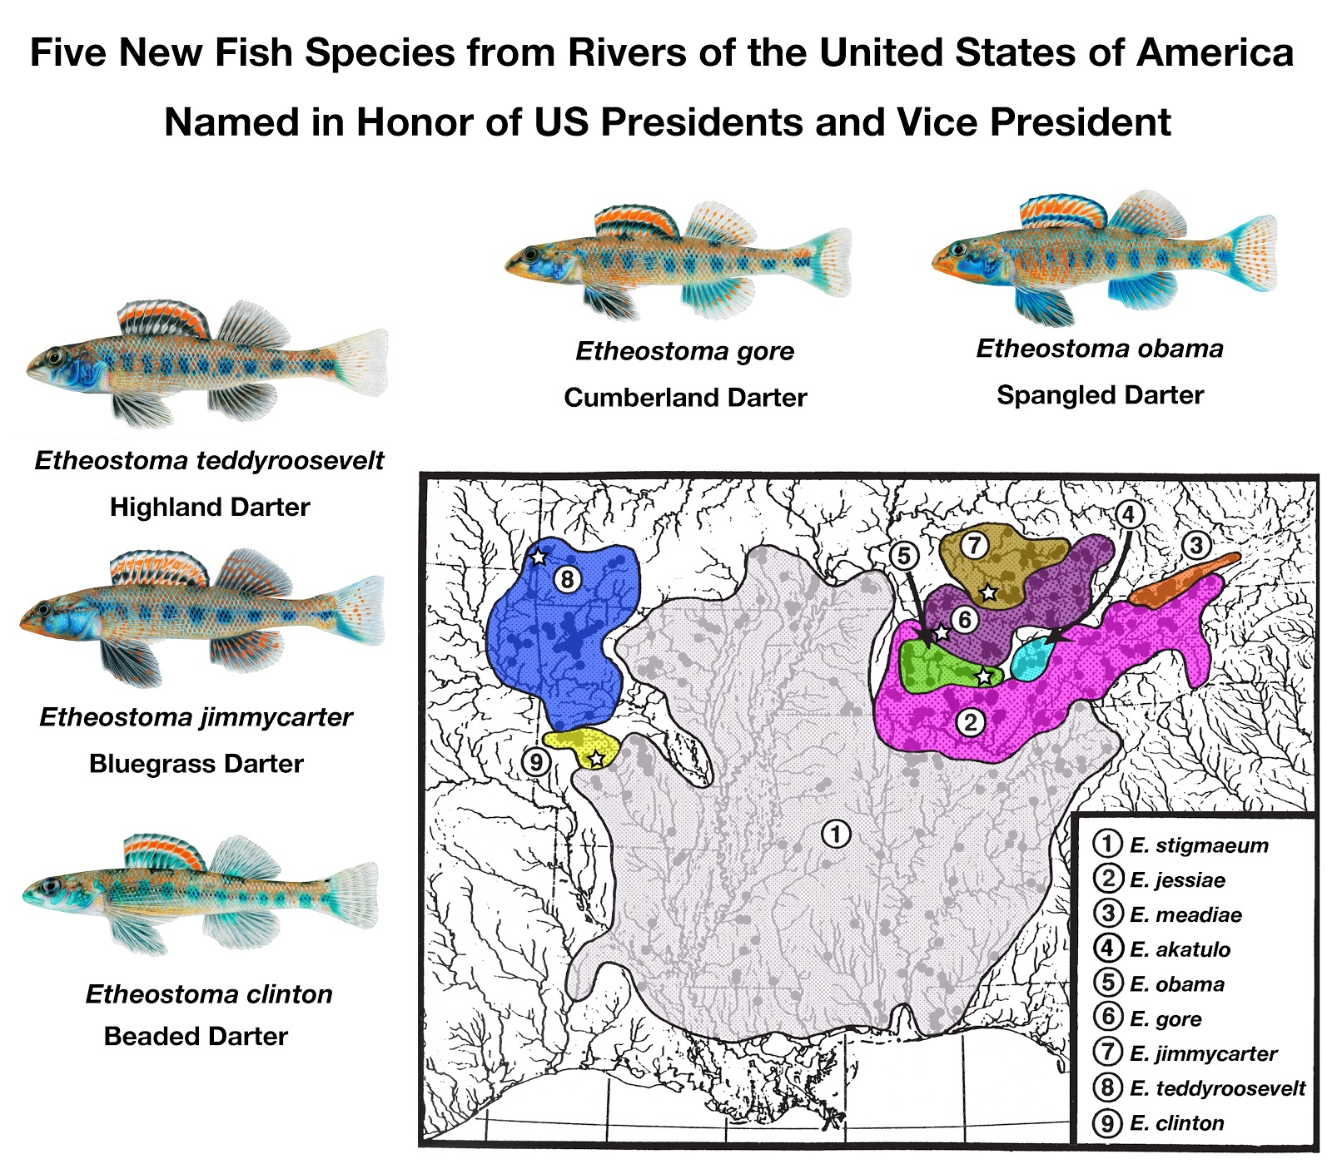
Srsly?
Layman, Steven R., and Richard L. Mayden. 2012. Morphological diversity and phylogenetics of the darter subgenus Doration (Percidae: Etheostoma), with descriptions of five new species. Bulletin of the Alabama Museum of Natural History Number 30:1-83.

Slide 2
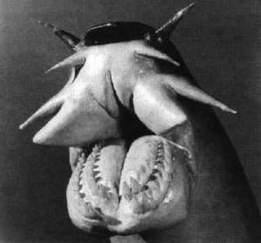
Be specific for
question 17!

