Slide 2
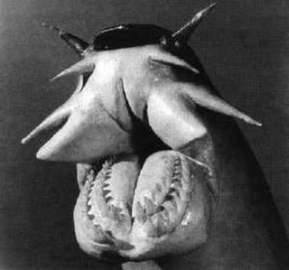
Be specific for
question 17!

