Slide 1
Ruby on Rails on TorqueBox
Martyn Taylor,
Software Engineer, RedHat
Notes:
Good afternoon-enthusiasim

Slide 2
Overview
Background
A look inside
  Make up
  Model
  View
  Controllers
TorqueBox
Practical Session

Slide 3


What is RoR?
Web Framework
MVC
Built on top of Ruby
Open Source (MIT License)
Focus on Convention over Configuration

Slide 4

A bit of History
David Heinemeir Hansson (Pic)
37 Signals
Released as Open Source 2004
Included in Apple OSX in 2006
Merged with Merb 2008
Release 3.2 2012
> 2100 Contributers

Slide 5
The Good Stuff
Rapid Development
Interpreted*
    Removes Compile, Build, Deploy Cycle
Shallow Learning Curve
Large Ruby Community
    (> 40000 Gems since 2009)
Matured Significantly - v3.0 Release
Documentation: http://guides.rubyonrails.org/
Applications: Twitter, GitHub, Groupon...
    (www.rubyonrails.org/applications)

Slide 6
The Not so Good Stuff
Convention only covers 95% Use Case
Version upgrades often not backward compatible
Maturity brings Complexity
Fanatical Community
No Decent IDE Support
    Emacs
    Aptana (eclipse)
Disclaimer:
The stuff in Red is opinion only; but based on solid facts, for which there are no references or evidence.

Slide 7
RVM
Command Line Tool
Manages multiple versions of ruby
Allows creation of library environments:
  gemsets
https://rvm.io//

Slide 8
def rails

Slide 9
Looking inside
Action Pack
Action Controller
Action Dispatch
Action View
Action Mailer
Active Model
Active Record
Active Resource
Active Support
Railties

Slide 10
Useful Commands
$ rails new
$ rails server
  WEBrick
  ./script/rails server
  port 3000
$ rails console
  IRB
  Loads rails environment
$ rake db:create:all
$ rake db:migrate
$ rake generate

Slide 11
Rails application
$ rails new <name>
├── app
│ ├── controllers
│ ├── models
│ └── views
├── config
│ ├── environments
│ ├── initializers
│ ├── locales
├── db
├── doc
├── Gemfile
├── lib
├── log
├── public
│ ├── images
│ ├── javascripts
│ └── stylesheets
├── Rakefile
├── script
│ └── rails
├── test
├── tmp
└── vendor

Slide 12
Environments
Development
Test
Production
RAILS_ENV=production

Slide 13
Bundler and Gemfile
Gemfile
  Specifies dependencies
  Gemfile.lock
Bundler => Rubygem
  Manages Application Depedencies
  The de facto standard for rails
  Determines dependencies from Gemfile
  Generates Gemfile.lock
    Locks dependencies and versions
$ bundle install
Your bundle is complete! Use `bundle show [gemname]` to see where a bundled gem is installed.

Slide 14
Gemfile Example
source "http://rubygems.org"
gem "rails", "3.2.2"
gem "rack-cache"
gem "nokogiri", "~> 1.4.2"
group :development do
gem "sqlite3"
end
group :production do
gem "pg"
end

Slide 15
Configuring DB
development:
adapter: sqlite3
database: db/development.sqlite3
pool: 5
timeout: 5000
test:
adapter: sqlite3
database: db/test.sqlite3
pool: 5
timeout: 5000
production:
adapter: sqlite3
database: db/production.sqlite3
pool: 5
timeout: 5000

Slide 16
Model

Slide 17
Model
Migrations
Validation
Associations
Querying

Slide 18
Migrations
Class < ActiveRecord::Migration
Database Mappings
Incremental Changes
Timestamped
  Allows easy upgrade
  Prevents Database Clashes
Transactional
Naming Convention
YYYYMMDDHHMMSS_<Class.name.underscore>.rb

Slide 19
Migrations
class CreateBaseImages < ActiveRecord::Migration
def self.up
create_table :base_images do |t|
t.integer :id
t.string :name
t.string :description
t.integer :template_id
t.timestamps
end
end
def self.down
drop_table :base_images
end
end
Called when migrations are run
Called on Rollback

Slide 20
Migration Generators
$ rails generate model User first_name:string dob:date
app/models/user.rb
class User < ActiveRecord::Base
end
db/migrate/20120626135824_create_users.rb
class CreateUsers < ActiveRecord::Migration
def self.up
create_table :users do |t|
t.string :first_name
t.date :dob
t.timestamps
end
end
def self.down
drop_table :users
end
end

Slide 21
Migration Generators
$ rails generate migration AddEmailToUser
db/migrate/20120626140751_add_email_to_user.rb
class AddEmailToUser < ActiveRecord::Migration
def self.up
end
def self.down
end
end

Slide 22
Migration Utilities
add_column
add_index
change_column
change_table
create_table
drop_table
remove_column
remove_index
rename_column

Slide 23
Supported Types
:binary
:boolean
:date
:datetime
:decimal
:float
:integer
:primary_key
:string
:text
:time
:timestamp #(:created_at, :updated_at)

Slide 24
Running Migrations
$ rake db:migrate
$ rake db:rollback
$rake db:rollback STEP=2
== CreateUsers: migrating ================================================
-- create_table(:users)
-> 0.0014s
== CreateUsers: migrated (0.0016s) ===========================================
== AddEmailToUser: migrating =============================================
== AddEmailToUser: migrated (0.0000s) ========================================
== AddEmailToUser: reverting =============================================
== AddEmailToUser: reverted (0.0000s) ========================================
== AddEmailToUser: reverting =============================================
== AddEmailToUser: reverted (0.0000s) ========================================
== CreateUsers: reverting ================================================
-- drop_table(:users)
-> 0.0005s
== CreateUsers: reverted (0.0006s) ===========================================

Slide 25
Schema
ActiveRecord::Schema.define(:version => 20120626140751) do
create_table "users", :force => true do |t|
t.string "first_name"
t.string "last_name"
t.date "dob"
t.datetime "created_at"
t.datetime "updated_at"
end
end
Matches Migration timestamp

Slide 26
Validations
When is validation performed?
  Before model is persisted
    create, create!
    save, save!
    update, update!
    update_attributes
Raises ActiveRecord::RecordInvalid Exception
Checking a model is valid
  valid?
  Invalid?

Slide 27
Validation Helpers
Acceptence
Associations
Confirmation
Exclusion
Format
Inclusion
Length
Numericality
Presence
Uniqueness

Slide 28
Validation Example
class User < ActiveRecord::Base
validates :first_name, :presence => true
validates :postcode,
:format => { :with => /^([A-Z][A-Z][0-9]? [0-9][A-Z]{2})$/,
:message => "must be a valid UK Postcode" }
end
>> User.create(:first_name => “Martyn”, :postcode => “Bad Post Code”)
=> ActiveRecord::RecordInvalid: Validation failed: must be a valid UK Postcode
>> User.create(:postcode => “NE1 1RU”)
=> ActiveRecord::RecordInvalid: Validation failed: FirstName can't be blank

Slide 29
Validation Errors
Model.errors

Slide 30
Conditional Validations
class Order < ActiveRecord::Base
validates :card_number, :presence => true, :if => :paid_with_card?
def paid_with_card?
payment_type == "card"
end
end

Slide 31
Custom Validators
class British < ActiveModel::Validator
def validate(record)
if [“England”, “Scotland”, “Ireland”, “Wales”].include?(record.country_of_origin)
errors.add(:country_or_origin, "Must be in the UK")
end
end
end
class Person
include ActiveModel::Validations
validates_with British
end

Slide 32
Custom Methods
class Person < ActiveRecord::Base
validate :must_be_british
def must_be_british
[“England”, “Scotland”, “Ireland”, “Wales”].include?(record)
end
end

Slide 33
Associations
Model Relationships
  belongs_to
  has_one
  has_many
  has_many :through
  has_one :through
  has_and_belongs_to_many

Slide 34
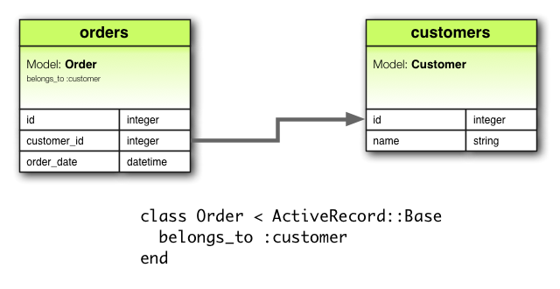
has_one and belongs_to
1 to 1 relationships
Can specify 1-way or bi-directional relationship
if table contains foreign_key
use has_one
else
use belongs_to
class Order
belongs_to :customer
end
class Customer
has_one :order
end

Slide 35
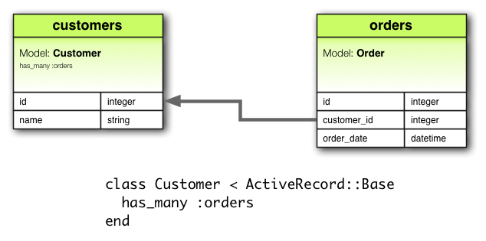
has_many
Specify 1 -> many
class Customer
has_many :orders
end
class Order
belongs_to :customer
end
Notice the plural

Slide 36
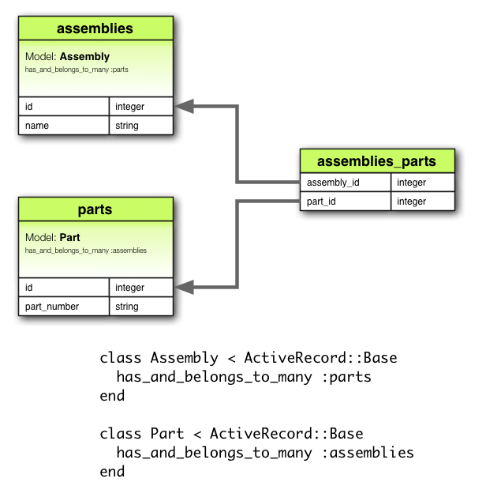
has_and_belongs_to_many
Many to many relationships
class Assembly < ActiveRecord::Base
has_and_belongs_to_many :parts
end
class Part < ActiveRecord::Base
has_and_belongs_to_many :assemblies
end

Slide 37
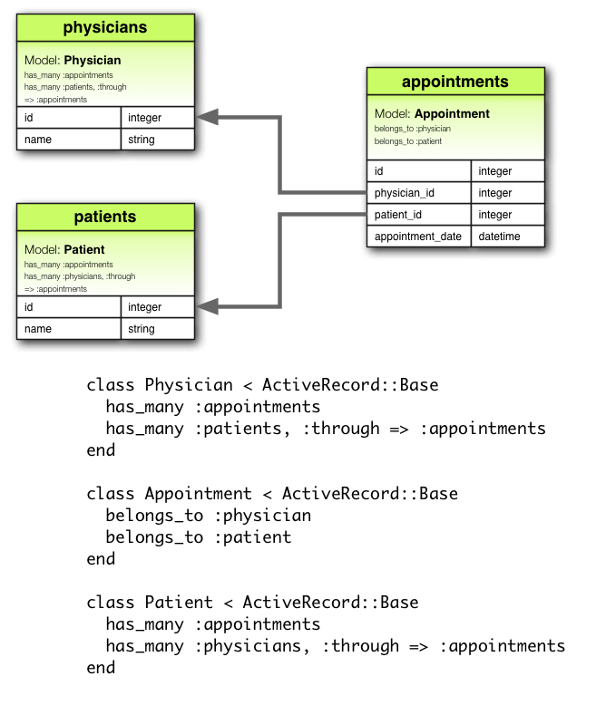
=> through
Specifies relationships through 3rd model
has_one, has_many
class Physicians
has_many :appointments
has_many :patients,
:through => :appointments
end
class Patients
has_many :appointments
has_many :physicians,
:through => :appointments
end
class Appointment
belongs_to :physician
belongs_to :patient
end

Slide 38
Active Record Queries
product = Product.find(10)
SELECT * FROM products WHERE (products.id = 10) LIMIT 1

Slide 39
Dynamic Finder Methods
Creates finder methods based on class attributes
find_by_
find_first_by_
find_last_by_
find_all_by_
customer = Customer.find_by_name("Martyn")
order = Order.find_by_order_date("01/01/2010".to_date)

Slide 40
Finder Conditions
String
customer = Customer.find_by_name(“Martyn”)
Integer
customer = Customer.find_by_age(50)
Array
Customers = Customer.find_by_name([“Martyn”, “Steve”])
Range
Customers = Customer.find_by_dob([“01/01/1980”.to_date..”31/12/1989”])

Slide 41
Where
String
customer = Customer.where(“name = 'martyn'”)
Integer
customer = Customer.where(“age = 50”)
Array
customers = Customer.where(:name => ['Martyn','Steve'])
Range
customers = Customer.where(:dob => (“01/01/1980”.to_date..”31/12/1989”))

Slide 42
Where
Multiple Conditions
customer = Customer.where(“name = ? AND age = ?”, “Martyn”, 27)
Hash Conditions
customer = Customer.where(:name => “Martyn”, :age => 27)
Boolean Conditions
customer = Customer.where(“age < ?”, 27)

Slide 43
Other Query Methods
where
select
group
order
reorder
reverse_order
limit
offset
joins
includes
lock
readonly
from
having

Slide 44
Rails Routing
Matches URL -> Controller Actions
Generates Paths and URLs
Specify CRUD operations
Nested Resources
Redirection
Constraints

Slide 45
Rails Routing
MyApplication::Application.routes.draw do
root :to => 'pages#main'
resources :products
resources :order do
resources :products
end
match "/sale_items" => redirect("/products")
resources :users, :constraints => {:id => /[A-Z][A-Z][0-9]+/}
end

Slide 46
Rake Routes
$ rake routes
root /(.:format) {:controller=>"pages", :action=>"main"}
products GET /products(.:format) {:controller=>"products", :action=>"index"}
POST /products(.:format) {:controller=>"products", :action=>"create"}
new_product GET /products/new(.:format) {:controller=>"products", :action=>"new"}
edit_product GET /products/:id/edit(.:format) {:controller=>"products", :action=>"edit"}
product GET /products/:id(.:format) {:controller=>"products", :action=>"show"}
PUT /products/:id(.:format) {:controller=>"products", :action=>"update"}
DELETE /products/:id(.:format) {:controller=>"products", :action=>"destroy"}
order_products GET /order/:order_id/products(.:format) {:controller=>"products", :action=>"index"}

Slide 47
Controller

Slide 48
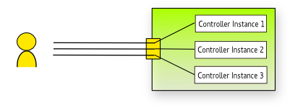
Controller
Extends ApplicationController
Methods mapped to routes
Convention to use RESTful Routes
Instantiated on each request
Destroyed after each response
config/routes.rb

Slide 49
class OrdersController < ApplicationController
def index
@orders = Order.all
respond_to do |format|
format.html # index.html.erb
format.xml { render :xml => @orders }
end
end
def show
@order = Order.find(params[:id])
respond_to do |format|
format.html # show.html.erb
format.xml { render :xml => @order }
end
end
def create
@order = Order.new(params[:order])
respond_to do |format|
if @order.save
format.html { redirect_to(@order, :notice => 'Order was successfully created.') }
format.xml { render :xml => @order, :status => :created, :location => @order }
else
format.html { render :action => "new" }
format.xml { render :xml => @order.errors, :status => :unprocessable_entity }
end
end
end
end

Slide 50
Retreving Params
params() available in each controller
params() => returns hash of data
Automatically converts content using content-type header
Query params and url params are treated the same
{
:order => {
:product => {
:id => '1'
},
:quantity => 2,
:cost {
:amount => 25,
:currency => "GBP"
}
}
# Extra Meta Data Here
}
<order>
<product id='1' />
<quantity>2</quantity>
<cost>
<amount>25</amount>
<currency>GBP</currency>
</cost>
</order>

Slide 51
Request and Response objects
Request
host
domain
format
port
protocol
query_string
get?, post? put? delete?
method
remote_ip
url
headers
Response
body
status
location
content_type
charset
headers

Slide 52
Sessions
Available through, session() instance method
Key/value store
Lazy Loaded
Scoped across controllers and views
To create => call session
To destroy => set to nil
# First time session is called. (A new session is created here)
session[:user_id] = authenticate_user().id
current_user = User.find(session[:user_id])
# Destroyed
session = nil

Slide 53
Session Stores
Configurable in config/initializers/session_store.rb
ActionDispatch::Session::CookieStore
  Stores everything on the client.
ActiveRecord::SessionStore
  Stores the data in a database using Active Record.
ActionDispatch::Session::CacheStore
  Stores the data in the Rails cache.
ActionDispatch::Session::MemCacheStore
  Stores the data in a memcached cluster (this is a legacy implementation; consider using CacheStore instead).

Slide 54
The Flash
Convenience method for passing user messages
Saved in the session
Cleared on each request

Slide 55
View

Slide 56
Responses
render
  Renders
    View
    Text
    xml, json
redirect_to
  Sends redirect to browers
head
  Returns only headers

Slide 57
eRuby
Embeds Ruby code inside text documents
Equivilent to JSP, ASP etc...
Default in Rails
Accesses global variables set in controller

Slide 58
app/controllers/orders_controller.rb
class OrdersController < ApplicationController
def index
@orders = Order.all
respond_to do |format|
format.html # index.html.erb
format.xml { render :xml => @orders }
end
end
app/views/orders/index.html.erb
<h1>Listing orders</h1>
<table>
<tr>
<th>Name</th>
<th></th>
<th></th>
<th></th>
</tr>
<% @orders.each do |order| %>
<tr>
<td><%= order.name %></td>
<td><%= link_to 'Show', order %></td>
<td><%= link_to 'Edit', edit_order_path(order) %></td>
<td><%= link_to 'Destroy', order, :confirm => 'Are you sure?', :method => :delete %></td>

Slide 59
Partials
Partials can be rendered inside views
Partials start with underscore
  _order_partial.html.erb
Parameters can be passed into partials from views
<h1>Listing orders</h1>
<table>
<tr>
<th>Name</th>
<th></th>
<th></th>
<th></th>
</tr>
<% @orders.each do |order| %>
<%= render :partial => "order.rb", :locals => { :order => order } %>

Slide 60
Layouts
Can be used to structure views
Views are rendered and inserted into layouts
Default site layout: layouts/application.html.erb
Yield renders view

Slide 61
Layouts: yield
layout
view
resulting html
<html>
<head>
</head>
<body>
<title>A simple page</title>
<p>Hello, Rails!</p>
</body>
</html
<html>
<head>
</head>
<body>
<%= yield %>
</body>
</html
<title>A simple page</title>
<p>Hello, Rails!</p>

Slide 62
Layouts: Named Yield
view
resulting html
layout
<html>
<head>
<%= yield :head %>
</head>
<body>
<%= yield %>
</body>
</html>
<html>
<head>
<title>A simple page</title>
</head>
<body>
<p>Hello, Rails!</p>
</body>
</html>
<% content_for :head do %>
<title>A simple page</title>
<% end %>
<p>Hello, Rails!</p>

Slide 63
Html Helpers
<%= form_tag("/search", :method => "get") do %>
<%= label_tag(:q, "Search for:") %>
<%= text_field_tag(:q) %>
<%= submit_tag("Search") %>
<% end %>
<form accept-charset="UTF-8" action="/search" method="get">
<label for="q">Search for:</label>
<input id="q" name="q" type="text" />
<input name="commit" type="submit" value="Search" />
</form>

Slide 64
HTML Helpers
<%= form_for @article, :url => { :action => "create" },
:html => {:class => "nifty_form"} do |f| %>
<%= f.text_field :title %>
<%= f.text_area :body, :size => "60x12" %>
<%= f.submit "Create" %>
<% end %>
<form accept-charset="UTF-8" action="/articles/create" method="post" class="nifty_form">
<input id="article_title" name="article[title]" size="30" type="text" />
<textarea id="article_body" name="article[body]" cols="60" rows="12"></textarea>
<input name="commit" type="submit" value="Create" />
</form>

Slide 65
HTML Helpers
<%= text_area_tag(:message, "Hi, nice site", :size => "24x6") %>
<%= password_field_tag(:password) %>
<%= hidden_field_tag(:parent_id, "5") %>
<%= search_field(:user, :name) %>
<%= telephone_field(:user, :phone) %>
<%= url_field(:user, :homepage) %>
<%= email_field(:user, :address) %>
http://guides.rubyonrails.org/form_helpers.html

Slide 66
end

Slide 67
def torque_box

Slide 68
Some intro to TorqueBox
Then straight into practical
  Install Torque Box
  Running blank rails app
  Create a small JIRAesk Task manager application

