Slide 1
Newcastle JBug
https://github.com/mtaylor/jbug
rvm use jruby@torquebox

Slide 2
Ruby on Rails on TorqueBox
Martyn Taylor,
Software Engineer, RedHat
Notes:
Good afternoon-enthusiasim

Slide 3
Overview
Background
A look inside
  Make up
  Model
  View
  Controllers
TorqueBox
Running Practical Session

Slide 4

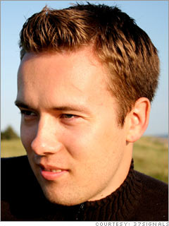
What is RoR?
Ruby Web Framework
Focus on Convention over Configuration
MVC
Open Source (MIT License)
David Heinemeir Hansson
Released as Open Source 2004
> 2100 Contributers
Version 3.2

Slide 5
The Good Stuff
Rapid Development
Interpreted
    Removes Compile, Build, Deploy Cycle
Shallow Learning Curve
Large Ruby Community
    (> 40000 Gems since 2009)
Matured Significantly - v3 Release
Applications: Twitter, GitHub, Groupon...
    (www.rubyonrails.org/applications)

Slide 6
The Not so Good Stuff
Convention only covers 95% Use Case
Version upgrades often not backward compatible
Maturity brings Complexity
Fanatical Community
No Decent IDE Support
    Emacs
    Aptana (eclipse)

Slide 7
RVM
Command Line Tool
Manages multiple versions of ruby
Allows creation of library environments:
  gemsets
https://rvm.io//

Slide 8
Rails application
$ rails new <name>
├── app
│ ├── controllers
│ ├── models
│ └── views
├── config
│ ├── environments
│ ├── initializers
│ ├── locales
├── db
├── doc
├── Gemfile
├── lib
├── log
├── public
│ ├── images
│ ├── javascripts
│ └── stylesheets
├── Rakefile
├── script
│ └── rails
├── test
├── tmp
└── vendor

Slide 9
Bundler and Gemfile
Gemfile
  Specifies dependencies
  Gemfile.lock
Bundler => Rubygem
  Manages Application Depedencies
  The de facto standard for rails
  Determines dependencies from Gemfile
  Generates Gemfile.lock
    Locks dependencies and versions
$ bundle install
Your bundle is complete! Use `bundle show [gemname]` to see where a bundled gem is installed.

Slide 10
Gemfile Example
source "http://rubygems.org"
gem "rails", "3.2.2"
gem "rack-cache"
gem "nokogiri", "~> 1.4.2"
group :development do
gem "sqlite3"
end
group :production do
gem "pg"
end
RAILS_ENV=production

Slide 11
Configuring DB
development:
adapter: sqlite3
database: db/development.sqlite3
pool: 5
timeout: 5000
test:
adapter: sqlite3
database: db/test.sqlite3
pool: 5
timeout: 5000
production:
adapter: sqlite3
database: db/production.sqlite3
pool: 5
timeout: 5000

Slide 12
Model
Migrations
Validation
Associations
Querying

Slide 13
Migrations
Database Mappings
Incremental Changes
Timestamped
  Allows easy upgrade
  Prevents Database Clashes
Transactional
Naming Convention
  YYYYMMDDHHMMSS_<Class.name.underscore>.rb
Creating Database
  $ rake db:create:all
  $ rake db:migrate

Slide 14
Migrations
class CreateBaseImages < ActiveRecord::Migration
def self.up
create_table :base_images do |t|
t.integer :id
t.string :name
t.string :description
t.integer :template_id
t.timestamps
end
end
def self.down
drop_table :base_images
end
end
Called when migrations are run
Called on Rollback

Slide 15
Migration Generators
$ rails generate model User first_name:string dob:date
app/models/user.rb
class User < ActiveRecord::Base
end
db/migrate/20120626135824_create_users.rb
class CreateUsers < ActiveRecord::Migration
def self.up
create_table :users do |t|
t.string :first_name
t.date :dob
t.timestamps
end
end
def self.down
drop_table :users
end
end

Slide 16
Migration Generators
$ rails generate migration AddEmailToUser
db/migrate/20120626140751_add_email_to_user.rb
class AddEmailToUser < ActiveRecord::Migration
def self.up
end
def self.down
end
end

Slide 17
Schema
ActiveRecord::Schema.define(:version => 20120626140751) do
create_table "users", :force => true do |t|
t.string "first_name"
t.string "last_name"
t.date "dob"
t.datetime "created_at"
t.datetime "updated_at"
end
end
Matches Migration timestamp

Slide 18
Validations
When is validation performed?
  Before model is persisted
    create, create!
    save, save!
    update, update!
    update_attributes
Raises ActiveRecord::RecordInvalid Exception
Checking a model is valid
  valid?
  Invalid?

Slide 19
Validation Example
class User < ActiveRecord::Base
validates :first_name, :presence => true
validates :postcode,
:format => { :with => /^([A-Z][A-Z][0-9]? [0-9][A-Z]{2})$/,
:message => "must be a valid UK Postcode" }
end
>> User.create(:first_name => “Martyn”, :postcode => “Bad Post Code”)
=> ActiveRecord::RecordInvalid: Validation failed: must be a valid UK Postcode
>> User.create(:postcode => “NE1 1RU”)
=> ActiveRecord::RecordInvalid: Validation failed: FirstName can't be blank

Slide 20
Conditional Validations
class Order < ActiveRecord::Base
validates :card_number, :presence => true, :if => :paid_with_card?
def paid_with_card?
payment_type == "card"
end
end

Slide 21
Custom Methods
class Person < ActiveRecord::Base
validate :must_be_british
def must_be_british
[“England”, “Scotland”, “Ireland”, “Wales”].include?(record)
end
end

Slide 22
Associations
Model Relationships
  belongs_to
  has_one
  has_many
  has_many :through
  has_one :through
  has_and_belongs_to_many

Slide 23
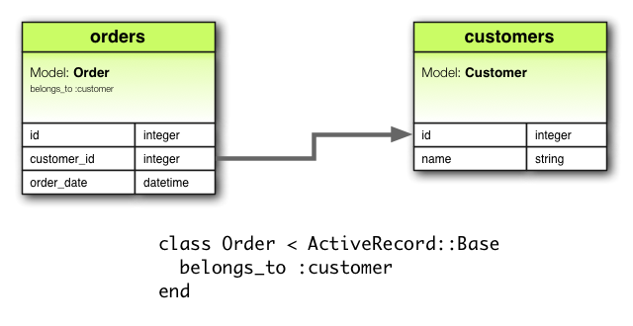
has_one and belongs_to
1 to 1 relationships
Can specify 1-way or bi-directional relationship
if table contains foreign_key
use has_one
else
use belongs_to
class Order
belongs_to :customer
end
class Customer
has_one :order
end

Slide 24
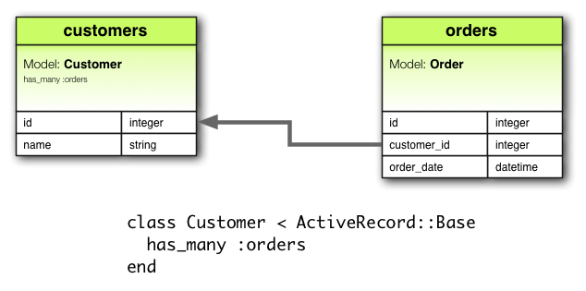
has_many
Specify 1 -> many
class Customer
has_many :orders
end
class Order
belongs_to :customer
end
Notice the plural

Slide 25
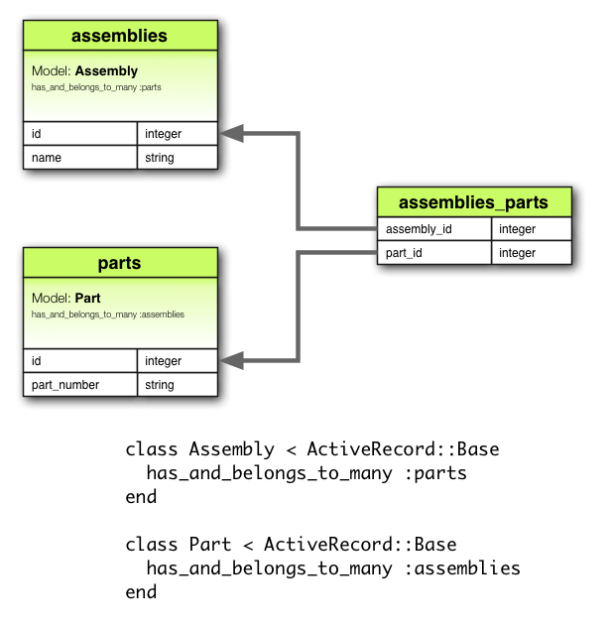
has_and_belongs_to_many
Many to many relationships
class Assembly < ActiveRecord::Base
has_and_belongs_to_many :parts
end
class Part < ActiveRecord::Base
has_and_belongs_to_many :assemblies
end

Slide 26
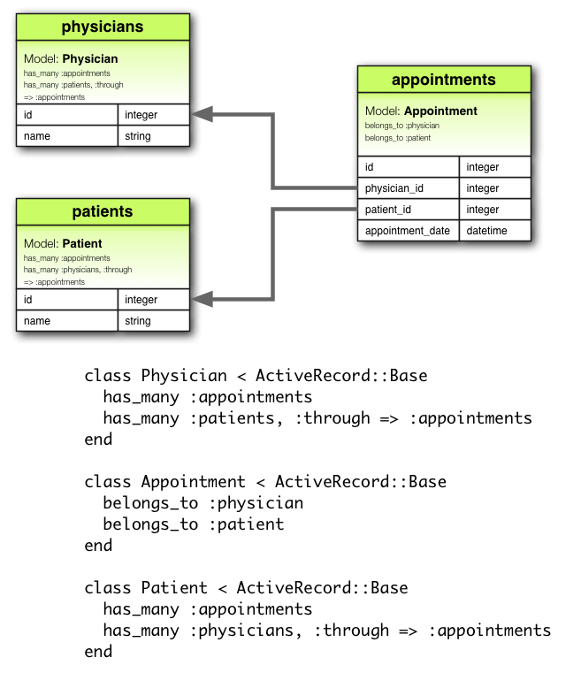
=> through
Specifies relationships through 3rd model
has_one, has_many
class Physicians
has_many :appointments
has_many :patients,
:through => :appointments
end
class Patients
has_many :appointments
has_many :physicians,
:through => :appointments
end
class Appointment
belongs_to :physician
belongs_to :patient
end

Slide 27
Active Record Queries
product = Product.find(10)
SELECT * FROM products WHERE (products.id = 10) LIMIT 1

Slide 28
Dynamic Finder Methods
Creates finder methods based on class attributes
find_by_
find_first_by_
find_last_by_
find_all_by_
customer = Customer.find_by_name("Martyn")

Slide 29
Finder Conditions
customer = Customer.find_by_name(“Martyn”)
customer = Customer.where(“name = ? AND age = ?”, “Martyn”, 27)
customer = Customer.where(:name => “Martyn”, :age => 27)
customer = Customer.where(“age < ?”, 27)

Slide 30
Face Blog

Slide 31
Rails Routing
Matches URL -> Controller Actions
Generates Paths and URLs
Specify CRUD operations
Nested Resources
Redirection
Constraints

Slide 32
Rails Routing
MyApplication::Application.routes.draw do
root :to => 'pages#main'
resources :products
resources :order do
resources :products
end
match "/sale_items" => redirect("/products")
resources :users, :constraints => {:id => /[A-Z][A-Z][0-9]+/}
end

Slide 33
Rake Routes
$ rake routes
root /(.:format) {:controller=>"pages", :action=>"main"}
products GET /products(.:format) {:controller=>"products", :action=>"index"}
POST /products(.:format) {:controller=>"products", :action=>"create"}
new_product GET /products/new(.:format) {:controller=>"products", :action=>"new"}
edit_product GET /products/:id/edit(.:format) {:controller=>"products", :action=>"edit"}
product GET /products/:id(.:format) {:controller=>"products", :action=>"show"}
PUT /products/:id(.:format) {:controller=>"products", :action=>"update"}
DELETE /products/:id(.:format) {:controller=>"products", :action=>"destroy"}
order_products GET /order/:order_id/products(.:format) {:controller=>"products", :action=>"index"}

Slide 34
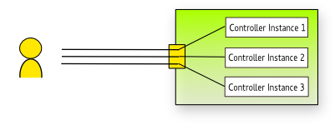
Controller
Extends ApplicationController
Methods mapped to routes
Convention to use RESTful Routes
Instantiated on each request
Destroyed after each response
config/routes.rb

Slide 35
Retreving Params
params() available in each controller
params() => returns hash of data
Automatically converts content using content-type header
Query params and url params are treated the same
{
:order => {
:product => {
:id => '1'
},
:quantity => 2,
:cost {
:amount => 25,
:currency => "GBP"
}
}
# Extra Meta Data Here
}
<order>
<product id='1' />
<quantity>2</quantity>
<cost>
<amount>25</amount>
<currency>GBP</currency>
</cost>
</order>

Slide 36
class OrdersController < ApplicationController
def index
@orders = Order.all
respond_to do |format|
format.html # index.html.erb
format.xml { render :xml => @orders }
end
end
def show
@order = Order.find(params[:id])
respond_to do |format|
format.html # show.html.erb
format.xml { render :xml => @order }
end
end
end

Slide 37
Sessions
Available through, session() instance method
Key/value store
Lazy Loaded
Scoped across controllers and views
To create => call session
To destroy => set to nil
# First time session is called. (A new session is created here)
session[:user_id] = authenticate_user().id
current_user = User.find(session[:user_id])
# Destroyed
session = nil

Slide 38
eRuby
Embeds Ruby code inside text documents
Equivilent to JSP, ASP etc...
Default in Rails
Accesses global variables set in controller

Slide 39
Controller Triggers
render
  Renders
    View
    Text
    xml, json
redirect_to
  Sends redirect to browers
head
  Returns only headers

Slide 40
controller
class OrdersController < ApplicationController
def index
@orders = Order.all
respond_to do |format|
format.html # index.html.erb
format.xml { render :xml => @orders }
end
end
view
<h1>Listing orders</h1>
<% @orders.each do |order| %>
<tr>
<td><%= order.name %></td>
<td><%= link_to 'Show', order %></td>

Slide 41
Partials
Partials can be rendered inside views
Partials start with underscore
  _order_partial.html.erb
Parameters can be passed into partials from views
<h1>Listing orders</h1>
<table>
<tr>
<th>Name</th>
<th></th>
<th></th>
<th></th>
</tr>
<% @orders.each do |order| %>
<%= render :partial => "order.rb", :locals => { :order => order } %>

Slide 42
Layouts
Can be used to structure views
Views are rendered and inserted into layouts
Default site layout: layouts/application.html.erb
Yield renders view

Slide 43
Layout Example
layout
view
resulting html
<html>
<head>
</head>
<body>
<title>A simple page</title>
<p>Hello, Rails!</p>
</body>
</html
<html>
<head>
</head>
<body>
<%= yield %>
</body>
</html
<title>A simple page</title>
<p>Hello, Rails!</p>

Slide 44
Html Helpers
<%= form_tag("/search", :method => "get") do %>
<%= label_tag(:q, "Search for:") %>
<%= text_field_tag(:q) %>
<%= submit_tag("Search") %>
<% end %>
<form accept-charset="UTF-8" action="/search" method="get">
<label for="q">Search for:</label>
<input id="q" name="q" type="text" />
<input name="commit" type="submit" value="Search" />
</form>

Slide 45
HTML Helpers
<%= form_for @article, :url => { :action => "create" },
:html => {:class => "nifty_form"} do |f| %>
<%= f.text_field :title %>
<%= f.text_area :body, :size => "60x12" %>
<%= f.submit "Create" %>
<% end %>
<form accept-charset="UTF-8" action="/articles/create" method="post">
<input id="article_title" name="article[title]" size="30" type="text" />
<textarea id="article_body" name="article[body]" cols="60" rows="12"></textarea>
<input name="commit" type="submit" value="Create" />
</form>

Slide 46
Face Blog 2

Slide 47
TorqueBox
Ruby Application Server
  Sinatra, Rack, RoR
Built on top of JBossAS
  “Ninja Grade”
  Clustering
  High Performance
Extra functionality
  Messaging
  XA Transactions

Slide 48
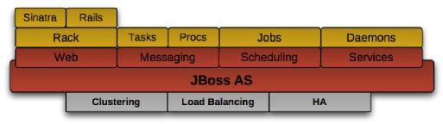
TorqueBox

Slide 49
TorqueBox Messaging
Deploying Destinations
torquebox.yml
application:
..
queues:
/queues/my_app_queue:
durable: false
topics:
/queues/my_app_topic:

Slide 50
TorqueBox Messaging
Publish
@queue = inject '/queues/foo'
@queue.publish "A text message"
@topic = inject '/topics/foo'
@topic.publish "A text message"
Receive/Subscribe
@queue = TorqueBox::Messaging::Queue.new('/queues/foo')
@message = queue.receive
@topic = TorqueBox::Messaging::Topic.new('/topics/foo')
@message = topic.receive

Slide 51
Message Processor
Ruby MDB
class MyConsumer < TorqueBox::Messaging::MessageProcessor
def on_message(body)
end
def on_error(exception)
end
end
application:
..
queues:
/queues/my_app_queue: MyConsumer

Slide 52
Face Blog 3

