Slide 1
Mirobotnics
An Introduction to programming in Java

Slide 2
A little bit about us

Slide 3
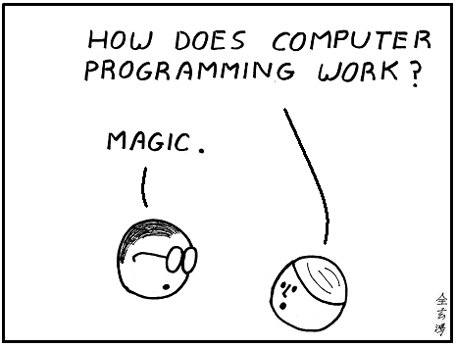


Objectives
Understand key concepts
of computer programming
Write and Run a simple
Java application
Have Fun!

Slide 4
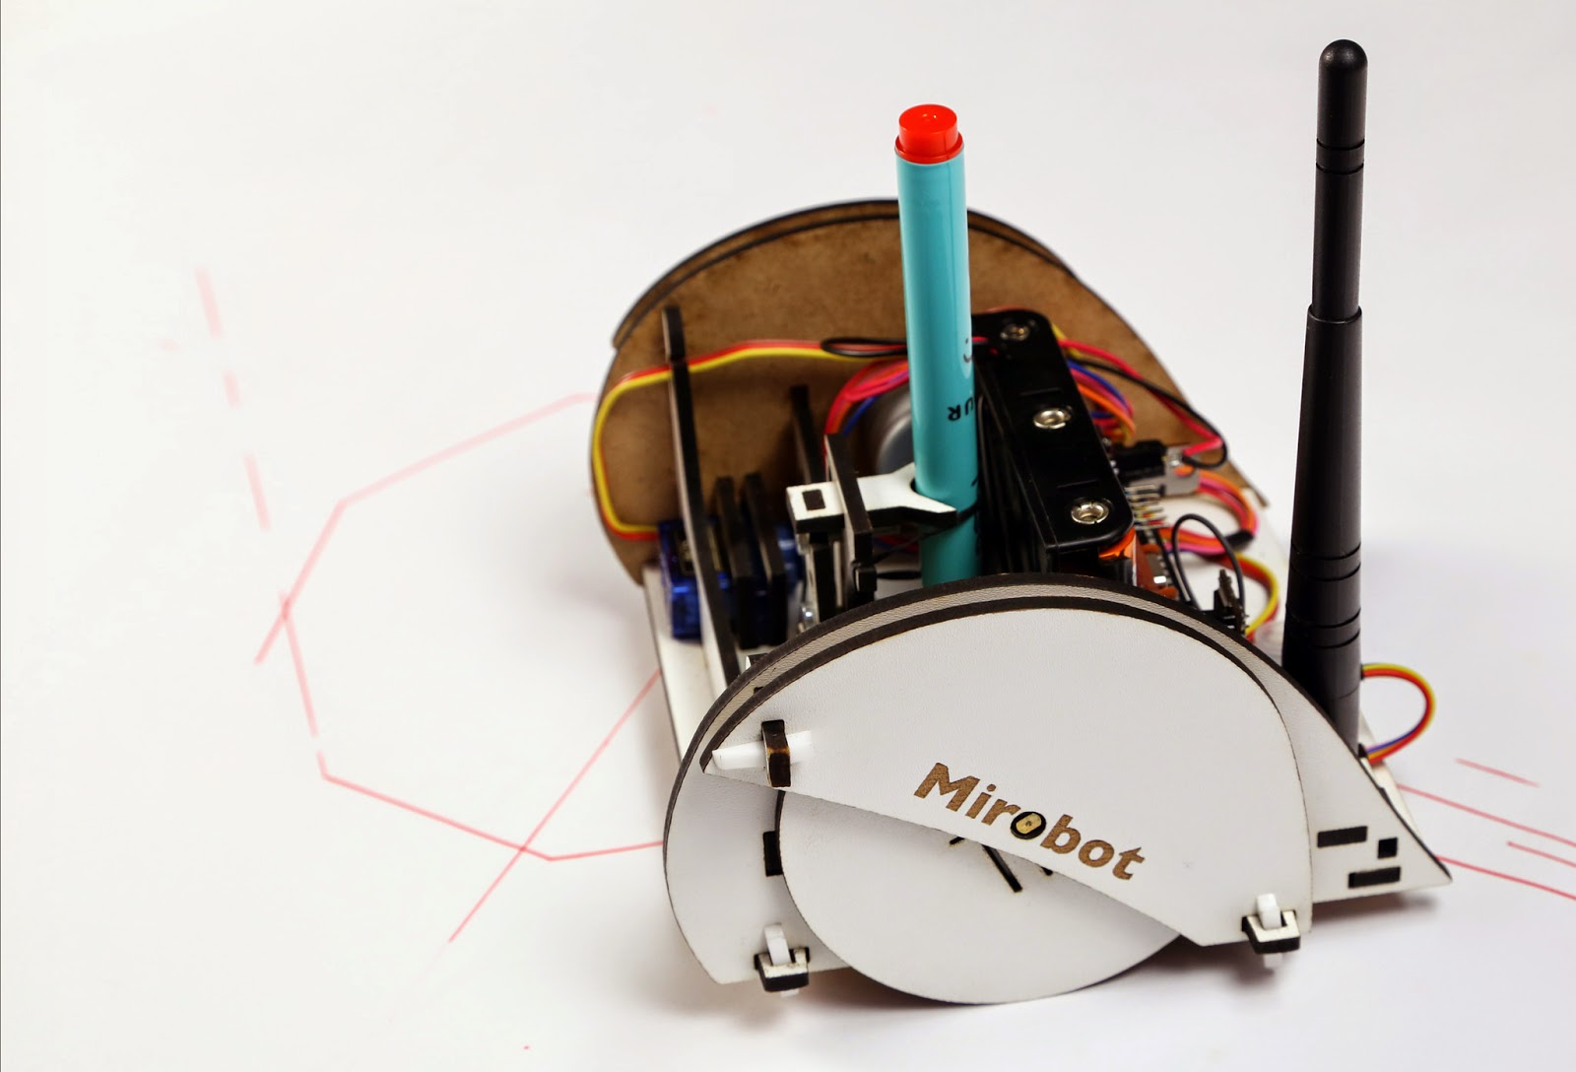
Today's programme
What is programming
How to program
  Object Orientation, Fields, Methods, Control Flow
Program Mirobot

Slide 5
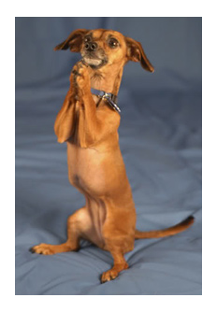
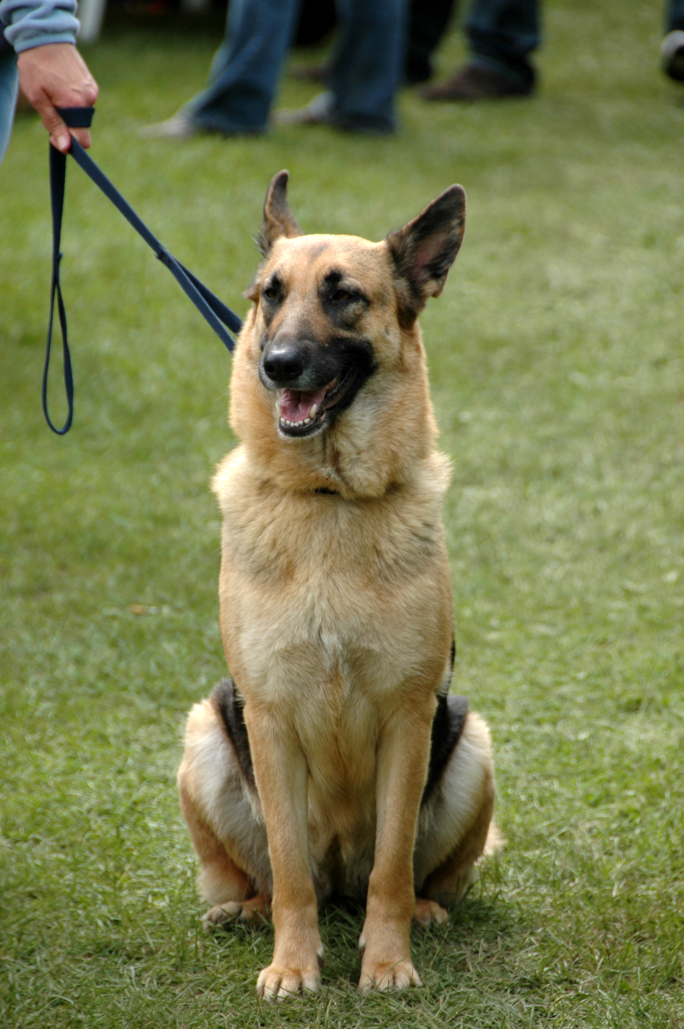
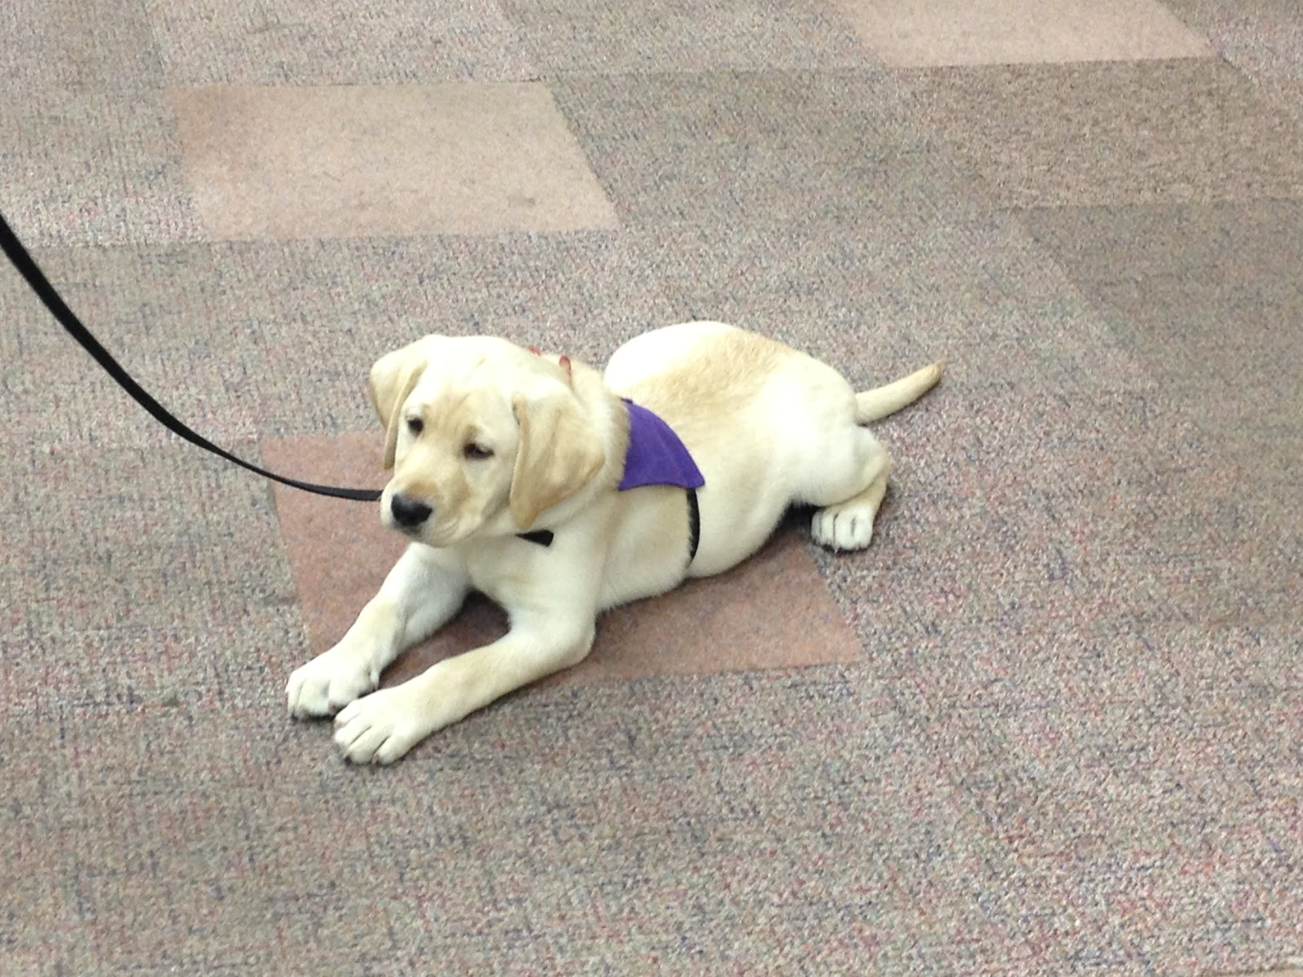
Programming
Creating a set of instructions for the computer
A computer is like an obedient dog.
  It will do anything you tell it to
“Sit Down”
“Lay Down”
“Beg”

Slide 6
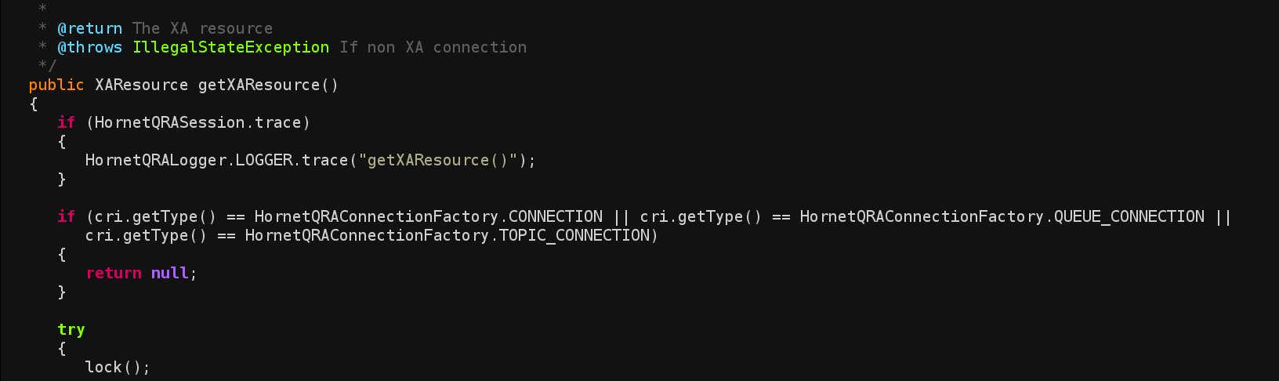
Programming
Computer instructions
  Like “dog instructions” but different
    Instead of saying “sit”, “lay down”, “beg”
    We write instructions in a programming languages.
      Java, Ruby, Python, C and lots more.
  We call the set of instructions for a computer “code”

Slide 7

Exercise
Writing Instructions: Making a cup of tea.
Write a list of instructions for someone who has never made tea before.
Think about:
The things do you need to make tea?
Cater for everyone: Some people take lots of sugar, some people have no milk....
Be precise... e.g. How many stirs should I do?
Notes:
Activity.
- Break into groups of 5
- Write down instructions on how to make a cup of tea.
- Reader has never made tea before
- Think about
- Ingredients
- Method
- Each group read out the instructions.
- Looks at fields, methods, control flow.

Slide 8
Programs
Fields
  The data (or information) needed to run the program
    Teaspoons of sugar = 3, Amount of milk = “3 drops”
Control Flow
  Decision making or looping instructions
    “If person wants milk then pour milk in cup”
    “keep adding sugar until there cup has 3 teaspoons”
Methods
  Collection of instructions and fields that perform some action.
    “make a cup of tea”...
      You just wrote this method.

Slide 9
Object Orientation

Slide 10
Fields

Slide 11
Control Flow

Slide 12
Methods

Slide 13
Classes

